Slide 1
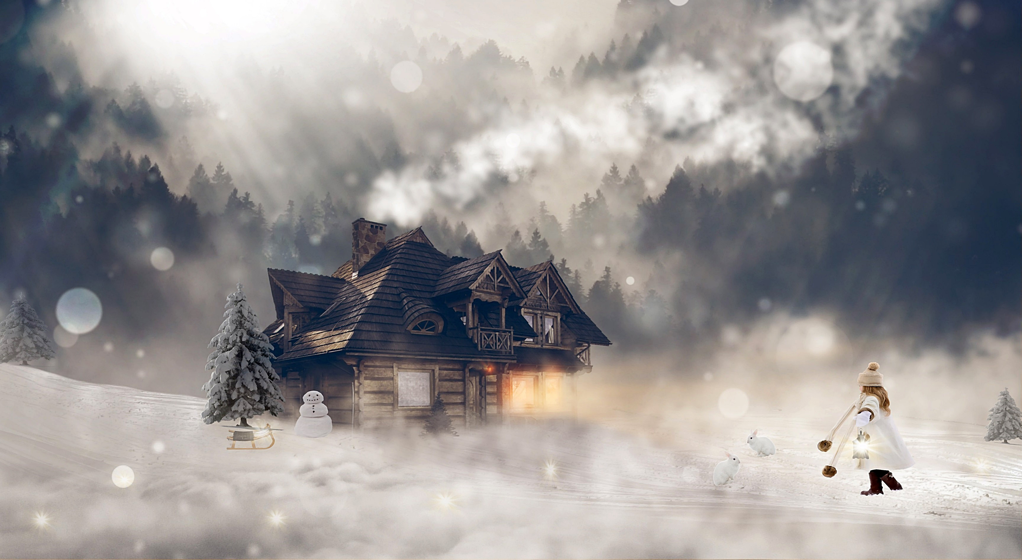
60 second quick write

Slide 2
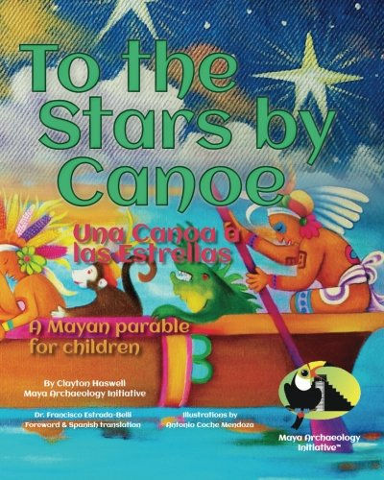
Spot the mistakes:
Itzama got out of the canoe into the river.
The star's were bright in the sky.
Why was the river so dangerous.
Slowly they climbed the mountain into the sacred cave.

Slide 3
Thursday LC: Can I design a cover for my book?

Slide 4
So far you have:
Designed your mythical character
Thought about the quest and the journey he/she will go on.
Today you are going to design a front cover and 'blurb' to hook the reader in.

Slide 5



Designing an effective front cover
What do you notice about the different illustrations?
What key information must be included?
What makes the different covers stand out?

Slide 6

The Back cover
Let's read the back cover together.
How does it hook the reader in?
What key information is included?

Slide 7
Home Learners
Now find some of your favourite books.
Take a look at the front and back covers.
What other information do they include?
How do they sell the book to the reader?

Slide 8
Learners in school
Choose books from the class library
Take a look at the front and back covers.
What other information do they include?
How do they sell the book to the reader?

Slide 9
LC: Can I design a cover for my book?
Toolkit:
Design an illustration for the front cover.
Add the key information (title, author)
Add any other extra information to hook the reader in.
Write a short blurb for the back of your book.

