Slide 1
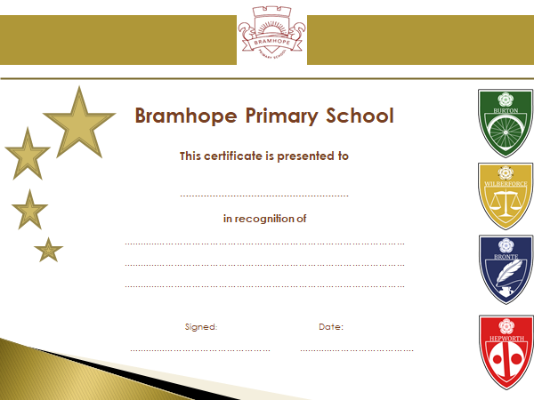
Certificates

Slide 2

Let’s share our blurbs
Think about what you like about it.
What makes you want to read the book?
Would you want more information?
Do you like it to end on a thought?

Slide 3
Some front covers

Slide 4
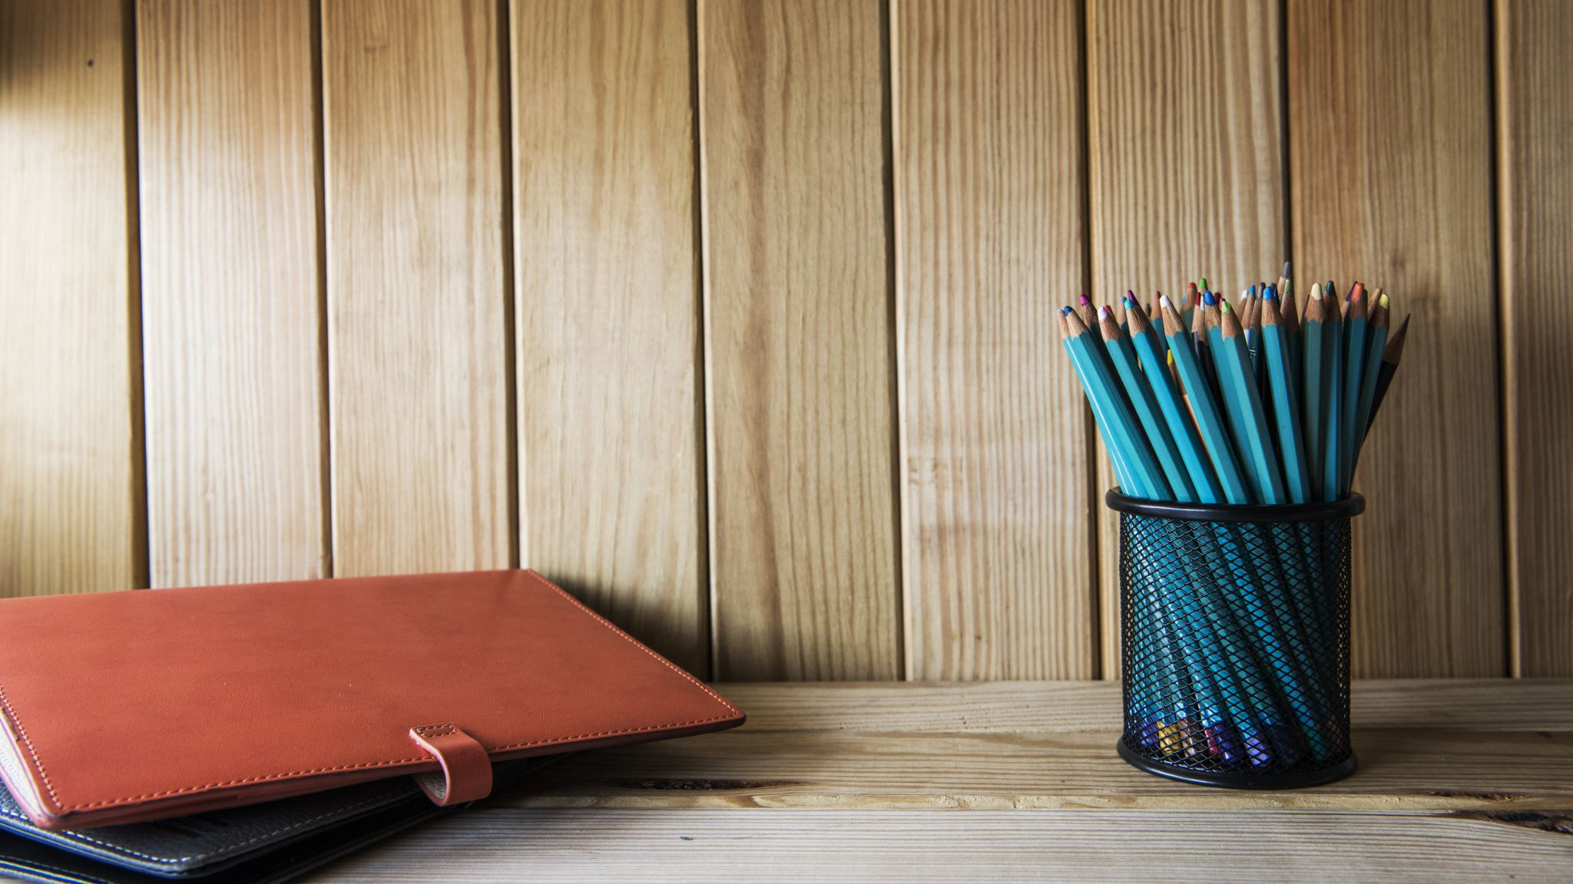
Any questions about this morning’s maths?

Slide 5
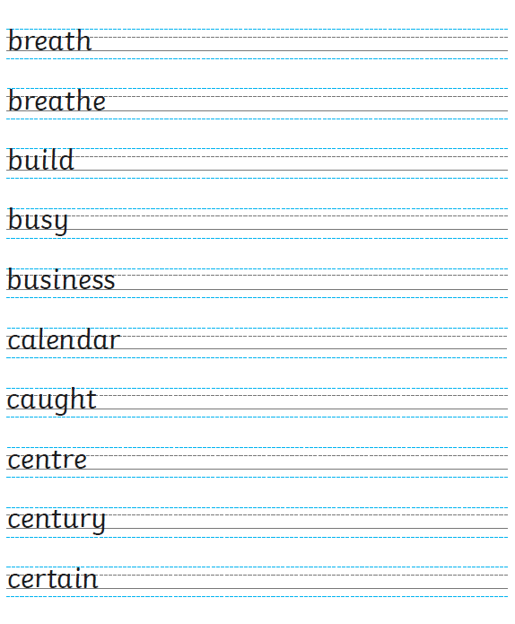
This is your handwriting for this afternoon. You will need to copy these out and remember to join the letters.
Remember:
Writing should be joined.
Writing should be on the line.
Capital letters should be clear and not joined.
Also remember that we would rather half was completed neatly than you rush to complete it all.

