Slide 1
Notes:
Nikola Tesla was an electrical and mechanical engineer and he came up with over 700 inventions!
He worked on many important things that we use every day, like x-rays, the radio, remote controls and even wi-fi.
Explain that his most important invention was the electrical system that gets electricity into our home across the world, called alternating current or AC.
Today we are going to take a journey through his life to discover:
who Nikola was
How he became an inventor
And why he is one of the most important inventors of all times.

Slide 2
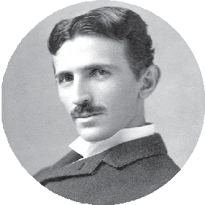
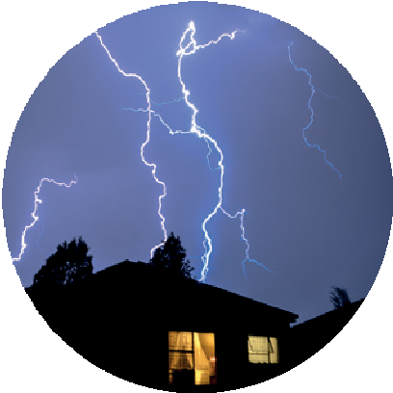
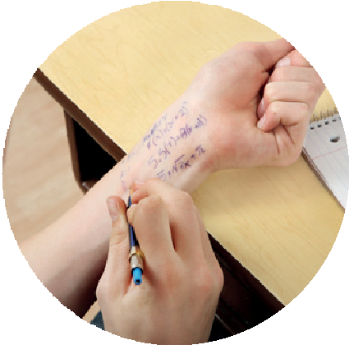
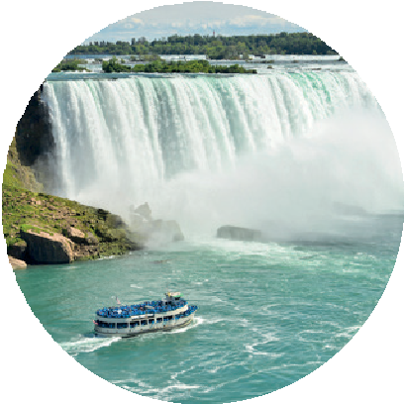
Nikola grows
up in Croatia
Born 10 July
1856, during a lightning storm
He is so good at maths that his teacher thinkst he is cheating!
Nikola is
given a picture
of Niagara Falls
He dreams
of turning the energy into electricity
Moving water has energy
Notes:
Nikola Tesla was born on 10 July 1856 in Croatia.
He was born during a lightening storm, which is a big coincidence because electricity would be important to him his whole life.
At school, Nikola loved science and maths. In fact, he was so good at doing difficult maths in his head that his teacher thought he was cheating!
When he was a child he was given a picture of the Niagara Falls, one of the biggest waterfalls in the world.
The moving water that goes over a waterfall falls a long way and is really fast.
Explain that moving water creates energy.
For more advanced pupils you can explain that electricity that doesn’t move is called static electricity and electricity that moves from one place to another is called current electricity.
He thought it would be amazing if he could turn all the energy from the moving water, into electricity, to power our homes and businesses.
This sparked his interest in science and made him want to become an engineer.

Slide 3
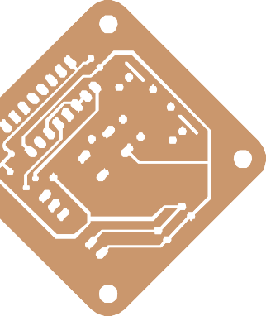
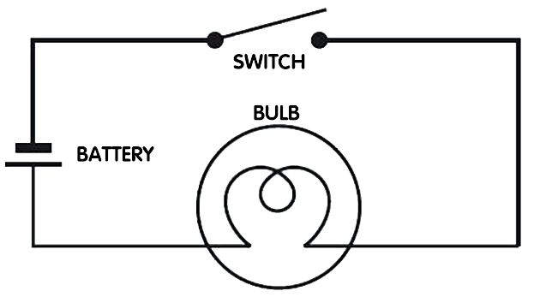
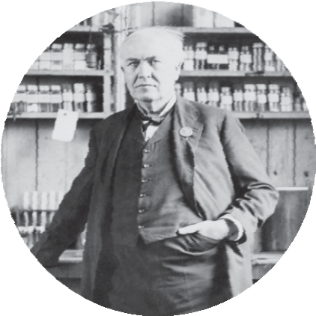
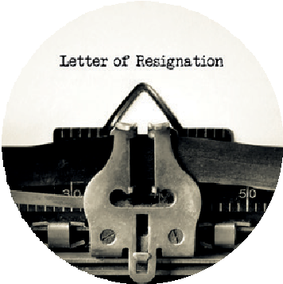

Nikola moves
to America
Nikola has an idea that will make electricity flow better!
He can’t afford to develop it
Electricity flows in a circuit
Nikola moves to
America and meets
Thomas Edison
Thomas gives a job but it doesn’t work out
Notes:
Nikola had always been interested in electricity but he made his real breakthrough at 24, when he had an idea for an invention which would make electricity flow better.
Explain that electricity flows through a circuit. The circuit needs to be a closed loop and have a power source, the electricity can be used to power many things including bulbs, motors and switches.
Nikola did not have a lot of money and could not afford to develop his idea further so he decided to move to America to make enough money so he could turn his idea into a reality.
Whilst in America he met Thomas Edison – a very successful business man who worked a lot with electricity.
Thomas can see how talented Nikola is and gives him a job.
He promised to give Nikola $50,000 if he could make one of Edison’s electrical generators better.
Nikola worked day and night for months, but when he finally succeeded and asked for payment, Edison pretended he was only joking.
Nikola was so shocked and furious that he resigned immediately.

Slide 4
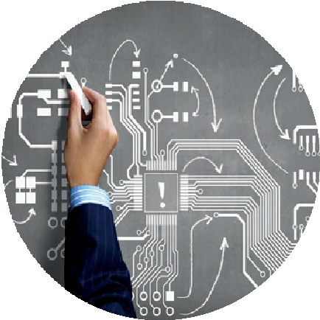
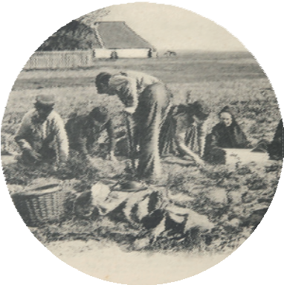
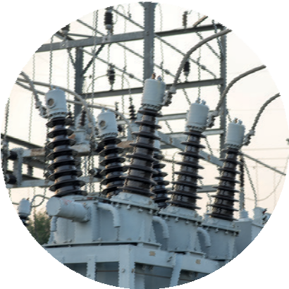
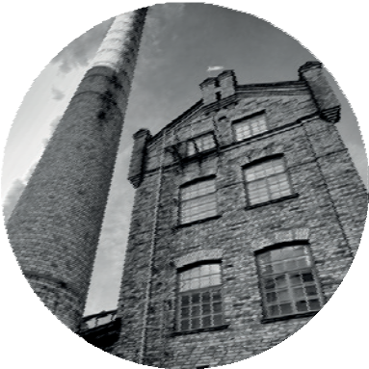
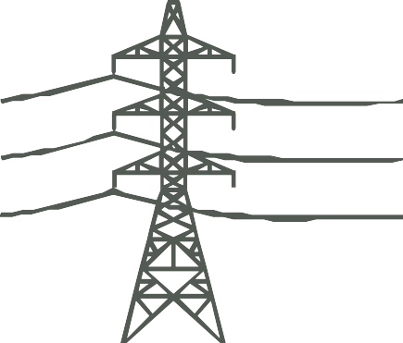
Nikola works on
his invention
Nikola works
He receives
as a labourer
money to start work on
for two years
his electrical system
He starts the
Tesla Electric
Nikola finally builds his electrical system and calls it
Company
AC or alternating current
It transports electricity faster and cheaper
Notes:
To make enough money to survive Nikola spent two years digging ditches.
Luckily, other people also believed in Nikola's talent and they gave him money to work on his invention.
He starts his own company, the Tesla Electric Company and finally builds his electrical system exactly a he had imagined it years ago he named it AC or alternating current.
His new AC system was much better than any other system that had been invented before. This was because it could move electricity around the world much faster, cheaper and with little waste.
He was now ready to put this AC system to the test in the real world!

Slide 5

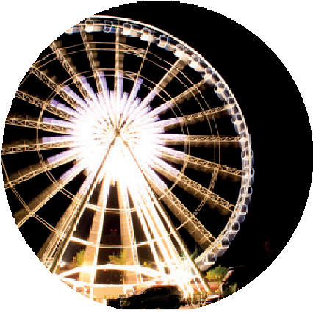
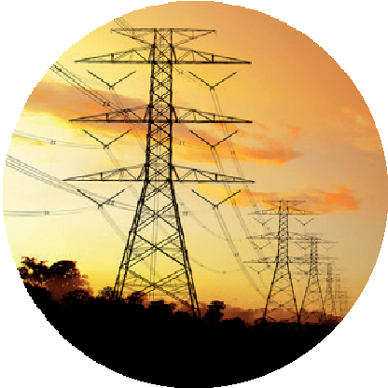
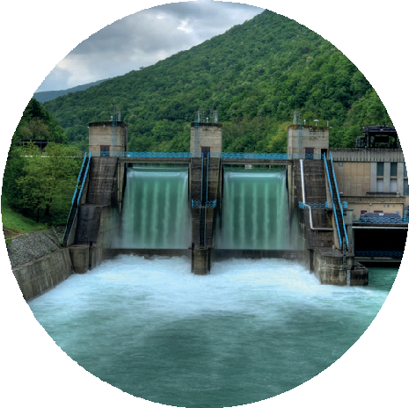
Nikola’s invention
takes off
In 1893 Nikola lights up Chicago World Fair with 100,000 lights
He writes words in neon light and amazes the crowd
Nikola helps
open an AC hydroelectric power station in Niagara Falls
Alternating current becomes standard electrical system in US
His dream comes true!
Notes:
An opportunity arrived in 1893, when he was asked to power a display of 100,000 lights for the Chicago World Fair, he also uses neon lights to write words. The fair is a huge success with 27 million visitors.
This success caught the eye of leading engineers who were building hydroelectric power stations - which use power in rivers to make electricity.
Explain that hydro means water in Greek.
Nikola's inventions and advice eventually meant that the water from Niagara Falls could be used to make his electricity – his early dream had now come true. There was so much power in the river that it could light up the entire city of Buffalo!!
Nikola’s new invention is under attack from competitors, including Edison, but he proves that it’s safe by using his own body to conduct electricity to power a light bulb!
Alternating current becomes the electrical system of choice in the US and soon in the rest of the world.

Slide 6
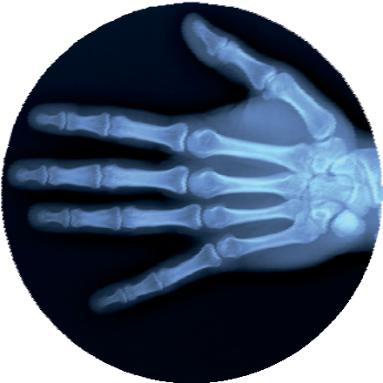
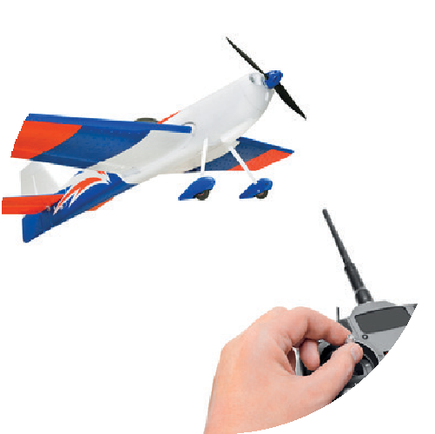
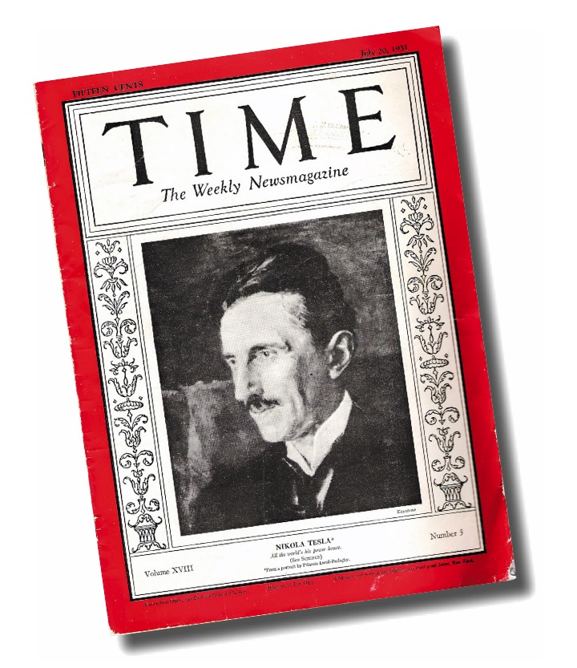

Nikola keeps
on inventing
Nikola works in many other technologies such as...
He has over 700 inventions to his name, including...
…x-rays
…neon lights
…robotics
...the radio and remote control
He believes energy can pass through the air –
that’s wi-fi!
Nikola is very well
Dies in 1943 at the
respected
He appears in
age of 86
Time magazine
in 1931
Notes:
Despite all this success, Nikola did not stop there. He made important advances in many new technologies that you might have heard of, such as x-rays, neon lights and robotics.
He was so busy that over his lifetime he came up with around 700 inventions, including the radio and the remote control.
Nikola was sometimes very ahead of his time – he thought that energy could pass through the air – which is how wi-fi works.
Explain that wireless communications, or wi-fi, is used to connect computers and mobile phones to the internet.
But Nikola never made a lot of money but he was very well respected. So much so that on his 75th birthday he received a birthday card from Albert Einstein! He also appeared in Time magazine in 1931 – a great honour.
He died at the age of 86 but is now known as the father of the modern world and was a true visionary.
His inventions changed the way we live our lives and his legacy lives on every time you switch on a light.

Slide 7
Find more resources about Nikola Tesla as well as other inspiring scientists at: www.bp.com/bpes/superscientists

