Slide 1
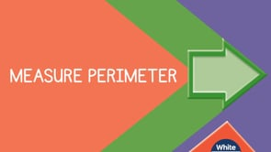


Slide 2

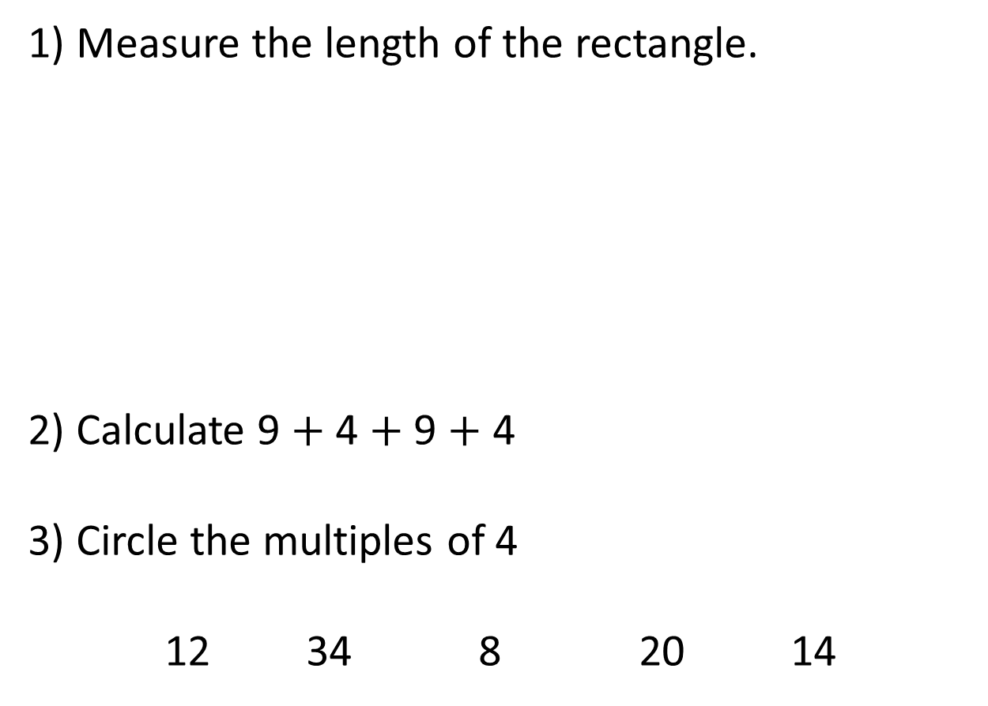
1) Measure the length of the rectangle.
2) Calculate 9 $+$ 4 $+$ 9 $+$ 4
3) Circle the multiples of 4
12 34 8 20 14

Slide 3
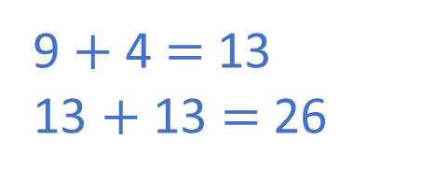
1) Measure the length of the rectangle.
2) Calculate 9 $+$ 4 $+$ 9 $+$ 4
3) Circle the multiples of 4
12 34 8 20 14
11 cm
cm
9 $+$ 4 $=$ 13
13 $+$ 13 $=$ 26

Slide 5
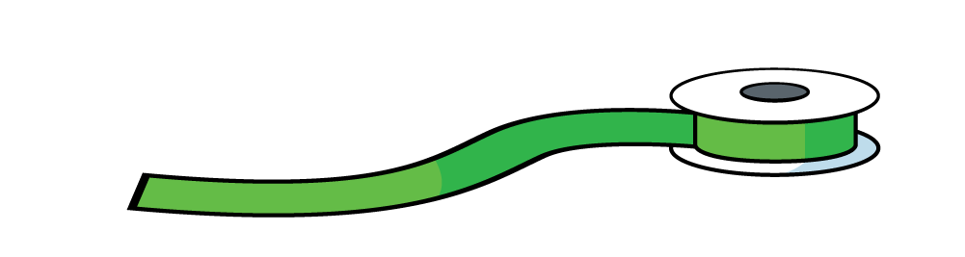
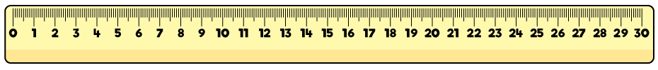
Perimeter is the length around a closed 2-D shape.
The perimeter of the rectangle is 22 cm.

Slide 6

Have a think
Which shapes can we measure the perimeter of?
B
A
A and D
D
C

Slide 7


Wow Eva! So that means that we can only find the perimeter of closed shapes.
I think I can find the perimeter of this shape because I can see that it must be a rectangle.
That’s right Tiny! There can’t be any gaps!
I don’t think we can just predict that it must be a rectangle.
It could be several other shapes, look!

Slide 8
Have a go at questions 1 and 2 on the worksheet

Slide 9
Perimeter is the length around a closed 2-D shape.
9 cm
13 cm
13 cm
9 cm
9 cm + 13 cm + 9 cm + 13 cm =
44 cm

Slide 10
Have a go at questions 3 and 4 on the worksheet

Slide 11
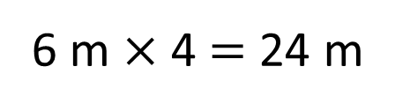
Can you work out the perimeter of the square?
6 m
6 m
6 m
6 m
6 m
6 m
6 m
6 m $×$ 4 = 24 m
6 m + 6 m + 6 m + 6 m = 24 m

Slide 12

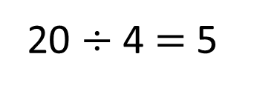
Draw a quadrilateral with a perimeter of 20 cm.
A quadrilateral is a 4-sided 2-D shape.
Square
20 $÷$ 4 $=$ 5
Have a think
How many different rectangles can you draw with a perimeter of 20 cm?

Slide 13
How many different rectangles can you draw with a perimeter of 20 cm?
1 cm
6 cm
3 cm
7 cm
4 cm
9 cm
8 cm
2 cm
width $+$ length $=$ $\frac{1}{2}$of the perimeter of a rectangle

Slide 14
Have a go at the rest of the worksheet

