Slide 1

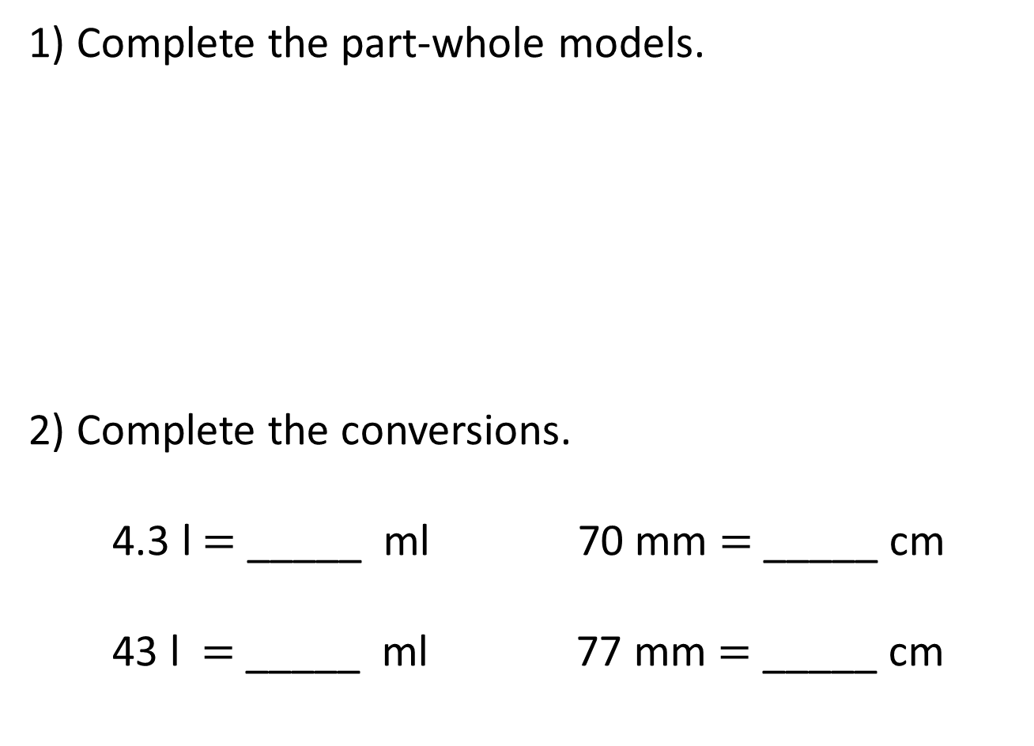
1) Complete the part-whole models.
2) Complete the conversions.
4.3 l $=$ _____ ml 70 mm $=$ _____ cm
43 l $=$ _____ ml 77 mm $=$ _____ cm
3.2 kg
25 m
2,000 g
2,000 cm

Slide 2
1) Complete the part-whole models.
2) Complete the conversions.
4.3 l $=$ _____ ml 70 mm $=$ _____ cm
43 l $=$ _____ ml 77 mm $=$ _____ cm
3.2 kg
25 m
2 kg
1.2 kg
20 m
5 m
2,000 g
2,000 cm
4,300
7
43,000
7.7

Slide 3
L.C. Can I convert miles and kilometres?
Toolkit

Slide 4
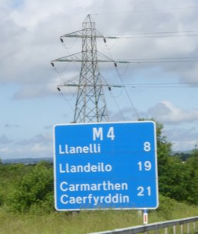
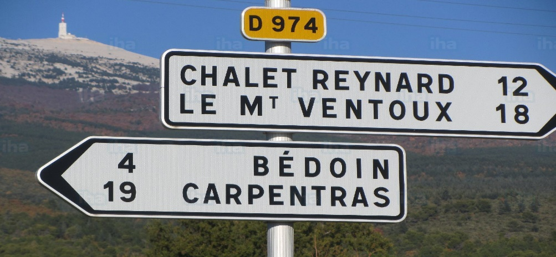
Miles and kilometres
Miles
Kilometres

Slide 5
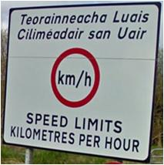
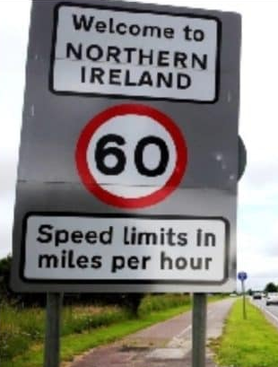

Slide 6




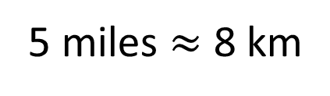
5 miles $≈$ 8 km
Have a think
1 mile
1 mile
1 mile
1 mile
1 mile
1 km
1 km
1 km
1 km
1 km
1 km
1 km
1 km
1 mile 1 km
$$>$$
1 mile 2 km
$$<$$
5 km 8 miles
$$<$$

Slide 7
Have a think
miles
2.5
5
10
12.5
15
20
km
4
8
16
20
24
32

Slide 8

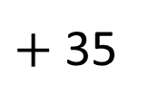
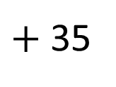
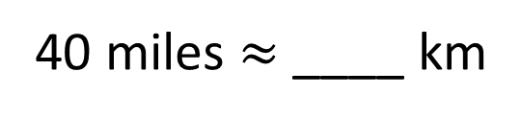
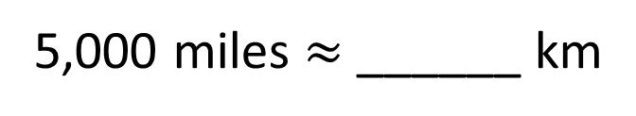
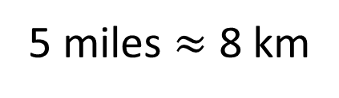
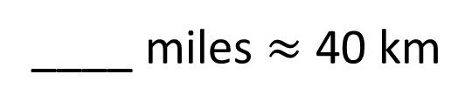
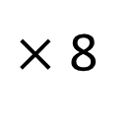
5 miles $≈$ 8 km
× 8
$×$ 8
$+$ 35
$+$ 35
43
64
40 miles $≈$ ____ km
____ miles $≈$ 40 km
25
8,000
5,000 miles $≈$ ______ km
Have a think

Slide 9
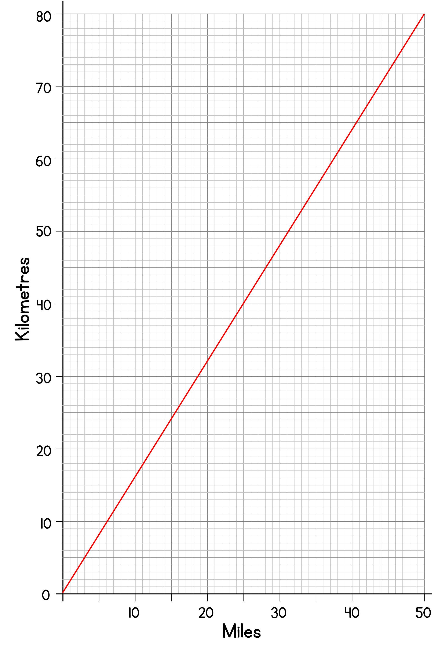
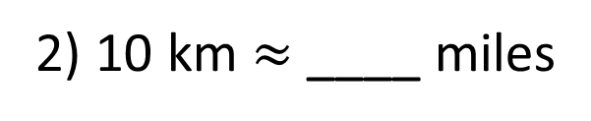
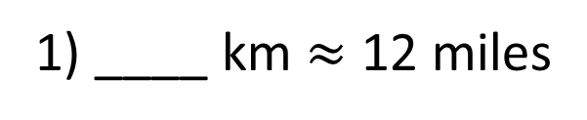

29
____ km $≈$ 18 miles
Have a think
1) ____ km $≈$ 12 miles
19
6
2) 10 km $≈$ ____ miles

Slide 10
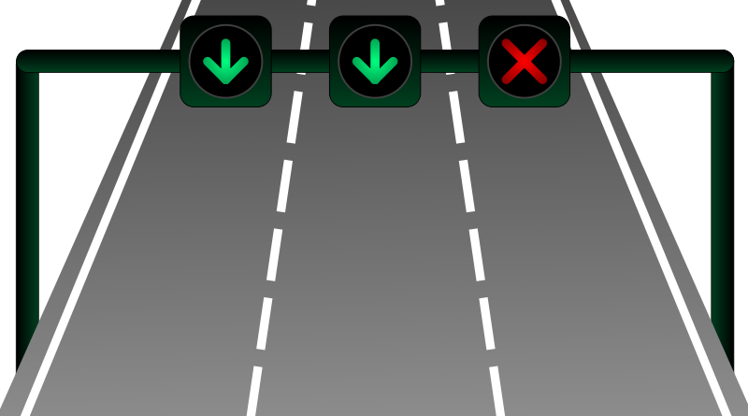
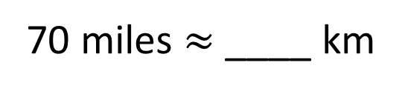
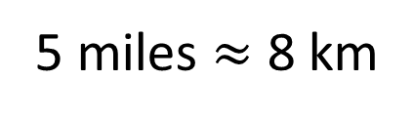
In Italy the motorway speed limit is 130 km/h.
In the UK the motorway speed limit is 70 mph.
In which country is the speed limit higher?
Italy
5 miles $≈$ 8 km
× 14
× 14
112
70 miles $≈$ ____ km

Slide 11
There are two ways to convert between miles and kilometres – exact and approximate conversion:
1 mile = 1.6093.44 km or 1 km = 0.6213712 miles.
To approximate this value, we could say that 1 mile = 8/5 km. Because this approximation is very close to the true value, it is often used.
To convert from miles to kilometres, you first divide by 5 and then multiply by 8.
miles → ÷5 → ×8 → kilometres
15 miles = 24 km
To convert from kilometres to miles, do the opposite –then divide by 8 and multiply by 5
kilometres → ÷8 → ×5 → miles
24 km = 15 miles

Slide 12
What are the missing numbers?
5 miles ≈ ? kilometres
8 kilometres ≈ ? miles

Slide 13
What are the missing numbers?
5 miles ≈ 8 kilometres
8 kilometres ≈ 5 miles

Slide 14
What are the missing numbers?
1 mile ≈ ? km
1 km ≈ ? miles

Slide 15
What are the missing numbers?
1 mile ≈ 1.6 km
1 km ≈ 5/8 or 0.625 miles

Slide 16
Convert to miles.
40 km
16 km
80 km

Slide 17
Convert to miles.
40 km = 25 miles
16 km = 10 miles
80 km = 50 miles

Slide 18
Convert to km.
50 miles
15 miles
25 miles

Slide 19
Convert to km.
50 miles = 80 km
15 miles = 24 km
25 miles = 40 km

Slide 20
Explain how to convert 10 miles to kilometres.

Slide 21
Explain how to convert 10 miles to kilometres.
As 5 miles ≈ 8 kilometres, 10 miles would be ≈ 16 kilometres. You can double it.

Slide 22
If 5 miles ≈ 8 kilometres then 15 miles ≈ 18 kilometres.
Is this correct?

Slide 23
If 5 miles ≈ 8 kilometres then 15 miles ≈ 18 kilometres.
Is this correct?
This is incorrect. Instead of understanding that 5 miles has been multiplied by 3 to make 15 miles, the assumption has been made that 10 miles have been added. This had led to the understanding that 10 should be added to both sides. The correct answer is 15 miles ≈ 24 kilometres.

Slide 24
5 children were raising money by running each day.
Myron ran 6 miles
Aston ran 2.5 miles
Raihan ran 8km
Osama ran 4.8km
Huxley ran 4 miles
Calculate the total distance they ran in:
a. miles b. kilometres

Slide 25
5 children were raising money by running each day.
Myron ran 6 miles
Aston ran 2.5 miles
Raihan ran 8km
Osama ran 4.8km
Huxley ran 4 miles
Calculate the total distance they ran in:
miles b. kilometres
Myron - 6 miles or 9.6km
Aston - 2.5 miles or 4km
Raihan - 5 miles or 8km
Osama - 3 miles or 4.8km
Huxley - 4 miles or 6.4km
a. 20.5 miles b. 32.8km

