Slide 1

Survivors
Extraordinary tales from the wild and beyond
Day Twenty-four

Slide 2

LC: Can I plan a news article?
Toolkit

Slide 3
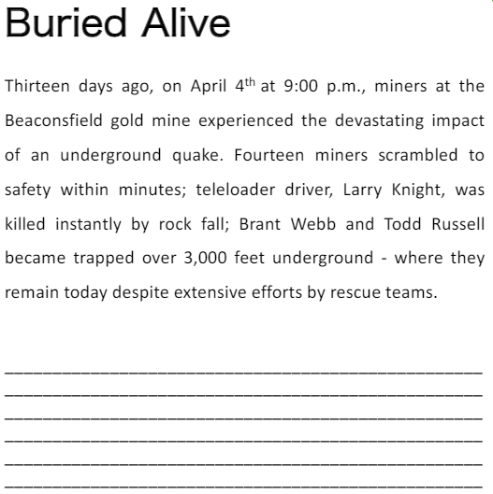
Take a closer look
This is an example of the headline and orientation from a newspaper article reporting on the mining disaster.

Slide 4

|Task
Write the main body of the newspaper report, including three witness quotes, following plans. Ensure correct tense and formality is used. Punctuate direct speech correctly and aim to use some split direct speech where the reporting clause separates the spoken words.

Slide 5
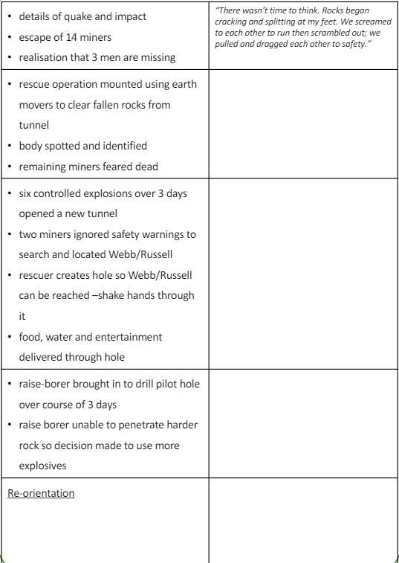
The next stage of the article will be to retell the events of the disaster, in chronological order, in considerably more detail than the orientation and with the inclusion of witness quotes.

Slide 6
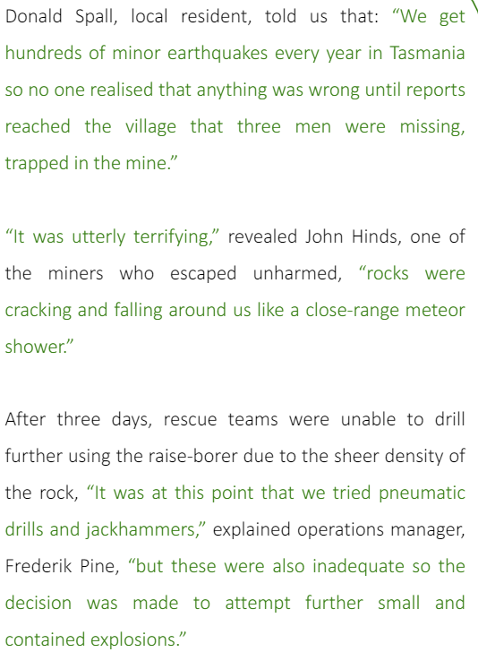
This demonstrates different ways in which quotes can be included within newspaper articles as direct speech. Use the examples to recap the punctuation rules of direct speech.
Examine the different uses of direct speech together, noting the simple introduction of the quote in example 1, the split quote in example 2 and the way quote 3 provides some of the story.

Slide 7
|Mini Task
Using your own copy of the news article planning sheet think about where your quotes will fit into the report.
You should use the quotes provided in yesterday’s work.

