Slide 1
L.C. Can I describe what is it like to visit the Western Wall if you are Jewish?
Toolkit

Slide 2
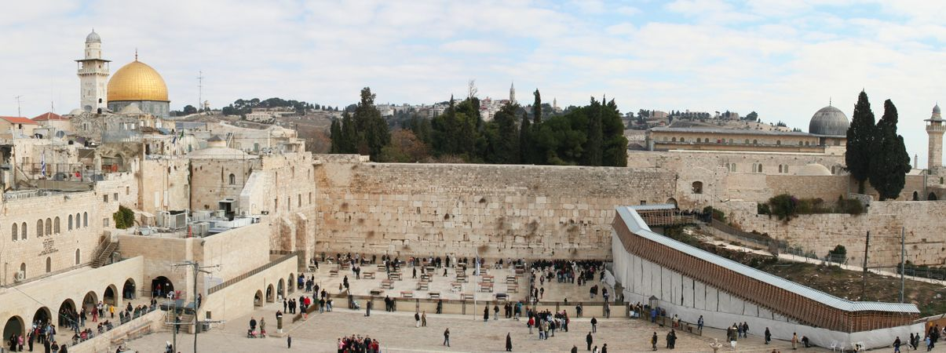
What do you know about the Western Wall?
What is it?
Who might visit it?
Where is it?
Why is it special?

Slide 3
Watch the clip.
https://www.bbc.co.uk/teach/class-clips-video/religious-studies-ks2-visiting-jerusalem/z76d7nb
The Western Wall (sometimes called the Wailing Wall, or the Kotel, the Hebrew word for wall) is one of the last remaining walls of the ancient Jewish Temple in Jerusalem.
The Temple was destroyed in 70 CE by the Romans, and much of what remains of the original structure is a small portion of an external supporting wall. Though it was not originally an important part of the Temple, this wall is considered an extremely holy place today. Located on the Temple Mount in Jerusalem‘s Old City, Jews and non-Jews from all over the world visit the Western Wall to pray and meditate. It is customary to write short prayers on pieces of paper and leave them in the crevices of the wall.

Slide 4
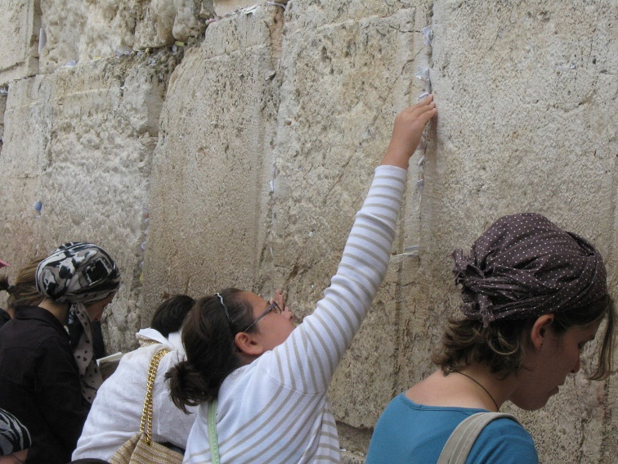
Your thoughts…….
Read the account of a visit to the Western Wall by a Jewish person. In thought bubbles, record the different feelings that she has.

Slide 5
Read the Amidah.
The Amidah is another important prayer in Judaism and is the central prayer used in worship services. It is often referred to as the 'standing prayer' as it is always recited while standing and facing Jerusalem . This prayer consists of 19 blessings, which can be split into three sections: praising God.
What do Jews believe about God?

Slide 6
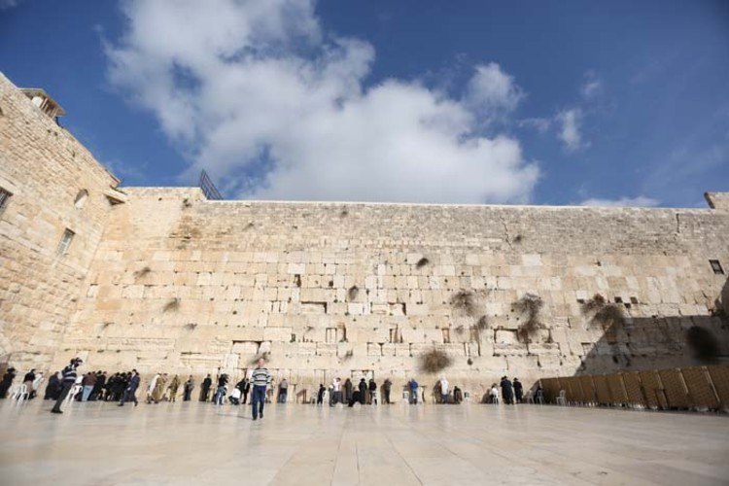
Write your own prayers/wishes.
Write your own prayers/wishes that you would put in the wall if you visited.
They do not need to be religious.

