Slide 1
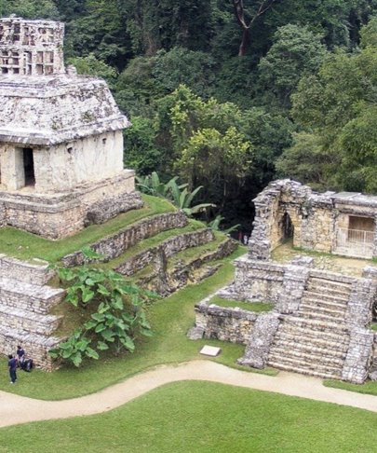
Maya Cities
Lesson 5

Slide 2
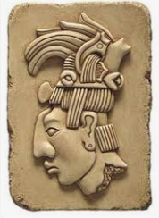
Imagine you are a King, designing a city from scratch
Consider who will live in your city
What jobs would people need to do?
What buildings would you need?

Slide 3
LC: Can I understand the design of Maya cities and social order within?
Toolkit
Design a city and include the main features
Explain their function

Slide 4
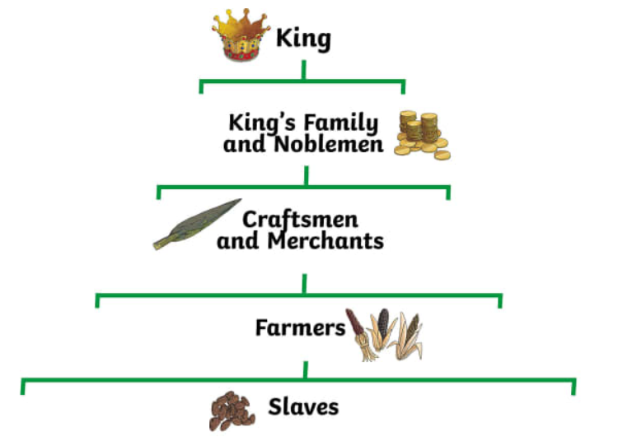
Maya social structure
Every society in the world is organised differently, but they often have some similarities. For example, most countries have a leader. The United Kingdom has the queen and the prime minister. America has a president.
Maya society was organised depending on how important the person was.
Roles in life were inherited – if your father was the King, you inherited the throne, if your father was a farmer, you became a farmer.
Slaves did all the manual labour and Maya society depended on them.
The social structure was represented in the layout and the buildings of the cities.

Slide 5

Maya cities
Historians have discovered several cities built by the Maya, including Chichen Itza, Palanque, El Mirador, Copan and Tikal. They were the first large cities to be built in America.
Maya territory was split into city states – they were far apart and each had their own ruler but they traded goods with each other. Despite this, they also had disagreements which led to conflict.
These cities were incredible and had many important buildings, palaces and temples. Pyramid-shaped temples had a shrine at the top, with a staircase on each side of the pyramid leading to this.

Slide 6
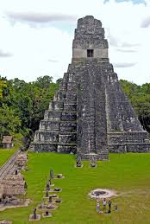
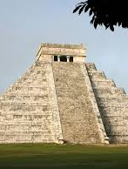
Maya pyramid temples
Priests were incredibly important and were believed to receive direct messages from the gods. They were highly educated people.
One of their most important jobs was to perform religious ceremonies.
The temples were the most sacred buildings in the city and were built on top of the towering, stepped pyramids. The temples were used for rituals and sacrifices – only priests, rulers and sacrificial victims were allowed to climb the stairs of the pyramid to the temple.

Slide 7
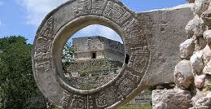
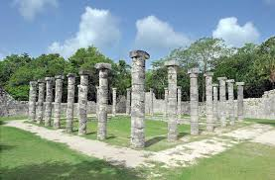
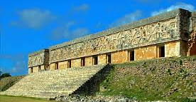
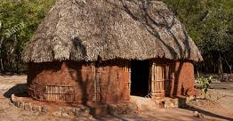
Maya cities
In the centre of a Maya city, was a large open square where markets were held.
Each city also had a 'pok ta pok' court. Pok ta pok was a popular ball game, which involved teams of players competing to put a ball through a stone hoop. These games were played for leisure but sometimes as part of religious festivals.
The ruling family lived in single storey palaces in the city centre and wealthy Maya also had houses in the city, made from limestone.
Most ordinary Maya people lived in small and simple homes on the edge of cities made of bricks or wood and had a thatched roof – we looked at these in lesson 2.

Slide 8
Location of the buildings
Maya chose the location of important buildings like pyramids and temples carefully so that they lined up with astronomical events.
Pakal the Great had his tomb built so it lined up with the sun so that at sunset on the winter solstice, the light appears to go down the stairs to his tomb.
The observatory at Chichen Itza called El Caracol is lined up with the path of the planet Venus – the Maya tracked Venus carefully because they thought it was linked to war.

Slide 9
Activity 1 – Design your own ancient Maya city
You should look for:
How are Maya cities are laid out?
Are there areas set aside for leisure, religion, living space?
Evidence of Maya culture e.g stelae (stone columns with carved images of Gods, writing, astronomical sites)

Slide 10
Activity 2 – Annotate your ancient Maya city
Explain how your city was built without the use of pack animals, the wheel or metal
Is there any evidence of social strata (hierarchy – Gods, Kings, Elite, farmers and how is this reflected in your city? - explain
Why do you think there is little evidence today of buildings for the poorer people? Think about thatched huts and materials used – add an explanation

Slide 11
Presenting your work
Design and label a map of a Maya city from a birds eye view including the features you have researched.
  Include: temple pyramids, public square, farmland, palace for the Ruler, different types of housing (depending on who you were in society), ball court, stela (columns with carved pictures of gods)
Or
Design a tourist guide to a lost Maya city describing the features that are found there and reasons to visit.
Also include features which have not survived but which a tourist would be interested to know about such as areas where the poorer people in society would have lived - explain why there are no actual ruins to look at.

Slide 12
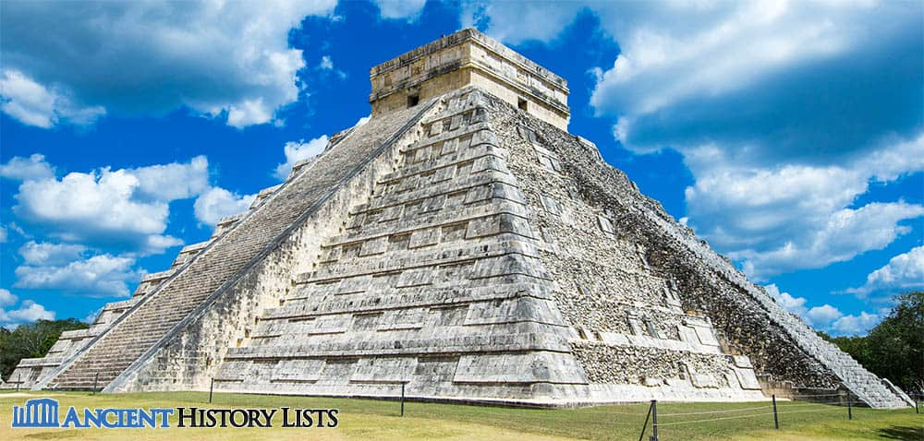
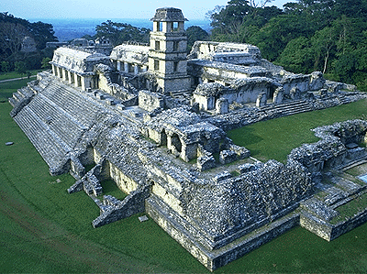
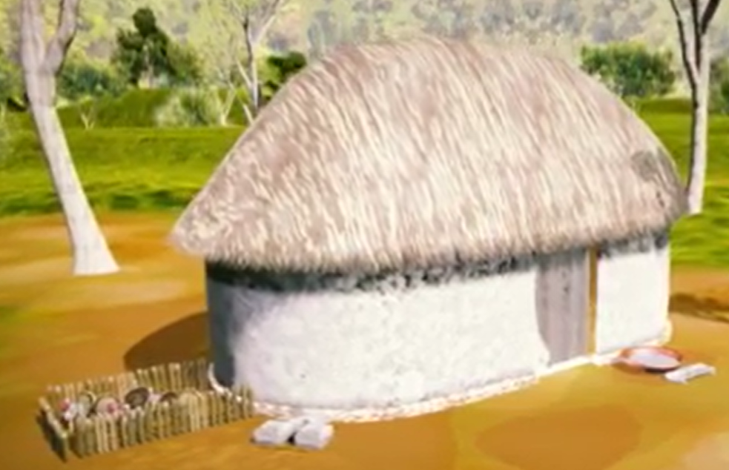

Maya buildings - drawing from a birds eye view
Maya temple pyramid
Maya palace complex
Maya house (poorer)

Slide 13


