Slide 1
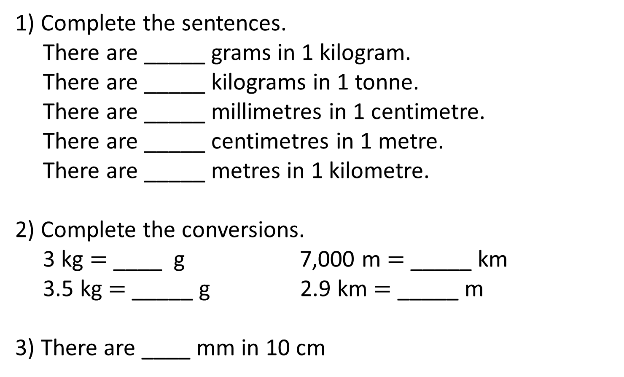
1) Complete the sentences.
There are _____ grams in 1 kilogram.
There are _____ kilograms in 1 tonne.
There are _____ millimetres in 1 centimetre.
There are _____ centimetres in 1 metre.
There are _____ metres in 1 kilometre.
2) Complete the conversions.
3 kg $=$ ____ g 7,000 m $=$ _____ km
3.5 kg $=$ _____ g 2.9 km $=$ _____ m
3) There are ____ mm in 10 cm

Slide 2
1) Complete the sentences.
There are _____ grams in 1 kilogram.
There are _____ kilograms in 1 tonne.
There are _____ millimetres in 1 centimetre.
There are _____ centimetres in 1 metre.
There are _____ metres in 1 kilometre.
2) Complete the conversions.
3 kg $=$ ____ g 7,000 m $=$ _____ km
3.5 kg $=$ _____ g 2.9 km $=$ _____ m
3) There are ____ mm in 10 cm
1,000
1,000
10
100
1,000
3,000
7
3,500
2,900
100

Slide 3
L.C. Can I calculate with metric measures including kilograms and kilometres?
Toolkit

Slide 4
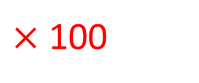
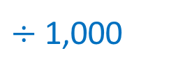
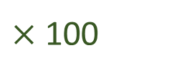
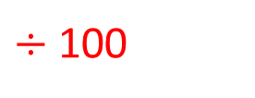
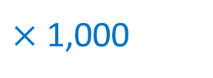
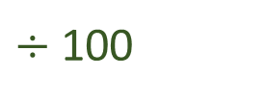
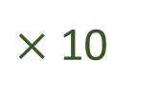
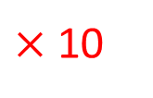
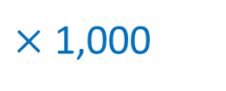
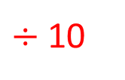
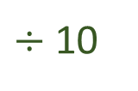
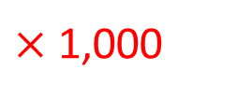
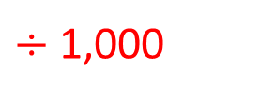
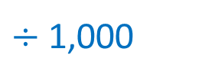
Length
$÷$ 10
$÷$ 100
$÷$ 1,000
mm
cm
m
km
$×$ 10
$×$ 100
$×$ 1,000
Mass
$÷$ 1,000
$÷$ 1,000
g
kg
tonne
$×$ 1,000
$×$ 1,000
Capacity
$÷$ 10
$÷$ 100
ml
cl
l
$×$ 10
$×$ 100

Slide 5

Eva, Alex, Ron, Amir and Mo are running around their school playground.
1 lap of the school playground is 300 m.
Eva runs 3 laps.
How far does she run?
900 m
laps
1
2
3
300
600
900
metres

Slide 6



Eva, Alex, Ron, Amir and Mo are running around their school playground.
1 lap of the school playground is 300 m.
Alex runs 5 laps.
How far does she run?
Write your answer in kilometres.
1.5 km
Have a think
laps
1
2
3
4
5
300
600
900
1,200
1,500
1500 $÷$ 1000
metres

Slide 7


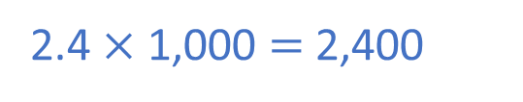

Eva, Alex, Ron, Amir and Mo are running around their school playground.
1 lap of the school playground is 300 m.
Ron runs 2.4 km
How many laps does he run?
Have a think
2.4 $×$ 1,000 $=$ 2,400
8 laps
$×$ 2
laps
1
2
3
4
8
300
600
900
1,200
2,400
$×$ 2
metres

Slide 8
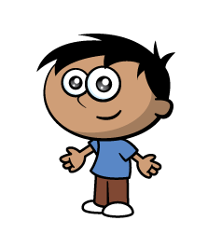

Eva, Alex, Ron, Amir and Mo are running around their school playground.
1 lap of the school playground is 300 m.
Amir runs 900 m
Mo runs 2,100 m
Mo runs 2.1 km
How many more laps did Mo run?
Mo ran 4 more laps
Have a think
laps
1
2
3
4
7
8
300
600
900
1,200
2,100
2,400
metres

Slide 9
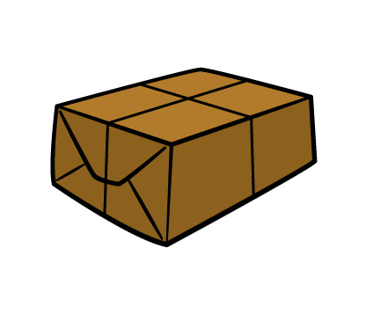

A parcel has a mass of 426 g.
Have a think
Whitney receives a parcel that has a mass 4 times greater.
What is the mass of Whitney’s parcel?
Give your answer in kg.
Th | H | T | O
 | 4 | 2 | 6
 |  |  | 4
426 g
W
426 g
426 g
426 g
$$×$$
426 g
1
7
0
4
1,704 g
1.704 kg
1
2

Slide 10

Tommy has 2 litres of orange juice.
He pours 450 ml for Dexter.
He gives a quarter of a litre to Dora.
He drinks 350 ml himself.
How much orange juice is left?
Give your answer in ml.
Have a think

Slide 11



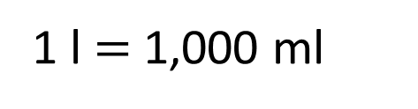
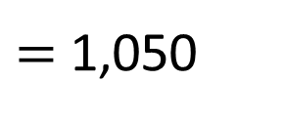
Tommy has 2 litres of orange juice.
He pours 450 ml for Dexter.
He gives a quarter of a litre to Dora.
2,000
He drinks 350 ml himself.
How much orange juice is left?
Give your answer in ml.
950 ml
1,050
950
450
$=$ 1,050
$$+$$
250
$$+$$
350
1 l $=$ 1,000 ml

Slide 12


A bag contains 20 apples.
Each apple has a mass of 75 g.
The bag itself has a mass of 18 g.
Jack has some bags of apples.
The total mass is 9.108 kg.
How many bags of apples does Jack have?
Have a think

Slide 13
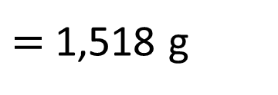
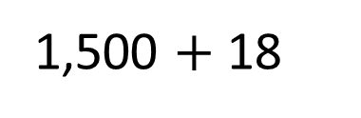
A bag contains 20 apples.
Each apple has a mass of 75 g.
The bag itself has a mass of 18 g.
Jack has some bags of apples.
The total mass is 9.108 kg.
How many bags of apples does Jack have?
Apples
1
2
20
75
150
1,500
Grams
1,500 $+$ 18
$=$ 1,518 g

Slide 14
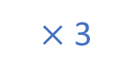
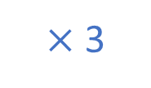
A bag contains 20 apples.
Each apple has a mass of 75 g.
Jack has 6 bags of apples.
The bag itself has a mass of 18 g.
Jack has some bags of apples.
The total mass is 9.108 kg.
How many bags of apples does Jack have?
Apples
Bags
1
2
6
$×$ 3
1,518
9,108
Grams
1,500
3,000
9,000
$×$ 3

Slide 15
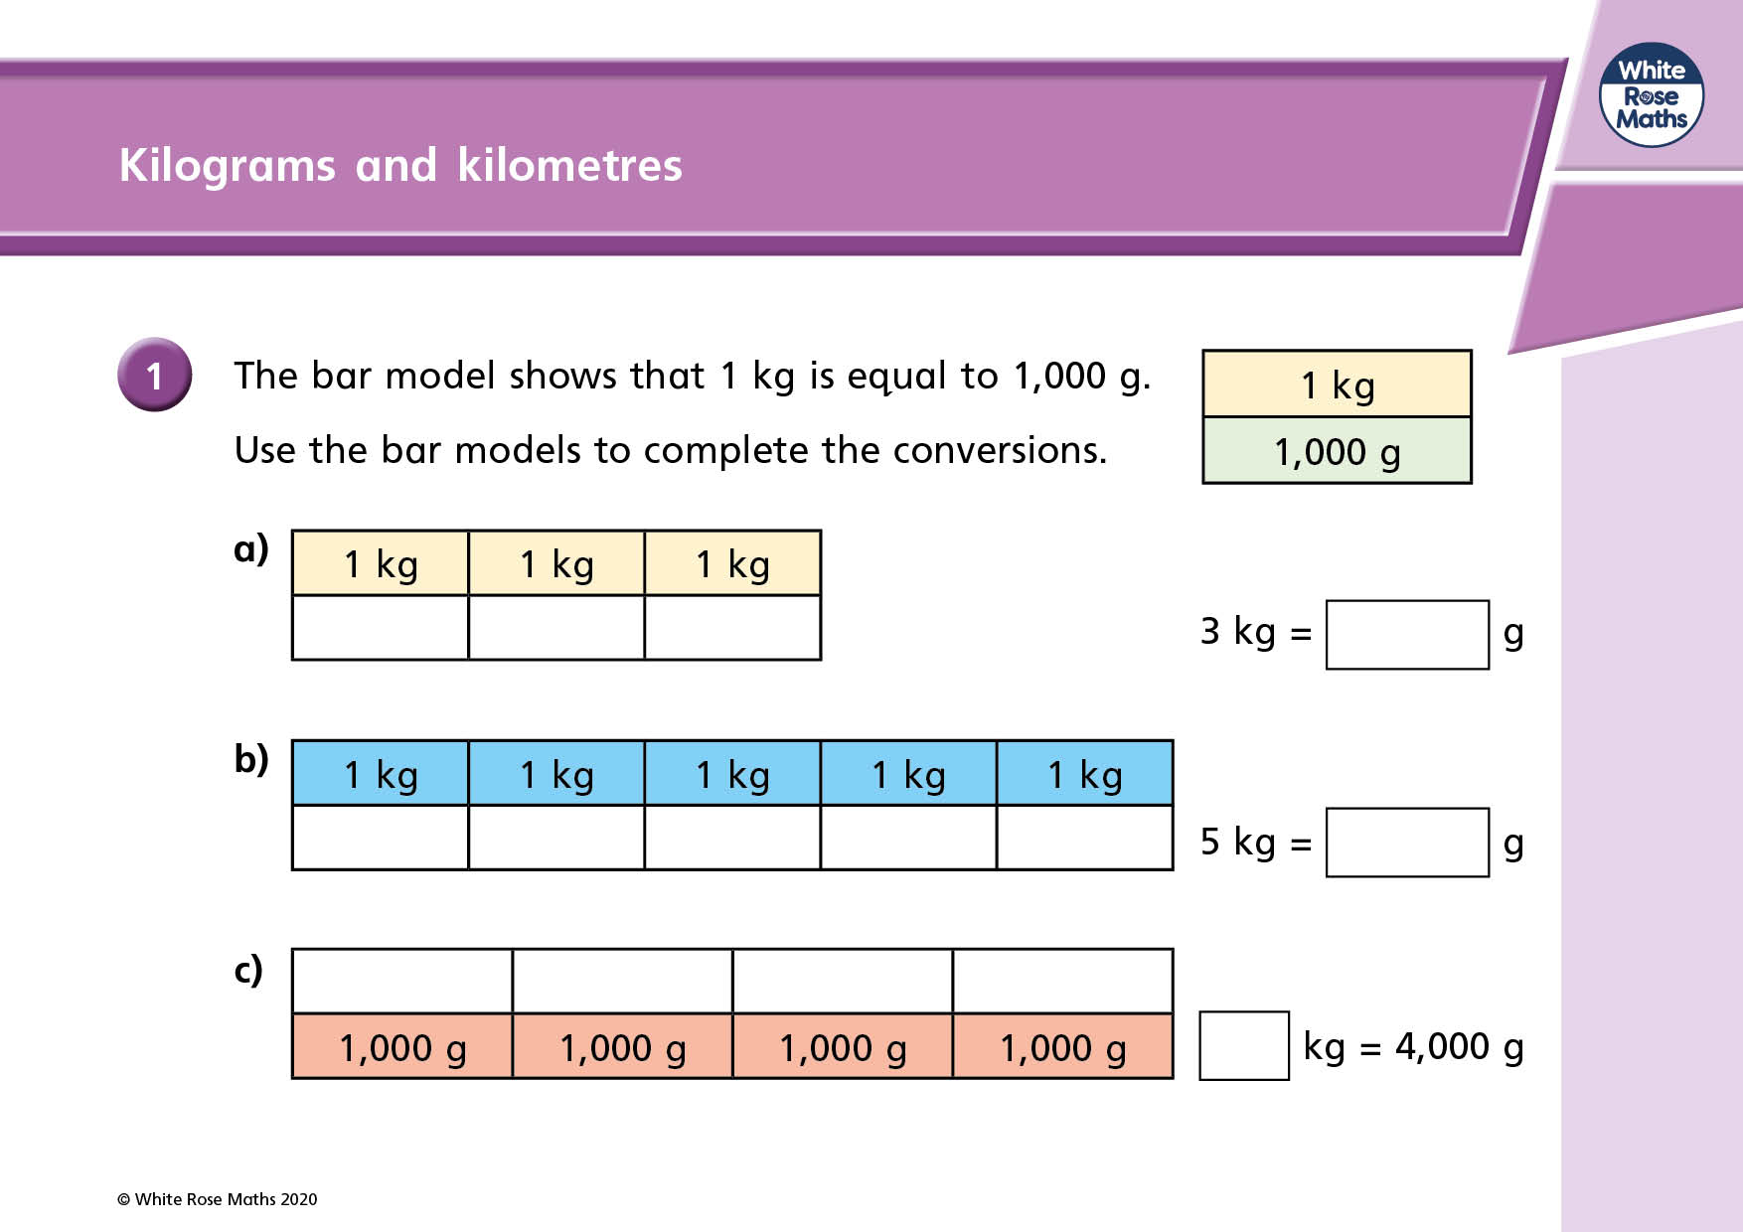

Slide 16
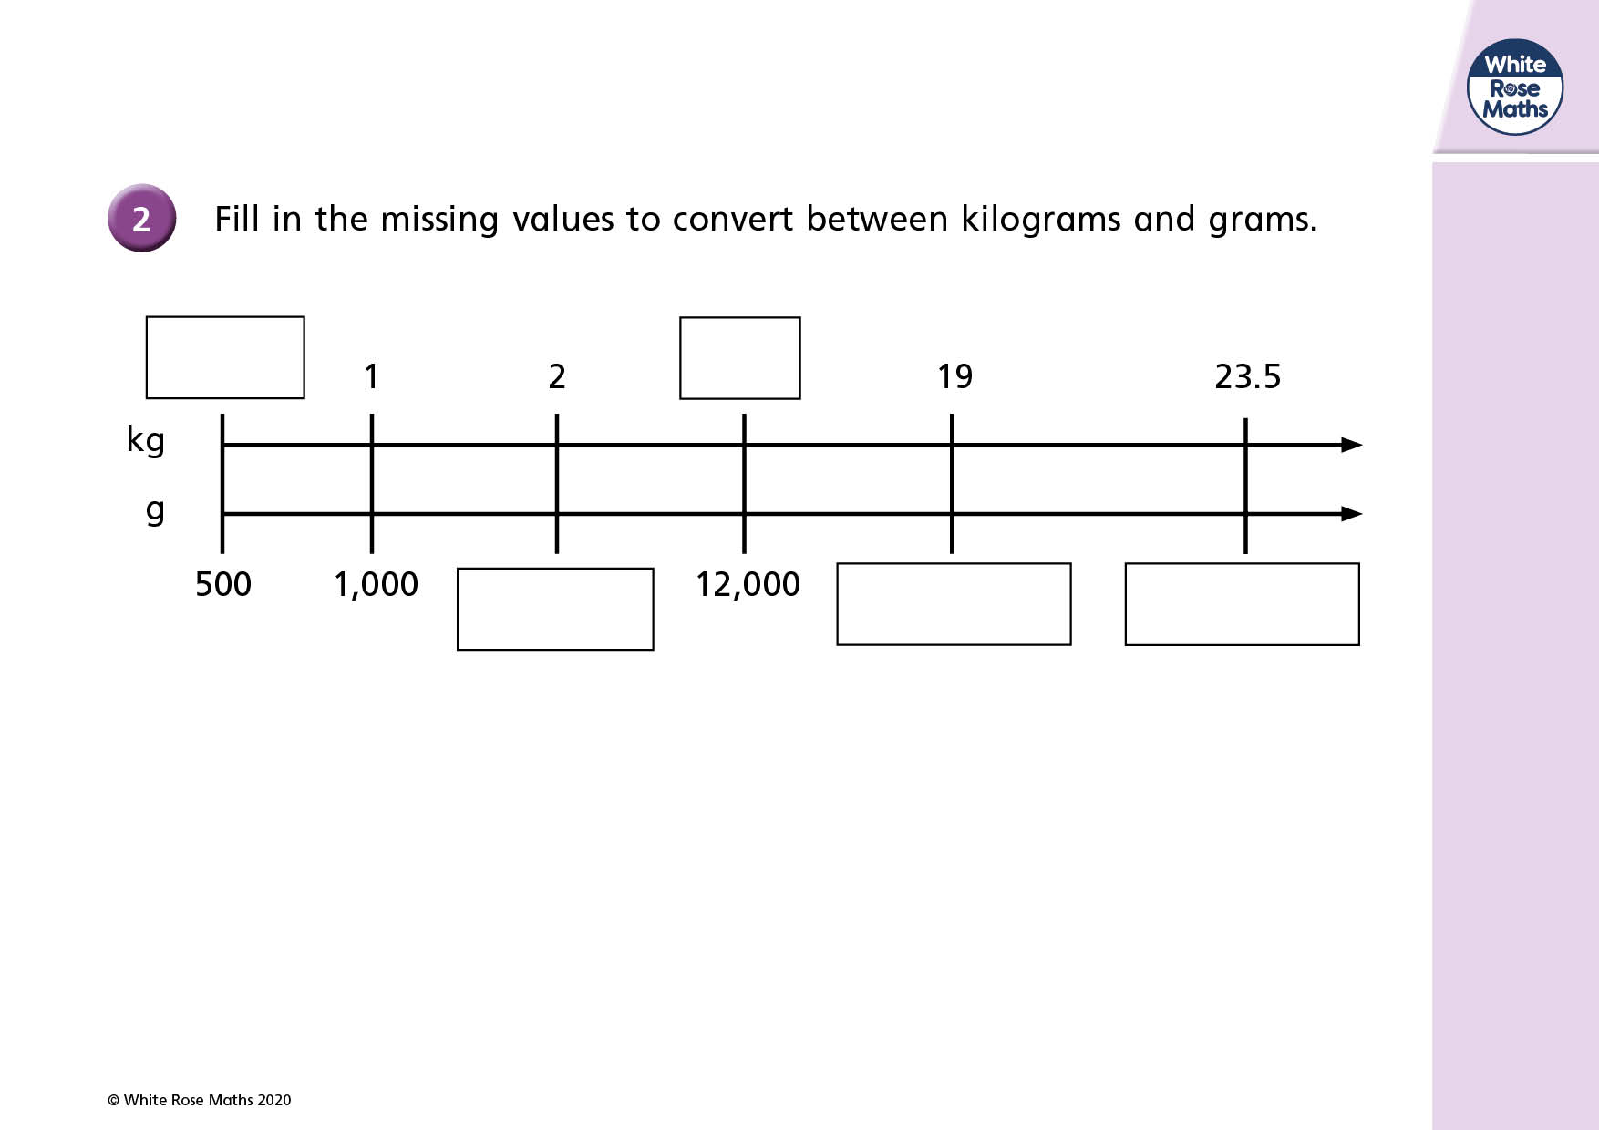

Slide 17
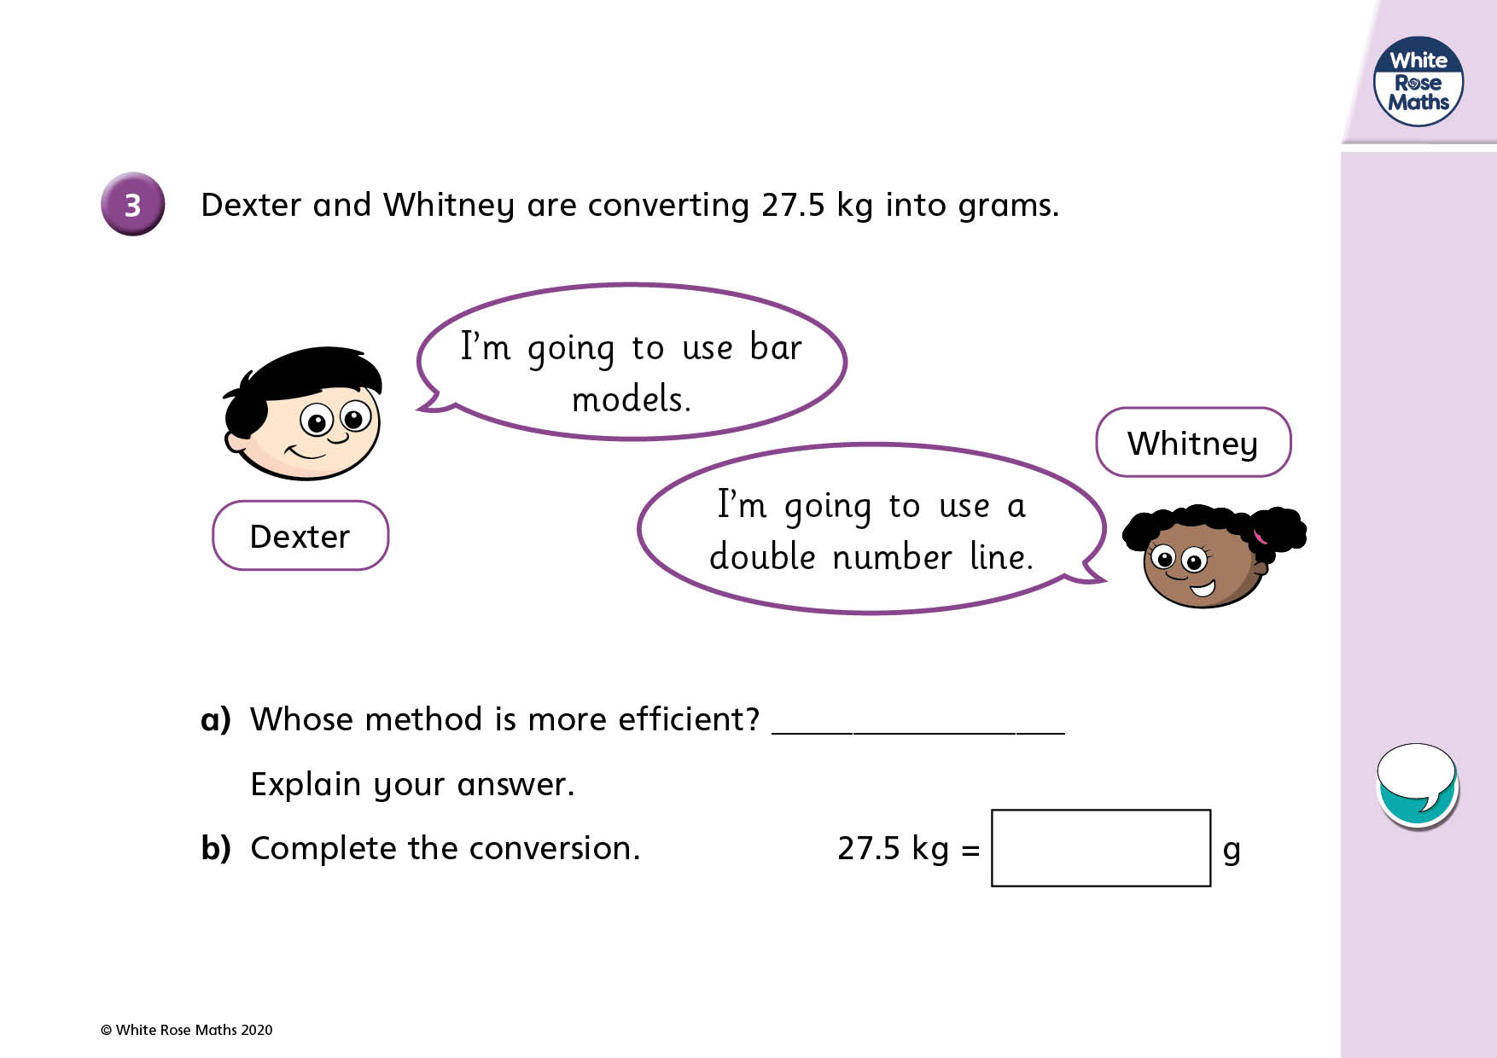

Slide 18
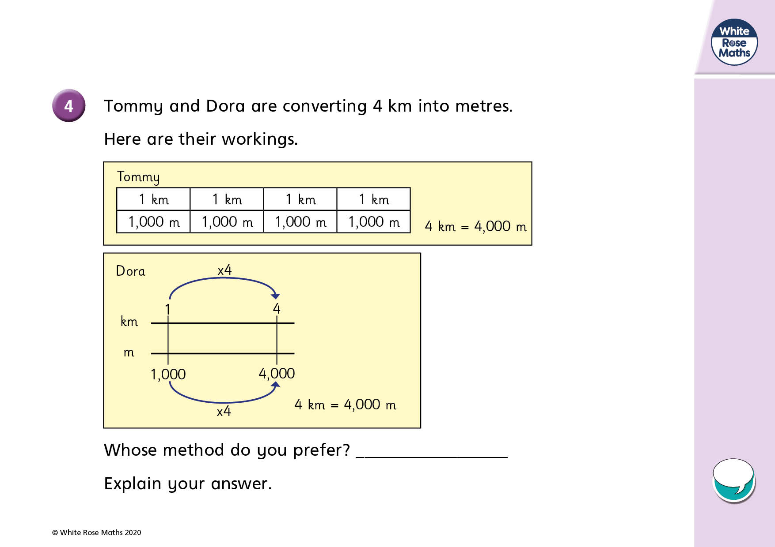

Slide 19
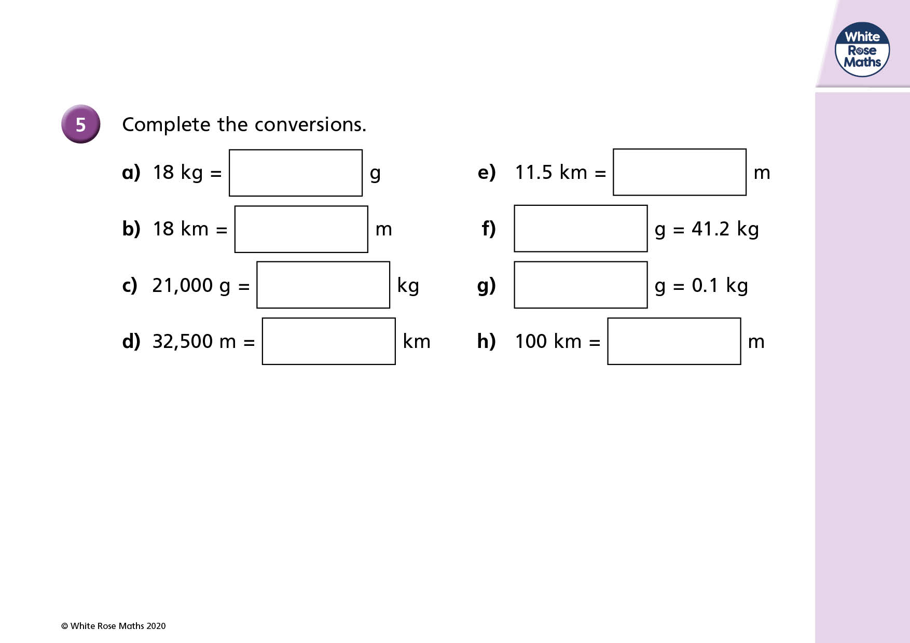

Slide 20
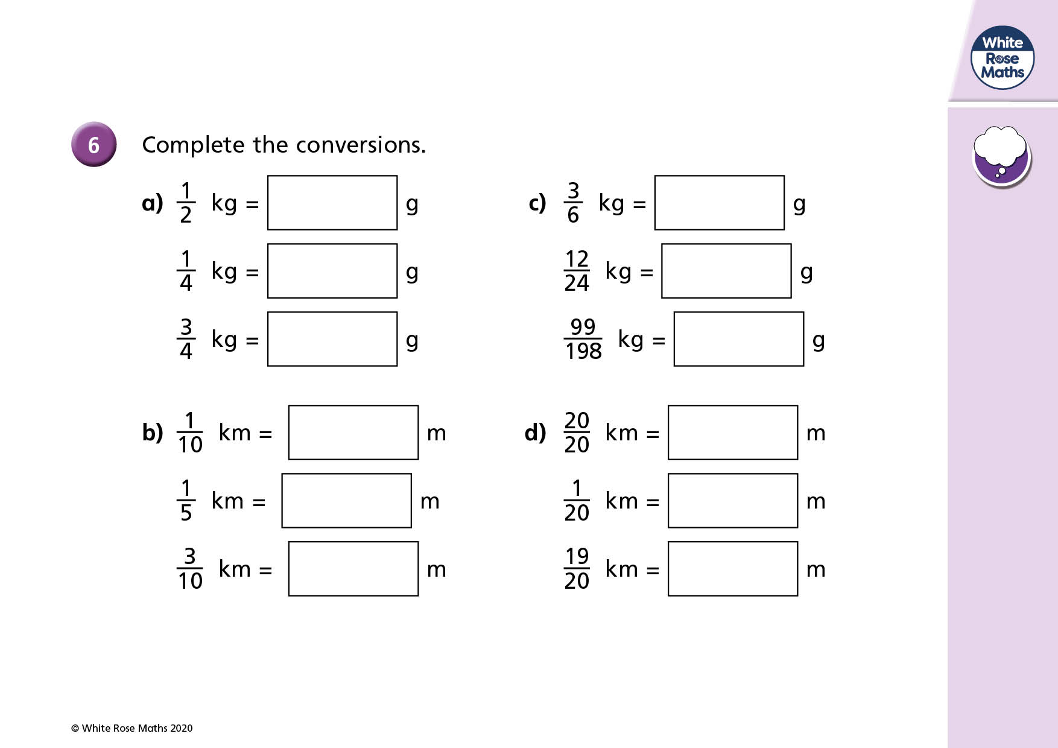

Slide 21
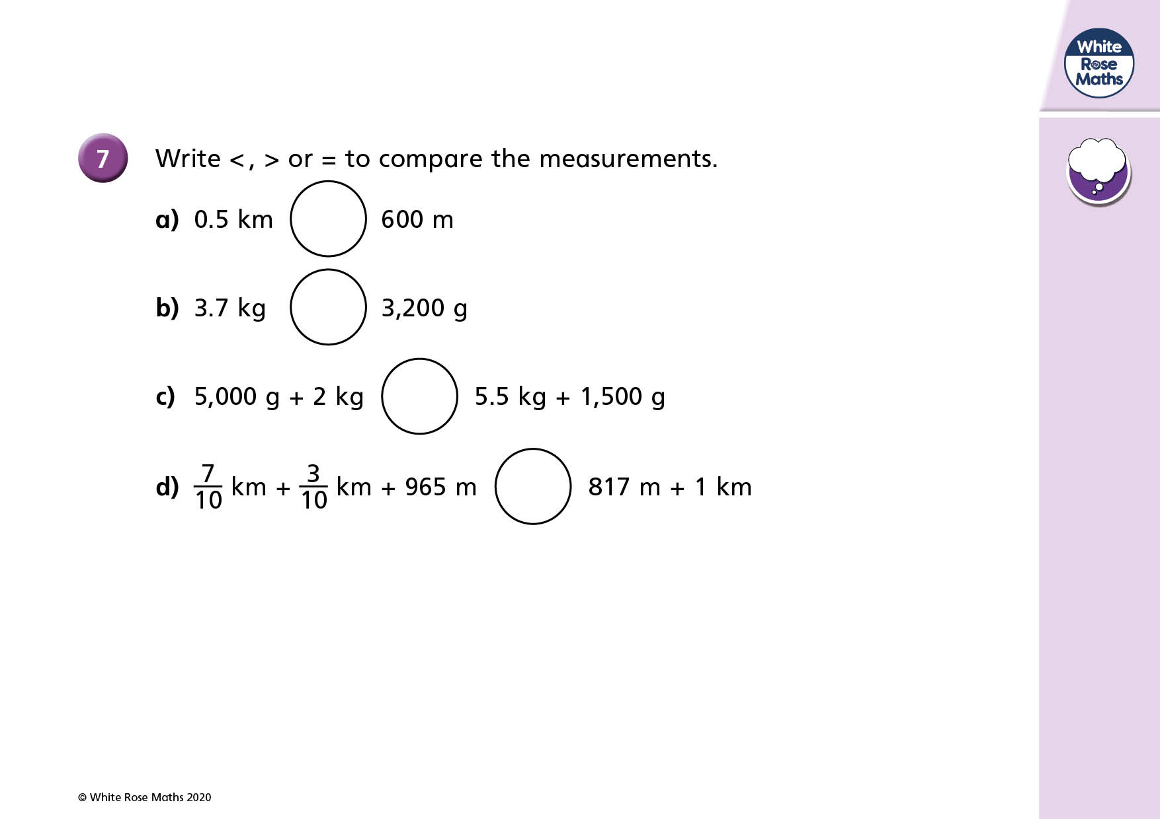

Slide 22
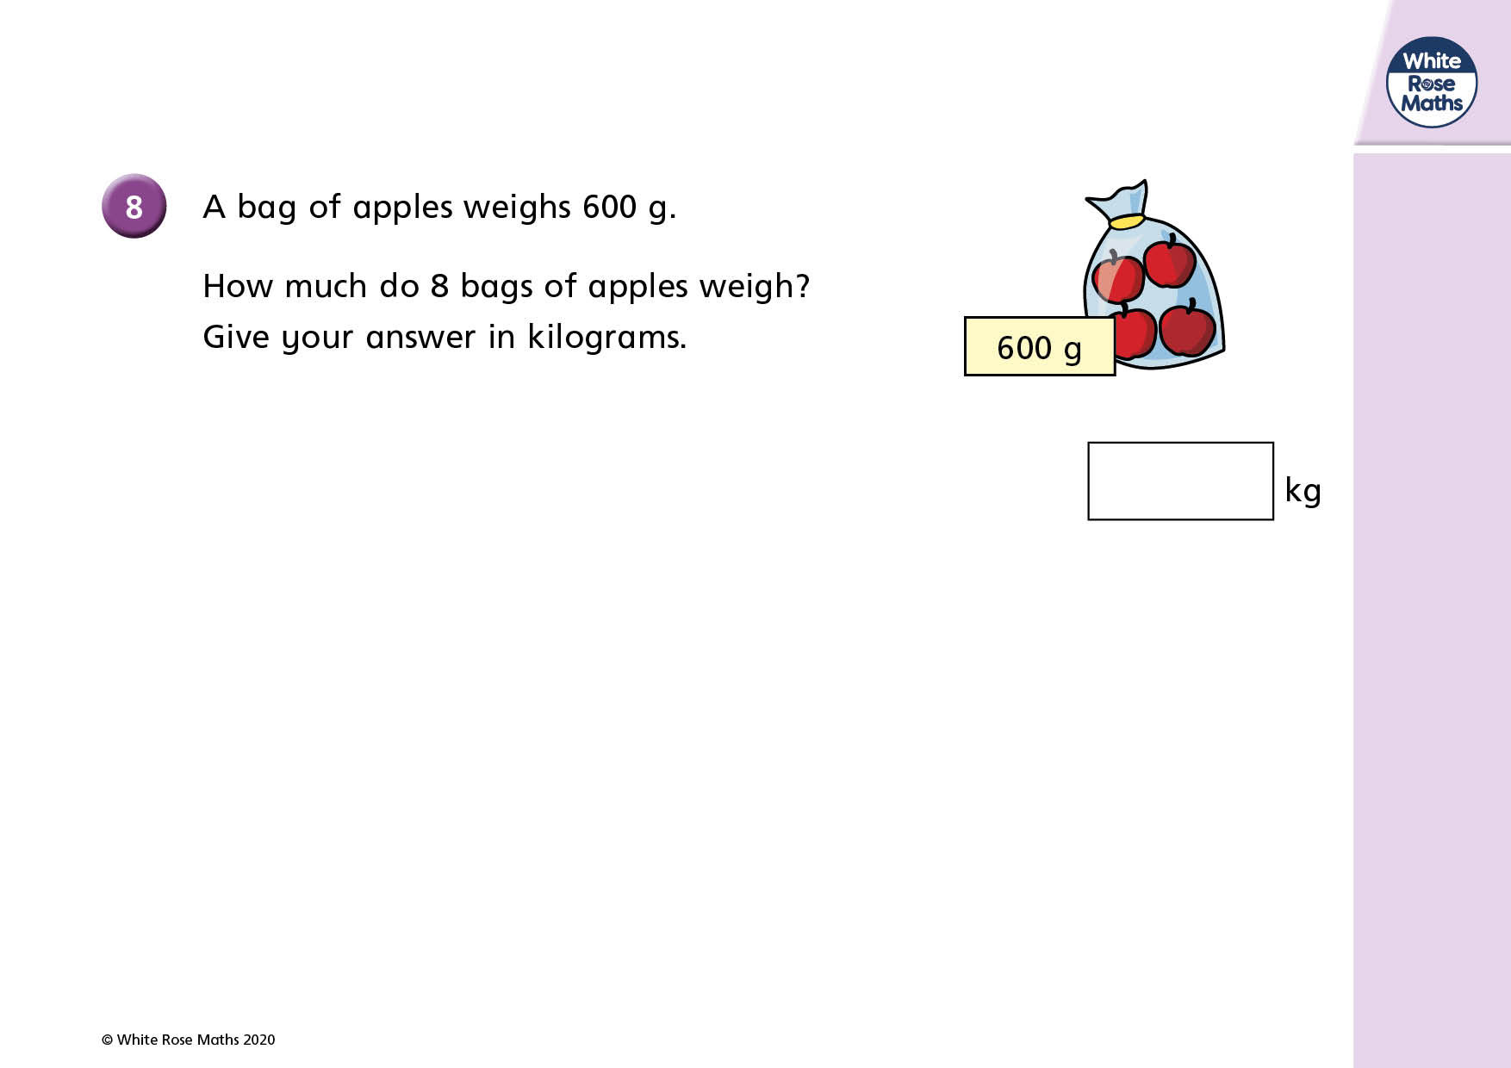

Slide 23
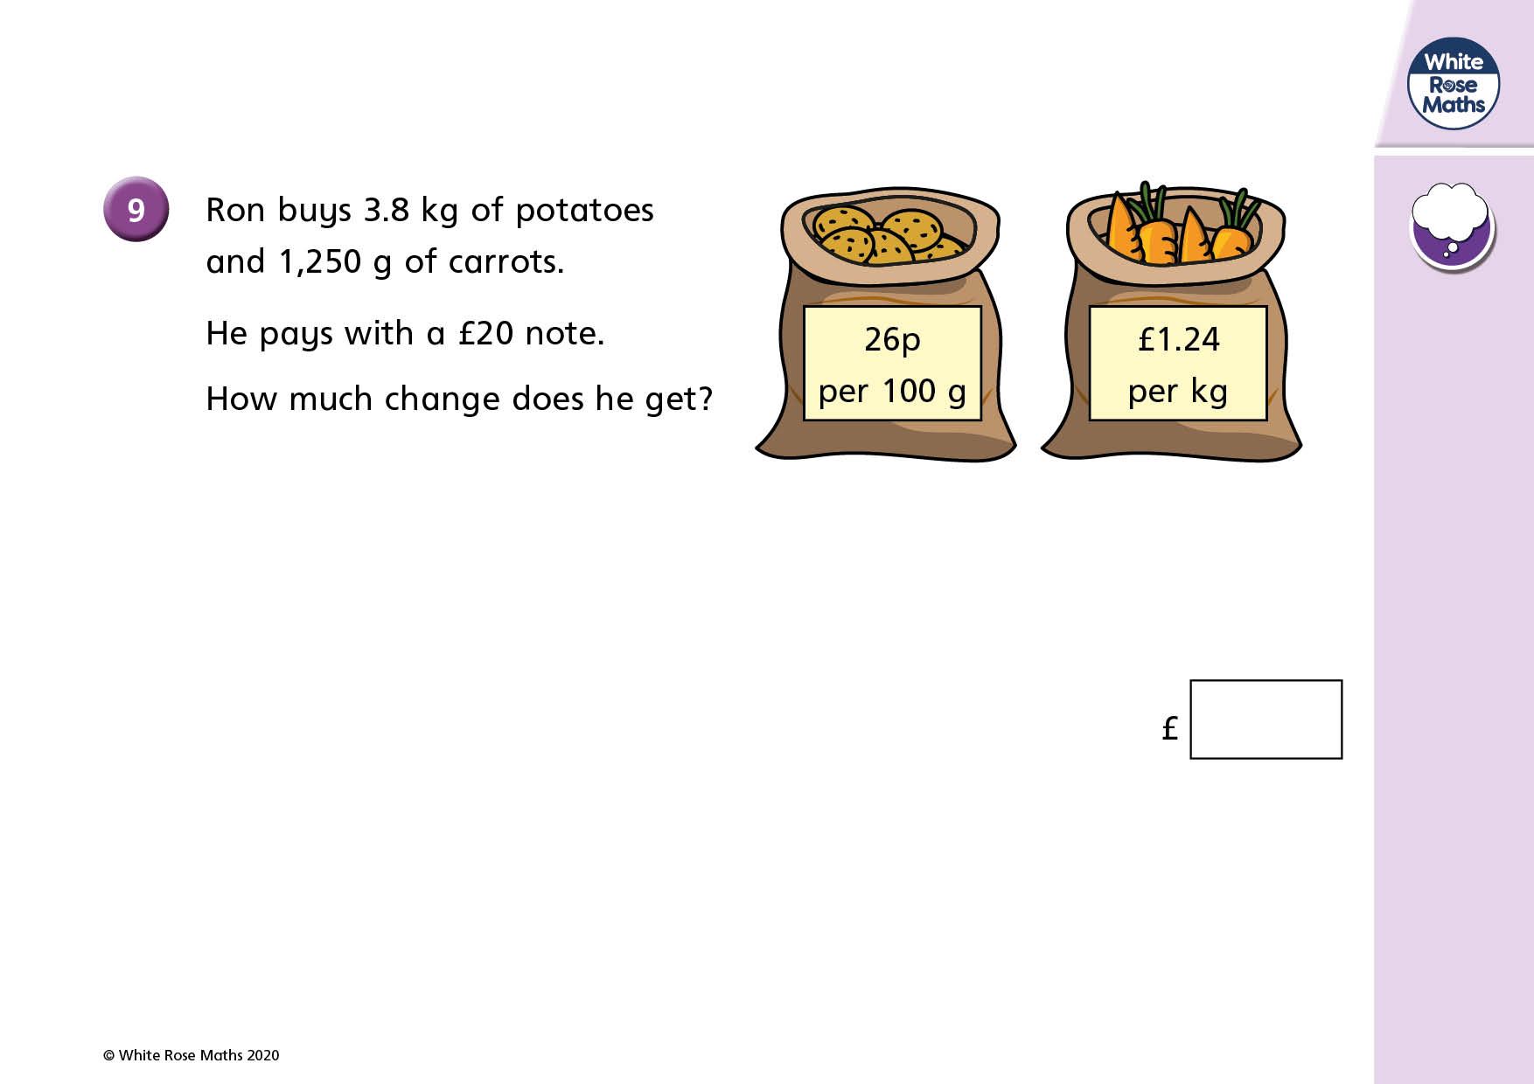

Slide 24


