Slide 1

Survivors
Extraordinary tales from the wild and beyond
Day Twenty-three

Slide 2

LC: Can I collect quotes from witnesses and family members?
Toolkit

Slide 3
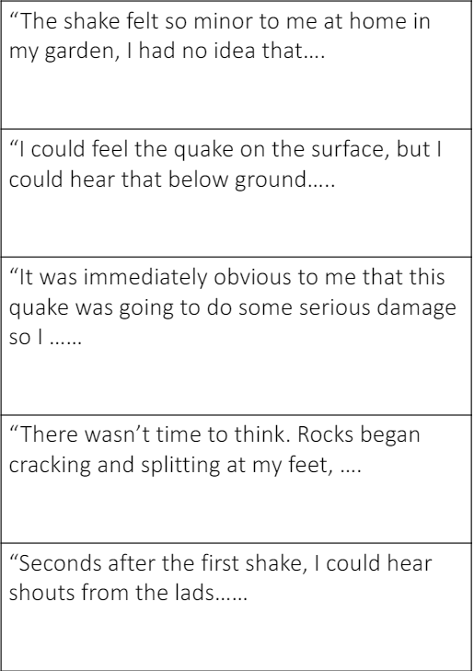
Who may have provided each of the quotes (which of the people involved in the survival story) and how each quote might finish.

Slide 4
What question do you think could have been asked of the witnesses/family members to elicit these responses?

Slide 5

Quotes
In Thursday’s lesson, we will be writing the main body of the newspaper article (a continuation of the headline and orientation written yesterday).
You may be including several perspectives within their report (1:mining company; 2:Larry’s bereaved family; 3:Webb’s and Long’s families; 4:escaped miners, 5:scientists/geologists) and therefore we need some quotes to include within the article to represent these views.
A quote is a phrase taken directly from a text or speech.
It’s important to carefully punctuate your quotations, so that the meaning is clear.

Slide 6
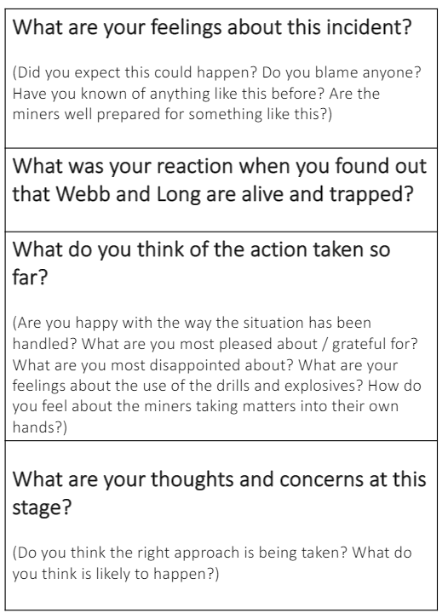
Interviewing
I want to split the class into different groups if your birthday is January to February group 1, April or May group 2, June or July group 3, August or September group 4, October and December group 5.
Your group corresponds to your role.
1:mining company; 2:Larry’s bereaved family; 3:Webb’s and Long’s families; 4:escaped miners, 5:scientists/geologists
Ask someone in your home to ask you the questions to the right. We are going to collate your answers on Teams to use as quotes in our news article writing.

Slide 7
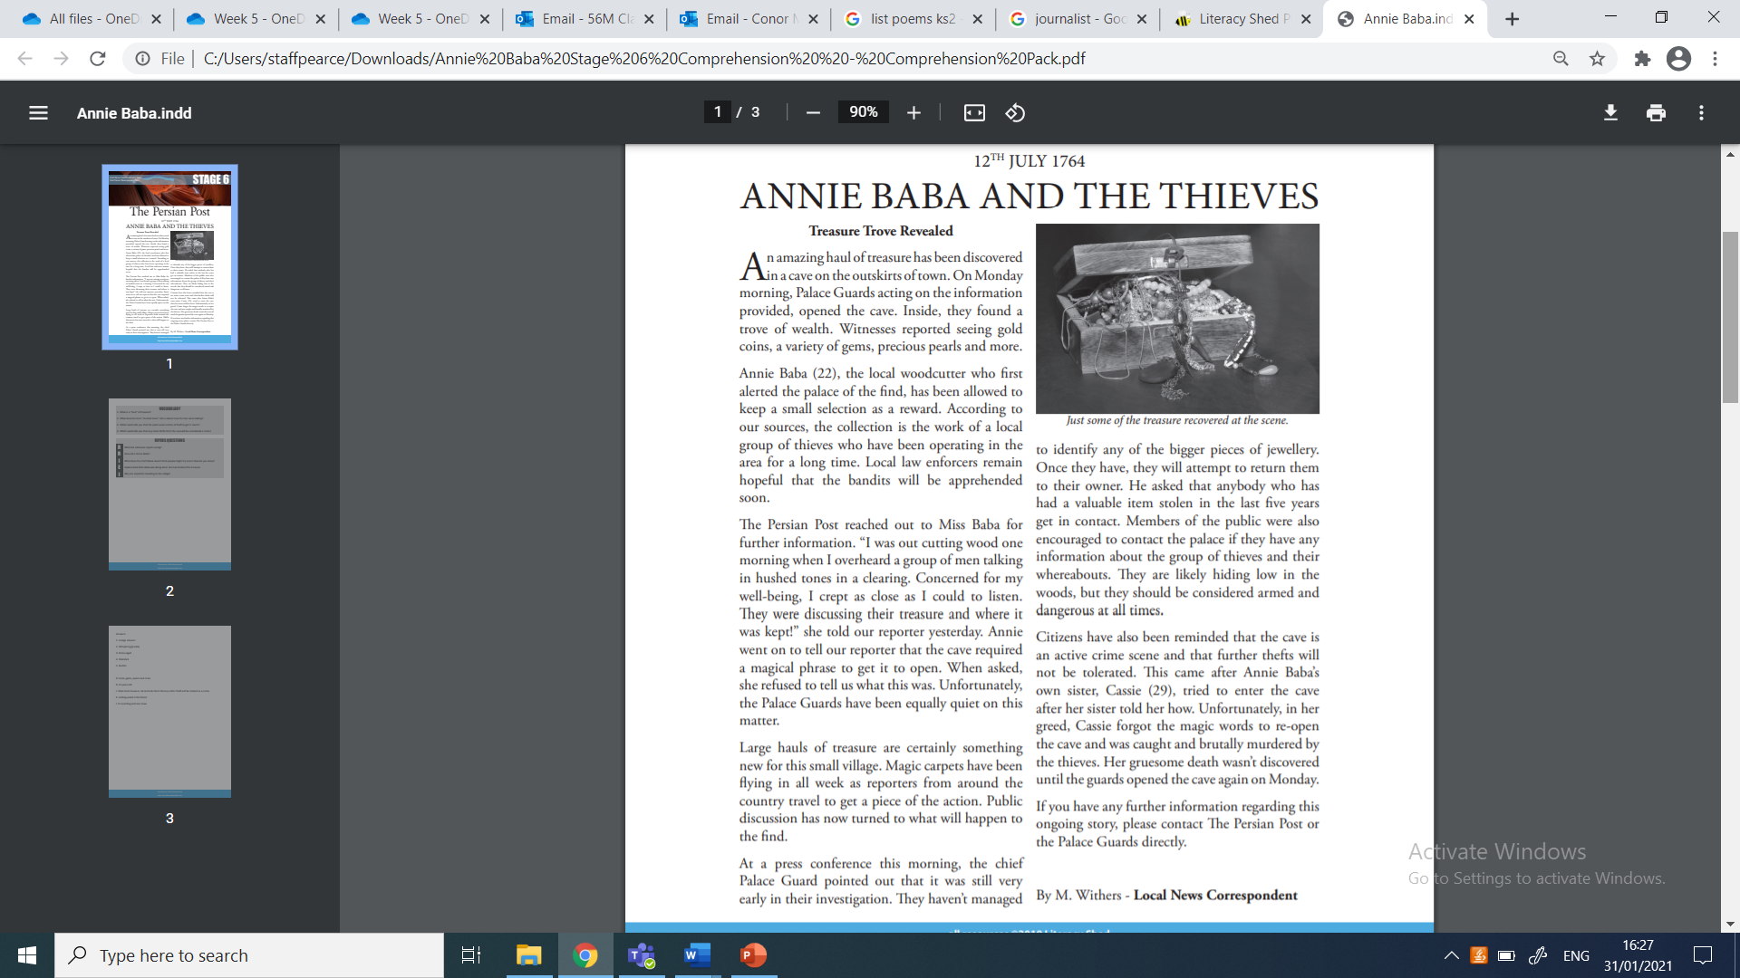
Before moving on
Have a look how quotes are introduced in this news article.
What words has the journalist used?

