Slide 1


Slide 3
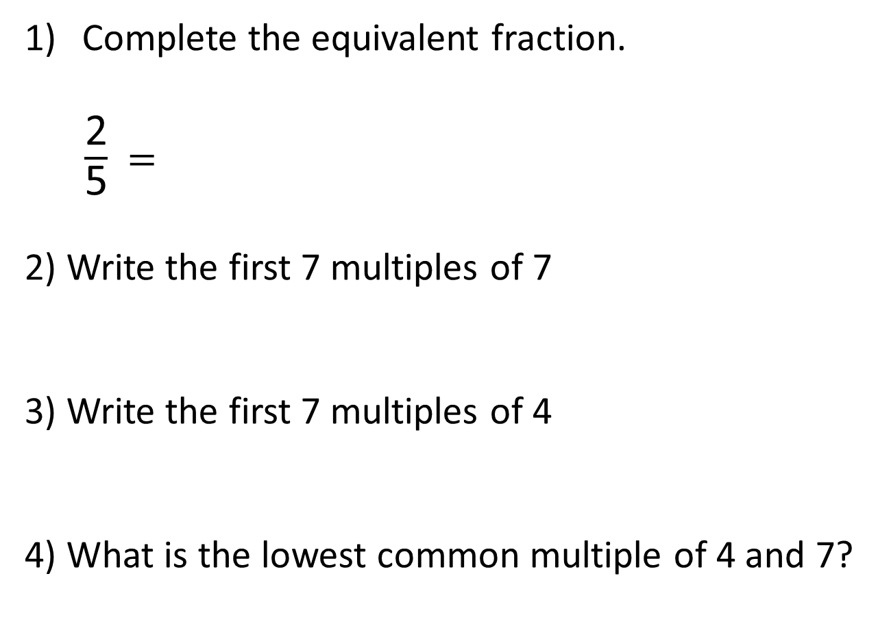

Complete the equivalent fraction.
$\frac{\text{2}}{\text{5}}$ $=$
2) Write the first 7 multiples of 7
3) Write the first 7 multiples of 4
4) What is the lowest common multiple of 4 and 7?
$$\frac{\text{8}}{\text{20}}$$

Slide 4


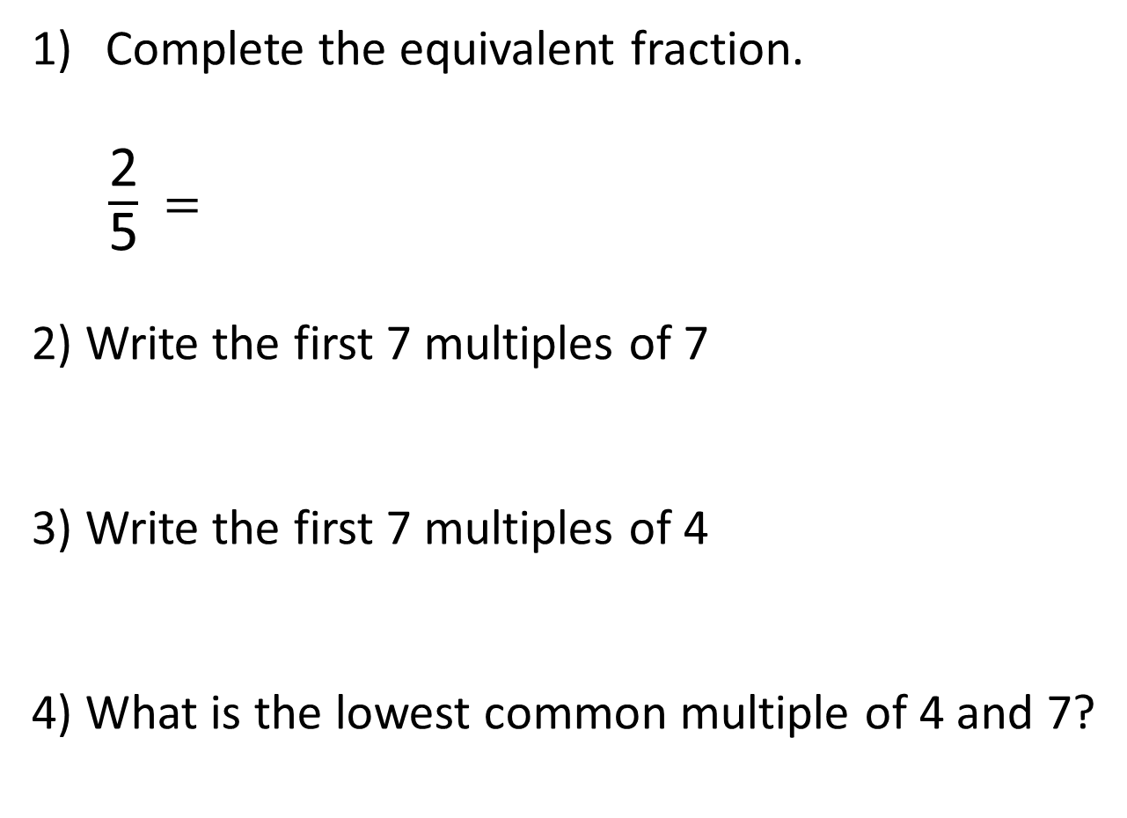
Complete the equivalent fraction.
$\frac{\text{2}}{\text{5}}$ $=$
2) Write the first 7 multiples of 7
3) Write the first 7 multiples of 4
4) What is the lowest common multiple of 4 and 7?
$×$ 4
$$\frac{\text{8}}{\text{20}}$$
$×$ 4
7, 14, 21, 28, 35, 42, 49
4, 8, 12, 16, 20, 24, 28
28

Slide 5
https://vimeo.com/500362215

Slide 7


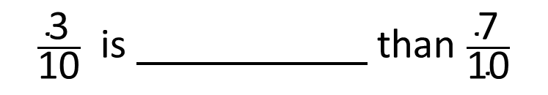

Write $>, <$ or $=$ to compare the fractions
$\frac{\text{3}}{\text{10}}$ $\frac{\text{7}}{\text{10}}$
$$<$$
$\frac{\text{3}}{\text{10}}$ is than $\frac{\text{7}}{\text{10}}$
smaller
greater
smaller
When the denominators are the same, the the numerator, the the fraction.
greater
smaller

Slide 8







greater
smaller
When the denominators are the same, the the numerator, the the fraction.
greater
smaller
Write $>, <$ or $=$ to compare the fractions
$\frac{\text{2}}{\text{5}}$ $\frac{\text{7}}{\text{15}}$
$$<$$
$×$ 3
Multiples of 5: 5, 10, 15
6
$\frac{\text{2}}{\text{5}}$ $=$ $\frac{}{\text{15}}$
$\frac{\text{6}}{\text{15}}$ $<$ $\frac{\text{7}}{\text{15}}$
$×$ 3

Slide 9



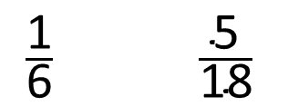
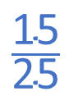

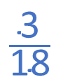
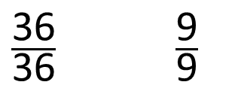
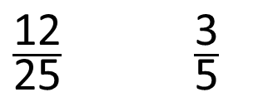

Have a think
Write $>, <$ or $=$ to compare the fractions
$$\frac{\text{3}}{\text{18}}$$
$\frac{\text{1}}{\text{6}}$ $\frac{\text{5}}{\text{18}}$
$$<$$
$\frac{\text{12}}{\text{25}}$ $\frac{\text{3}}{\text{5}}$
$$\frac{\text{15}}{\text{25}}$$
$$<$$
$\frac{\text{36}}{\text{36}}$ $\frac{\text{9}}{\text{9}}$
$$=$$

Slide 10

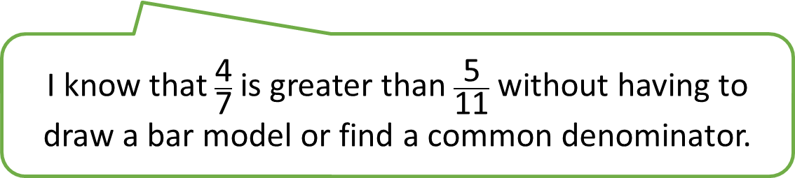
Have a think
I know that $\frac{\text{4}}{\text{7}}$ is greater than $\frac{\text{5}}{\text{11}}$ without having to draw a bar model or find a common denominator.

Slide 11
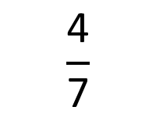
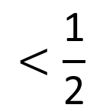
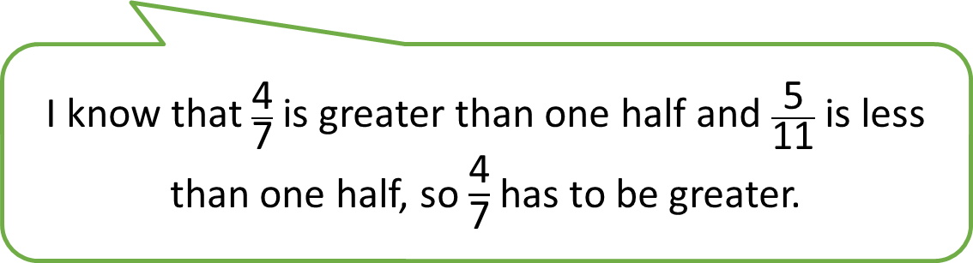
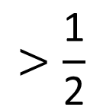

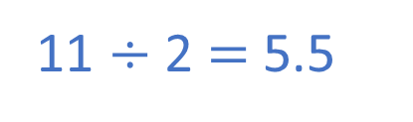
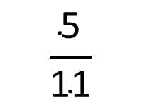
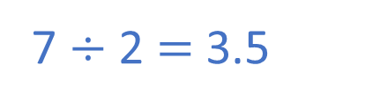
I know that $\frac{\text{4}}{\text{7}}$ is greater than one half and $\frac{\text{5}}{\text{11}}$ is less than one half, so $\frac{\text{4}}{\text{7}}$ has to be greater.
I know that $\frac{\text{4}}{\text{7}}$ is greater than $\frac{\text{5}}{\text{11}}$ without having to draw a bar model.
$$\frac{\text{5}}{\text{11}}$$
$$>\frac{\text{1}}{\text{2}}$$
$$<\frac{\text{1}}{\text{2}}$$
$$\frac{\text{4}}{\text{7}}$$
7 $÷$ 2 $=$ 3.5
11 $÷$ 2 $=$ 5.5

Slide 12
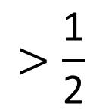
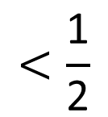
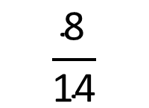
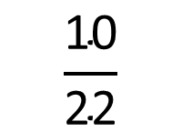

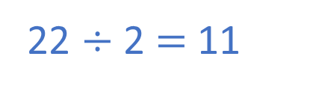

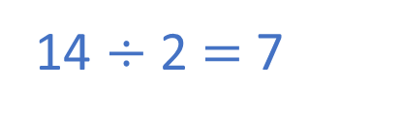
Have a think
$\frac{\text{8}}{\text{14}}$ $\frac{\text{10}}{\text{22}}$
$$>$$
14 $÷$ 2 $=$ 7
22 $÷$ 2 $=$ 11
$$>\frac{\text{1}}{\text{2}}$$
$$\frac{\text{8}}{\text{14}}$$
$$<\frac{\text{1}}{\text{2}}$$
$$\frac{\text{10}}{\text{22}}$$

Slide 13

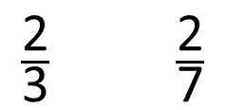

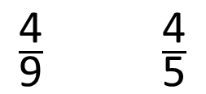
$\frac{\text{4}}{\text{9}}$ $\frac{\text{4}}{\text{5}}$
$$<$$
$\frac{\text{2}}{\text{3}}$ $\frac{\text{2}}{\text{7}}$
$$>$$
Have a think
What’s the same and what’s different?
What do you notice?
greater
smaller
When the numerators are the same, the the denominator, the the fraction.
greater
smaller

Slide 14

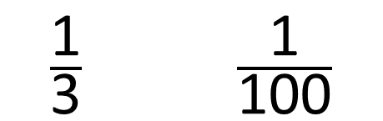
$\frac{\text{1}}{\text{3}}$ $\frac{\text{1}}{\text{100}}$
$$>$$
greater
When the numerators are the same, the the denominator, the the fraction.
smaller
smaller
When the numerators are the same, the the denominator, the the fraction.
greater

Slide 15




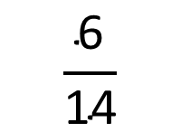

Write $>, <$ or $=$ to compare the fractions
$\frac{\text{3}}{\text{7}}$ $\frac{\text{6}}{\text{11}}$
$$<$$
When the numerators are the same, the greater the denominator, the smaller the fraction.
$\frac{\text{3}}{\text{7}}$ $\frac{\text{6}}{\text{11}}$
$×$ 2
$$\frac{\text{6}}{\text{14}}$$

Slide 16



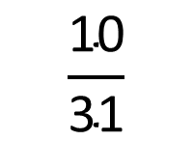




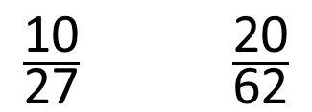
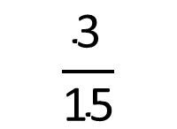

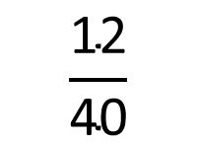
Have a think
When the numerators are the same, the greater the denominator, the smaller the fraction.
$\frac{\text{3}}{\text{10}}$ $\frac{\text{12}}{\text{37}}$
$\frac{\text{10}}{\text{27}}$ $\frac{\text{20}}{\text{62}}$
$$<$$
$$>$$
$×$ 4
$÷$ 2
$$\frac{\text{10}}{\text{31}}$$
$$\frac{\text{12}}{\text{40}}$$
$\frac{\text{3}}{\text{8}}$ $\frac{\text{1}}{\text{5}}$
$$>$$
$×$ 3
$$\frac{\text{3}}{\text{15}}$$

Slide 17
Have a go at questions
1 - 4 on the worksheet

