Slide 1

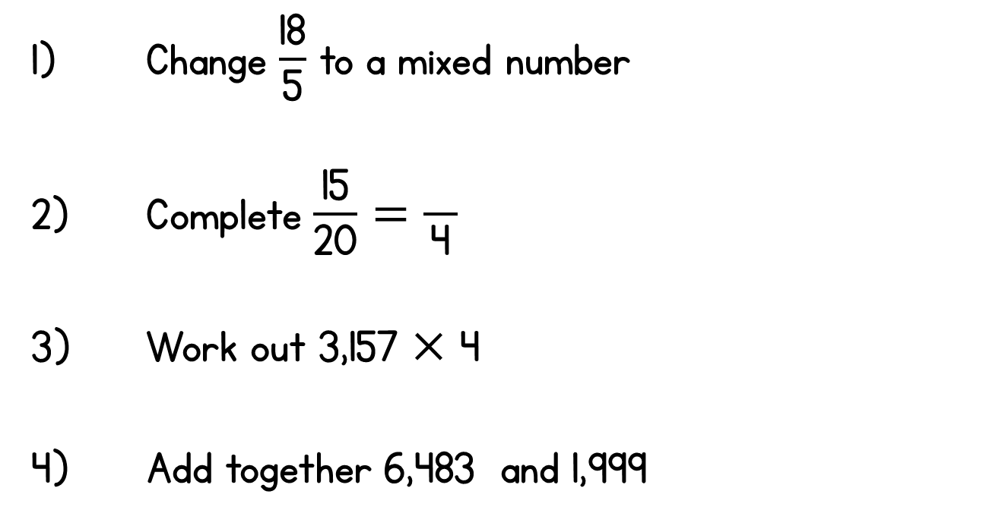

Year 5 | Week 4 | Day 3

