Slide 1

British Victorian Composers
Notes:
1

Slide 2
We are finding out how life was different in Victorian times
We are considering what kinds of music Victorians would have had
We are gaining an understanding of some types of music popular in the Victorian times
Classics for Kids
Notes:
2

Slide 3
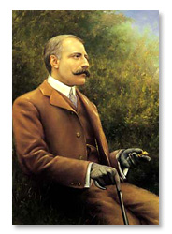
Edward Elgar
1857 – 1934
Classics for Kids
Lesson Tutor: Classical Composer Biography: Edward Elgar
Notes:
3

Slide 4
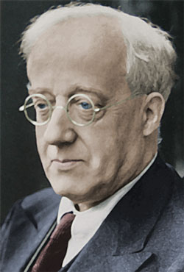
Gustav Holst
1874-1934
DSO Kids | Listen by Composer
Notes:
4

Slide 5
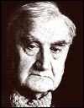
Ralph Vaughan Williams
1872 – 1958
Classics for Kids
Notes:
5

Slide 6
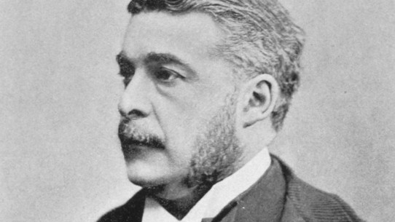
Arthur Sullivan
1842-1900
Notes:
6

Slide 7
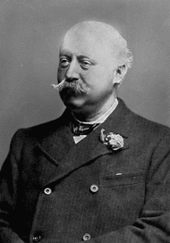
Hubert Parry
1848-1918
Hubert Parry: Biography - Classic Cat
Notes:
7

Slide 8
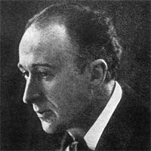
Frederick Delius
1862-1934
Frederick Delius Biography - Sublime Music, Tragic Life

Slide 9
Other British Victorian Composers
Samuel Coleridge Taylor 1875-1912
Michael W Balfe 1808-1870
Roger Quilter 1877-1953
Ethel Smyth 1858-1944
Maude Valerie White 1855-1937
Notes:
9

Slide 10
Research a Victorian Composer.
The sort of information you will need to find out is a bit about their lives,
What kind of music they wrote i.e. songs, orchestral, opera
Some examples of their music
You can include pictures, website links.
Notes:
10

