Slide 1
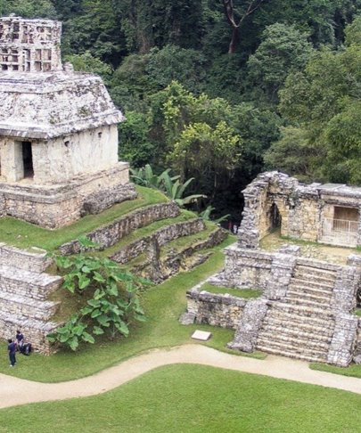
Maya Cities
Lesson 5

Slide 2
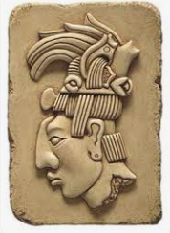
Imagine you are a King, designing your city from scratch
Who will live in your city
What jobs would people need to do?
What buildings would you need?

Slide 3
LC: Can I understand the design of Maya cities?
Toolkit
Design a city and include the main features
Yr 4 Challenge:
Explain the use of the buildings

Slide 4
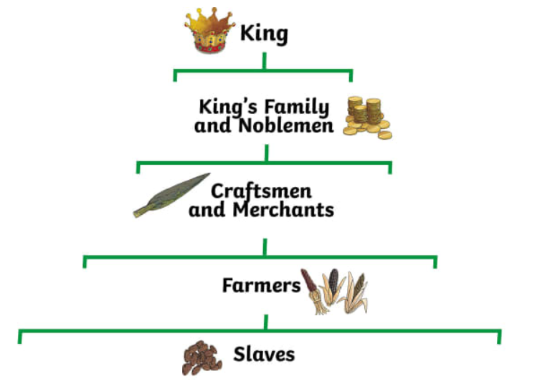
Maya social structure
Every society in the world is organised differently, but they often have some similarities. For example, most countries have a leader. The United Kingdom has the queen and the prime minister. America has a president.
Maya society was organised depending on how important the person was.
Roles in life were inherited – if your father was the King, you inherited the throne, if your father was a farmer, you became a farmer.
Slaves did all the hard work and Maya society depended on them.
The social structure was reflected in the layout and the buildings of the cities.

Slide 5

Maya cities
Historians have discovered several cities built by the Maya, including Chichen Itza, Palanque. They were the first large cities to be built in America.
The Maya had city states – they were far apart and each had their own ruler but they traded goods with each other.
These cities were incredible and had many important buildings, palaces and temples. Pyramid-shaped temples had a shrine at the top, with a staircase on each side of the pyramid leading to this.

Slide 6
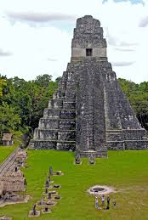
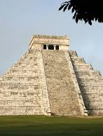
Maya pyramid temples
Priests were very important and were believed to receive direct messages from the gods.
One of their most important jobs was to perform ceremonies.
The temples were the most sacred buildings in the city and were built on top of the towering, stepped pyramids. The temples were used for rituals and sacrifices – only priests and rulers were allowed to climb the stairs of the pyramid to the temple.

Slide 7
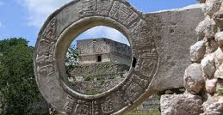
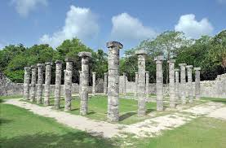
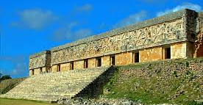
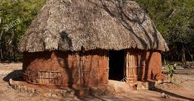
Maya cities
In the centre of a Maya city, was a large open square where markets were held.
Each city also had a 'pok ta pok' court. Pok ta pok was a popular ball game, which involved teams of players competing to put a ball through a stone hoop. These games were sometimes played as part of religious festivals.
The Kings lived in single storey palaces in the city centre and wealthy Maya also had houses in the city, made from limestone.
Most ordinary Maya people lived in small and simple homes on the edge of cities made of bricks or wood and had a thatched roof.

Slide 8
Location of the buildings – Yr4 information
Maya chose the location of important buildings like pyramids and temples carefully so that they lined up with astronomical events.
Pakal the Great had his tomb built so it lined up with the sun so that at sunset on the winter solstice, the light appears to go down the stairs to his tomb.
The observatory at Chichen Itza called El Caracol is lined up with the path of the planet Venus – the Maya tracked Venus carefully because they thought it was linked to war.

Slide 9
Activity 1 – Design your own ancient Maya city
You should include:
Temples and Pyramids
Areas for sport (ball court) and trade (market square)
Houses for wealthy people
Houses for ordinary people
Evidence of Maya culture such as Stelae (stone columns with carved pictures of Maya gods)

Slide 10
Challenge for year 4
Explain how your city was built without the use of pack animals, the wheel or metal
Is there any evidence of social strata (hierarchy – Gods, Kings, Elite, farmers and how is this reflected in your city? - explain
Why do you think there is little evidence today of buildings for the poorer people? Think about thatched huts and materials used – add an explanation

Slide 11
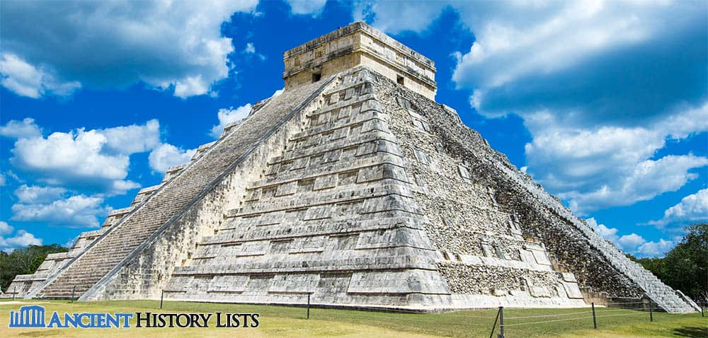
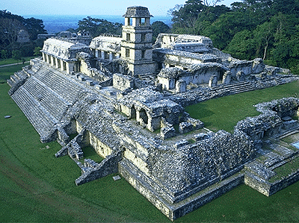
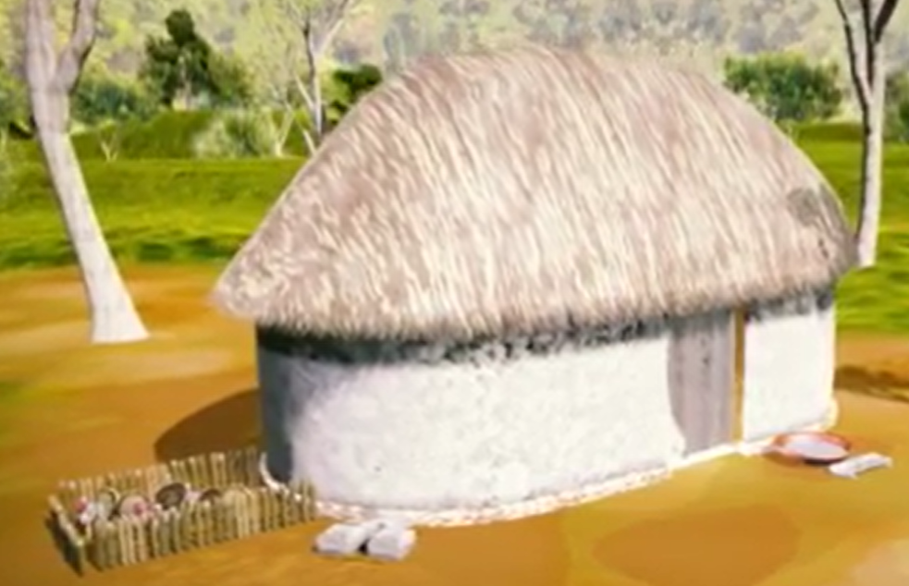

Maya buildings - drawing from a birds eye view
Maya temple pyramid
Maya palace complex
Maya house (poorer)

Slide 12


