Slide 1
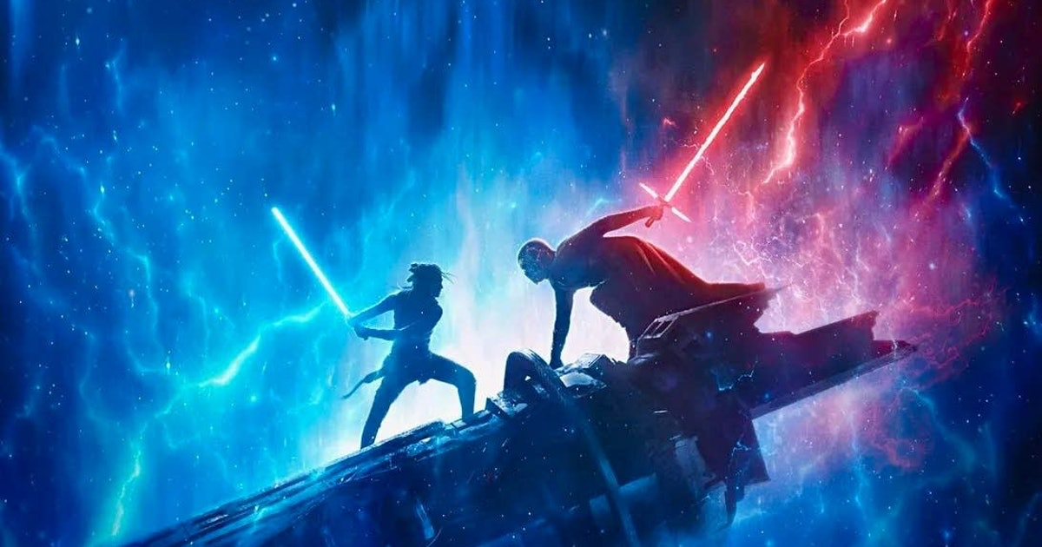
60s Quick Write.

Slide 2
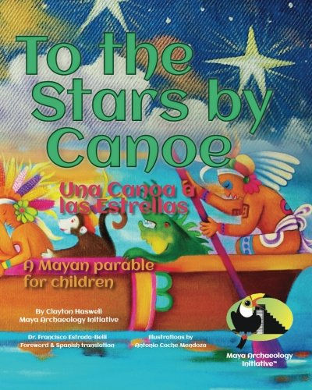
Wednesday LC: Can I design my own quest?

Slide 3
Recap - Features of myths:
Gods and goddesses
Magical elements and powers
Heroic characters
May explain a strange/important happening in nature
May include dangerous acts or quest
May include magical creatures
Set in ancient times.
Often try and explain why the world is the way it is.

Slide 4
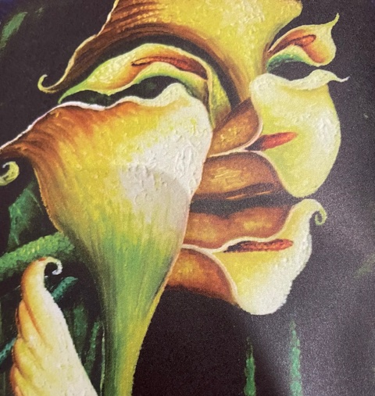
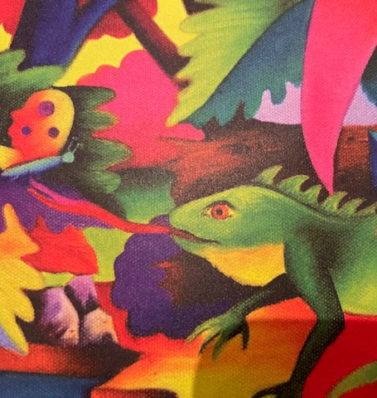
What was Itzama's quest?

Slide 5
His task was to free mankind.
He had to cross a raging river and climb a mountain and then find the sacred cave. With the help of other mythical creatures, he managed to pull man and woman from the dark cave and set mankind free!

Slide 6
Today's focus is on thinking about the quest in your story.

Slide 7
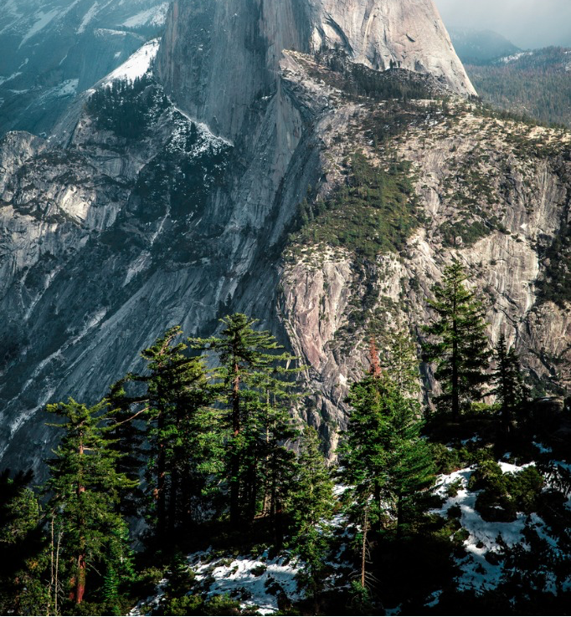
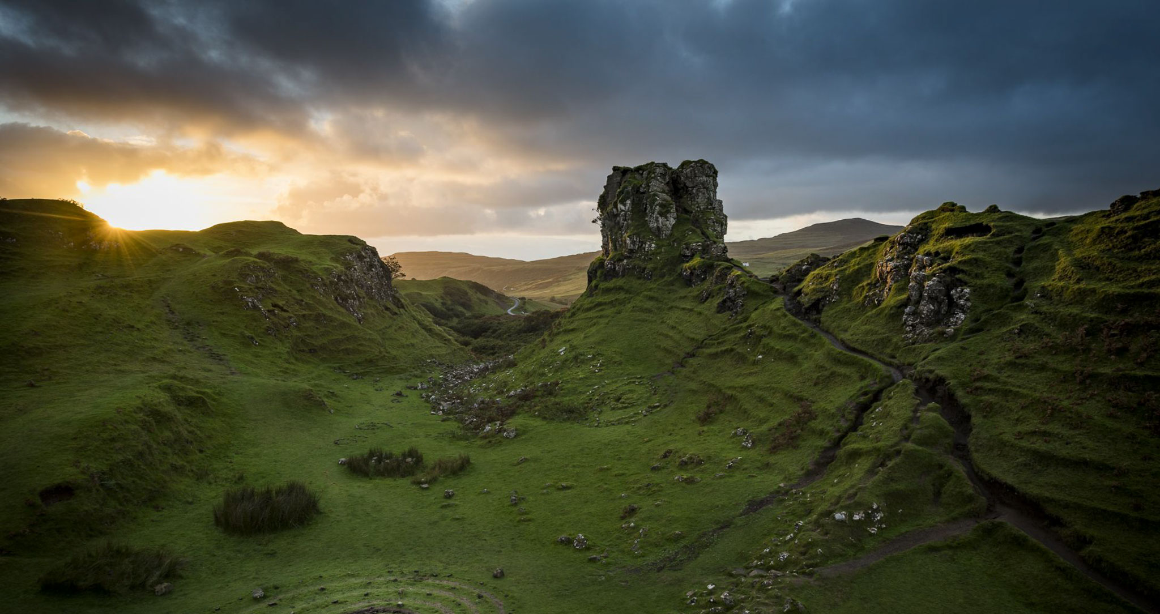
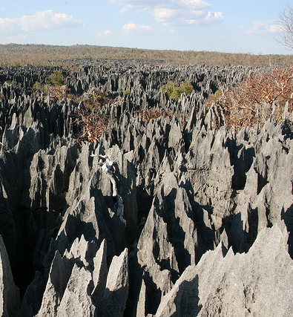
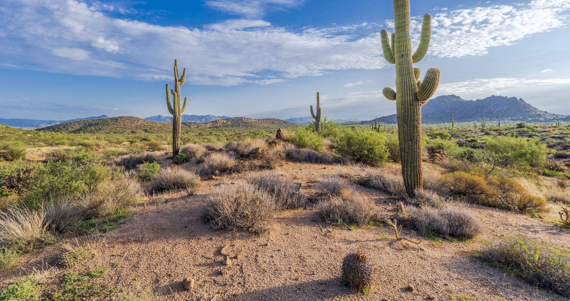
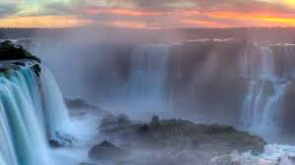
Where will your character have to journey?

Slide 8
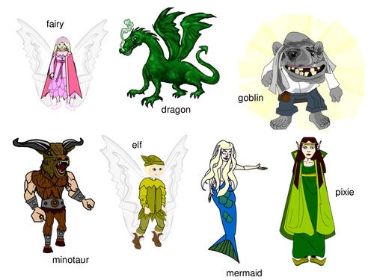
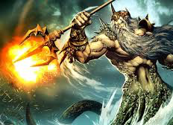
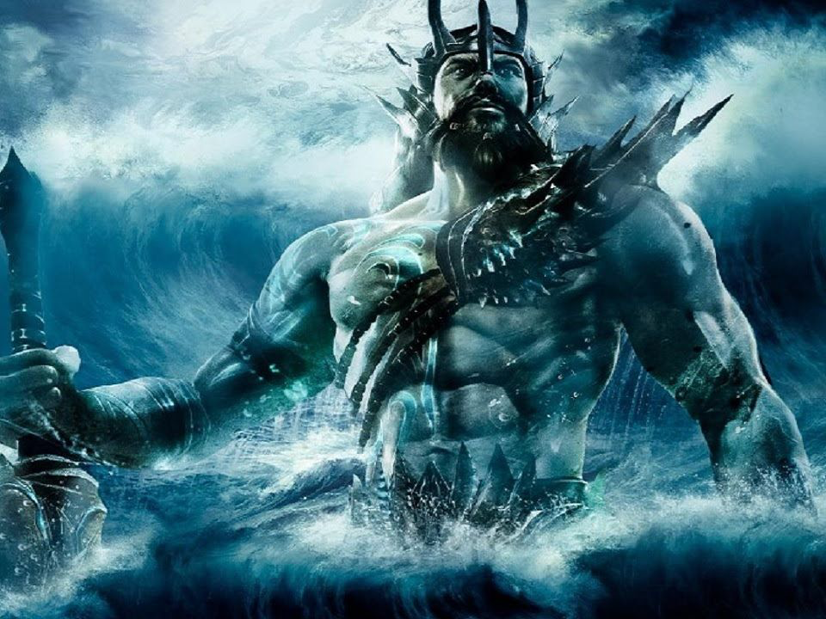
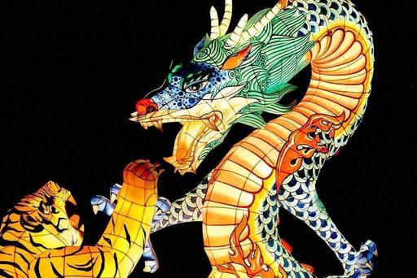
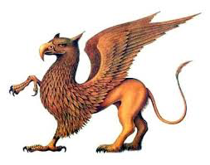
Who might your mythical creature meet along the way?

Slide 9
Wednesday LC: Can I design my own quest?
Draw a mind map to show the journey your character goes on.
Remember that there may be lots of stages to the journey.
You will need this planning next week.
Chilli Challenge: Write a short paragraph to describe the quest.

Slide 10


