Slide 1
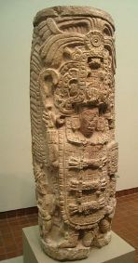
Maya sculpture
Stela

Slide 2
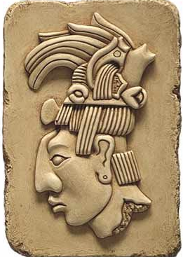
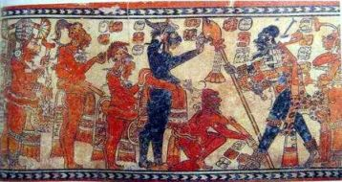
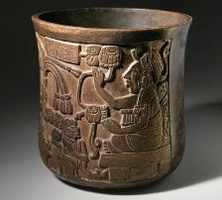
Maya Art
The Maya civilization existed for over 1500 years. During that time the Maya created many works of art. The art of the Maya was heavily influenced by their religion as well as other cultures such as the Olmecs and the Toltecs. The subject for much of their artwork was the Maya kings who wanted to make sure they were remembered throughout history.

Slide 3
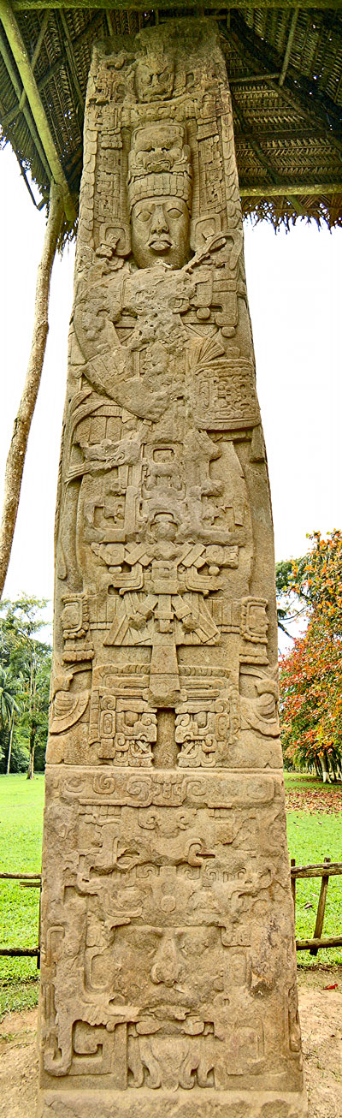
Sculpture
The Maya are perhaps most famous for their work in stone. They built many monumental structures including tall pyramids and palaces. They also made a lot of sculptures out of stone. One popular type of Maya sculpture was the stela. A stela was a large tall stone slab covered with carvings and writing. The stela was popular during the Classic Maya period when most major cities had stela built in honor of their kings. Stela were often located near altars. Some stelae were very large. The largest Maya stela discovered to date is the Stela E from the city of Quirigua. It weighs 65 tons and is around 34 feet tall!

Slide 4
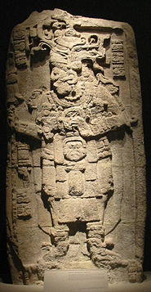
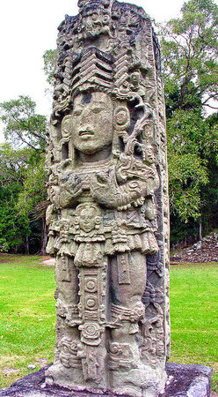
In regard to these hefty carved stones, Stephens penned the following excerpt,
"standing as they do in the depths of the forest, silent and solemn, strange in design, excellent in sculpture, rich in ornament...their uses and purposes and whole history so entirely unknown....“
(https://www.khanacademy.org)

Slide 5
Can you design your own Maya-style stela?
Using the pictures and hieroglyphics on the next page, design your own Maya-style stela sculpture. Note how ornate (highly decorated) they are and study their depiction of the kings. Can you spot any hieroglyphics?
Tips
Plan your design first
Mark out the rough size you’d like your drawing to be
‘Ghost sketch’ first (very light sketch)
Once you’re happy add detail and shading etc.
Have fun!

Slide 6
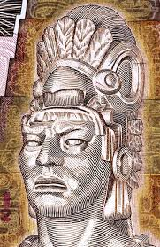
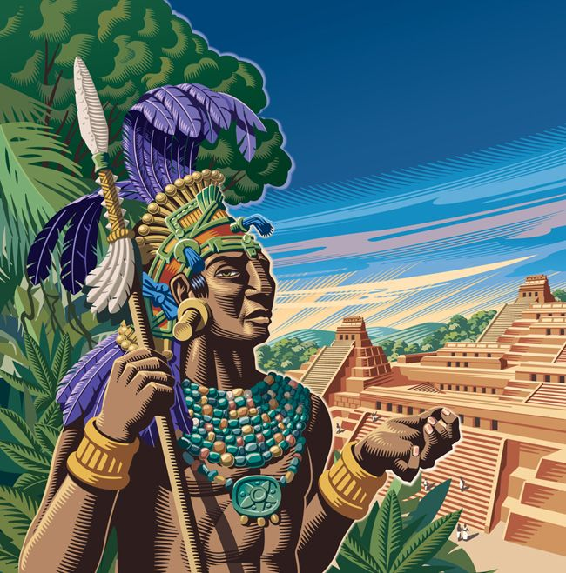
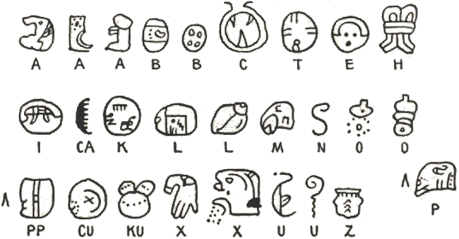
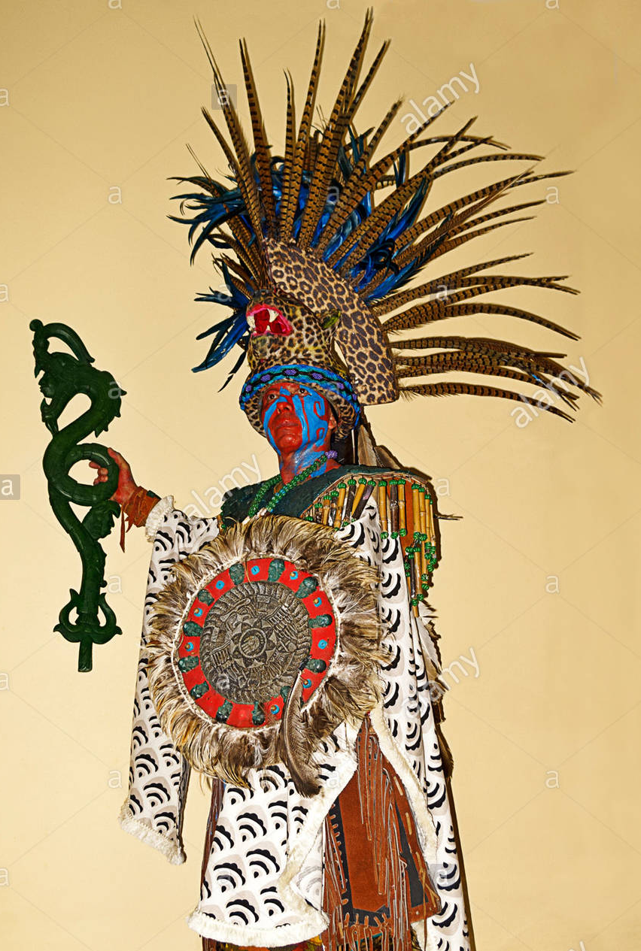

Maya King Depictions and
Hieroglyphs

