Slide 1
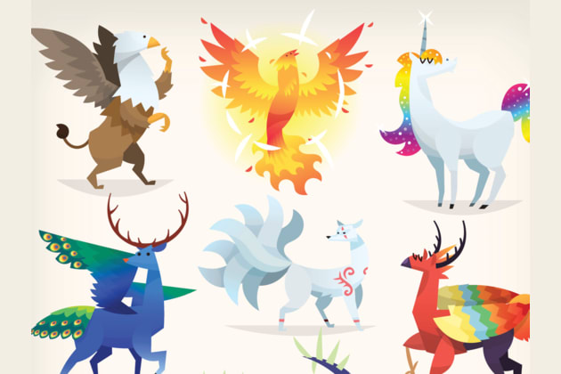
Warm Up
If you could have a mystery power what would it be?

Slide 2
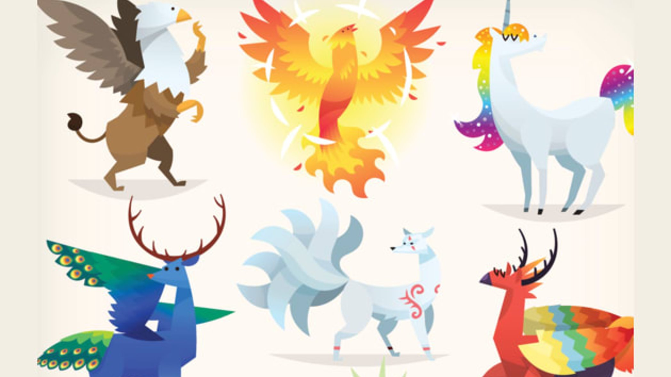
Tuesday: LC: Can I describe my mythical creature?
Today we’d like you to write a paragraph to describe your mythical character.
This piece of work is to be submitted on Teams.

Slide 3
Toolkit
Use your design and key vocabulary from Monday.
Write in a paragraph.
Include key similes and metaphors.
Year 4 expanded noun phrases.

Slide 4
A Bad Example
He walks on legs. He wears a red cape. His eyes are a burning orange. He has fangs. He has sharp horns. He has bad breath.
What is wrong with this example?
How might we improve it?

Slide 5
A Good Example
The enormous creature walks stiffly towards its prey on its hind legs. It wears a red cape, which swishes lazily around the creature’s furred feet. Its eyes are a burning orange, and a glint around its mouth gives the merest suggestion of sharp fangs. It has horns as sharp as razors and breath which smells of rotting flesh. There is nowhere to hide from him.
What makes this example better?
Can you magpie any of the phrases.

Slide 6
Tuesday: LC: Can I describe my mythical creature?
Today we’d like you to write a paragraph to describe your mythical character.
This piece of work is to be submitted on Teams.

