Slide 1


Slide 2
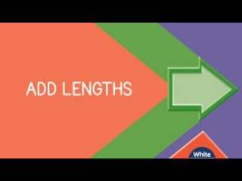

Slide 4
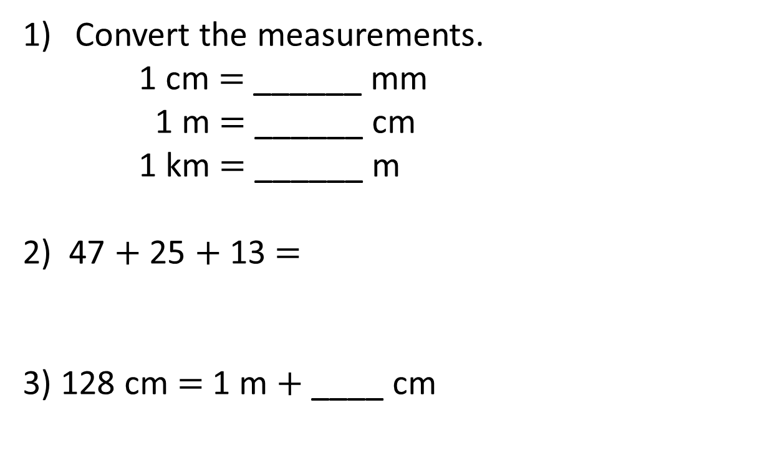
Convert the measurements.
1 cm $=$ ______ mm
1 m $=$ ______ cm
1 km $=$ ______ m
2) 47 $+$ 25 $+$ 13 $=$
3) 128 cm $=$ 1 m $+$ ____ cm

Slide 5
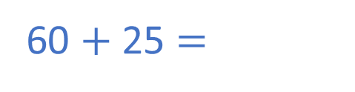
Convert the measurements.
1 cm $=$ ______ mm
1 m $=$ ______ cm
1 km $=$ ______ m
2) 47 $+$ 25 $+$ 13 $=$
3) 128 cm $=$ 1 m $+$ ____ cm
10
100
1,000
60 $+$ 25 $=$
85
28

Slide 7
Tommy uses toy bricks to make a tower.
What is the height of the tower?
53 cm
18 cm
23 cm
12 cm
12 cm
17 cm

Slide 8
 | T | O
 | 5 | 3
 | 1 | 8
+
53 cm
7
1
1
18 cm
23 cm
12 cm
12 cm
17 cm
The height of the tower is 71 cm.

Slide 9

What is the length of the tower?
Have a think
23 + 17 = 40
40 + 24 = 64
53 cm
64 cm
18 cm
23 cm
12 cm
12 cm
17 cm
24 cm

Slide 10
cm
20 mm + 10 cm =
12
30
10 mm = 1 cm
12 cm
2 cm + 10 cm =
180 cm
1 m 80 cm + cm
20
= 2 m
180 cm + cm
= 200 cm
20
1 m
100 cm
80 cm

Slide 11
Have a go at questions 1 – 3 on the worksheet
Notes:
Can we simplify?
Discuss reduction structure – take away

Slide 12
H | T | O
 | 6 | 3
 | 4 | 5
A mat is 45 cm long.
A rug is 63 cm long.
How long are they altogether?
108 cm
+
1
0
8
108 cm
= 1 m and 8 cm
1 m
8 cm
1
108 cm
?
Mat
Rug
45 cm
63 cm

Slide 13

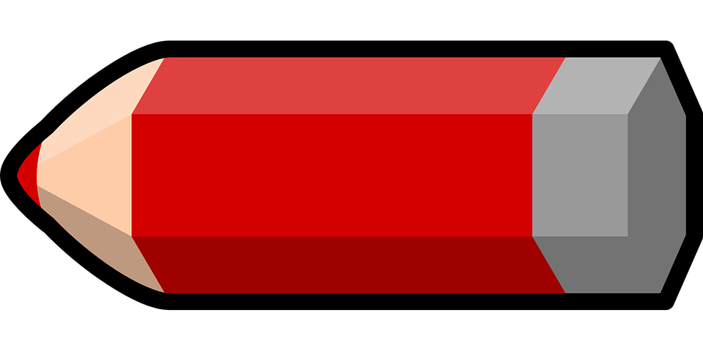
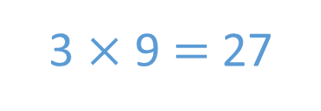
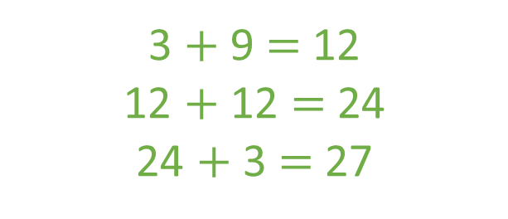
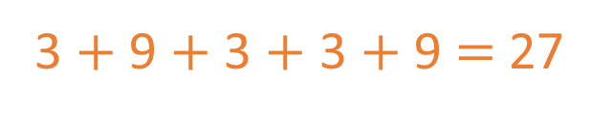
A paperclip is 30 mm long.
A crayon is 9 cm long.
Dexter arranges some paperclips
and crayons like this:
Does his pattern fit onto a 30 cm long piece of paper?
Have a think
27 cm
Yes
3 cm
3 cm
30 mm
30 mm
9 cm
3 cm
30 mm
9 cm
3 $+$ 9 $+$ 3 $+$ 3 $+$9 $=$ 27
3 $+$ 9 $=$ 12
12 $+$ 12 $=$ 24
24 $+$ 3 $=$ 27
3 × 9 $=$ 27

Slide 14
Have a go at the rest of the worksheet
Notes:
Can we simplify?
Discuss reduction structure – take away

