Slide 1
1) What is the most appropriate unit.
Length can be measured in l / m / g
Mass can be measured in ml / kg / km
Capacity can be measured in l / g / cm
2) Match each item to a sensible estimate.
A can of pop
A tin of paint
A teaspoon of medicine
335 ml
5 ml
5 l

Slide 2
1) What is the most appropriate unit.
Length can be measured in l / m / g
Mass can be measured in ml / kg / km
Capacity can be measured in l / g / cm
2) Match each item to a sensible estimate.
A can of pop
A tin of paint
A teaspoon of medicine
335 ml
5 ml
5 l

Slide 3
L.C. Can I use metric measures including millimetres and metres?
Toolkit

Slide 4
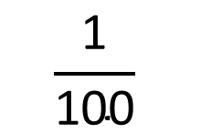
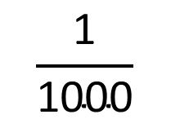
Which of these prefixes do you know?
$$\frac{\text{1}}{\text{1000}}$$
Milli
One thousandth
$$\frac{\text{1}}{\text{100}}$$
Centi
One hundredth
Kilo
One thousand
1,000

Slide 5
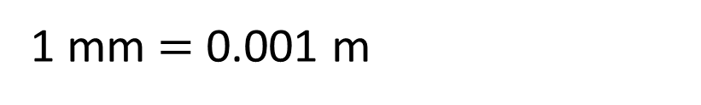
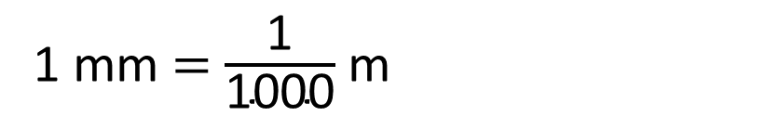
Milli
metre
One thousandth of a
metre
1 mm $=$ $\frac{\text{1}}{\text{1000}}$ m
1 mm $=$ 0.001 m

Slide 6
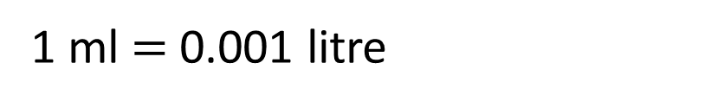
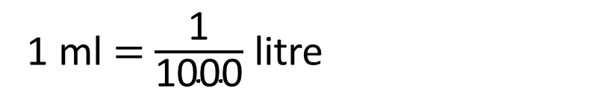
Milli
litre
One thousandth of a
litre
1 ml $=$ $\frac{\text{1}}{\text{1000}}$ litre
1 ml $=$ 0.001 litre

Slide 7
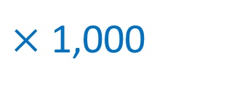
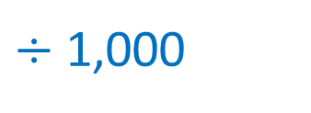
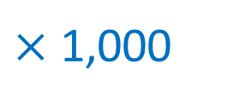
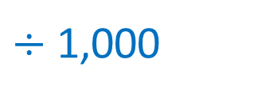
$÷$ 1,000
mm
m
$×$ 1,000
$÷$ 1,000
ml
l
$×$ 1,000

Slide 8


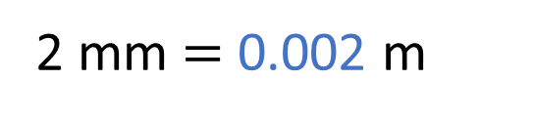
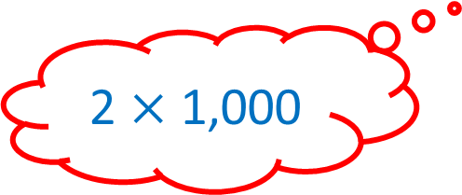
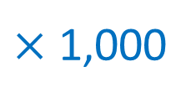
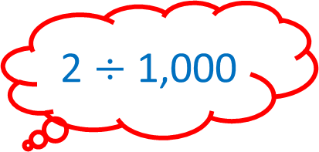
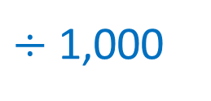

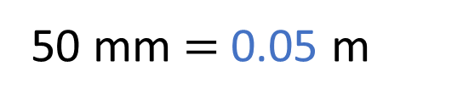
Have a think
2 $÷$ 1,000
$÷$ 1,000
2 mm $=$ 0.002 m
mm
m
$×$ 1,000
2,000 mm $=$ 2 m
2 $×$ 1,000
50 mm $=$ 0.05 m
500 mm $=$ 0.5 m

Slide 9



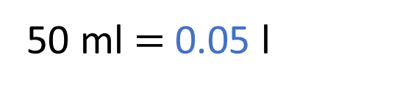
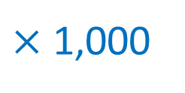
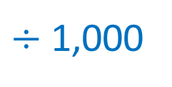
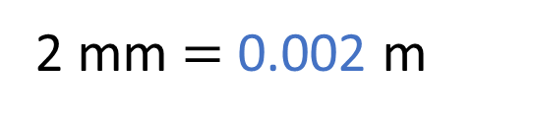

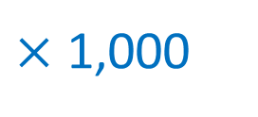
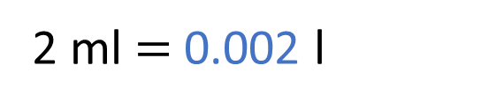

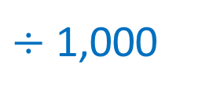
What will stay the same? What will change?
Have a think
$÷$ 1,000
2 mm $=$ 0.002 m
2 ml $=$ 0.002 l
mm
m
2,000 mm $=$ 2 m
$×$ 1,000
2,000 ml $=$ 2 l
50 mm $=$ 0.05 m
50 ml $=$ 0.05 l
$÷$ 1,000
ml
l
500 mm $=$ 0.5 m
500 ml $=$ 0.5 l
$×$ 1,000

Slide 10
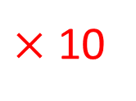
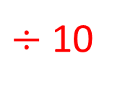
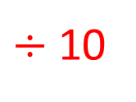

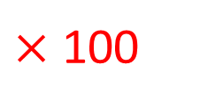
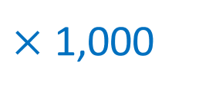
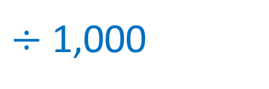
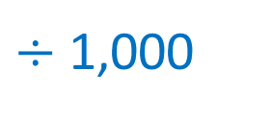
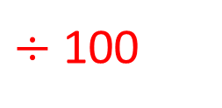
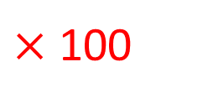
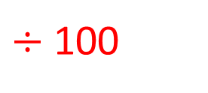

$÷$ 1,000
$÷$ 10
$÷$ 100
mm
cm
m
$×$ 10
$×$ 100
$×$ 1,000
$÷$ 1,000
$÷$ 10
$÷$ 100
ml
cl
l
$×$ 10
$×$ 100
$×$ 1,000

Slide 11
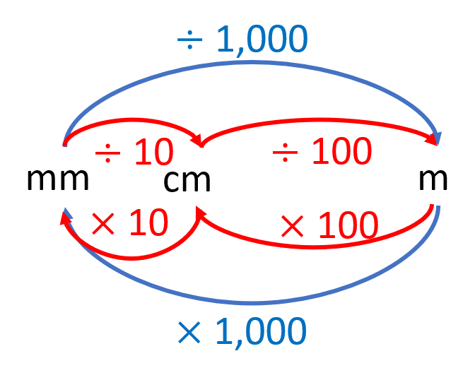
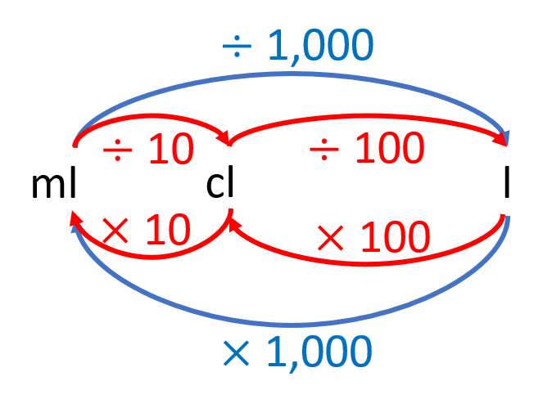
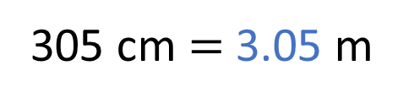
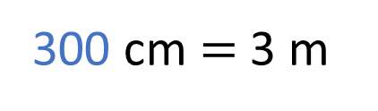
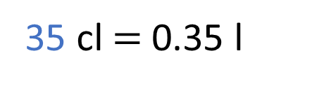
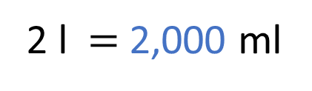
300 cm $=$ 3 m
2 l $=$ 2,000 ml
305 cm $=$ 3.05 m
35 cl $=$ 0.35 l
Have a think

Slide 12

A large car might have a mass of around 2 tonnes.
1 tonne is 1,000 kilograms

Slide 13
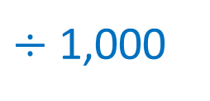
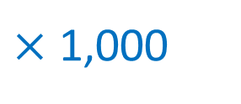
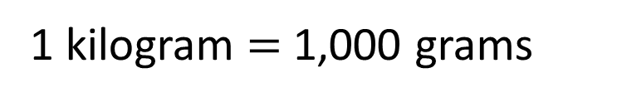
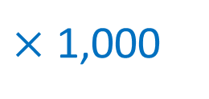
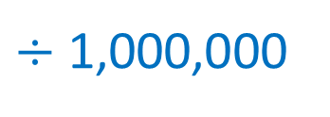

$÷$ 1,000,000
$÷$ 1,000
$÷$ 1,000
g
kg
tonne
$×$ 1,000
$×$ 1,000
1 kilogram $=$ 1,000 grams

Slide 14
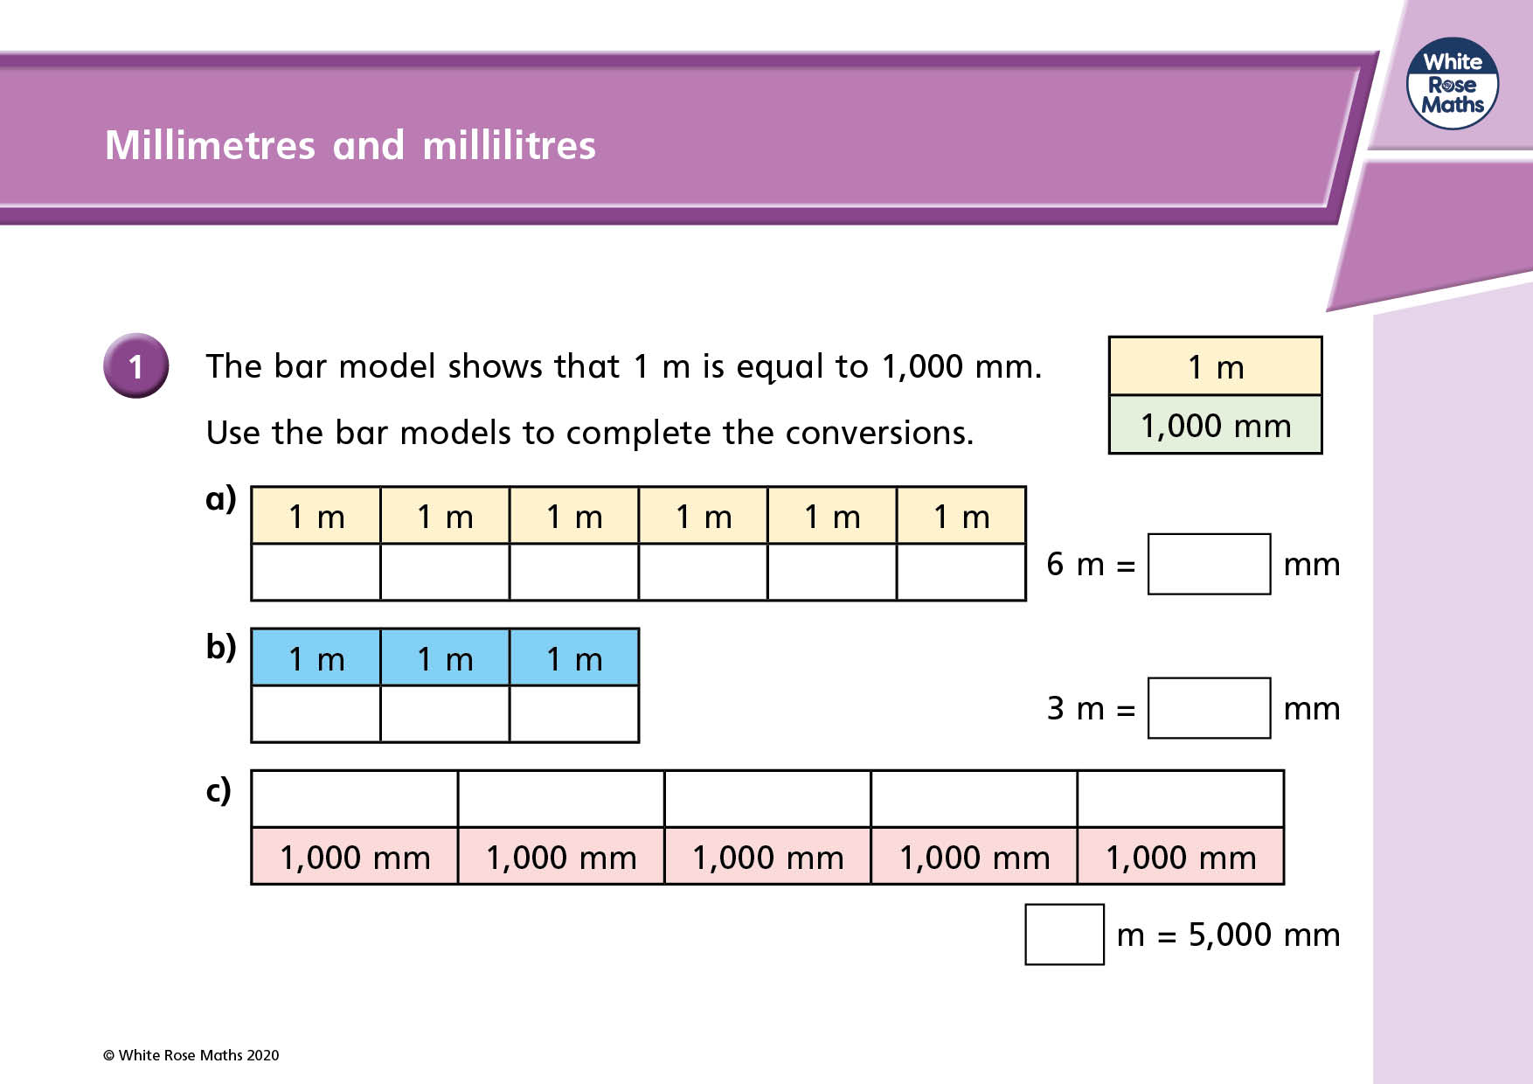

Slide 15
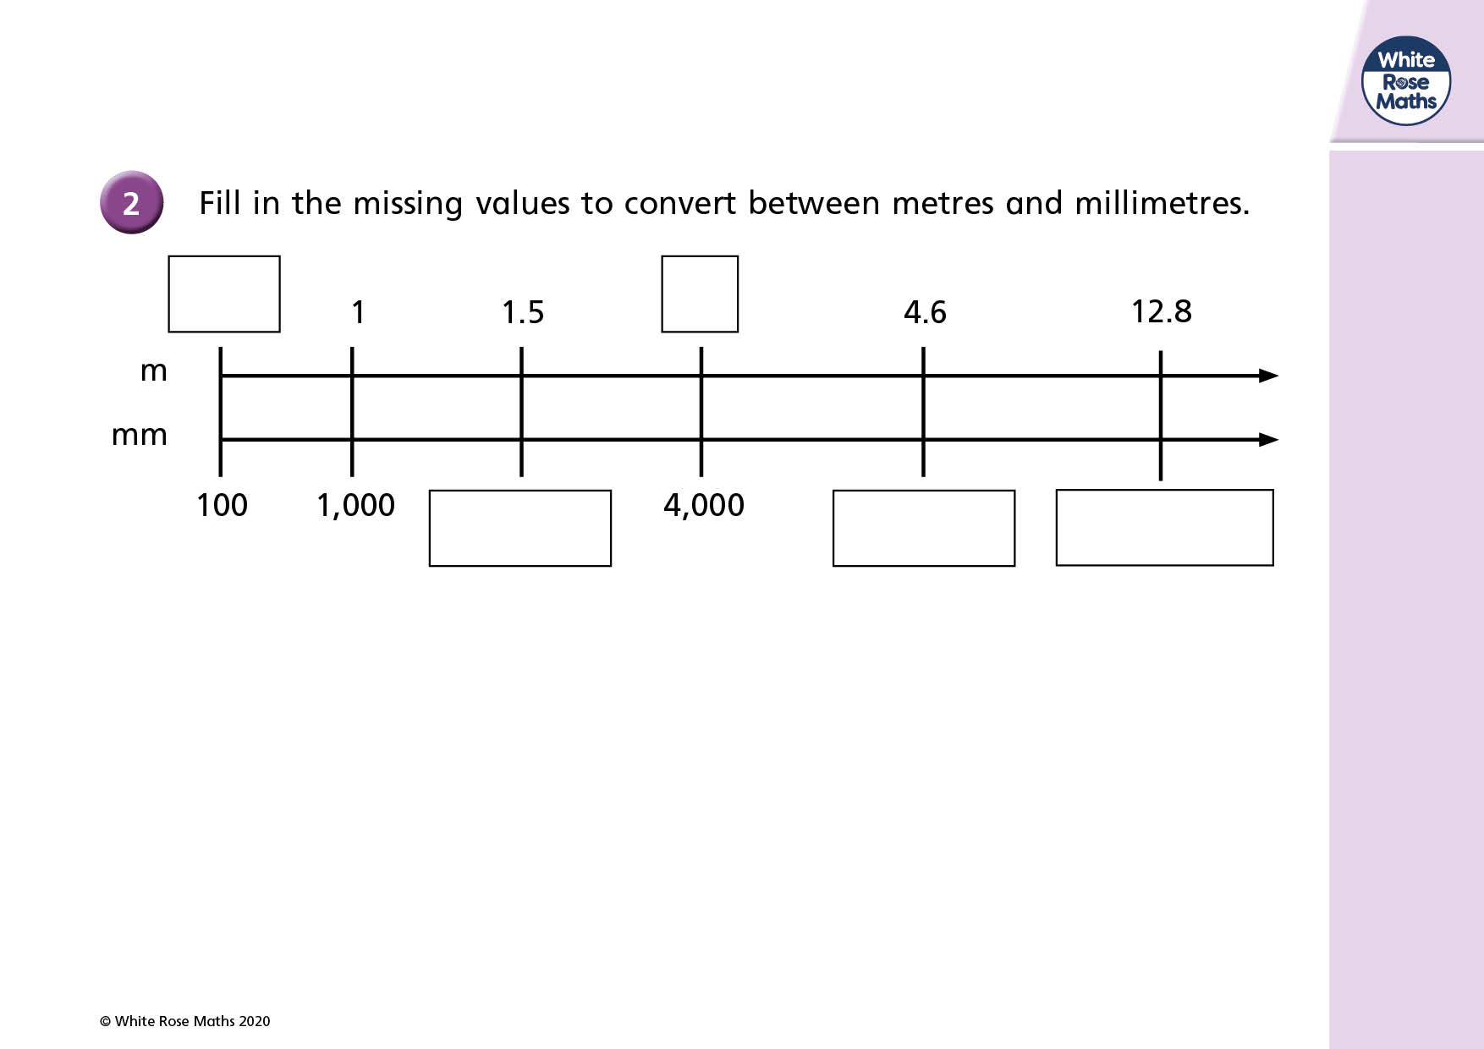

Slide 16
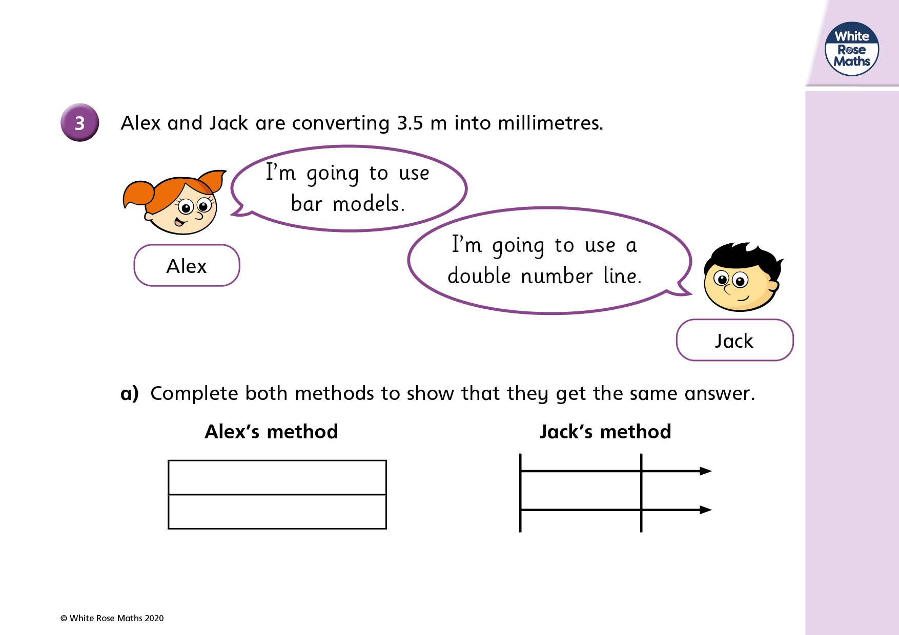

Slide 17
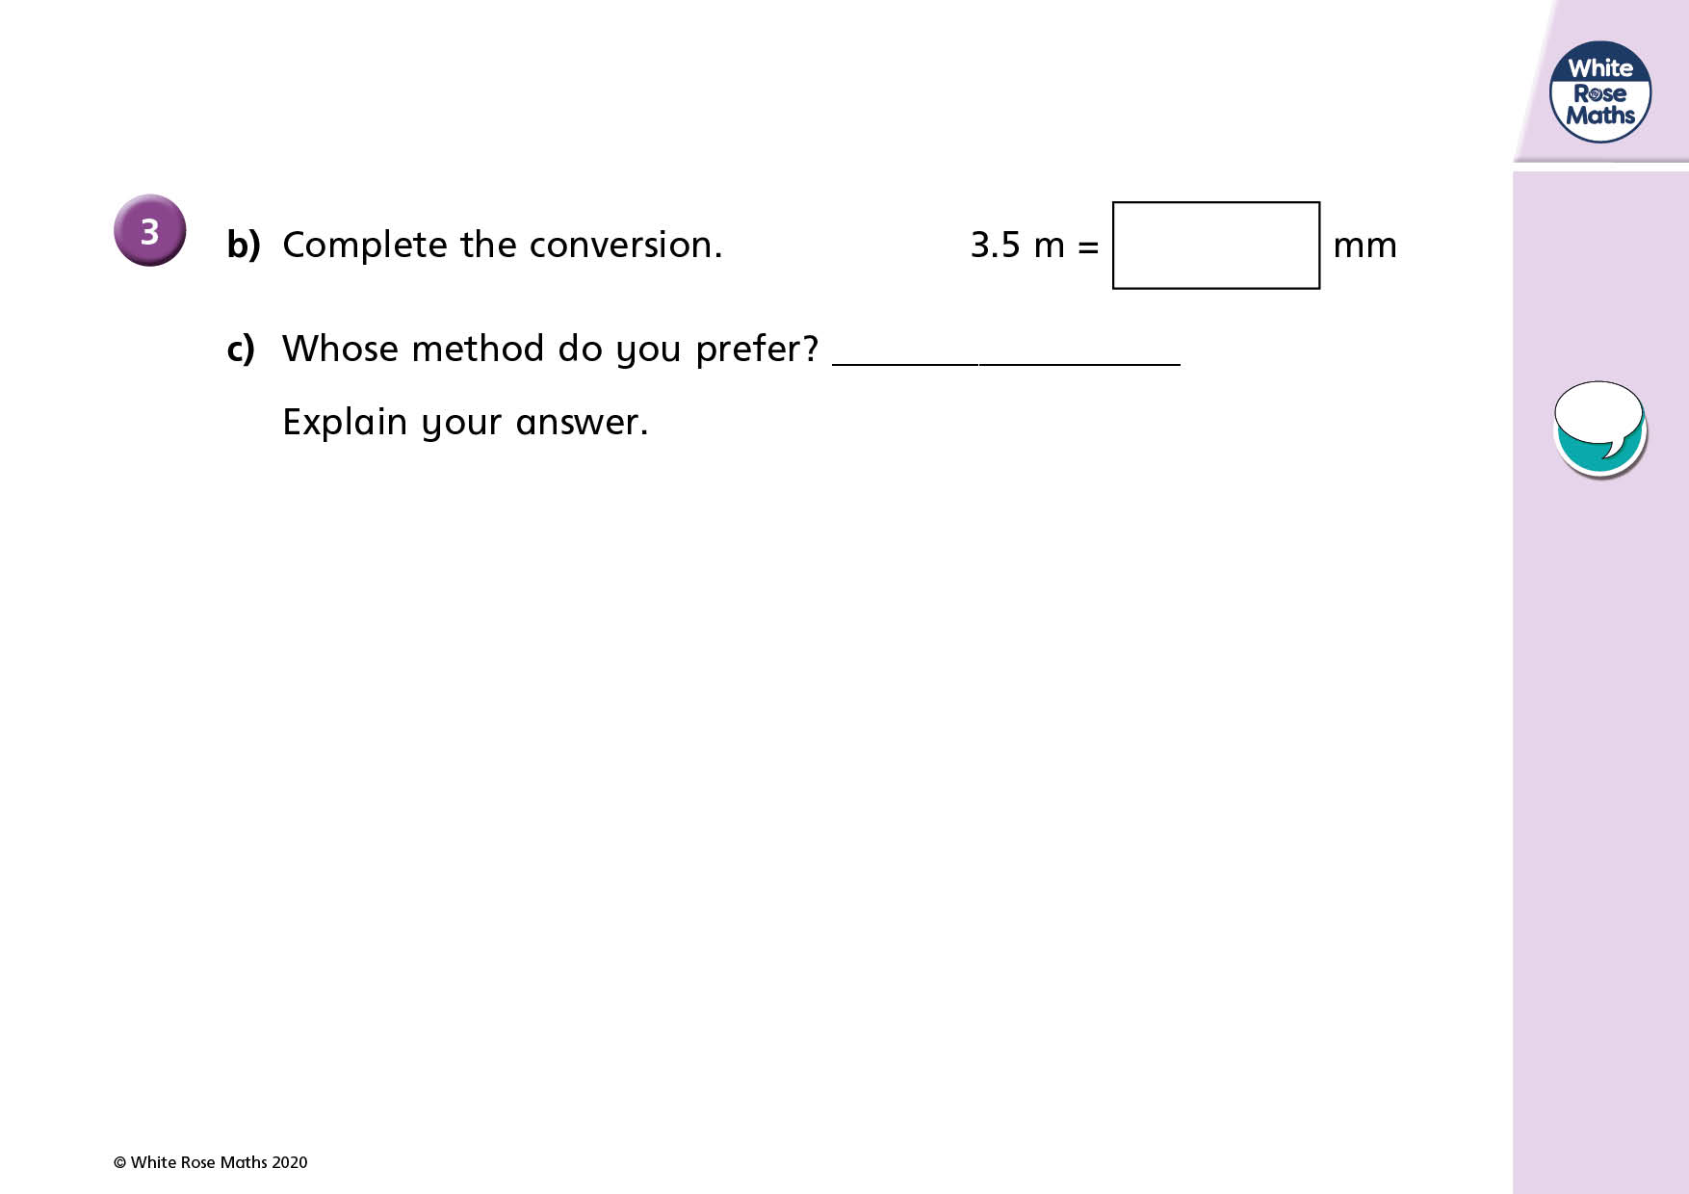

Slide 18
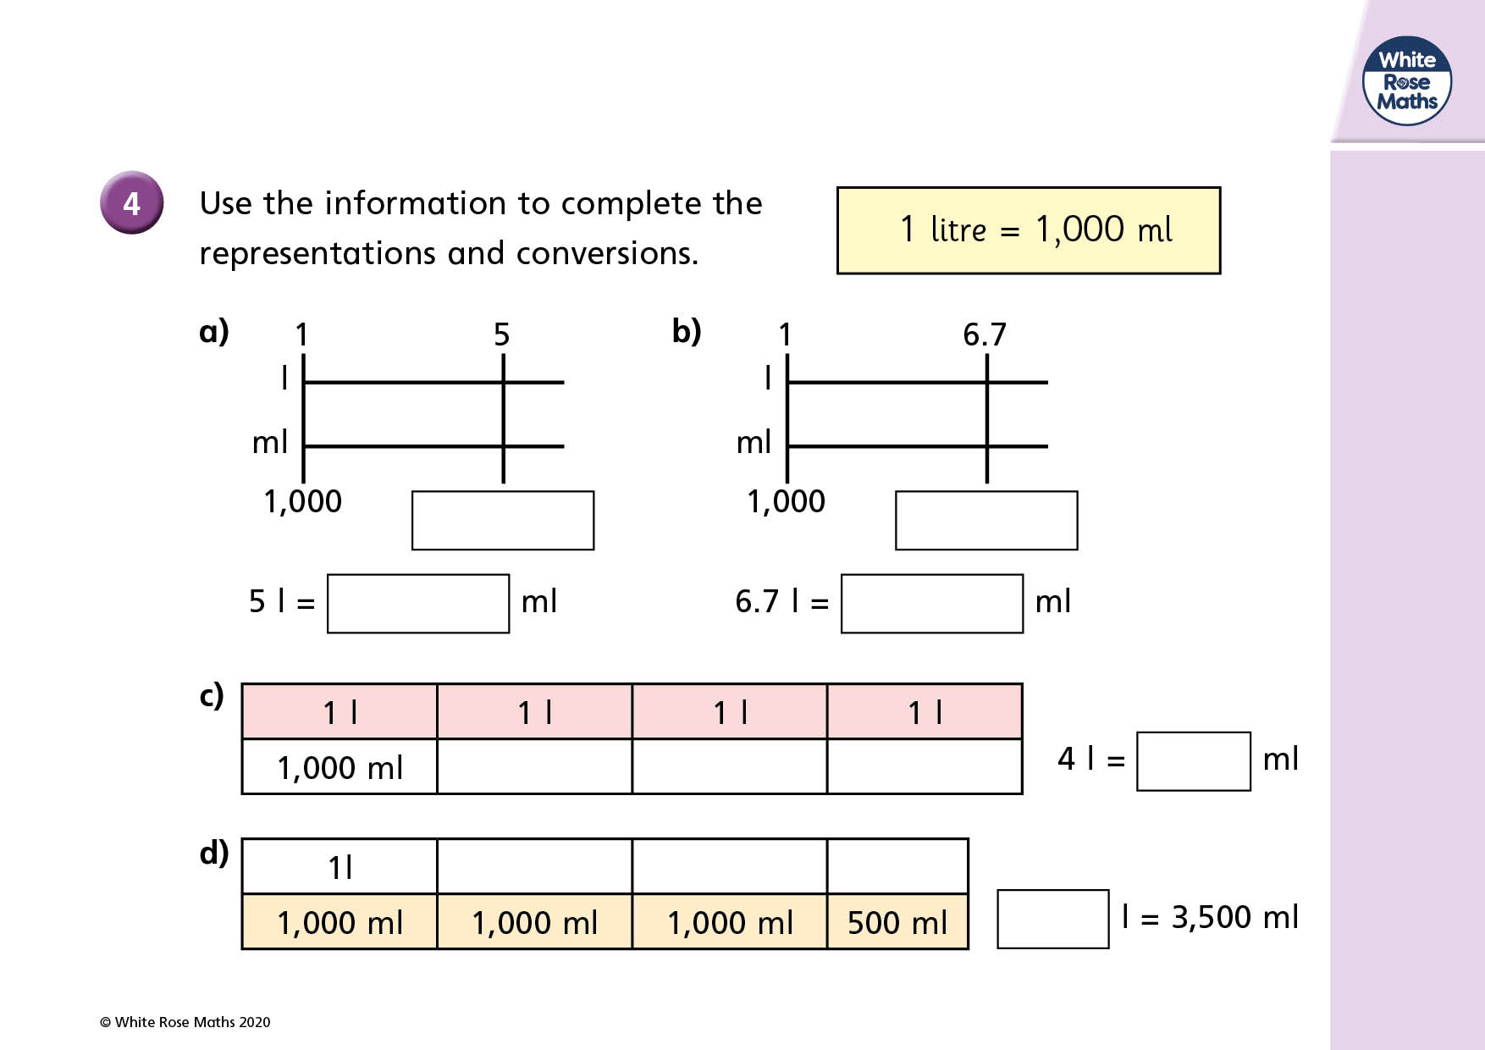

Slide 19
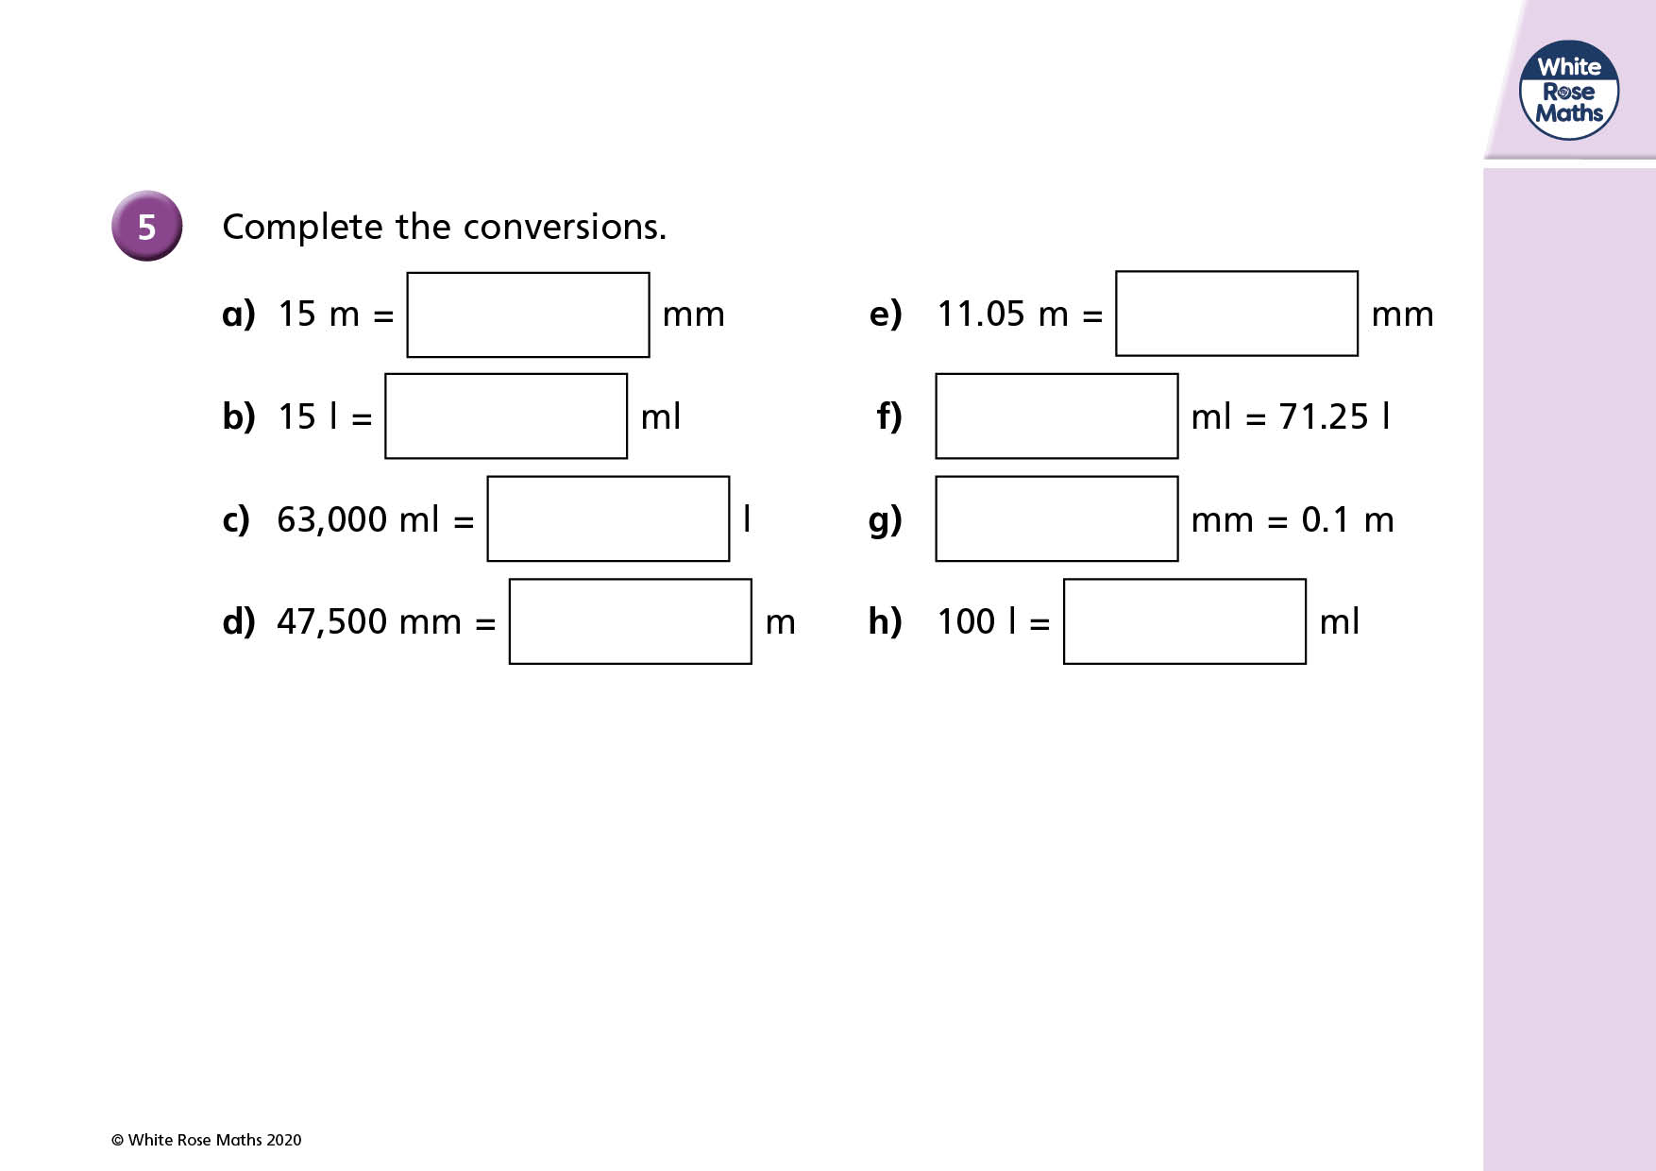

Slide 20


Slide 21


Slide 22


Slide 23


