Slide 1
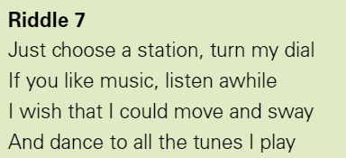
Warm Up - Riddles

Slide 2
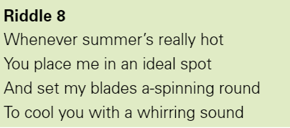
Warm Up - Riddles

Slide 3
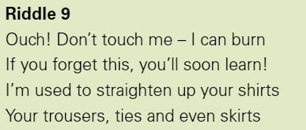
Warm Up - Riddles

Slide 4
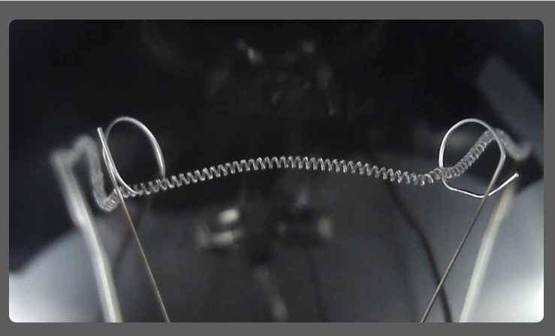
Warm Up – Zoom in Zoom out
This is on Explorify if you want to try it.
https://explorify.wellcome.ac.uk/en/activities/zoom-in-zoom-out/curly-coil

Slide 5

LC: Can I research Nikola Tesla?
By the end of the lesson, you should:
Be able to explain who Nikola Tesla was
Explain what he is known for
Be able to give some key facts about his life

Slide 6
LC: Can you find out about Nikola Tesla?
By the end of the lesson, you should:
Be able to explain who Nikola Tesla was
Explain what he is known for
Be able to give some key facts about his
Task
Choose how to present your research.
Tips:
Use the information sheet to help you.
Complete in your book.
Make sure you have clearly shown who he is, what he did and other key facts.

Slide 7
Subheadings could include:
Childhood and early life
First achievement
AC system
Hydroelectric power
New technologies
Legacy

