Slide 1

Survivors
Extraordinary tales from the wild and beyond
Day Twenty-two

Slide 2
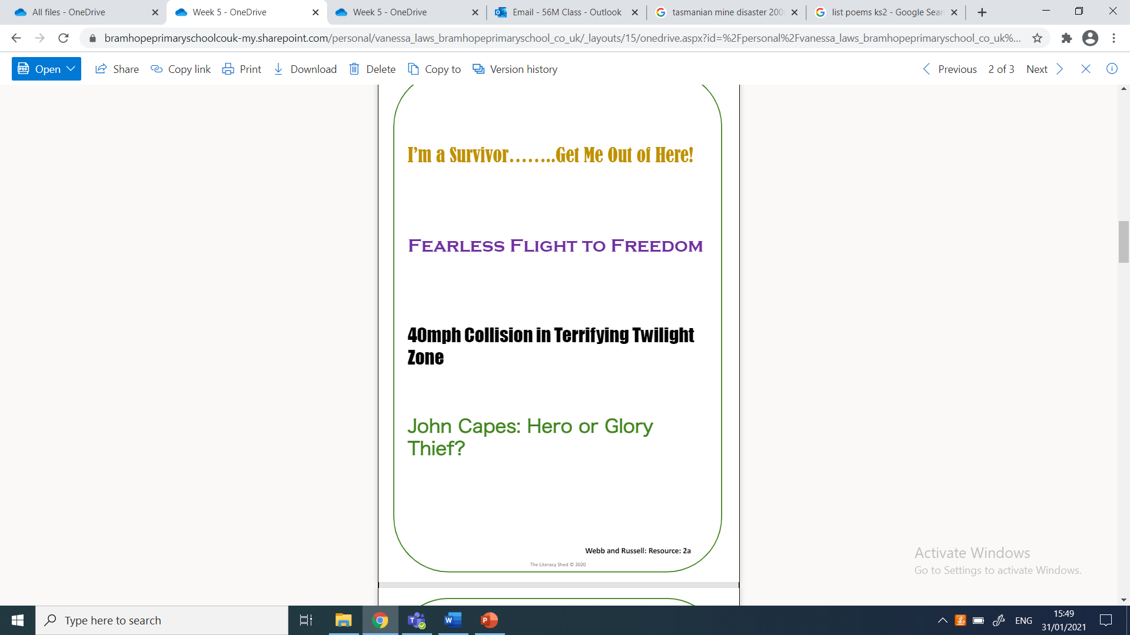
What do you imagine these are?

Slide 3
LC: Can I write a news headline and orientation?

Slide 4
What features can you identify?
alliteration
puns
hyperbole
intrigue

Slide 5
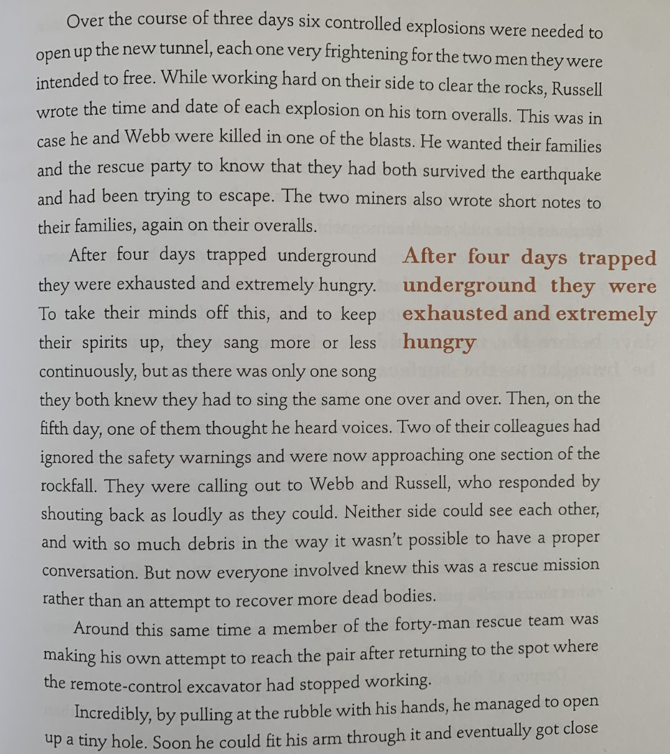
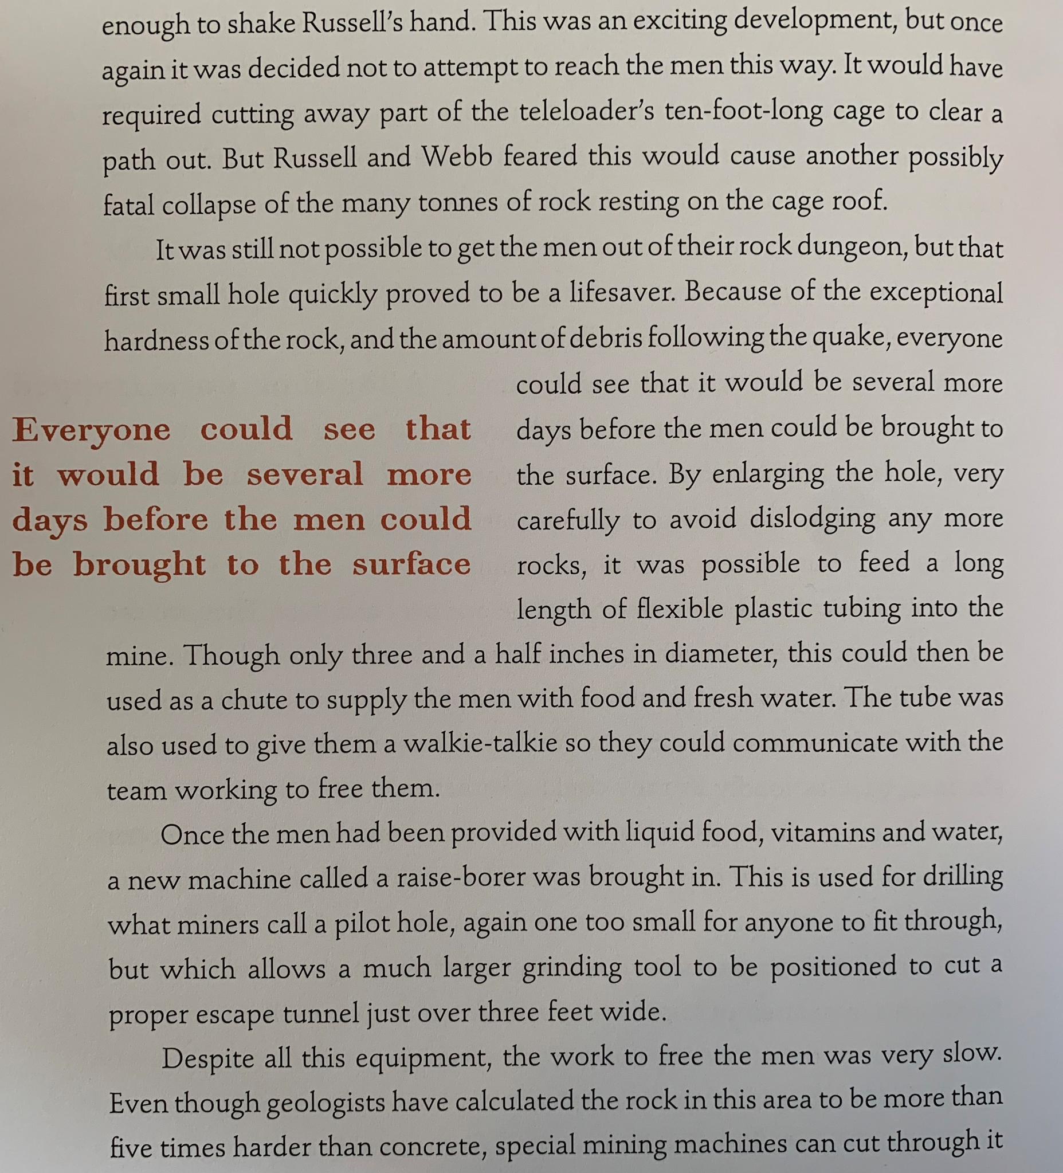

Slide 6
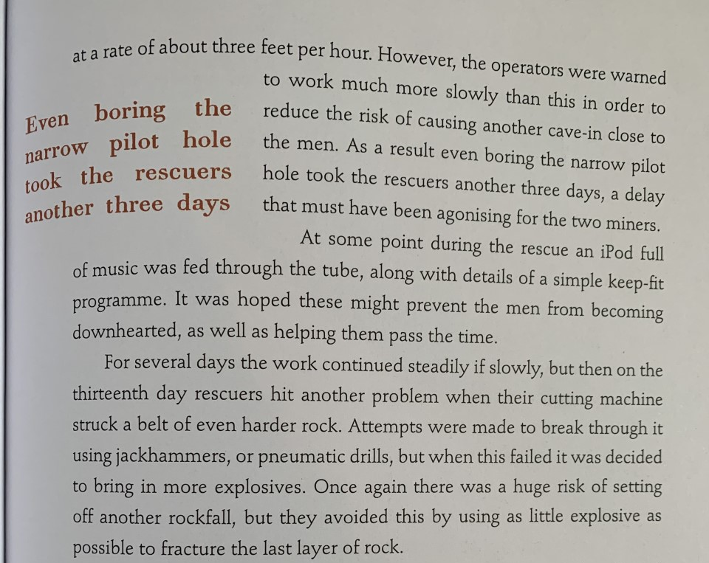

Slide 7
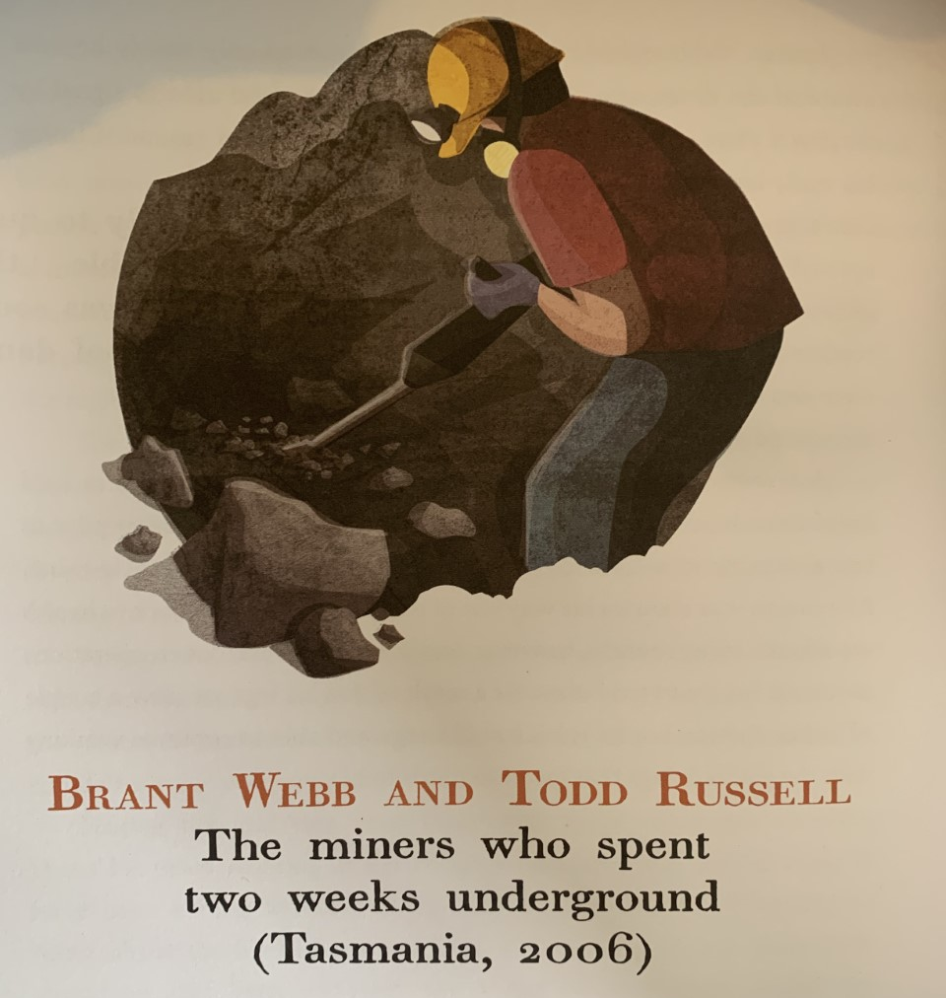

When and where is the story set?
Who is involved in the story and what do we know about them?
What was the expected outcome of the day?
How did the men react in the crisis?
What was the unexpected crisis?

Slide 8

You’re hired
You are in a unique position here of knowing that this is a survival story and therefore at least one of these men must escape with their lives. However, everyone involved at this point in the story is, no doubt, very concerned that the men could die.
Make a list of all the possible outcomes of the story from the perspective of those involved.
Now imagine that you are reporting on the story at this point in its development. Considering all the potential outcomes and what has happened so far, what might an effective headline for this article be?
Challenge yourself to write three or four different headlines on whiteboards, using a variety of techniques.
Think about how they can be improved further by condensing / exaggerating / playing with words / finding synonyms to allow for alliteration.

Slide 9
Creating a news story
1 Headline.
2 Subhead.
3 Byline.
4 Lead/ Orientation
5 Body or running text.
6 Reorientation.
An orientation is an opening paragraph which has the purpose of telling the story contained within the article briefly and without resolution (thus ensuring the reader will continue to read).
Have a look at the examples survivors week 5 day 2 resource.
Can you identify the features?

Slide 10
Who, When, What, Where, Why, How
Which of these questions are answered in the orientation examples?
Most likely the How and Why are not covered as these are covered within the main body of text

Slide 11
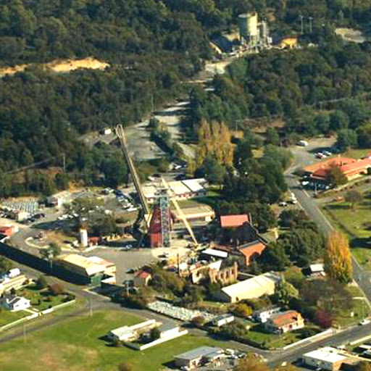
|Task
Write a headline and an orientation under your headline which details the Who, What, Where and When of the miners’ story at the point at which more explosives are being considered. Try to write this information formally and concisely (2 sentences).
Challenge
Consider how they can ensure the information is sensationalised so that readers will be hooked.

