Slide 1
La ropa
Clothes

Slide 2
La ropa
We are continuing to learn the vocabulary for clothes; la ropa.
Can you remember any of the Spanish words from last time?
Eg skirt, dress, sweatshirt, jumper, shirt, T-shirt, trousers, socks, scarf, woolly hat, shoes, boots, gloves, coat?
https://www.youtube.com/watch?v=ejwMNvyp8EI
Have another look through the slides and try to say the Spanish words as you go. Remember, words in Spanish are pronounced as they are written, there are no tricks (well very few).

Slide 3
La ropa
This week we are going to write sentences about clothes using the word 'hay' (pronounced 'eye', we don't pronounce the letter 'h' at the start of words in Spanish).
The word 'hay' means there is or there are
In my suitcase there is a...
En mi maleta hay un...
En mi maleta hay una...

Slide 4
La ropa
Y3/4
This week you are going to write some simple sentences of your own. I will give you the structure for you to follow.
In my suitcase there is a coat.
En mi maleta hay un abrigo.
Remember to use the correct un for the masculine (boy) nouns and una for the feminine (girl) nouns.
Y4 You are also going to put 2 items of clothing together using 'y', the Spanish word for 'and'.
In my suitcase there is a coat and a hat.
En mi maleta hay un abrigo y un gorro.

Slide 5
La ropa
Y5/6
This week you are going to write some sentences with adjectives and some sentences with plurals.
Remember, in Spanish the adjective comes after the noun
There are 2 main rules for making plurals
if the noun ends in a vowel (aeiou) add 's'
if the noun ends in a consonant, add 'es'
The word 'hay' stays the same for 'there is' and 'there are'.

Slide 6
La ropa
Y5/6
In my suitcase there is a blue coat.
En mi maleta hay un abrigo azul.
In my suitcase there are 2 coats.
En mi maleta hay 2 abrigos.
Challenge
When the noun is masculine, the adjective ending doesn't change, it doesn't have to agree. What happens to the adjectives ending in 'o' when the noun is feminine?

Slide 7
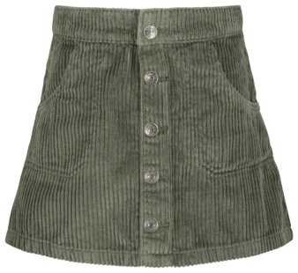
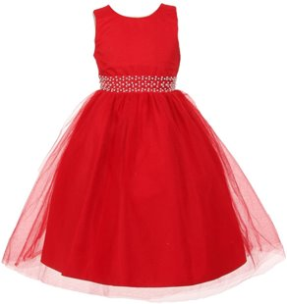
La ropa
una falda
un vestido

Slide 8
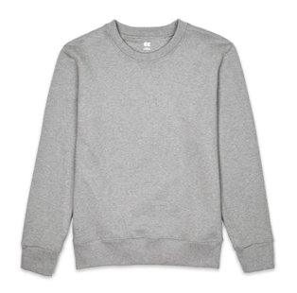
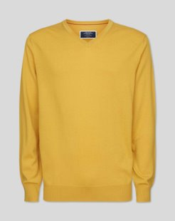
La ropa
un jersey
una sudadera

Slide 9
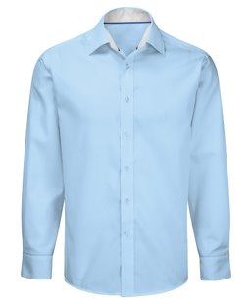
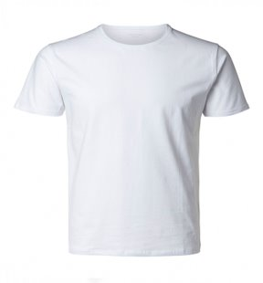
La ropa
una camisa
una camiseta

Slide 10
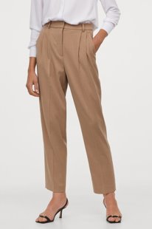
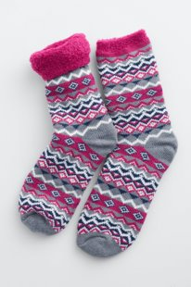
La ropa
unos pantalones
unos calcetines

Slide 11
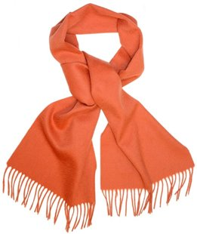
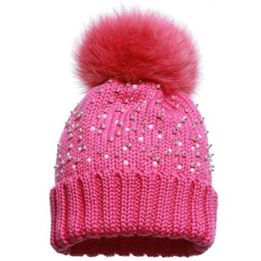
La ropa
una bufanda
un gorro de lana

Slide 12
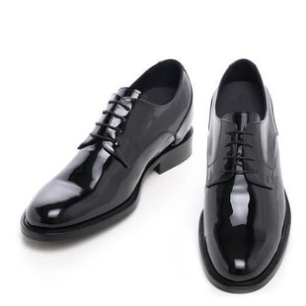
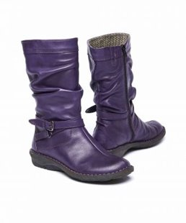
La ropa
unos zapatos
unas botas

Slide 13
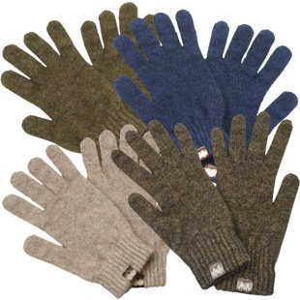
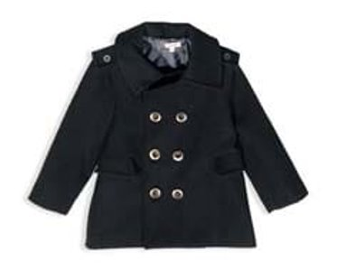
La ropa
unos guantes
un abrigo

