Slide 1



1) What is the most appropriate unit.
Length can be measured in ml / cm / kg
Mass can be measured in l / tonne / km
Capacity can be measured in mm / g / ml
2) Match each length to a sensible estimate.
The height of a giraffe
The length of a ladybird
The length of a rubber
5 cm
5 m
5 mm

Slide 2
1) What is the most appropriate unit.
Length can be measured in ml / cm / kg
Mass can be measured in l / tonne / km
Capacity can be measured in mm / g / ml
2) Match each length to a sensible estimate.
The height of a giraffe
The length of a ladybird
The length of a rubber
5 cm
5 m
5 mm

Slide 3
L.C. Can I use metric measures including metres and kilometres?
Toolkit

Slide 4

Have a think
Match the measure to its definition.
Length
The amount of matter that makes up an object or substance
The maximum amount that something can contain
Capacity
The measurement of something from end to end
Mass

Slide 5
Length | The measurement of something from end to end
Capacity | The maximum amount that something can contain
Mass | The amount of matter that makes up an object or substance
Sort the metric units into the correct categories.
Have a think
cm
ml
g
tonne
km
Length | Capacity | Mass
mm
m
l
kg

Slide 6



What is the most appropriate unit to measure the mass of each object?
g
kg
tonnes
Have a think

Slide 7



What is the most appropriate unit to measure the capacity of each object?
ml
ml
l
g
Have a think

Slide 8
Circle the best estimate for each item.
The capacity of a bottle of shampoo.
3 l
30 ml
300 ml
3 ml
The length of a book.
20 cm
200 cm
2 m
20 mm
The mass of an adult dog.
15 g
15 kg
1.5 kg
150 kg
Have a think

Slide 9
Circle the best estimate for each item.
The capacity of a bottle of shampoo.
The capacity of a bottle of shampoo.
3 l
30 ml
300 ml
3 ml
The length of a book.
20 cm
200 cm
2 m
20 mm
The mass of an adult dog.
15 g
15 kg
1.5 kg
150 kg

Slide 10



I’m going to measure the length of the desk in mm
You could do Tiny but millimetres is usually used to measure the length of small items. I think centimetres would be better.
... or even metres and centimetres!
Have a think

Slide 11
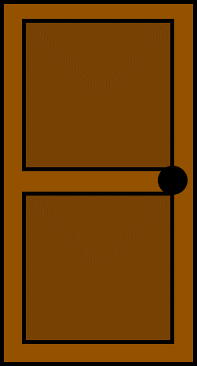


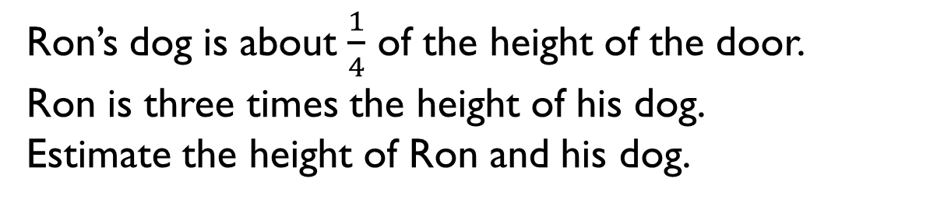
1.
Ron’s dog is about $\frac{1}{4}$ of the height of the door.
Ron is three times the height of his dog.
Estimate the height of Ron and his dog.

Slide 12

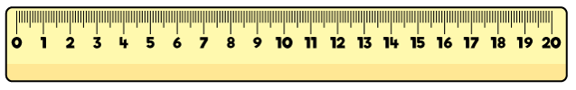
2.
Teddy thinks his chew bar is 13.2 cm long.
Do you agree? Explain why.

Slide 13
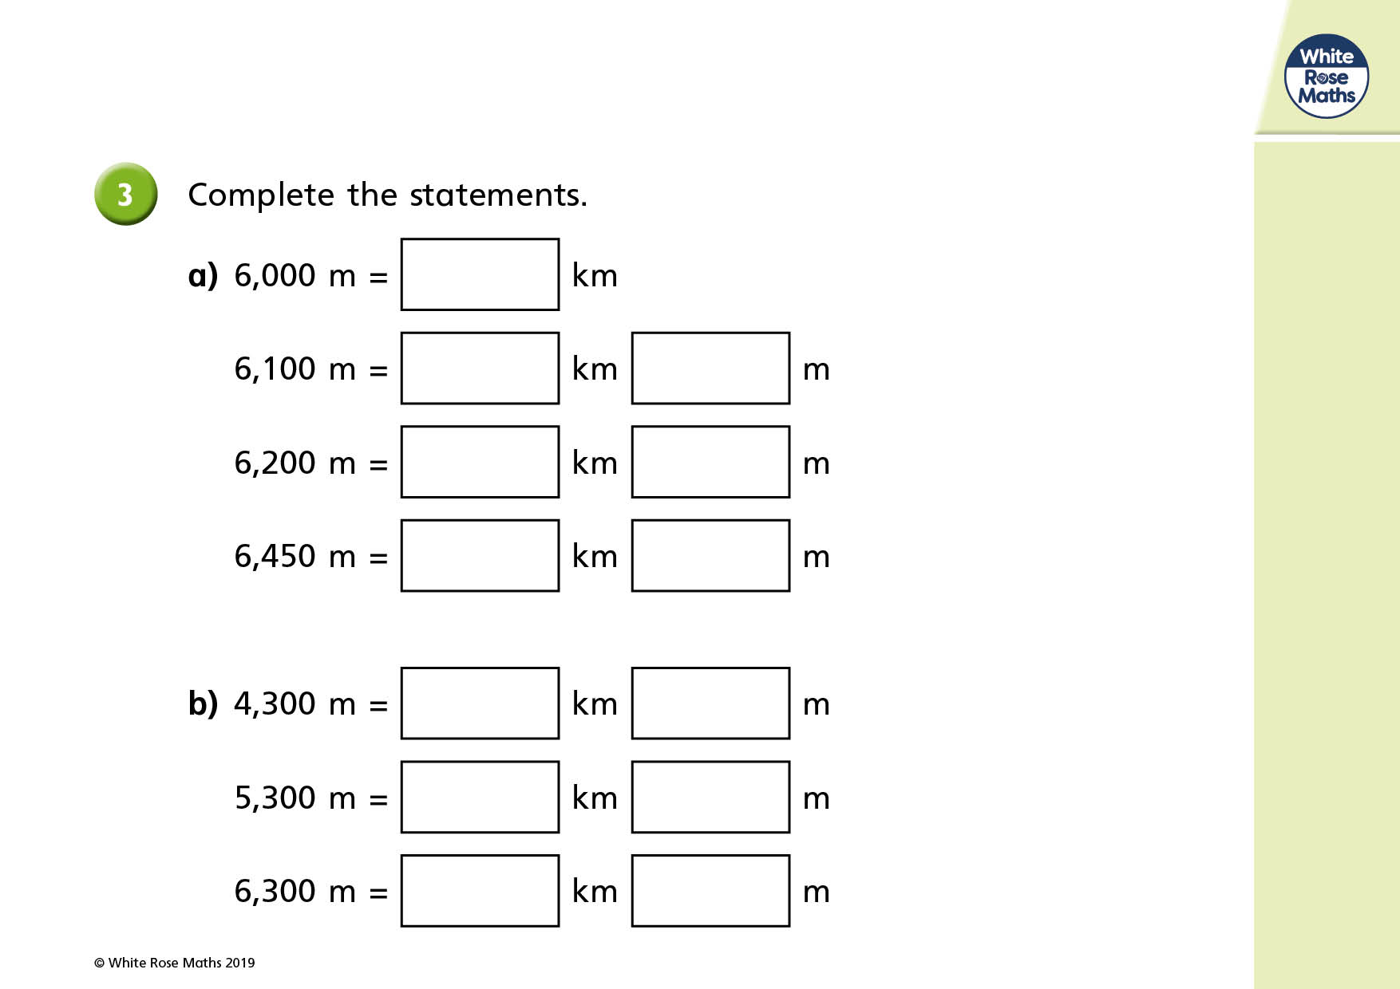

Slide 14
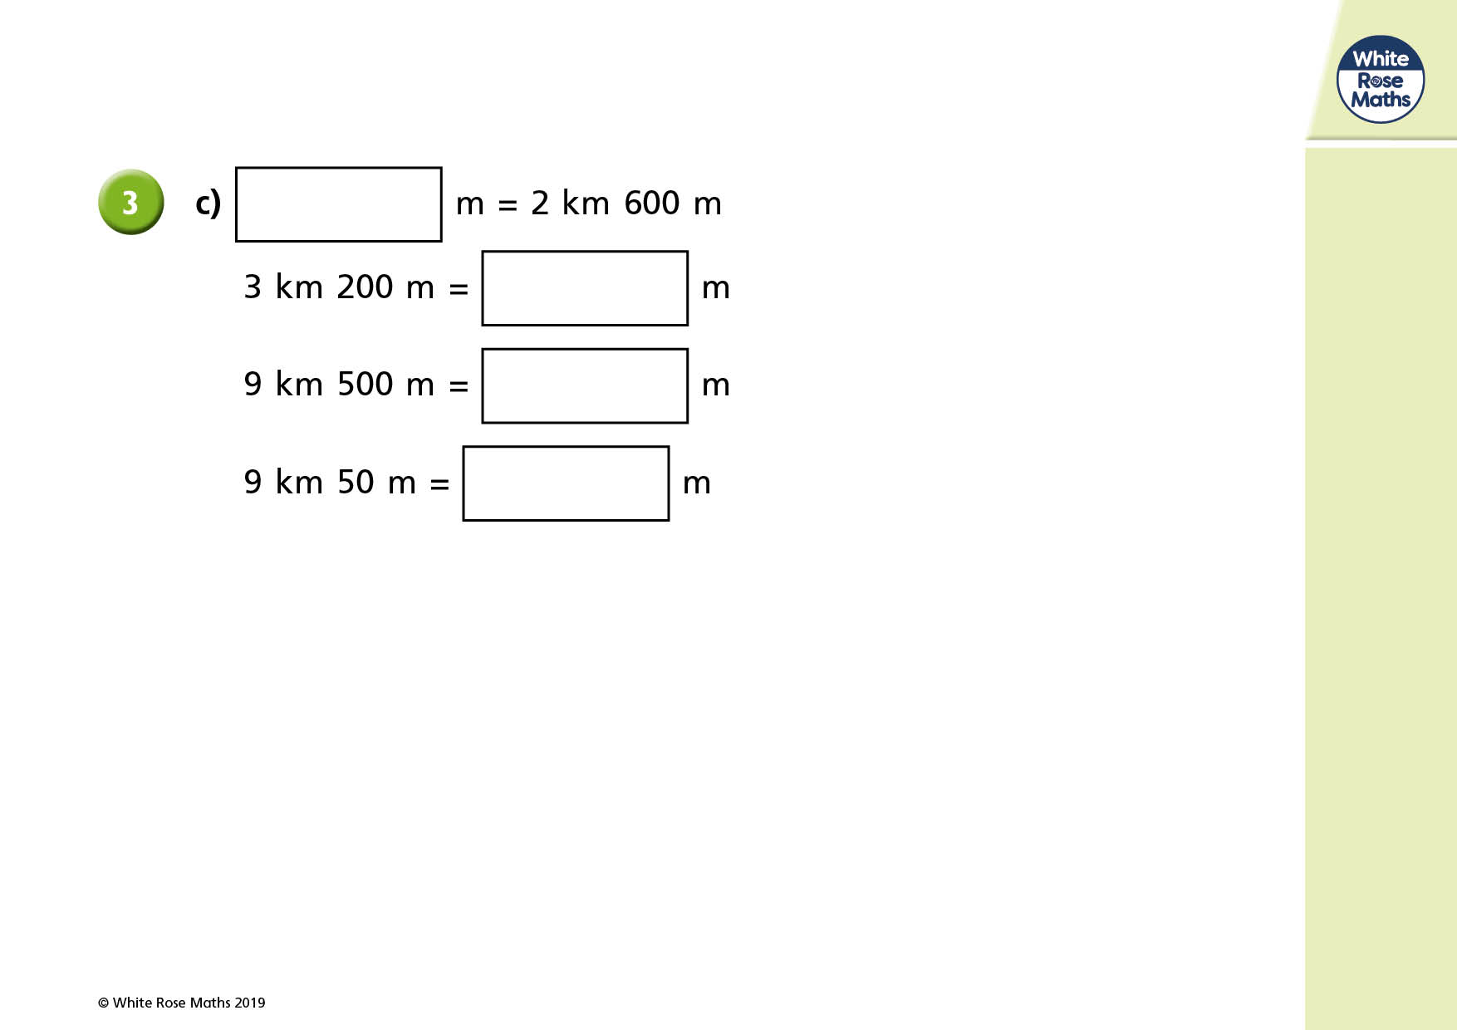

Slide 15
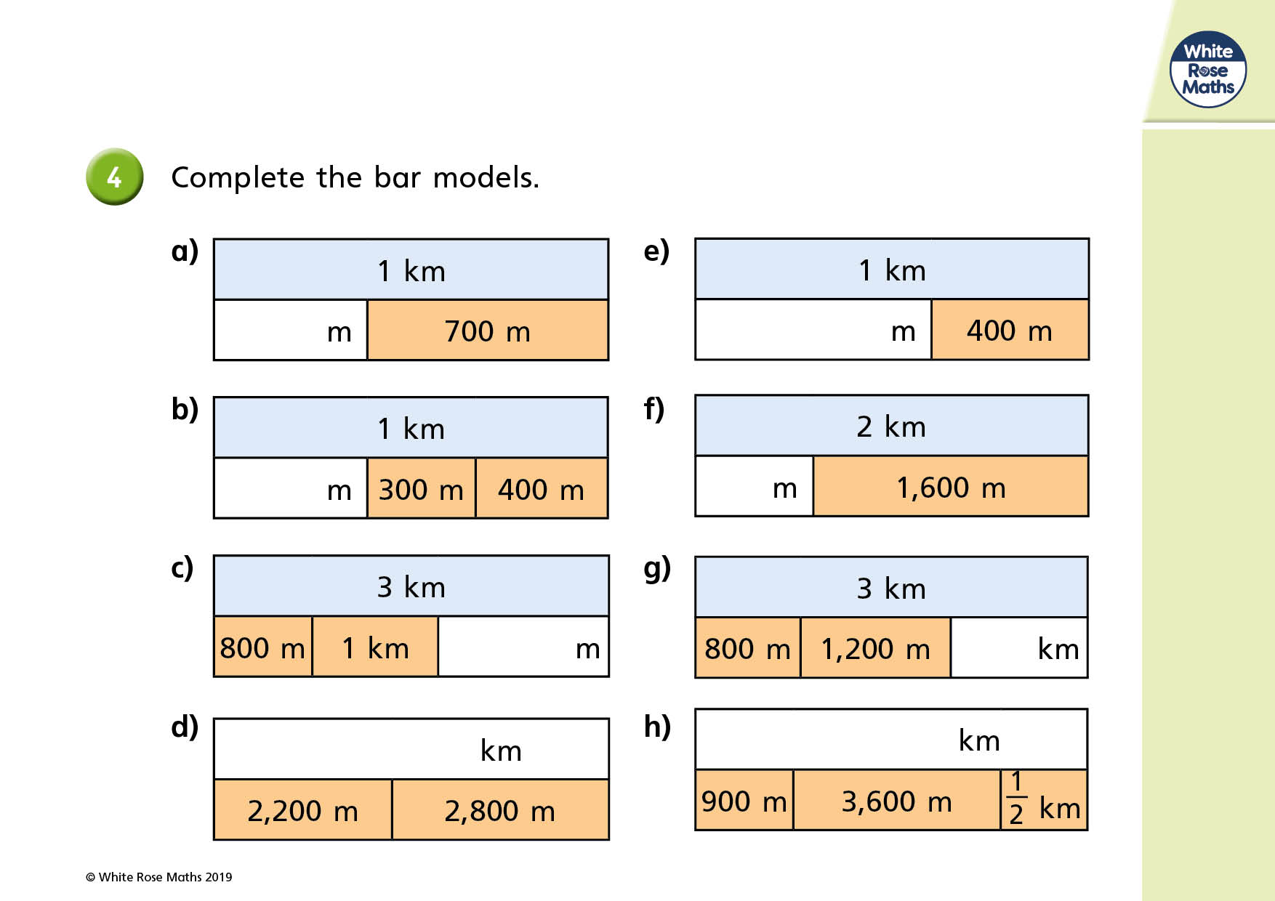

Slide 16
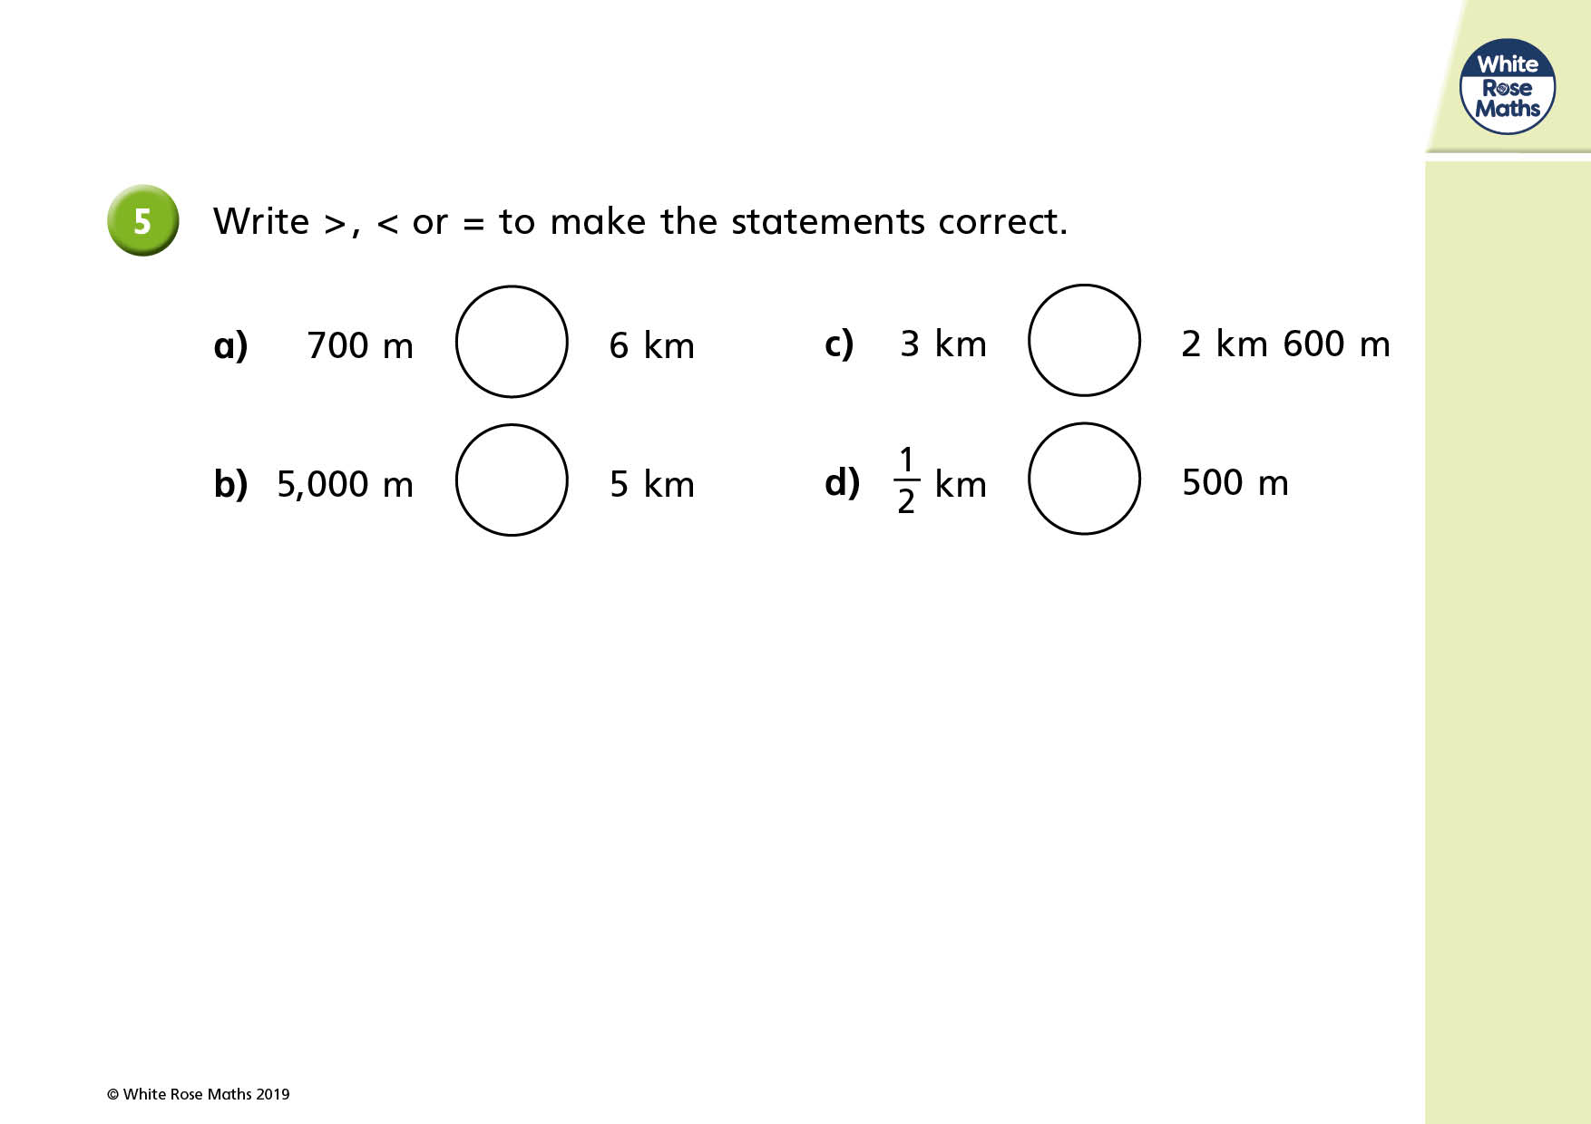

Slide 17
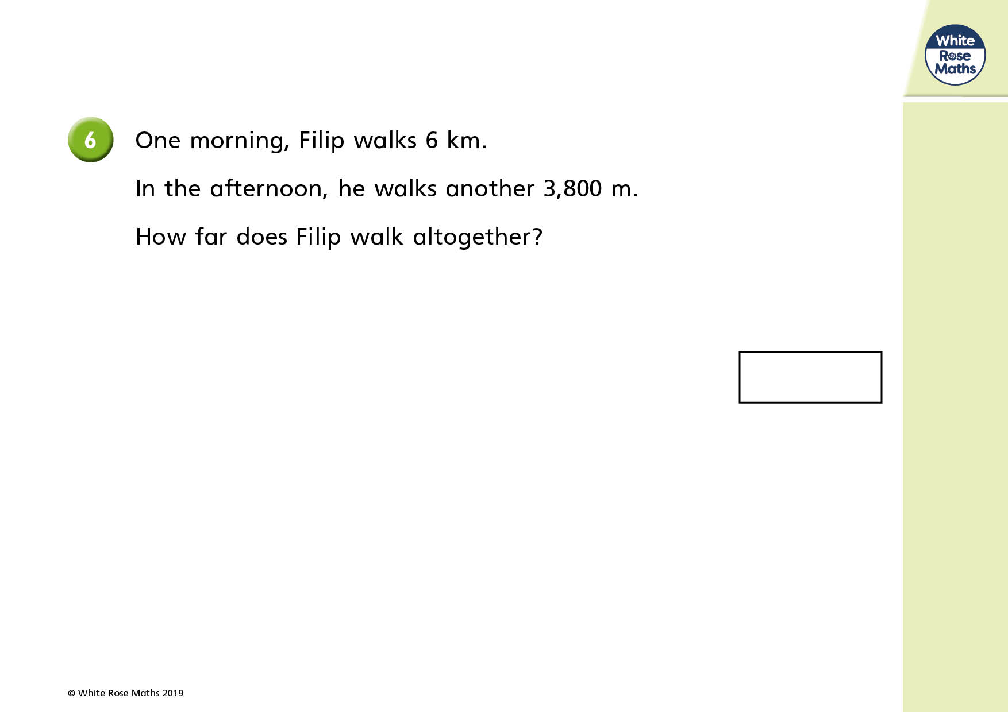

Slide 18


