Slide 1

Survivors
Extraordinary tales from the wild and beyond
Day Twenty-one

Slide 2

A new week, a new story.

Slide 3
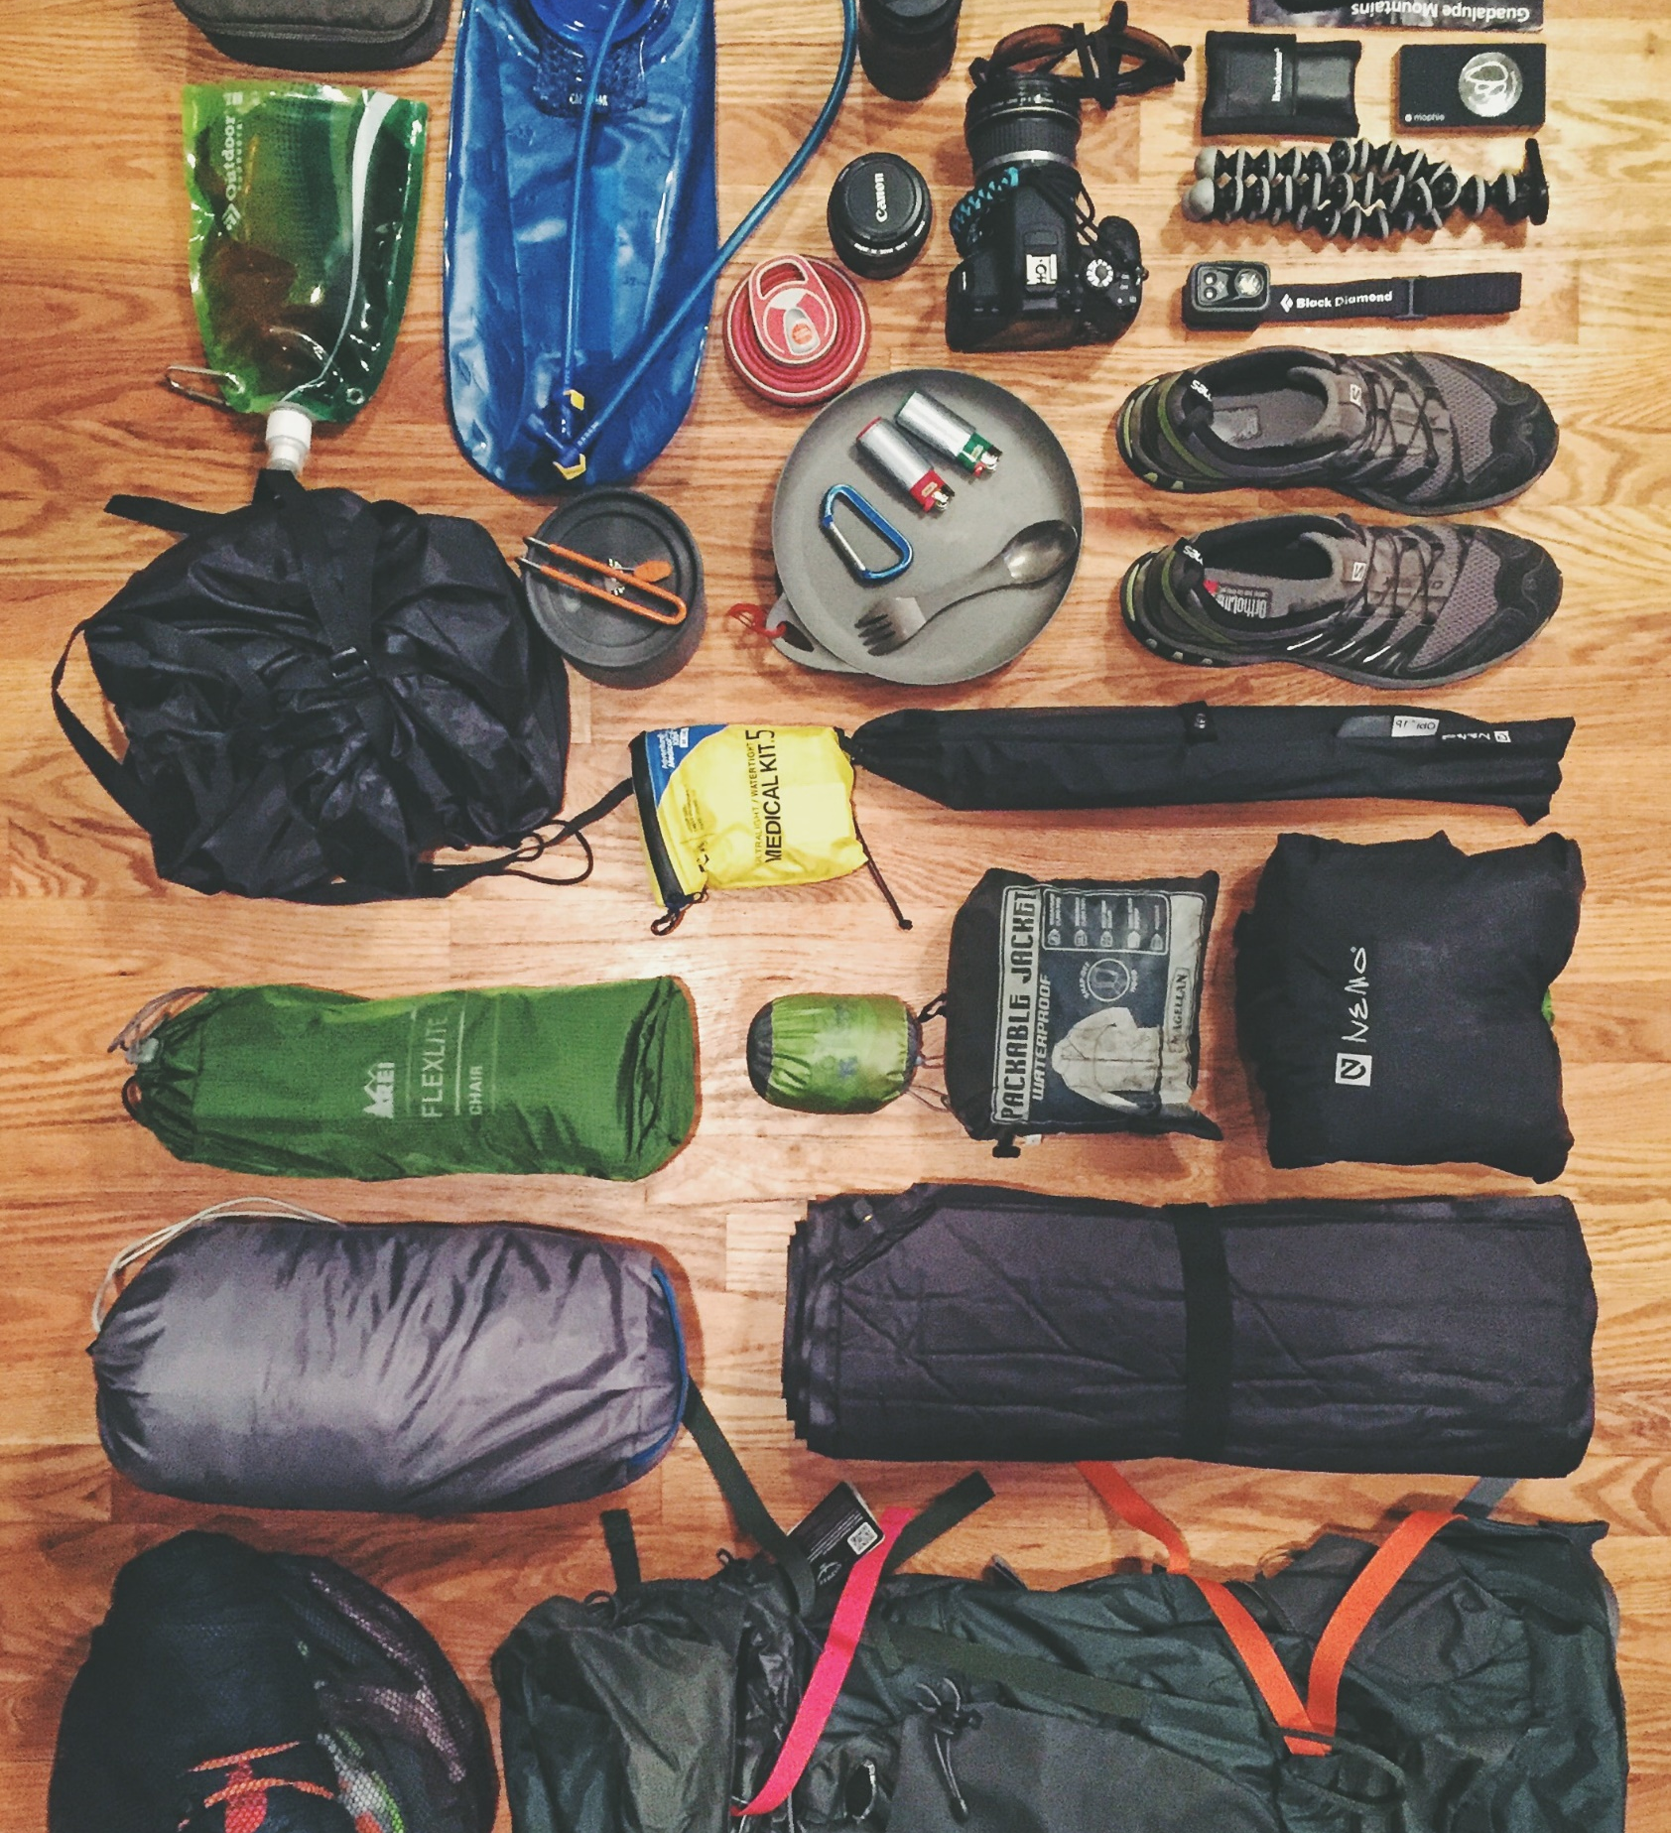
LC: Can I write a list poem?
Toolkit
following a poetic structure

Slide 4
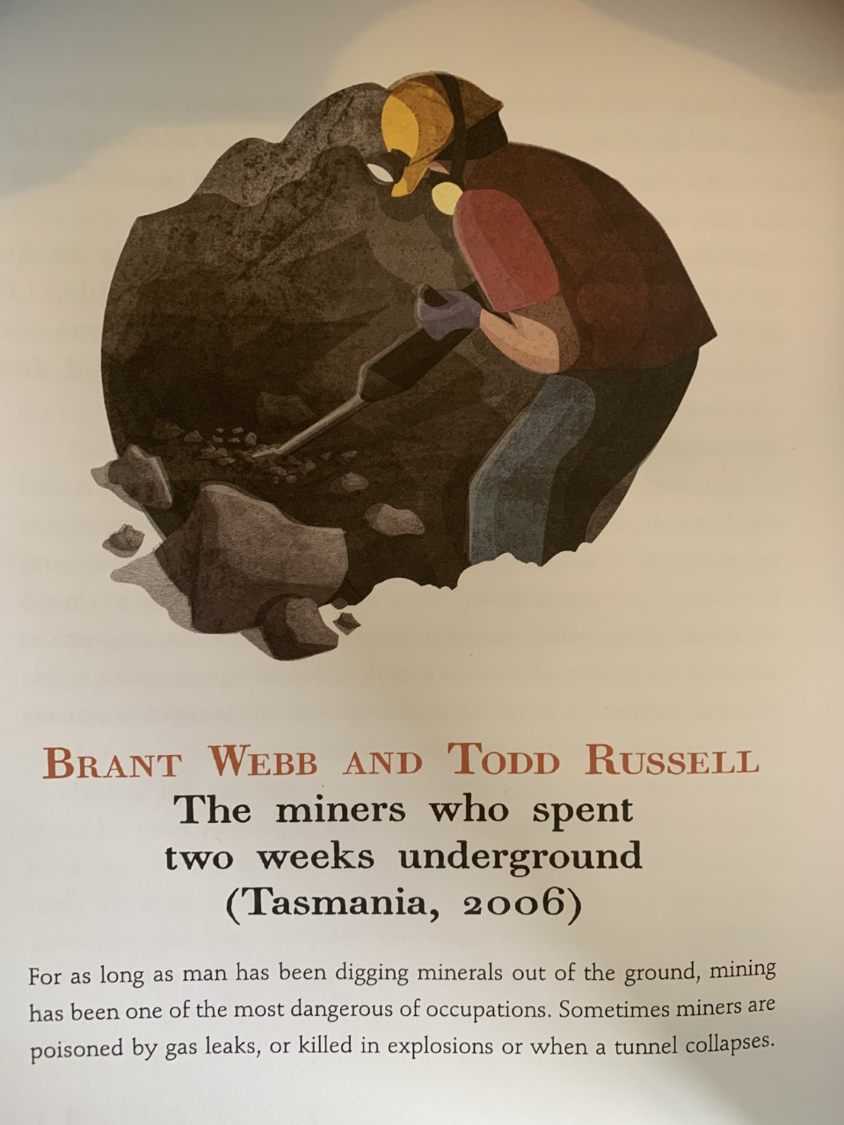
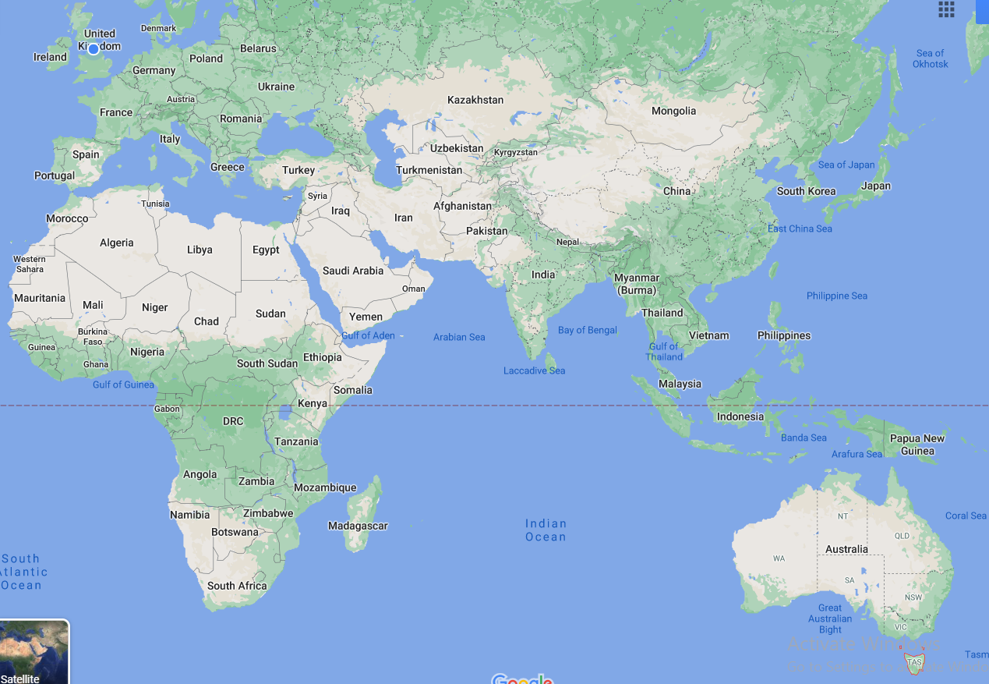
This is a story from 2006, from Tasmania which is an Australian Island State.
Tasmania is marked by the red star.

Slide 5
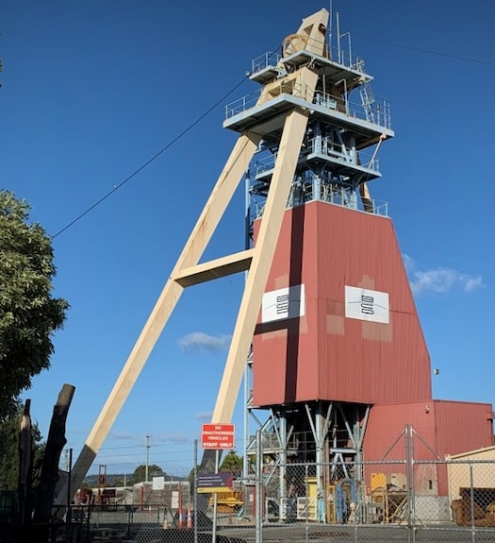
What could this unbelievable story be about?
What do you predict might have caused these miners to be underground for two weeks?
And what might the circumstances be like for this story to be a story of survival?

Slide 6
Mini task
While you read think about what Webb and Russell had going in their favour.

Slide 7
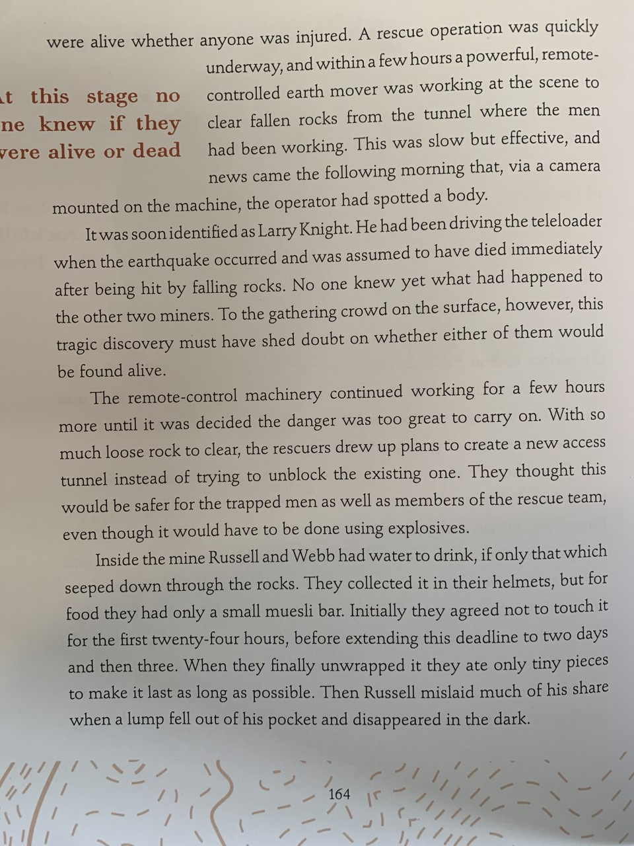
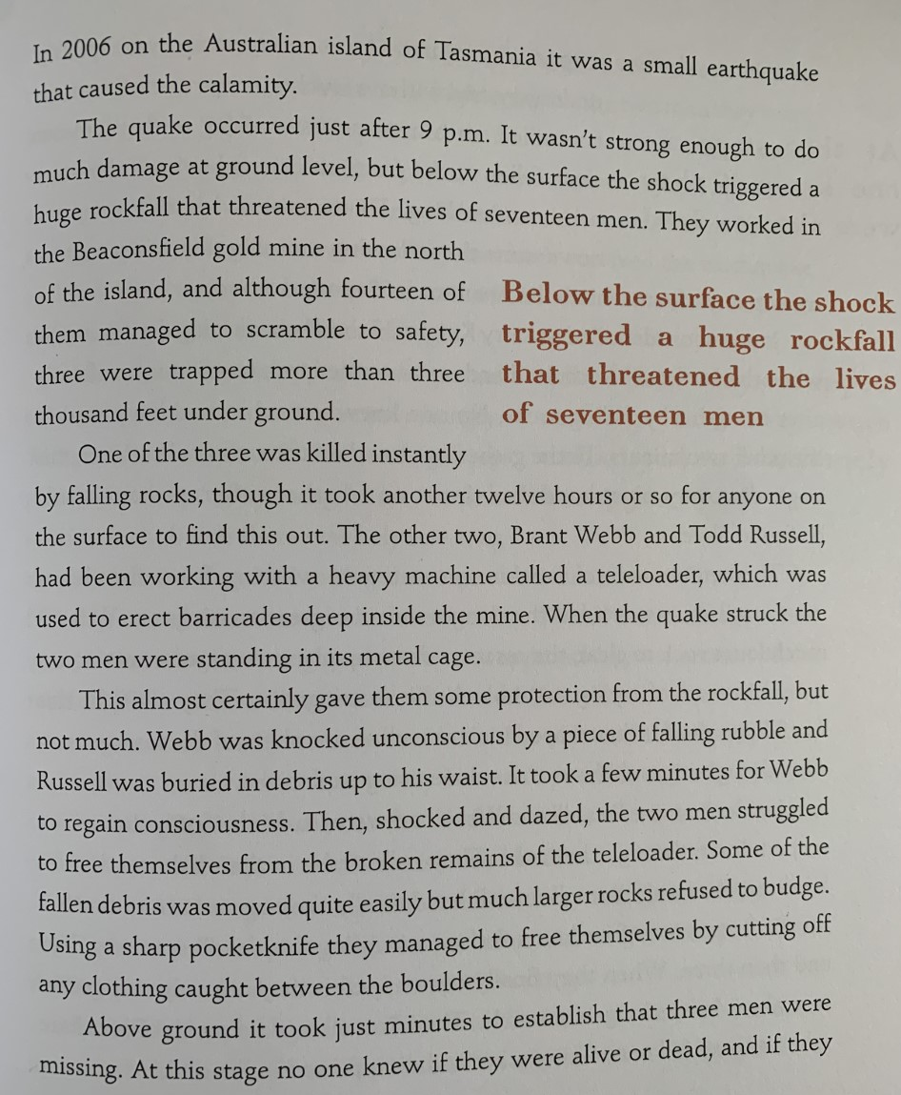
Pages
163 and 164

Slide 8
What are do Russell and Webb have going in their favour and against them?
not seriously injured,
Can you list three for and three against?

Slide 9
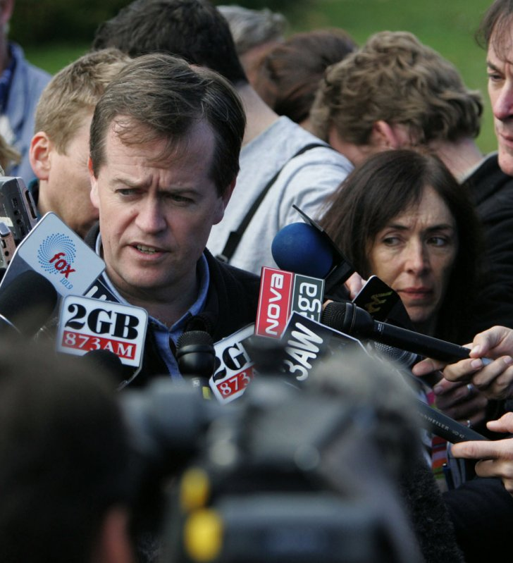
What would have it been like for those who knew them?
What must it be like for Webb and Russell’s families at this stage?
Might they have been aware of the earthquake and concerned?

Slide 10
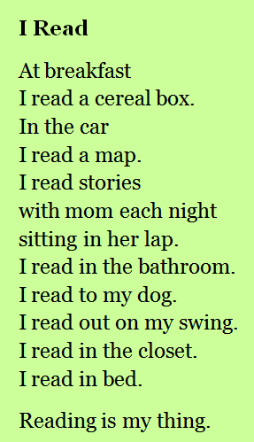
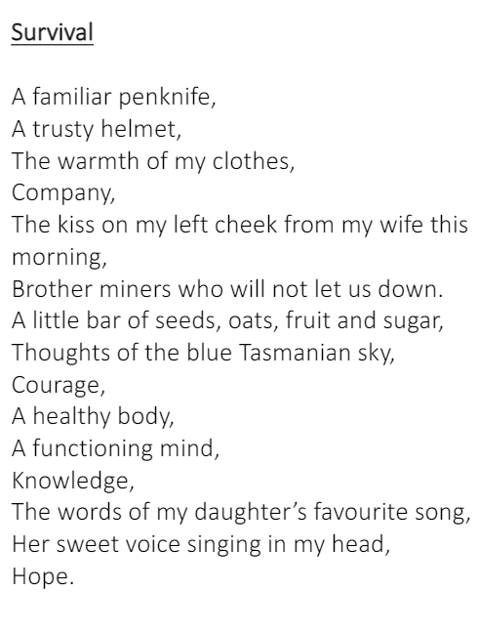
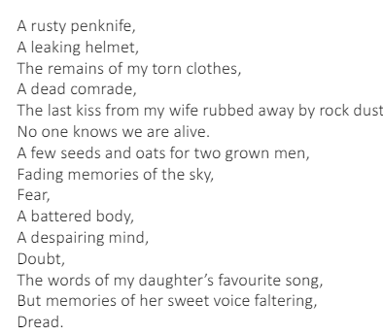
Example list poems

Slide 11
Notice the impact of single words alongside longer lines.
Why do you think the two full stops have been used?
How has the poem been ordered/ structured? Why?
What is the overall impact?
Why has ‘Hope.’ been chosen for the ending line?
You are going to create a list poem thinking about the things that Russell and Webb have in their favour.
You should vary sentence length, consider use of punctuation, use adjectives thoughtfully and ensure they convey the character/ make it personal.

Slide 12
|Task
Use a combination of ideas from reading the extract and what you believe the men would have had to create your own list poem.
Consider and improve word choice and order of lines. Carefully consider the impact of the last line. adult. In this style, write an alternative poem to own, which shows the despair as opposed to hope. Try to echo the ideas from the first poem. What would be an appropriate title for this?
This piece of work does not need to be summited for feedback, however if you want to share it you can upload it to Teams.

Slide 13

You can read your poem on the afternoon check up to earn house points for your house.

