Slide 1
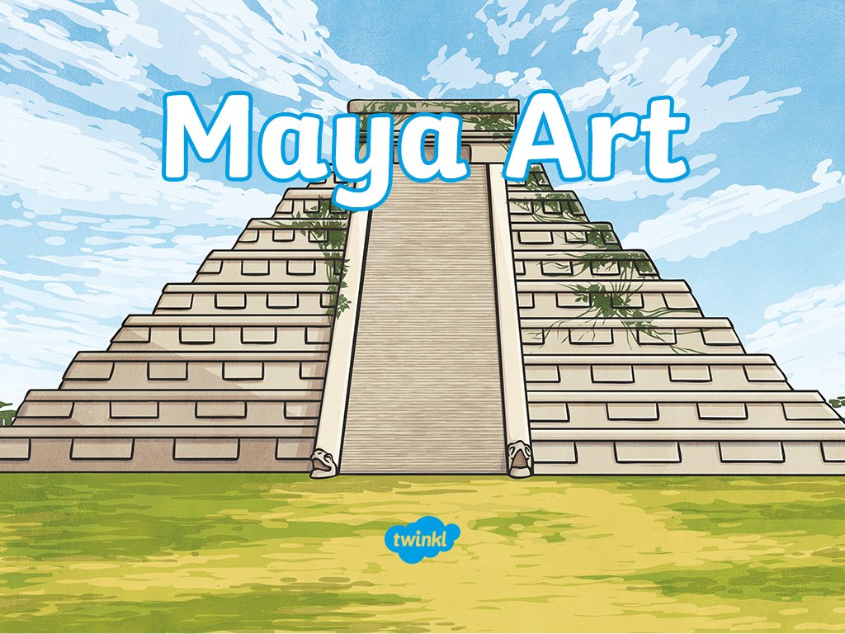

Slide 2
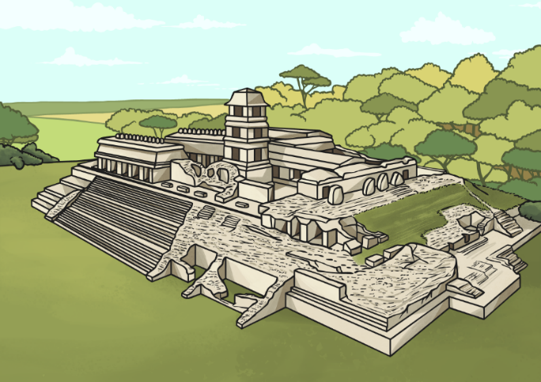
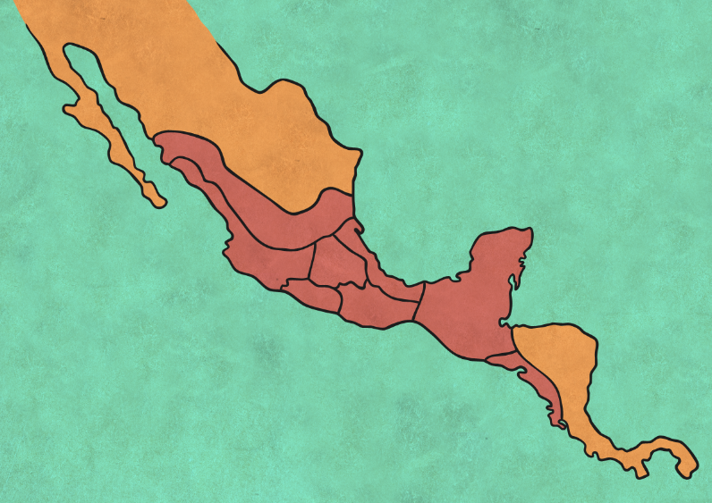

Who Were the Maya?
The Maya were a civilisation who lived in modern-day Mexico, Guatemala, Belize, Honduras and El Salvador. The Maya civilisation lasted from around 1000 BC to
AD 1697.
Can you locate the Maya civilisation on the map?
Click here to find it!

Slide 3
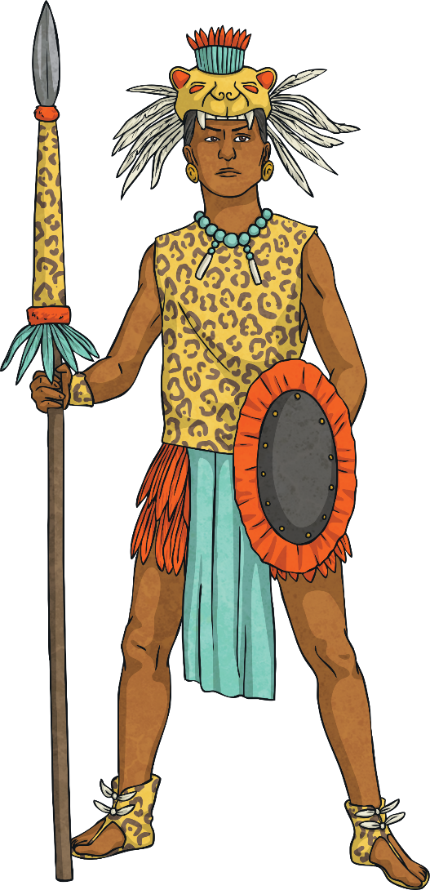
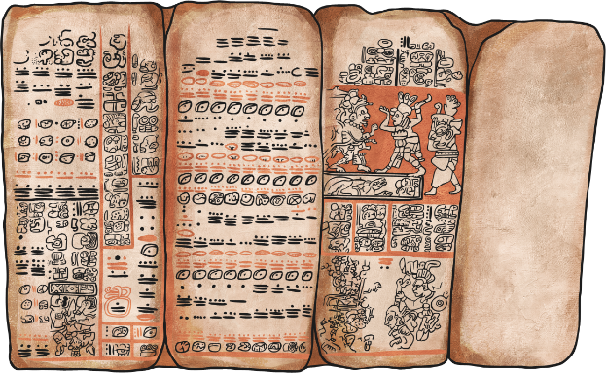
Maya Civilisation
The Maya created many different types of artwork.
Their art depicted their religious beliefs, their way of life, wars they had fought, how they sacrificed people and their kings. Maya kings had a desire to be remembered and art was the best way they could achieve this.

Slide 4
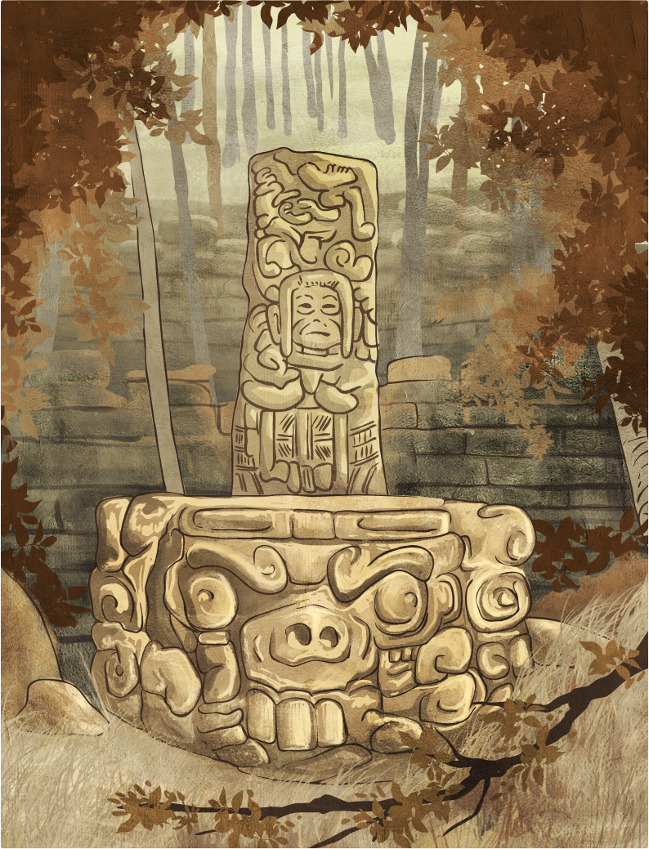
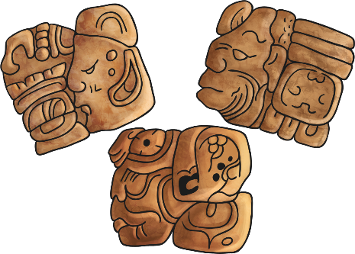
Sculpture
Many sculptures were made of stone. They were often positioned beside altars. The largest sculpture was discovered in the city of Quirigua. The craftsmen would have used stone chisels and wooden mallets.
Maya sculptors also worked in limestone, wood and sandstone.

Slide 5
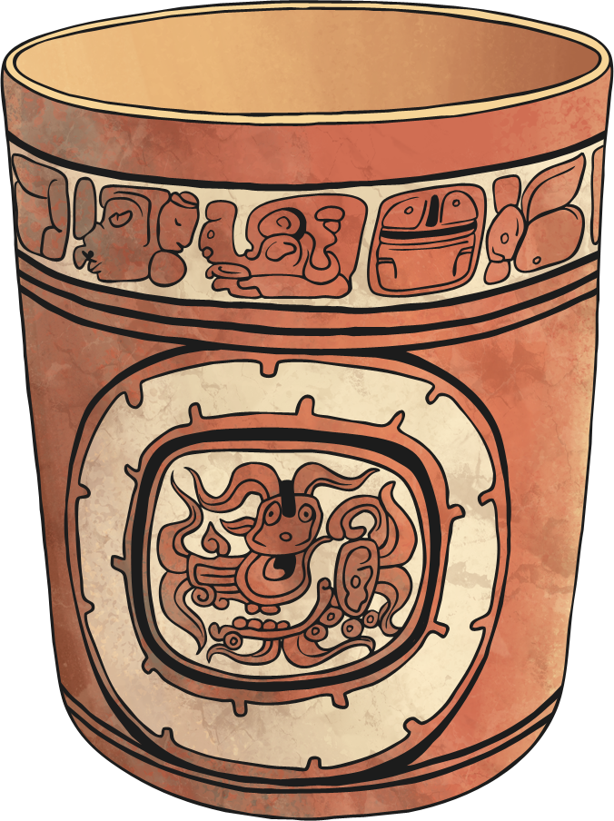
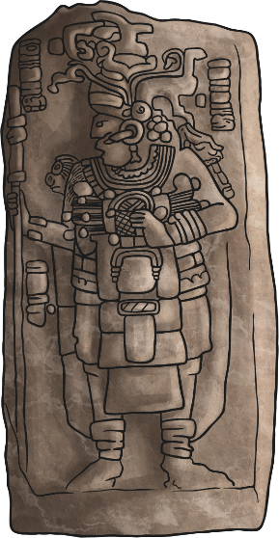
Ceramics
The Mayas made cooking pots, bowls, jars and vases from clay. These vessels often had decorative patterns. They painted the vessels in a style called polychrome using a range of colours, such as orange, red and yellow. The decorations were from Maya mythology and everyday life. These pots are of great importance for archaeologists trying to understand more about the Maya era.

Slide 6
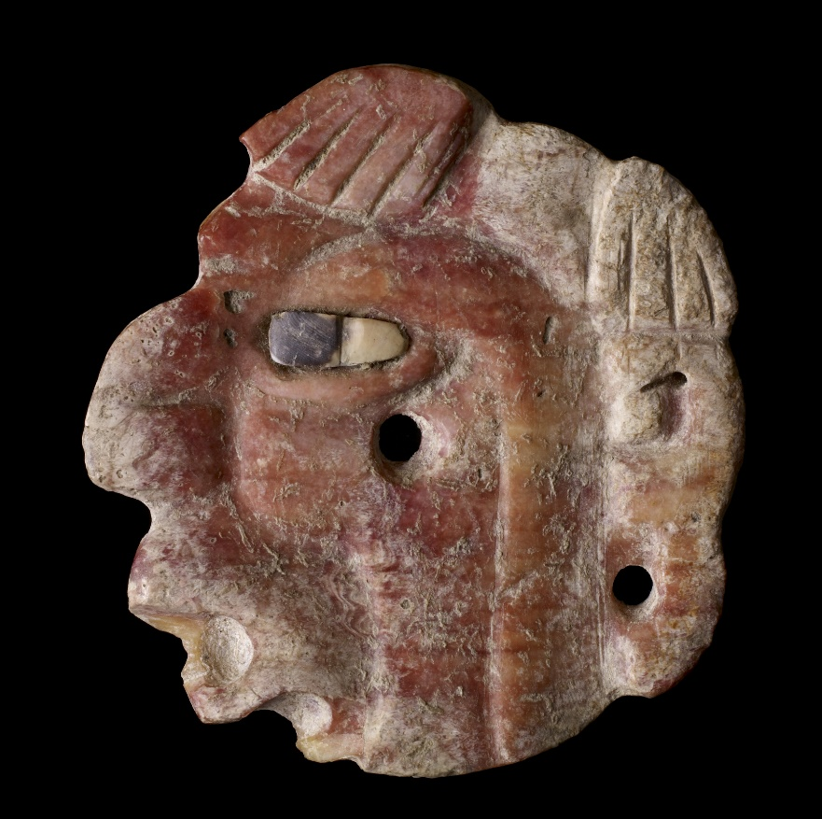
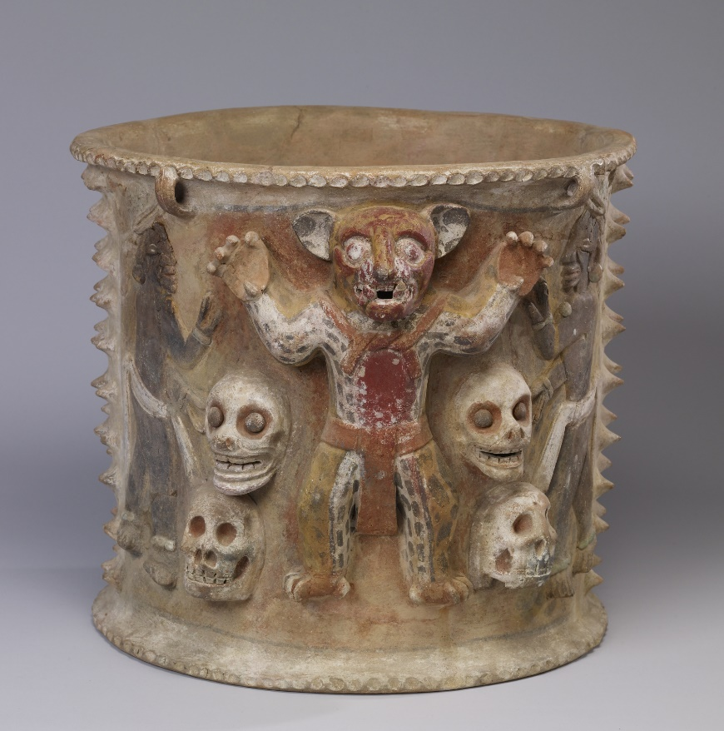
Ceramics
An engraved head
A polychrome urn

Slide 7
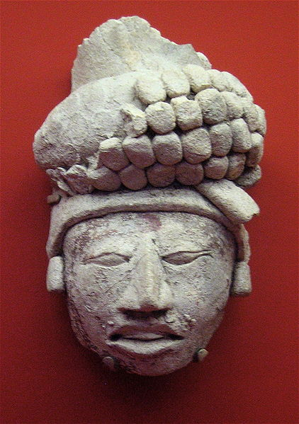
Ceramics
The carved head of a nobleman

Slide 8
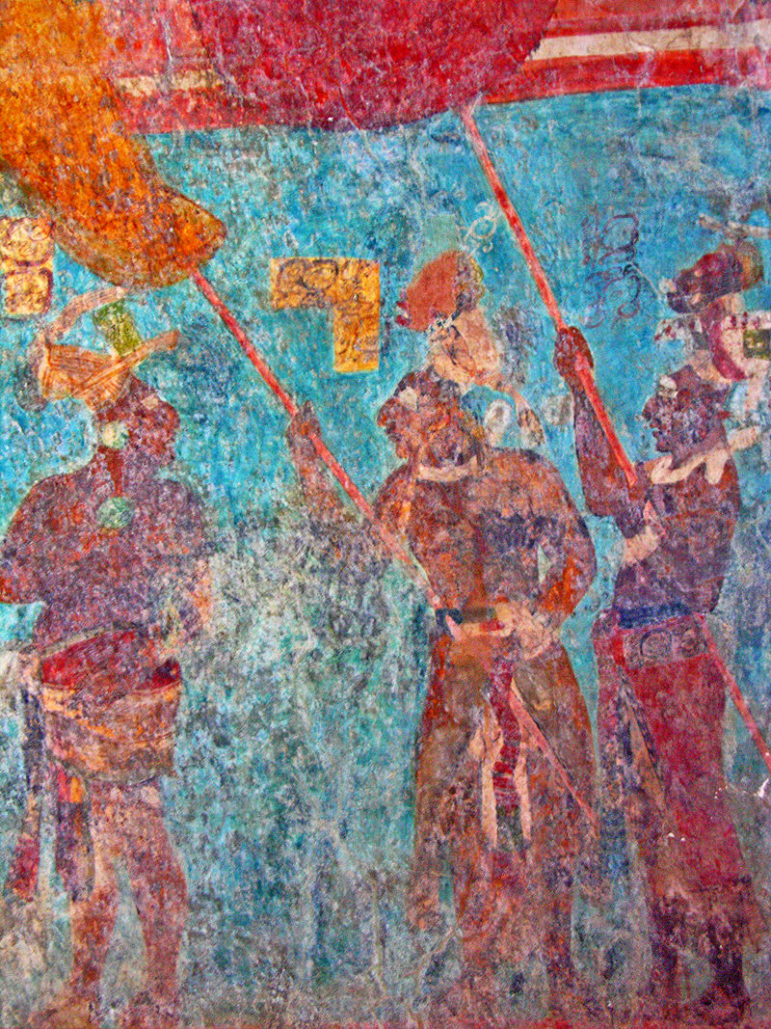
Frescoes
Frescoes have been discovered on the walls of Maya temples. These frescoes show scenes of daily life, stories, battles and religious events. The most famous fresco was discovered in Bonampak in Chiapas, Mexico.

Slide 9
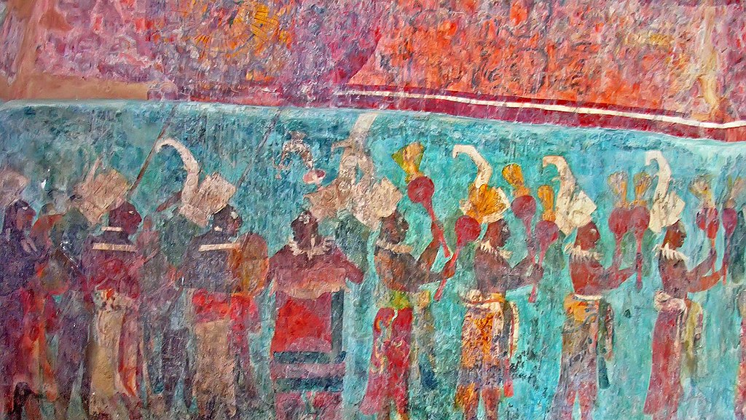
Frescoes
What could you say about the Mayas from this fresco?

Slide 10
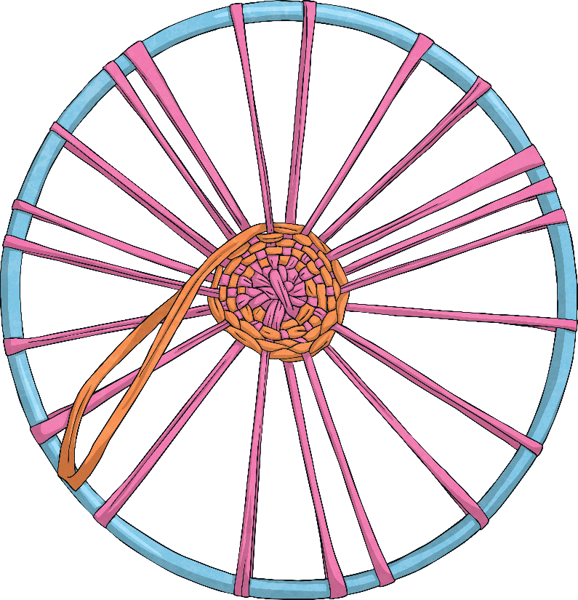
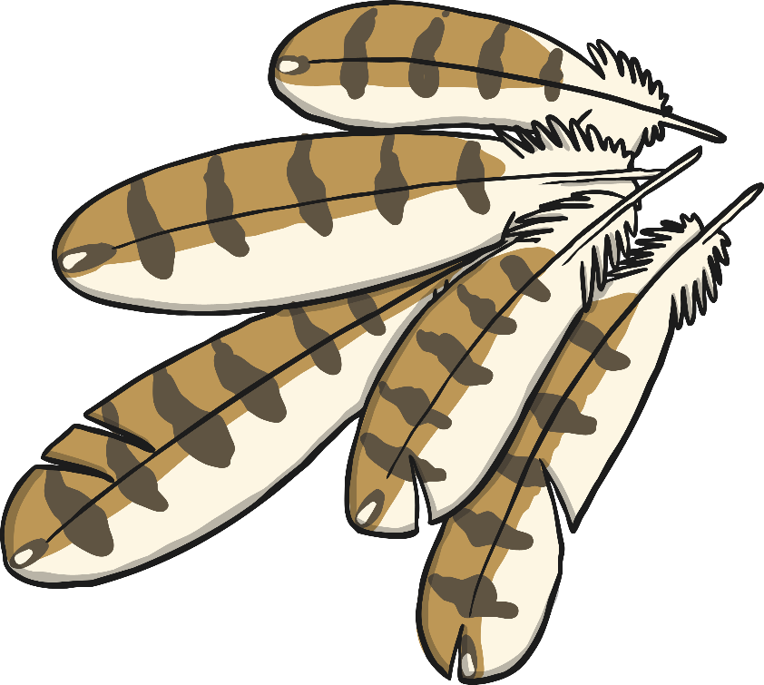
Weaving and Feather Work
From the carvings and paintings, archaeologists can say that the Mayas wore large headdresses made from feathers. These were a sign of status with the nobility wearing clothing made from feather too.

Slide 11
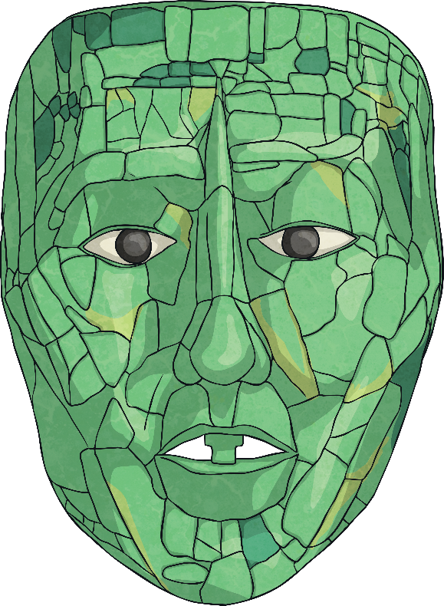
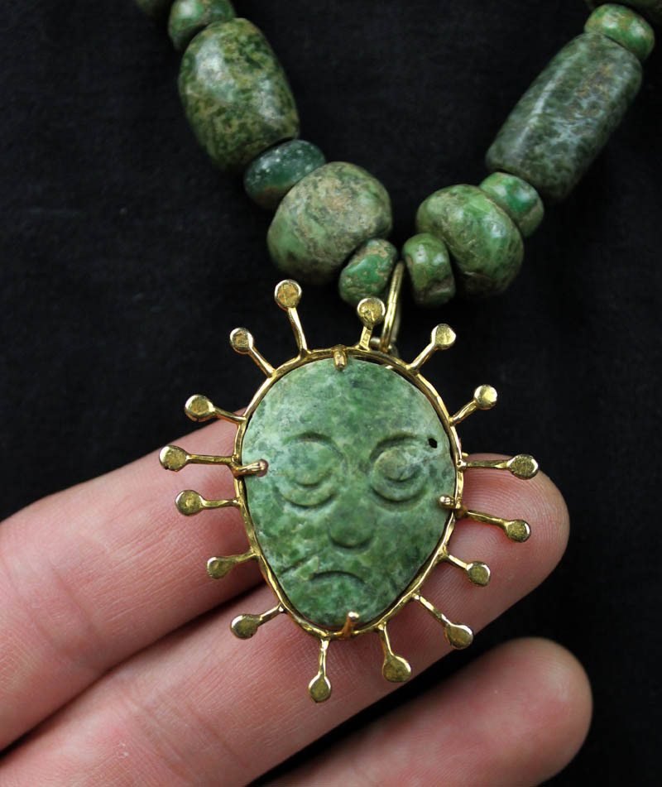
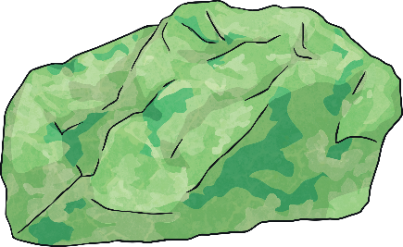
Jade Jewellery
Jade was very valuable to the Maya.
Some pendants, necklaces and engravings were made from jade.

Slide 12
Ancient Maya Jewellery
Early on in the civilization metal was hard to find so the Maya made jewellery from bone, jaguar teeth, claws, stone, and feathers. With the discovery of more metals they would eventually incorporate bronze, gold and silver. The precious stone jade was also used in jewellery. Jade was also used as an offering to the gods, as trading currency, and sometimes as a treatment for kidney disease. Jade was held in higher regard than even gold and silver as the Maya considered it to ne sacred and holy and the ultimate symbol for everything good including eternal love. Religion was extremely important to the Mayas and it is reflected in their jewellery. Men and women pretty much wore the same jewellery with the exception of lip and nose plugs and men with high social status wore nose plugs. The ear plugs worn were so heavy that often they would permanently disfigure the ear lobe. Thanks to archaeological finds in ancient ruins much has been found. The ancient Maya believed strongly in the afterlife and archaeologists have found masks with jade, mother-of-pearl, and various ceramics in the tombs of kings. It was also common for a single jade bead to be buried with the deceased. They left these offerings and gifts to the gods after their deaths. Maya jewellery is truly a beautiful sight to
behold.

Slide 13
Can you design your own Maya-inspired jewellery?
Using the information you have read so far and the pictures on the next page design your own Ancient Maya-style piece/pieces of jewellery. Consider the materials and tools they would have had access to and the highly ornate (decorated) nature of the designs.
Tips
Plan your design first
Mark out the rough size you’d like your drawing to be
‘Ghost sketch’ first (very light sketch)
Once you’re happy add detail, colour and shading etc.
Have fun!

Slide 14



