Slide 1
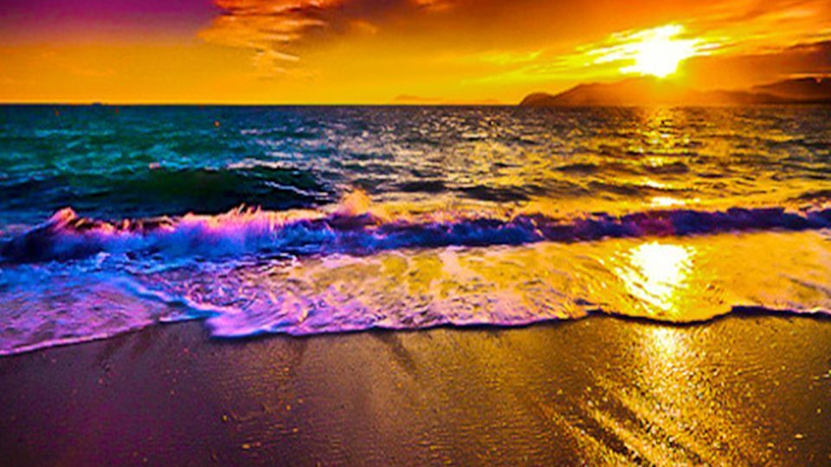
60s Quick Write.

Slide 2
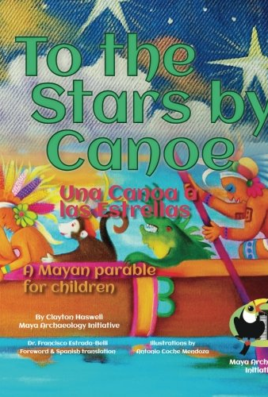
Monday: LC: Can I design my own mythical creature?
Today we are going to design our own mythical creature.
We will do a drawing of our creature and label it.
You will use today's piece to help with your writing tomorrow.

Slide 3
What are the characteristics of mythical creatures?
They are often unusual to look at:
  They may be a combination of different animals
  They may have unusual features (horns etc)
They often have mysterious powers.
Mythical creatures may be a force for good or a source of evil in a myth.

Slide 4
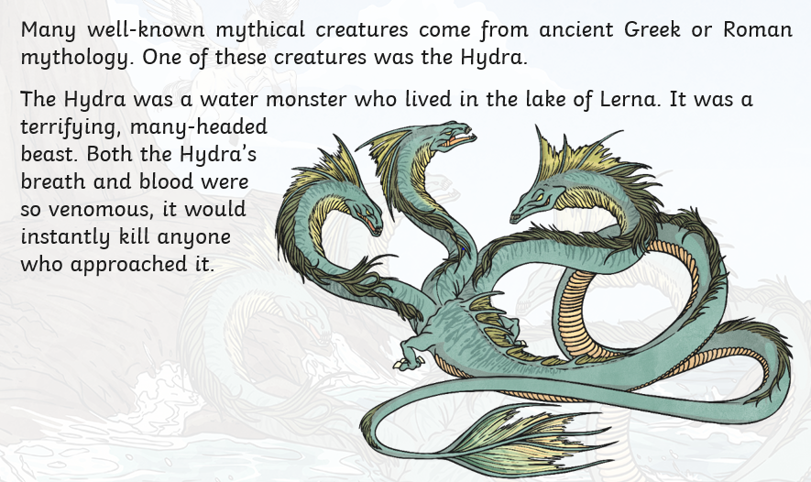
The Hydra

Slide 5
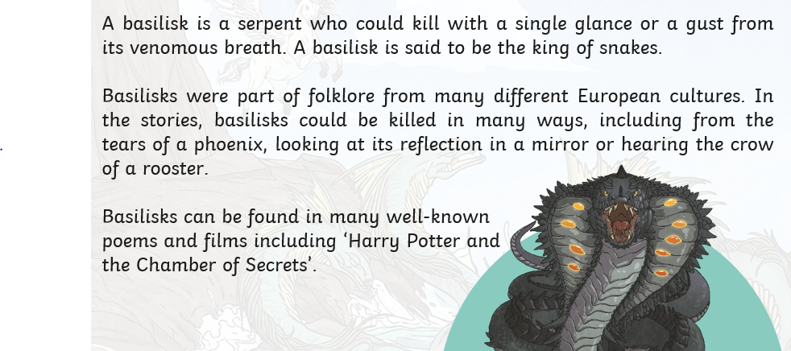
A Basilisk

Slide 6
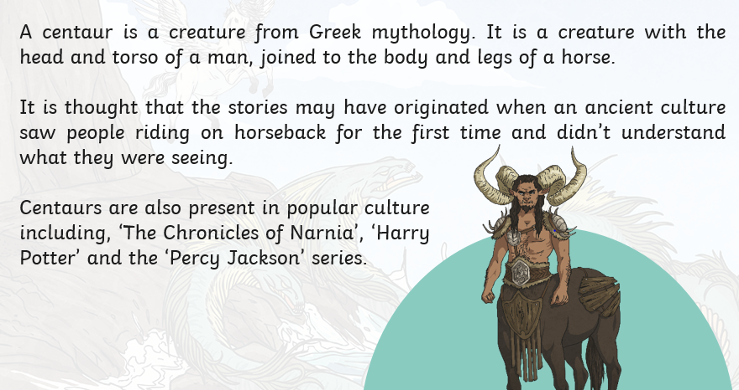
A Centaur

Slide 7
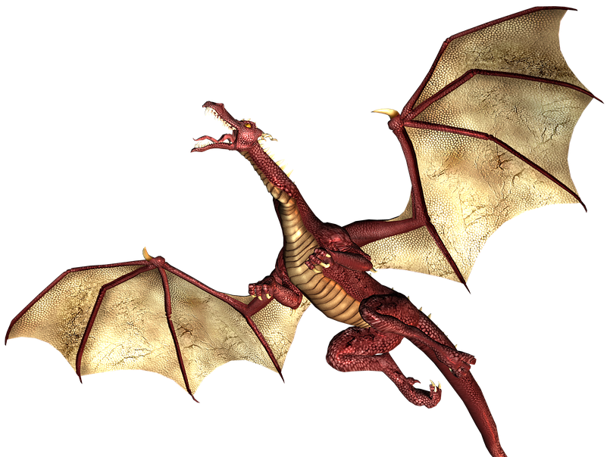
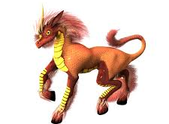
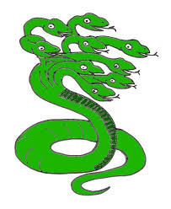
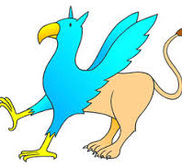
What will your mythical creature look like?
Think about:
What they look like
How they might move.
Special powers they might have (able to fly, to talk etc)

Slide 8
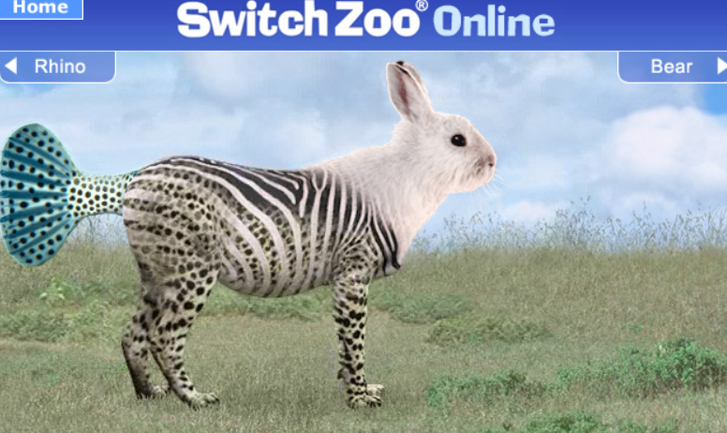
Here are some resources you may want to use:
https://switchzoo.com/newzoo/zoo.htm
Switch zoo lets you create your own creatures as a match of different animals.

Slide 9
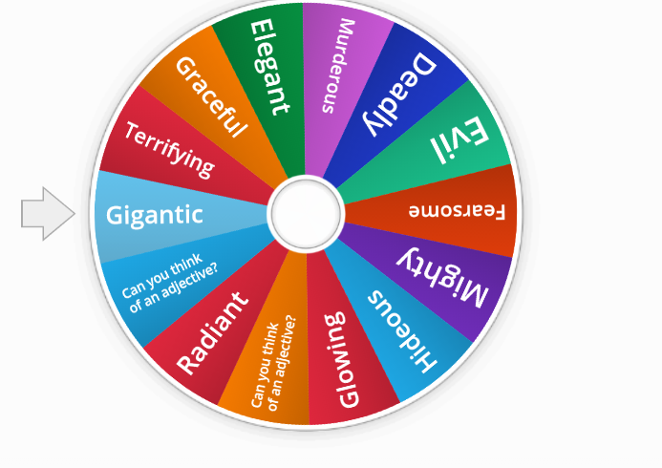
Here are some resources you may want to use:
Adjective Word Wheel
Click on the link above to spin the wheel to generate some excellent adjective ideas to describe your character.

Slide 10
Monday: LC: Can I design my own mythical creature.?
Draw your character in your book.
Label it with key nouns and adjectives to describe it.
Remember to use your learnings from last week:
  - similes and metaphors - 'teeth as sharp as daggers'.
  - expanded noun phrases – 'horns with deadly poison'.
  Senses - 'smells like rotten flesh'

