Slide 1
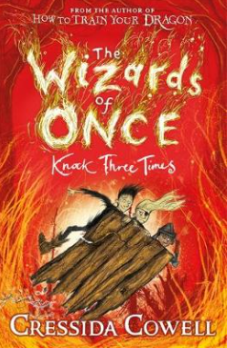
LC: Can I make inferences about a story?

Slide 2
Vocabulary
morsels – a small amount of food
tender – easy to cut or chew
ragged – rough/tired

Slide 3
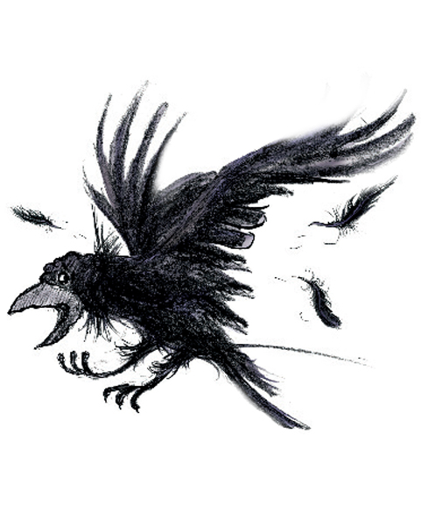
Can you decode the witches’ language??
‘Thaw si ti gniod tou ereh?’ whined Breakneck, waggling her nose from side to side. ‘Yhw si ydobon gnitcetorp ti? Od uoy kniht ti dluoc eb a part?’

Slide 4

You need to read pages 9-11 for guided reading today.
Remember: Your highlighters will be useful for highlighting evidence to support your answers.

Slide 5
Question: Me
How do you know that the witches
liked to eat children?

Slide 6
Question: Me
One of the witches was drooling
because he could smell the
children’s blood which was compared
to the smell of cake in the
oven which normal humans
would want to eat!

Slide 7
Question: You
How do you know the witches were
being careful about approaching
the children?

Slide 8
Question: You
It mentions that the witches are being
cautious and that normally they would
snatch the children up and take them
back to their nests to feed. Something
was stopping them as there aren’t
usually things flying at this time of night.

Slide 9
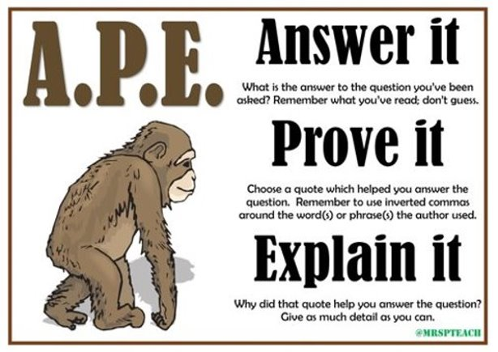
Remember to try and find some evidence in the text to support your answer.

Slide 10
Retrieval
Name the two witches.
What was the smell of human blood compared to?
Name three things that would have been flying in the air
before the witches returned to the wildwoods.
4. Where did wizard humans keep their babies safe?
5. What was Xar’s dangerous secret?

Slide 11
Inference
How do you know that the witches were not around for a while?
Which animal would you compare the witches to? Why?
How do you know the children were frightened?
Why do you think the witches were confused by the smell of magic?
Why was Bodkin not a very good bodyguard?

Slide 12
Retrieval - answers
Ripgrizzle and Breakneck
A cake baking in the oven
3. birds, sprites, cockatrices, dragons, piskies
4. Treeforts
5. He had stolen some magic from a witch

Slide 13
Inference - answers
It talk about their return to the wildwoods which suggests they have been away.
I would compare the witches to a bird as the author uses the word swooping to describe how they move, describes them as fastening their claws into the children and that they would take the children back to their nest. These are all characteristics of a bird.
The children were frightened because they were shaking when they were singing so they were perhaps nervous. Also it mentions that they showed ‘false bravery’ which suggests they were pretending to be brave.
Xar had stolen the magic so he shouldn’t have had it. He was hiding the magic so the witches couldn’t see it. They might have been confused because they could smell magic but not see it.
Bodkin wasn’t a very good bodyguard because he didn’t like to fight and would fall asleep in dangerous situations. He therefore wouldn’t be able to protect Wish if she was in danger.

