Slide 1


Slide 2
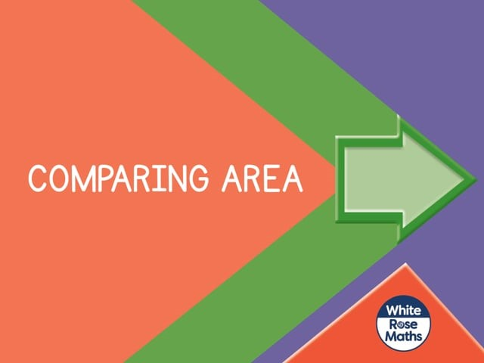

Slide 4



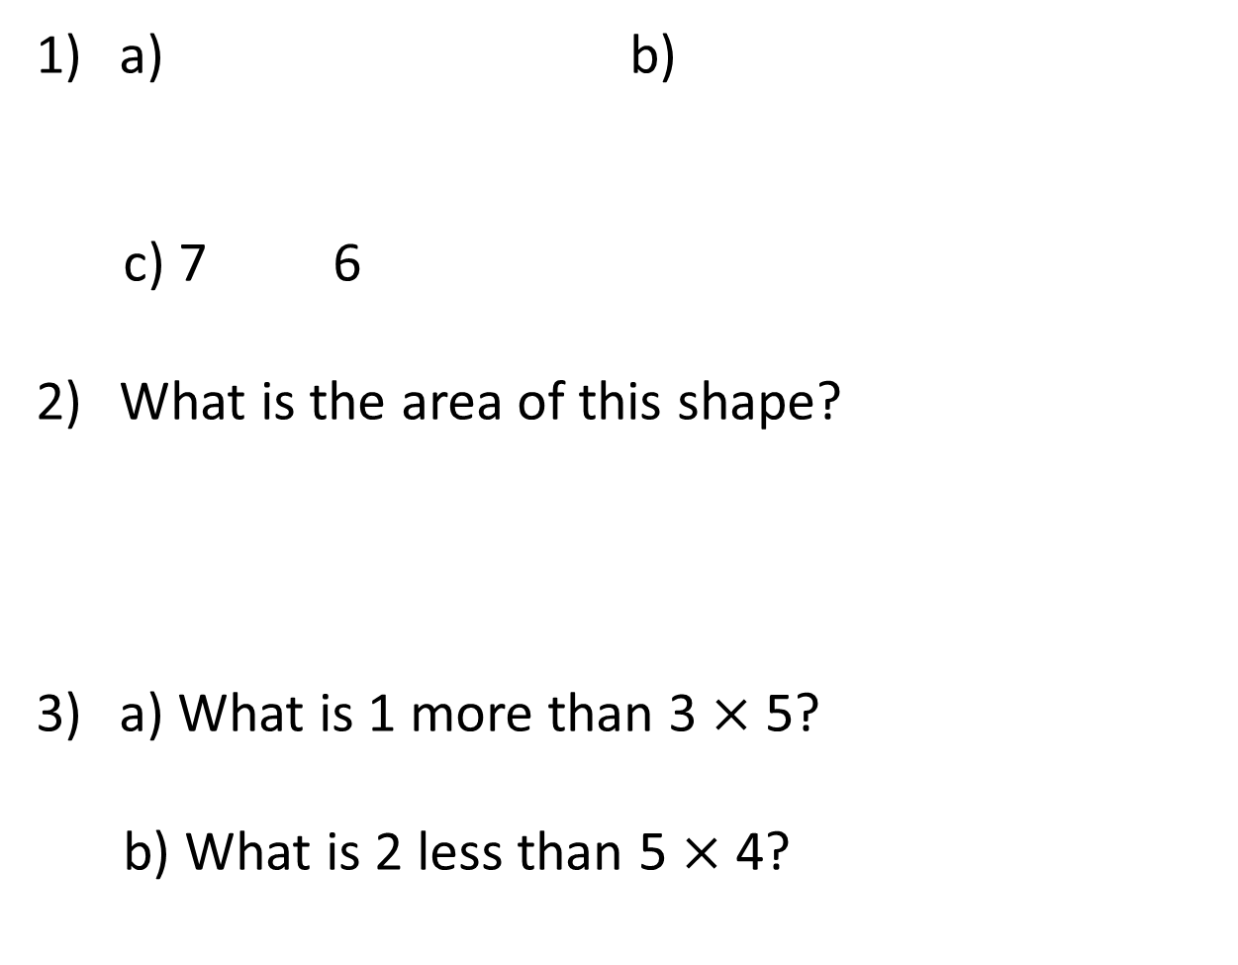
a) b)
c) 7 6
What is the area of this shape?
a) What is 1 more than 3 $×$ 5?
b) What is 2 less than 5 $×$ 4?

Slide 5
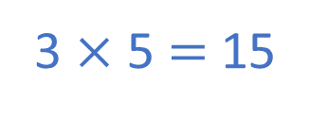

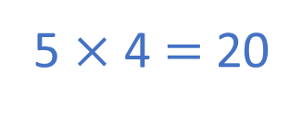
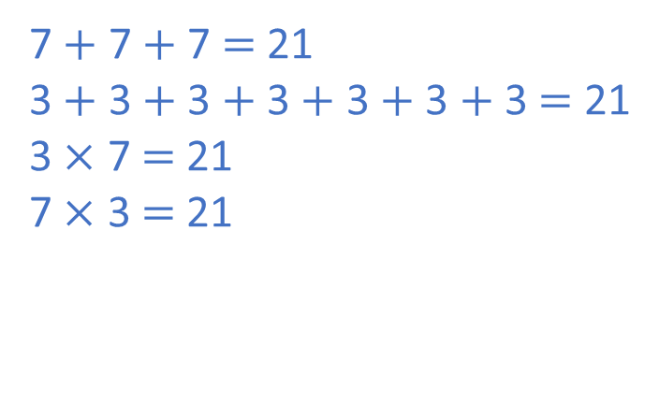
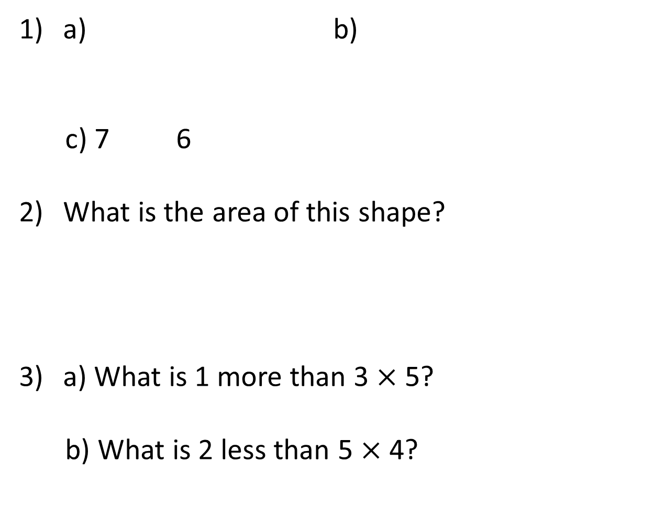
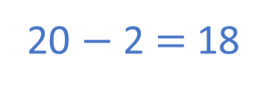


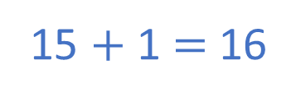
a) b)
c) 7 6
What is the area of this shape?
a) What is 1 more than 3 $×$ 5?
b) What is 2 less than 5 $×$ 4?
$$=$$
$$<$$
$$>$$
1
2
3
4
5
6
7
7 $+$ 7 $+$ 7 $=$ 21
3 $+$ 3 $+$ 3 $+$ 3 $+$ 3 $+$ 3 $+$ 3 $=$ 21
3 $×$ 7 $=$ 21
7 $×$ 3 $=$ 21
8
9
10
11
12
13
14
15
16
17
18
19
20
21
3 $×$ 5 $=$ 15
15 $+$ 1 $=$ 16
5 $×$ 4 $=$ 20
20 $−$ 2 $=$ 18

Slide 7


Have a think
What is the area of this shape?
What is the area of this shape?
Which shape has the larger area?
1
2
3
1
$$>$$
4
2
5
6
7
3
4
5
7 squares
6
6 squares

Slide 8
Have a go at question 1 on the worksheet

Slide 9

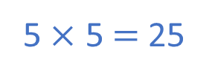
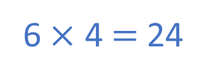
Have a think
Which shape has the smaller area?
5
6
1
2
3
4
5
6
7
8
9
10
11
12
$$<$$
4
5
13
14
15
16
17
18
19
20
21
22
23
24
6 $×$ 4 $=$ 24
5 $×$ 5 $=$ 25

Slide 10

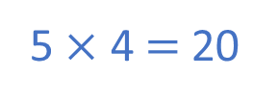
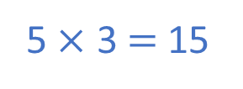
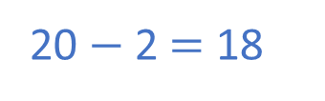
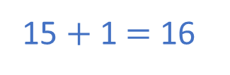
Have a think
Which shape has the greater area?
5
5
$$<$$
3
4
5 $×$ 3 $=$ 15
5 $×$ 4 $=$ 20
15 $+$ 1 $=$ 16
20 $−$ 2 $=$ 18

Slide 11
Have a go at questions
2 - 4 on the worksheet

Slide 12
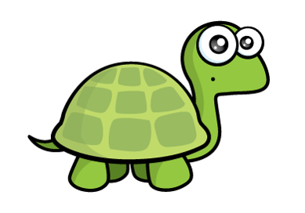
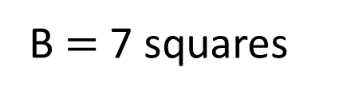
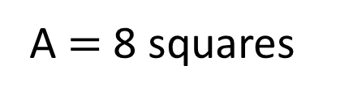
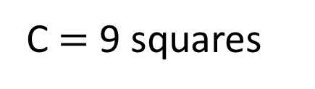
Order the shapes from largest to smallest.
Have a think
2
B is really long so I think it has the largest area
4
A
B
7
A $=$ 8 squares
C
B $=$ 7 squares
C $=$ 9 squares
Do you think Tiny is correct?
C , A , B

Slide 13
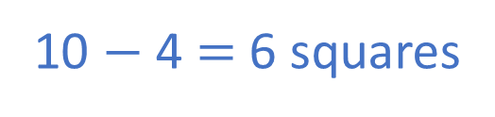
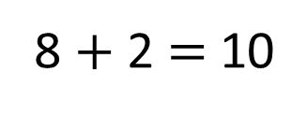
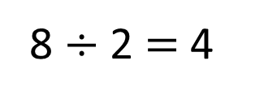
The area of Shape A is halved.
Have a think
One extra square is added to Shape C.
What is the difference between the smallest and largest area now?
A
B
A
8 $÷$ 2 $=$ 4
B
7
C
8 $+$ 2 $=$ 10
C
10 $−$ 4 $=$ 6 squares

Slide 14
Have a go at the rest of the worksheet

