Slide 1
L.C. Can I use and identify pronouns?
Toolkit

Slide 2
Pronouns: The Rules
Pronouns are words used to replace a noun. Without pronouns, spoken and written English would be very repetitive.
For example:
Sam heard a strange noise from inside the cavern. There was definitely something inside it.
Nicola loves to play golf. She finds it very relaxing.
Nova played in the crisp snow. She left her paw prints in it.

Slide 3
Personal Pronouns: The Rules
Personal pronouns represent people, places and things. They refer back to either the object or subject of the sentence. Personal pronouns often signal whether the noun they refer back to is singular or plural and its gender.
E.g. He pointed at her. She pointed to him.
them him you
it you I
we she he they us me

Slide 4
Possessive Pronouns: The Rules
Possessive pronouns show you the ownership of something. There are not to be confused with possessive apostrophe words such Ben’s pencil or Simon’s trousers. They don’t need an apostrophe!
E.g. He rode his bike home.
mine yours ours his
her theirs its

Slide 5
Relative Pronouns: The Rules
Relative pronouns are the first words used in a relative clause.
that who whom which whose
Jim, who was dressed as a superhero, was going to a fancy dress party.
His cat, whose name is Mr Pickle, brought a live rat in from the garden.

Slide 6
Reflexive Pronouns: The Rules
Reflexive pronouns reflect back on an earlier noun or pronoun.
himself yourself myself ourselves themselves
He taught himself to play the accordion.
I caught myself looking in the mirror.

Slide 7

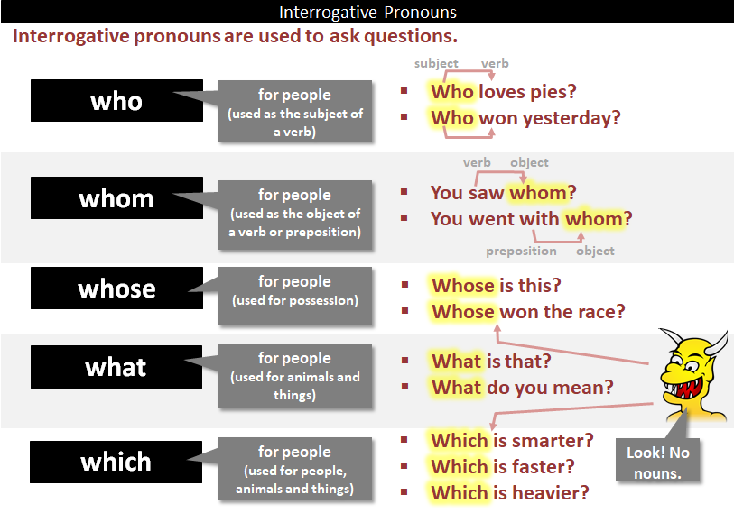
Interrogative Pronouns: The Rules
Interrogative pronouns are used to ask questions when there is an unknown subject or object.

Slide 8
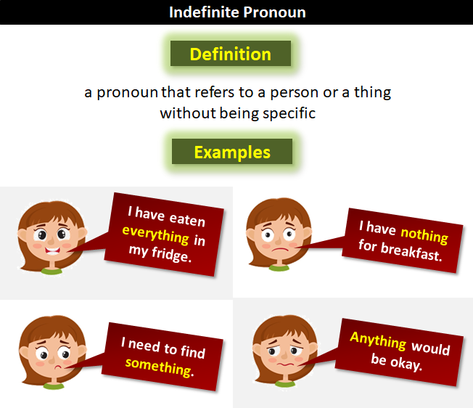
Indefinite Pronouns: The Rules
Indefinite pronouns do not refer to any specific person or thing, but still can take the place of a noun.
somebody
nobody
anybody
no-one
anyone
There isn’t anyone at home.

Slide 9

Pronouns: The Tricky Bits
Me and Danielle worked at the computer.
This sentence is incorrect. Think about it… would ‘me worked at the computer’ be grammatically correct?
Danielle and I worked at the computer.
‘I’ is the correct pronoun to use. Always place the other person first.

Slide 10
Quick quiz!
Add the correct possessive pronoun.
It’s my house - it’s ........
It’s their cat- it’s ………
It’s Laura’s pen- it’s ……..
It’s Jack’s bike - it’s ………
It’s your idea - it’s ……
It’s our money - it’s ……..

Slide 11
Quick quiz!
Add the correct possessive pronoun.
It’s my house - it’s mine
It’s their cat- it’s theirs
It’s Laura’s pen- it’s hers
It’s Jack’s bike - it’s his
It’s your idea - it’s yours
It’s our money - it’s ours

Slide 12
Task
Your task is to produce a double page spread/PowerPoint all about pronouns.
You need to explain what each type is and give examples of when you would use them.
Personal pronouns
Possessive pronouns
Relative pronouns
Reflexive pronouns
Interrogative pronouns
Indefinite pronouns

