Slide 1

Survivors
Extraordinary tales from the wild and beyond
Day Fourteen

Slide 2
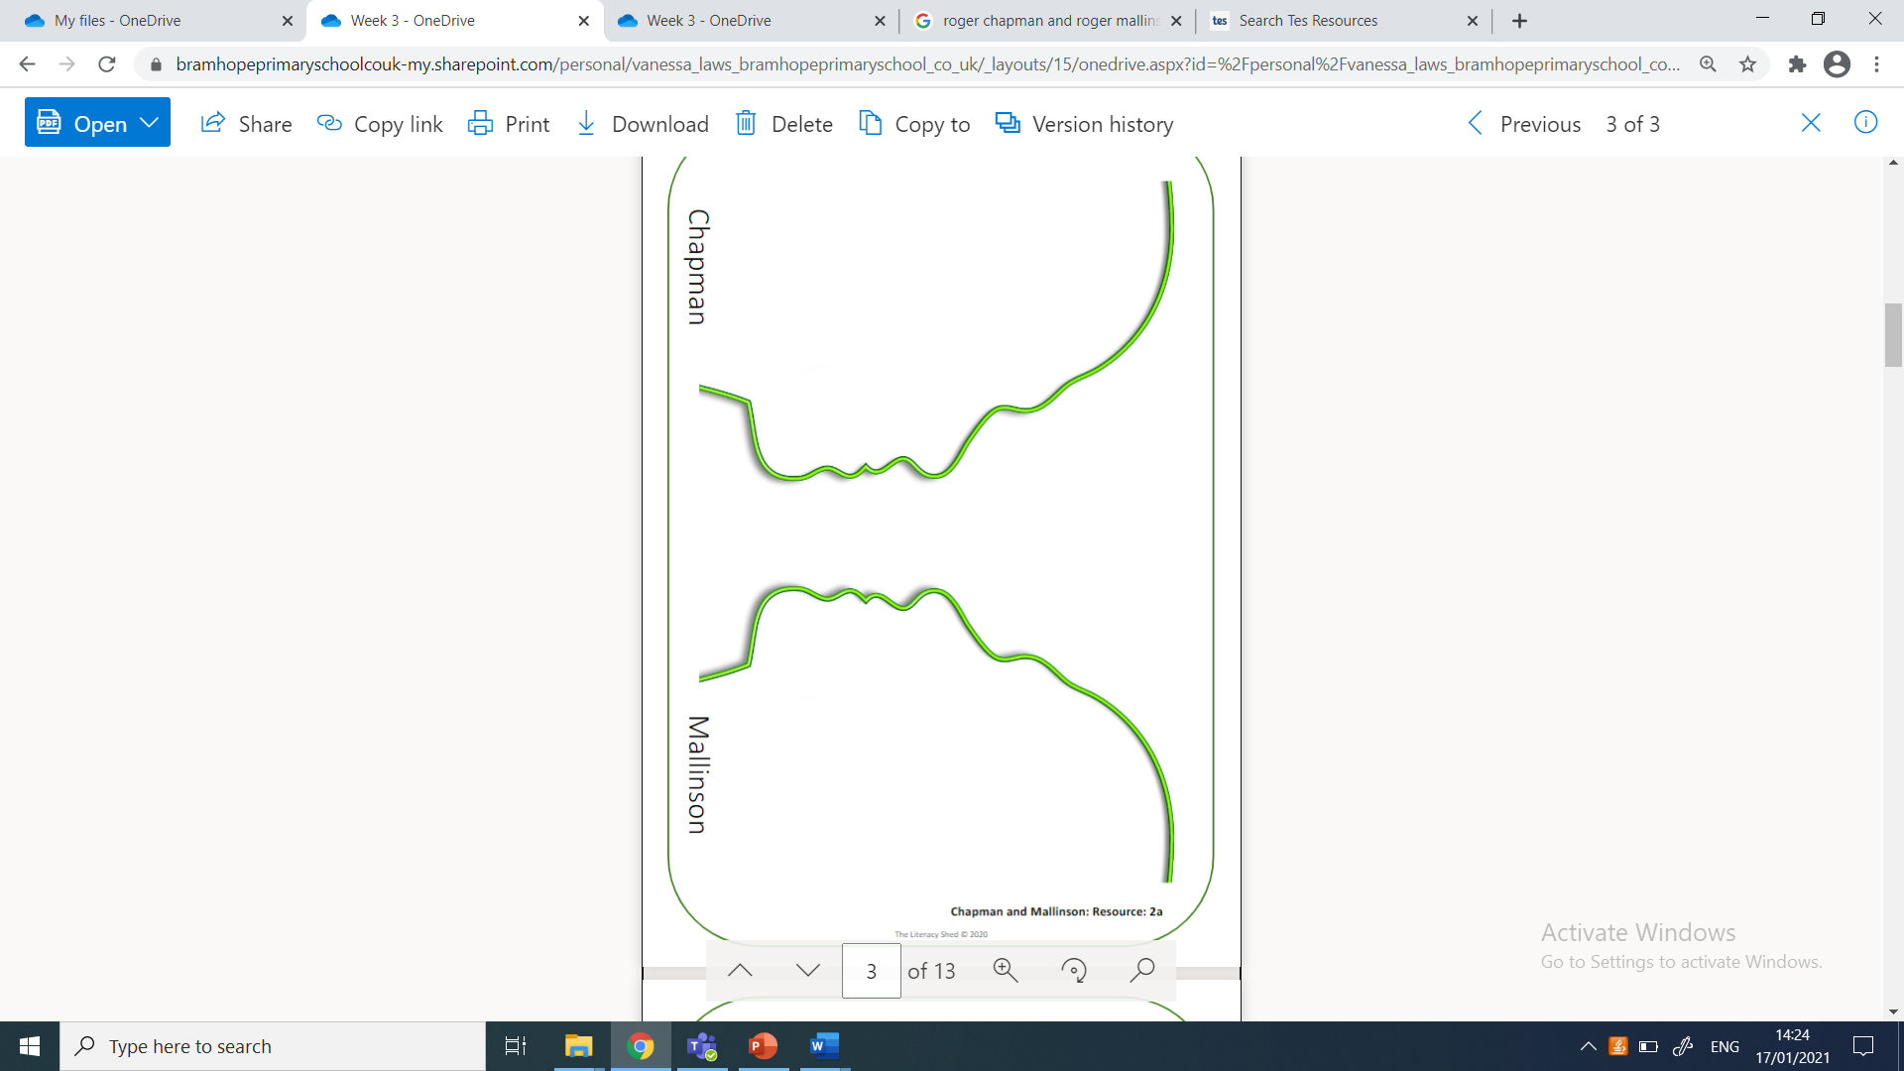
LC: Can I plan a personal profile?
Toolkit
Each man had his own characteristics and personality traits but together they survived.

Slide 3
Planning a character profile
Your task in this lesson (and next)will be to draft and write an online-style profile page for either Chapman or Mallinson. Use your knowledge of these men to present the events from the perspective of one or other i.e. focus on their role in the story -Mallinson as the engineer and Chapman as the experienced submariner.
You will be allowed to make up unknown details as long as these are in keeping with the available information e.g. the disaster happened in 1973 therefore both men would have been born more than 20 years prior (considering their marital/family status and work experience)etc.
First, make a choice about which man you would like to focus on.

Slide 4
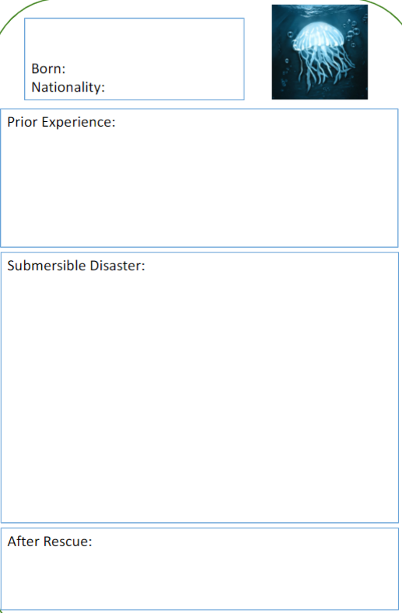
|Task
Make bullet-point notes, using a layout like the one shown, about chosen survivor’s prior experience; involvement in the disaster; and life after the rescue. Ensure these notes are in chronological order and refer to the Aron Ralston text from yesterday to help with layout and detail.
Use Survivors week 3 day 14 resource to help with additional facts.
I’ve included a word bank on the following page.
Beware! There are some red herrings included.

Slide 5


