Slide 1

L.C. Can I create a code for living that will help the world?
Toolkit

Slide 2
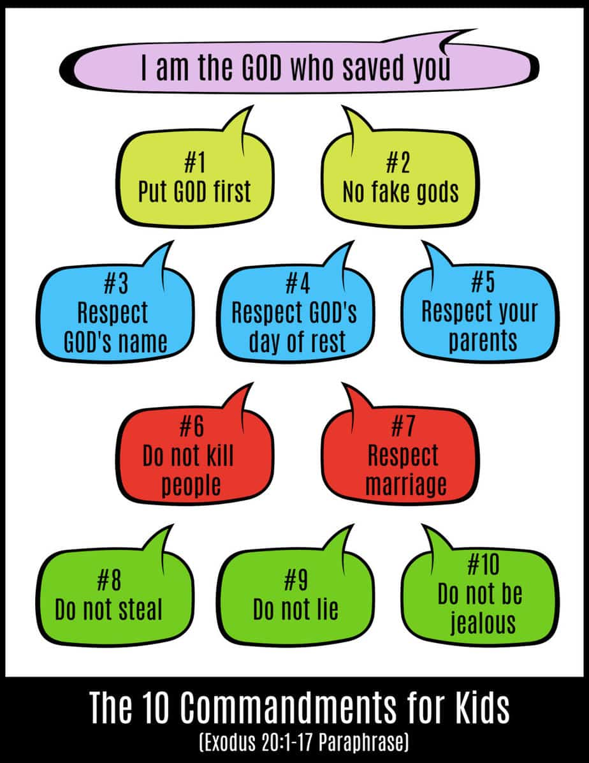
Religions have their own ‘codes for living’.
Christians have the Ten Commandments.

Slide 3
Religions have their own ‘codes for living’.
Muslims have the Five Pillars of Islam.
https://www.bbc.co.uk/teach/class-clips-video/religious-education-ks2-my-life-my-religion-what-is-islam/zbmrwty

Slide 4
Religions have their own ‘codes for living’.
Humanists have their own code for living.
Be honest.
Use your mind
Tell the truth
Do to other people what you would like them to do to you.

Slide 5
Task
Can you come up with ten sentences that would make a code for living in a post-Covid world.
What would you change about how we are living now?
What have you learned from being in lockdown?
You can re-use ideas from Christian, Muslim and humanist sources, but you should also add your own ideas.

Slide 6
Think about………………
What would the impact of the codes for living be?
What would help people to keep to these codes?
What would be the right thing to do to stop a person from breaking the codes for living?

Slide 7
Presenting your work.
The ‘Ten Commandments’ were written on ‘tablets of stone’.
You can express your codes through art, calligraphy or IT.

