Slide 1

Survivors
Extraordinary tales from the wild and beyond
Day Fifteen

Slide 2
LC: Can I write a personal profile?
Toolkit
Chronological order

Slide 3
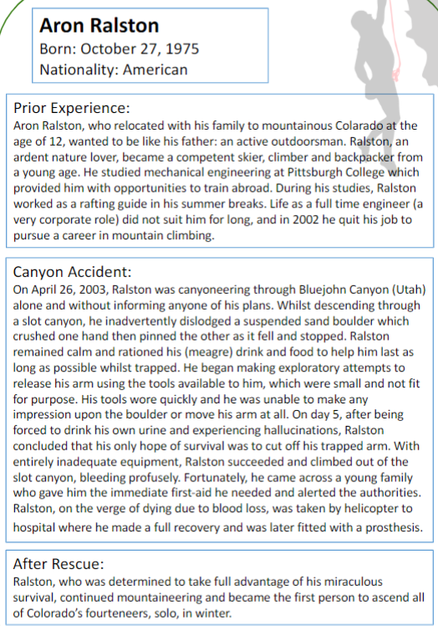
Revisiting an existing personal profile
This week’s focus writing with parenthesis.
Before writing your own profile, reread Aron’s to remind yourself of the expectations.

Slide 4
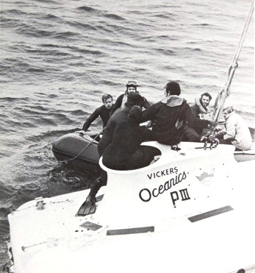
|Task
Use your notes to write an online-style profile page of either Chapman or Mallinson. Ensure events and character are conveyed clearly and with detail through use of correctly punctuated parenthesis.

Slide 5
Consider why David Long chose to title this story ‘The men who shared a sandwich on the seabed’?

Slide 6
FAQs
Can I add my own research? Absolutely
Can I type my work? Yes, but you may need an adult to show you how to add brackets.
Can I add photographs to enhance my work? Yes, one or two carefully placed photographs can add to your writing.
Can I do a powerpoint? No.
Do I need to upload this piece of work? Yes.

