Slide 1
LC: What are the 5 pillars of Islam?
This will include looking at:
- The names of all 5 pillars
- What each pillar means
This week you will learn a little more what Muslims believe.
There is a video to watch and then you need to explain what each of the 5 pillars is called and what this means.
Complete this in your home learning book. Don't forget the LC and the date.

Slide 2
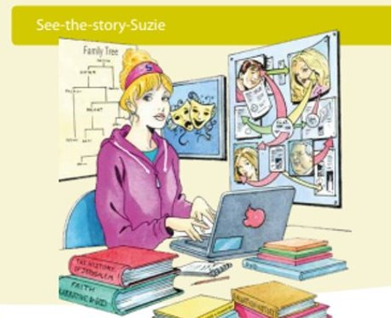
Today we will be See- the- story-Suzie.
Remember, she looks at stories to see how religions are shaped and why a religion chooses to do certain things.
Just like last week you will watch videos and find out facts.

Slide 3
Watch the videos. You may need to watch twice to help you complete the work sheet about the 5 pillars.
This video is from the BBC. It is quite short but will tell you what you need to know about the 5 pillars
https://www.bbc.co.uk/teach/class-clips-video/religious-studies-ks1-the-five-pillars-of-islam/zv84jhv
This video is also from BBC bitesize.
https://www.bbc.co.uk/teach/class-clips-video/religious-education-ks2-my-life-my-religion-what-is-islam/zbmrwty

Slide 4
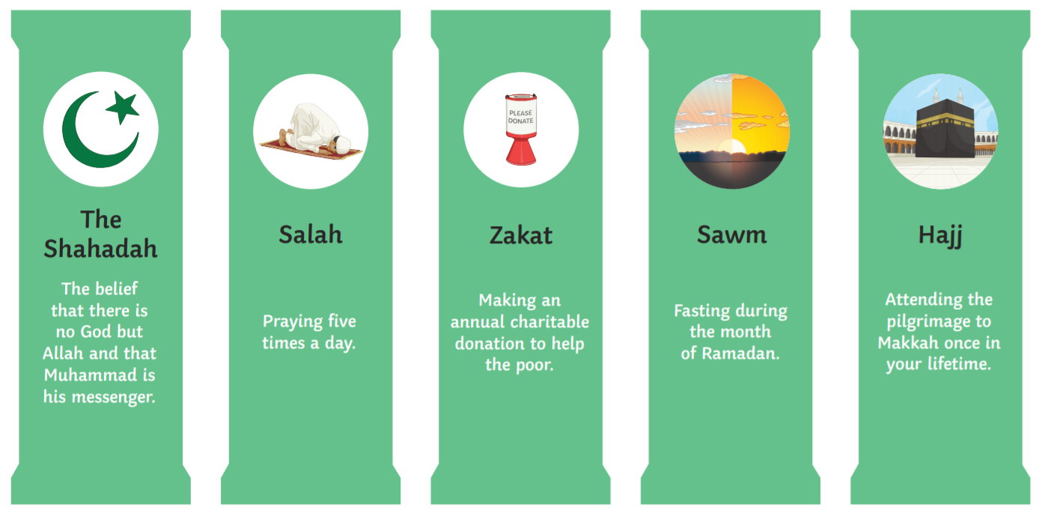
These are the 5 pillars – You can use this to help you.

Slide 5
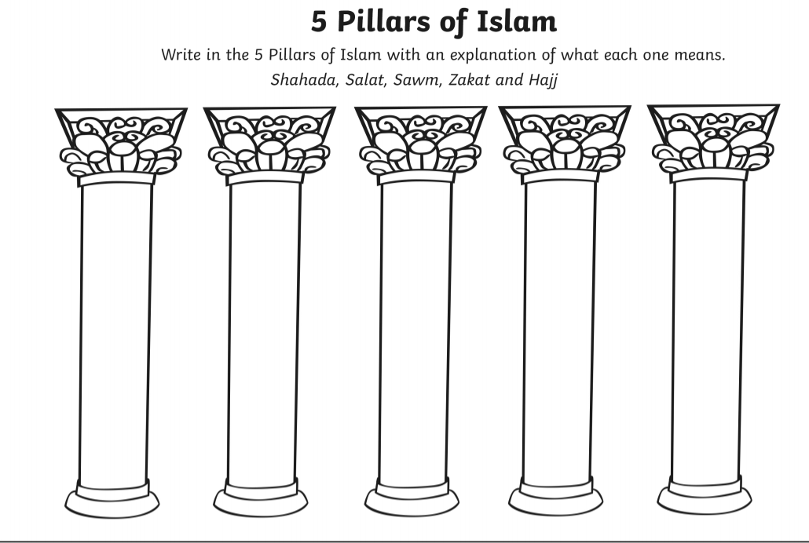
The worksheet looks like this, but you could draw the pillars or write them in a list. Use your home learning book. Make sure you check your spellings with the help sheet on the last slide or from the top of the worksheet.

