Slide 1
Friday: Spot the mistakes.
Mrs Lawson said it was the happiest day of my life.
Mrs Colbourn exclaimed I have never been prouder of the pupils at Bramhope Primary School.
At 11am Rashford arrived at the school.
Nobody believed it could of happened in Leeds!

Slide 2
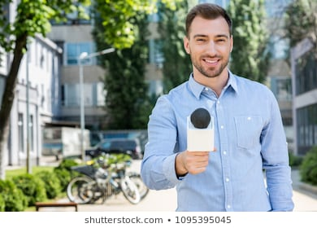
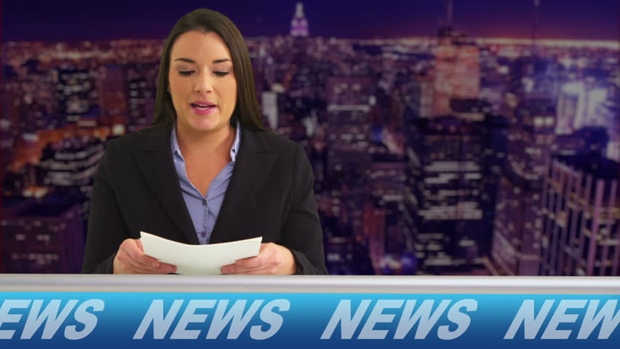
Yesterday, you wrote a script as a studio news presenter telling the audience about a key event.
Today, we’d like you to focus on interviewing a witness from the scene.

Slide 3
Different roles of witnesses.
To provide expert opinion (e.g. scientists)
To provide information about an investigation (e.g. police officers)
To learn more about what people who were there may have seen or heard.

Slide 4
Different types of questions you may want to ask your witness.
What did you hear when the event happened?
Where were you when the event took place?
How are you feeling now?
What further information do you have as an expert in the field?

Slide 5

Toolkit
Welcome audience to the scene.
Introduce yourself : “I’m Mrs Hahnel reporting for BBC News.
Explain that you are reporting LIVE from the scene.
Introduce your witness "...and I’m with officer Scott to find out more about the …”
Ask questions to find out more information about the – 5 Ws
Interviewing a witness.
Remember to:

Slide 6
Reporter: I'm Ben Thackson and I'm live at the scene of an extraordinary world record here in Yorkshire. Today, cooks at a leading bakery have made the largest birthday cake ever recorded. The cake measures over 10 metres tall! I'm joined by Chef Bennett, the legendary baker. When did you decide to go for the World Record?
Chef Bennett: It was in early Spring 2020 when we decided to go for 'tallest cake in the world' record. It seemed impossible but we've managed it finally.
Reporter: Why did you decide to break the record?
Chef Bennett: It seemed like a good challenge at the time. We love baking and are well-known in the community. 2020 has been such a difficult year and we thought it would cheer up all the local residents.
Reporter: Well you've certainly caught the world's attention. Thank you and back to Beth in the studio.
Modelled Example:

Slide 7
Toolkit
Welcome audience to the scene.
Introduce yourself : “I’m Mrs Hahnel reporting for BBC News.
Explain that you are reporting LIVE from the scene.
Introduce your witness "...and I’m with officer Scott to find out more about the …”
Ask questions to find out more information about the – 5 Ws
LC: Can I write a script from a reporter at the scene?
Remember to:

