Slide 1
Warm up questions coming up!

Slide 2

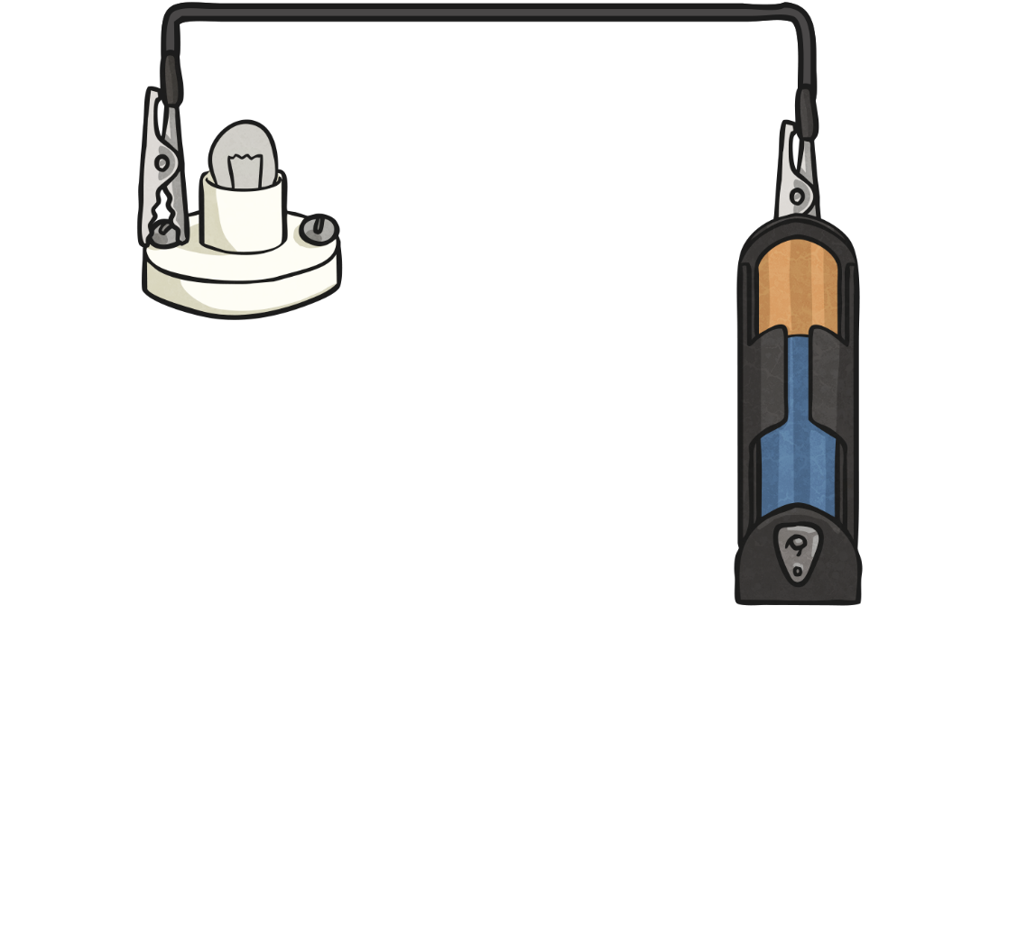
Complete or Incomplete?

Slide 3
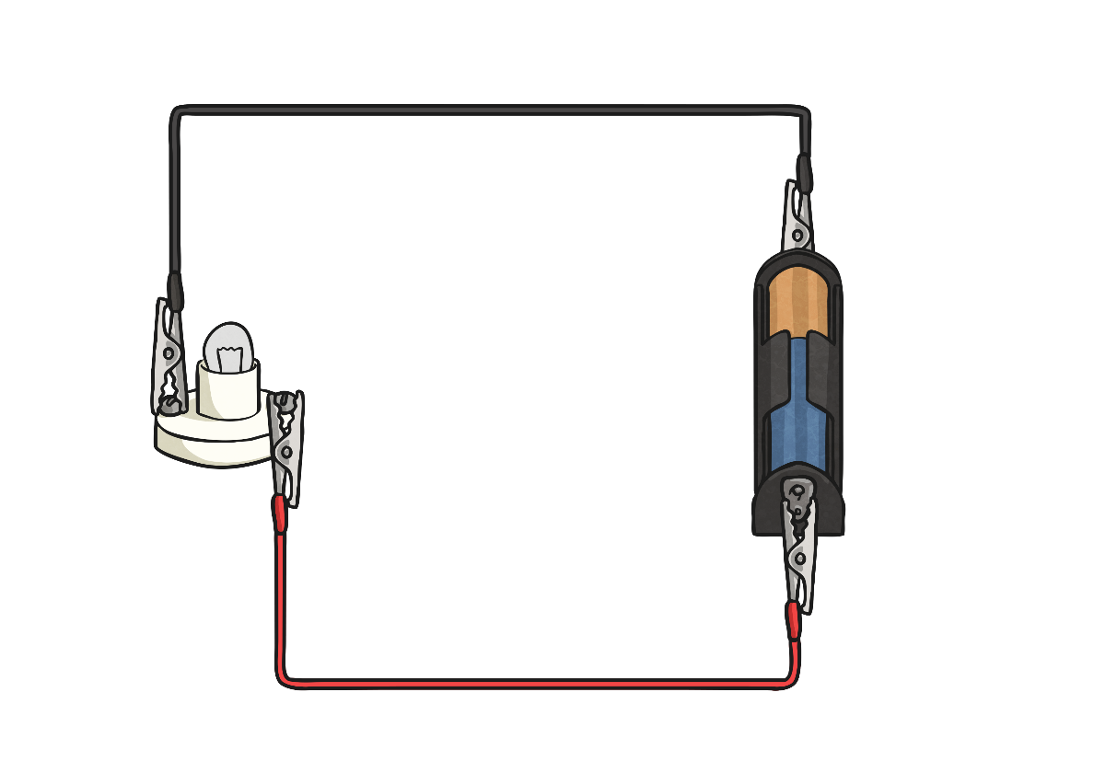
Complete or Incomplete?

Slide 4
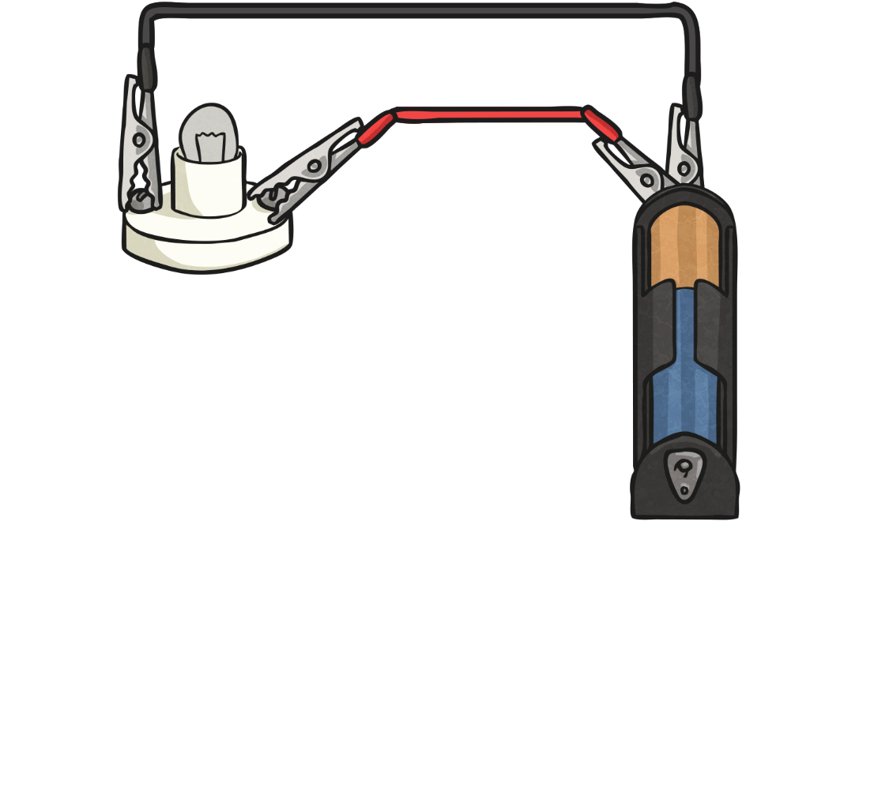
Complete or Incomplete?

Slide 5
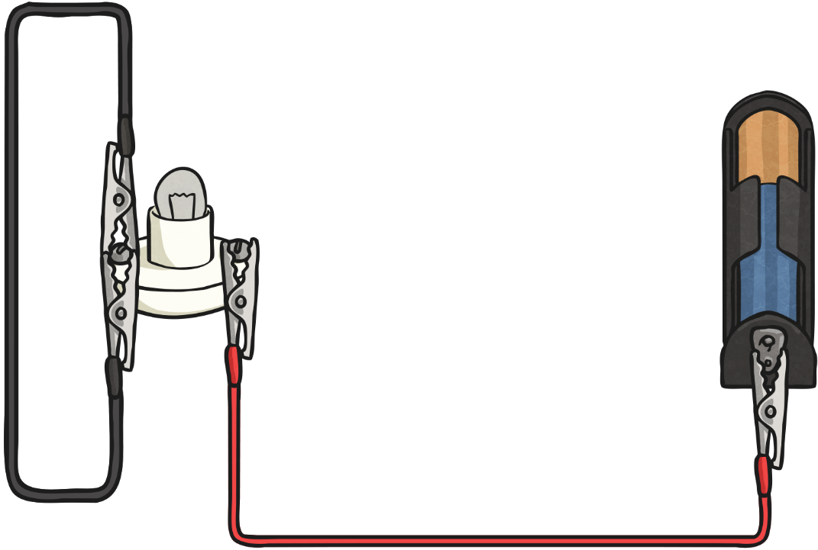
Complete or Incomplete?

Slide 6
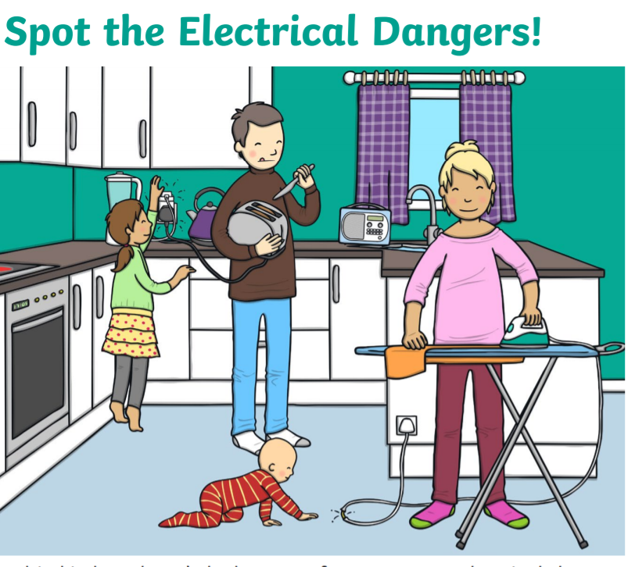
Warm Up
Can you spot the electrical hazards?

Slide 7

LC: Can I explain the dangers of electricity and how to stay safe?
By the end of the lesson you should:
Be able to identify electrical dangers at home, at school and out and about.
Be able to explain how to stay safe.

Slide 8
LC: Can I explain the dangers of electricity and how to stay safe?
This video clip shows the power of electricity.
https://www.bbc.co.uk/bitesize/clips/z8x2tfr
This video clip is about how to stay safe.
https://www.bbc.co.uk/bitesize/topics/zjrrd2p/articles/z96ckqt

Slide 10
Electricity
Talk About It
  Electricity is a vital part of everyday life. Look around the room and see how many things you can find that need electricity?
Although we use electricity every day, it can be dangerous and safety rules must be followed.

Slide 11
Why Can Electricity Be Dangerous?
Electricity is energy that can flow from place to place; this is called a current. This flow of energy powers all kinds of things, such as computers, lights and televisions.
Fires can be caused if electrical equipment is damaged or incorrectly used.

Slide 12
Why Can Electricity Be Dangerous?
Being careless with electricity could cause an electric shock. If an electrical current enters your body, your heartbeat is interrupted. Your lungs contract so it is difficult to breathe and skin can be burnt. In the worst cases, a person can die from an electric shock.
Talk About It
  How can we be safe around electricity?

Slide 13
Electricity Safety at Home
There are lots of ways to stay safe around electricity when you are at home.
Never put your fingers in a plug socket. Even if the switch is in the off position, there will still be an electrical current in the socket.
If you need to unplug equipment, turn off the switch on the socket and then carefully take the plug out. Don’t try to yank it out!
Don’t overload sockets. Using lots of extension cords could damage the electrical system and cause a fire.
If you notice an electrical wire is damaged, you must tell a grown-up straight away.

Slide 14
Electricity Safety at Home
Make sure electrical wires are tucked out of the way because they can be a trip hazard. If a pet chewed on wires, it could get an electric shock. If wires dangle from kitchen surfaces, young children could pull them causing appliances to fall and cause an injury.
If a piece of bread gets stuck in the toaster, do not use a knife to try and get the bread out - a knife is metal so it will conduct electricity.
Don’t touch a light switch or plug socket with wet hands. Water conducts electricity so could cause an electric shock. This is why most bathroom lights have pull cords instead of switches.

Slide 15
Electricity Safety at Home
Hair straighteners, hairdryers and other electrical devices shouldn’t be used in the bathroom. Some bathrooms have special plugs so that electric shavers can be used but these are not for normal appliances.
When you leave the house, electrical equipment, such as tumble dryers shouldn’t be left on. Sometimes these appliances can overheat and cause a fire.
If you are not sure about anything, it is important to always ask an adult for help.

Slide 16
Electricity Safety at Home
Chargers for phones and tablets are something that must be used with care. Here are some ways to keep safe when charging devices:
Make sure you use a genuine brand of charger from a shop. Some cheap chargers may not have undergone the appropriate safety checks. There have been cases where fake chargers have overheated and caused house fires.
Never charge your device under your pillow while you sleep. If the charger overheats, it may catch fire.

Slide 17
Electricity Safety at School
The same safety rules for home can be applied at school.
Schools do lots of things to make sure children are safe around electricity:
All electrical equipment at school is safety tested by an electrician every year. This even includes chargers for laptops and tablets.
At schools, electrical equipment is installed by a qualified electrician. If items need to be repaired, this is also done by an electrician.

Slide 18
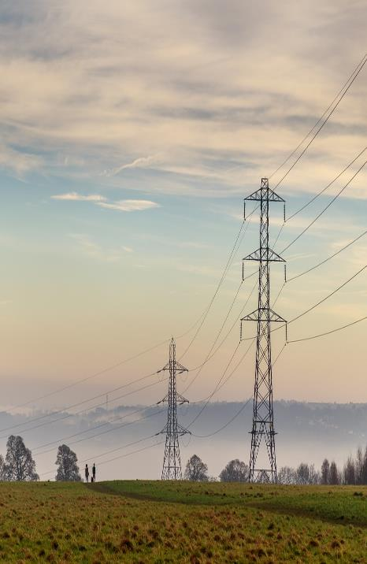
Electricity Safety out and About
These pylons support thick cables which carry electrical current around an area.
You should take great care when walking near pylons, making sure you don’t get too close. You should never climb a pylon.
Kites shouldn’t be flown near pylons or electricity cables. If a kite got caught in the wires, it could act as a conductor and you would get an electric shock.

Slide 19
Electricity Safety out and About
Before you climb a tree, you should look above to check that there are not any electrical cables running through it.
If you are using electrical equipment outdoors, it is important that you use
a suitable outdoor extension lead, not one for indoor use. Outdoor leads are waterproof, which is important as electricity and water don’t mix!

Slide 20
LC: Can I explain the dangers of electricity and how to stay safe?
By the end of the lesson you should:
Be able to identify electrical dangers at home, at school and out and about.
Be able to explain how to stay safe.
Task
Create a poster or mind map to explain how we can stay safe using electricity.
Tips:
Use the PowerPoint to help you.
You can add anything else you have thought of as well.
Complete on plain paper or in your book.
Add pictures as well. Make it colourful and eye catching.
Send this to your class email address if you want to share it.
3/4 H and 3/4HL send to 34hl@bramhopeprimaryschool.co.uk
4/5 S send to 45s@bramhopeprimaryschool.co.uk

Slide 21
LC: Can I explain the dangers of electricity and how to stay safe?
Here’s a little game to have a go at to test your knowledge.
https://www.bbc.co.uk/bitesize/topics/zjrrd2p/articles/z96ckqt

