Slide 1
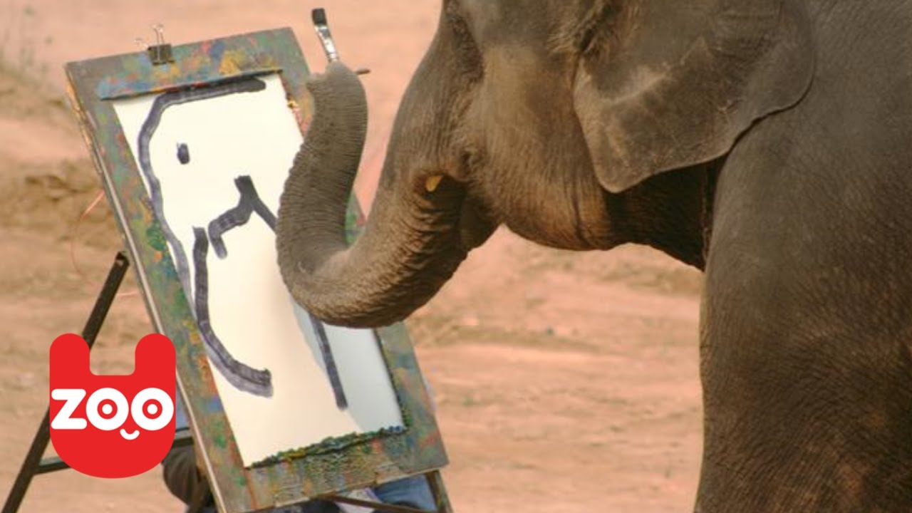
Thursday: Can you think of a headline to go with the image?
.

Slide 2
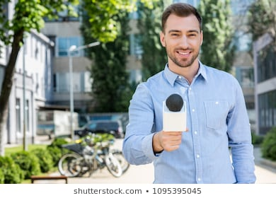
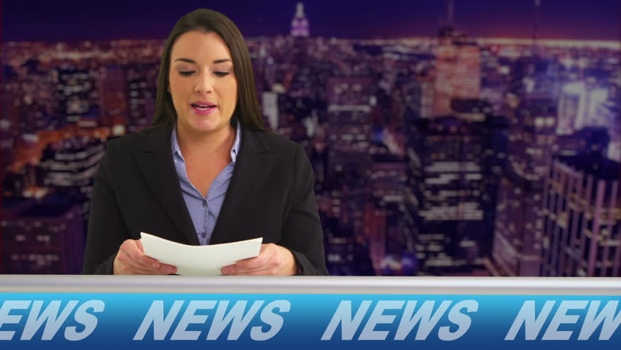
Today, we are going to practise being a TV studio reporter and write a script for a TV studio presenter.
What do you think the key similarities and differences are between TV and written reporting?
Click on the Newsround website, and watch today’s Newsround to see how newsreaders report the news. https://www.bbc.co.uk/newsround

Slide 3


Key Similarities:
Contains key information – 5 Ws
Uses formal language.
Includes witness reporting.
Key Differences
Welcome audience to the news.
Introduce themselves…. “I’m Mrs Hahnel and welcome to BBC News”
They may interview witnesses (which we shall do tomorrow)
Similarities and Differences between TV and Written Reports.

Slide 4
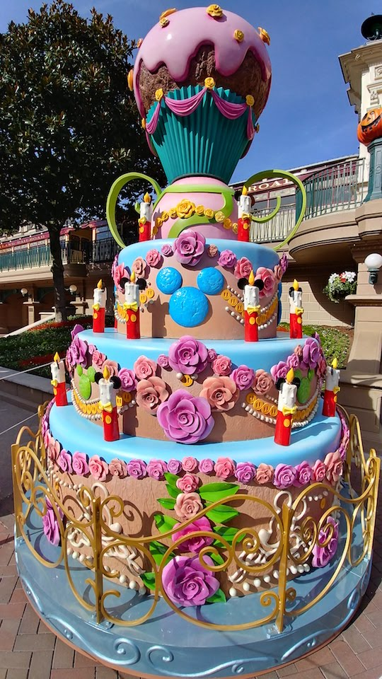
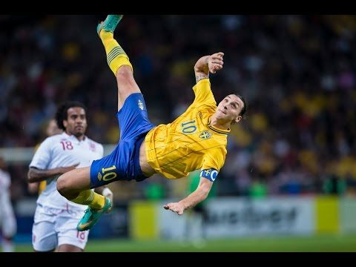
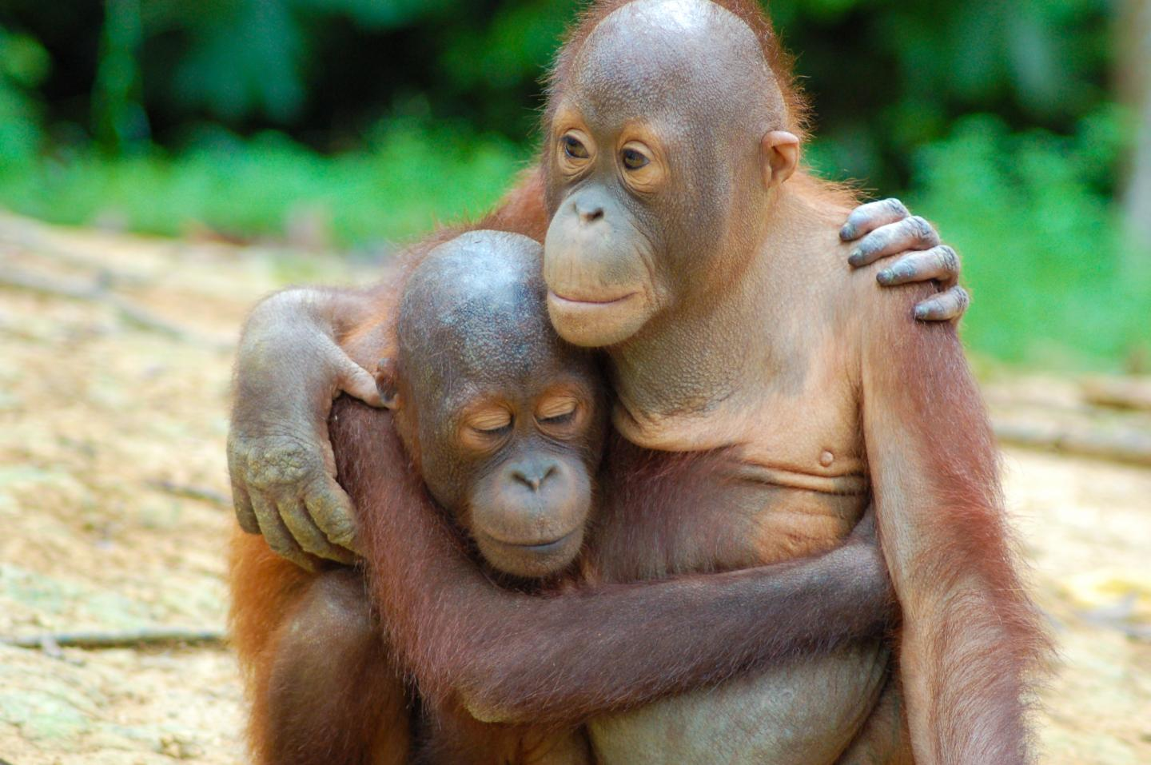
What will your Newsround reporter report on?
1. Tallest birthday cake ever!
2 Legendary Goal of a decade!
3. Baby Orangutan reunited with mum!

Slide 5

Thursday - LC: Can I write a script for a Newsround reporter?
Toolkit
Choose one of the images or headlines.
What do you think the 5Ws might be.
Write a script for your news report.
You may choose to record it or practise with an adult if so, you may want to use the following clip: BBC News
Spag: remember to include fronted adverbials and conjunctions.

