Slide 1
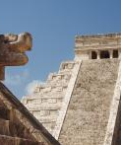
Lesson 3
The Ancient Maya

Slide 2
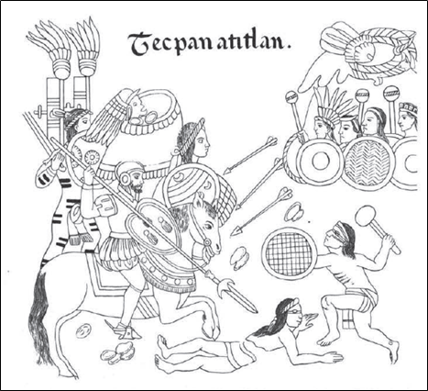
Look at this picture – what do you think it shows?

Slide 3
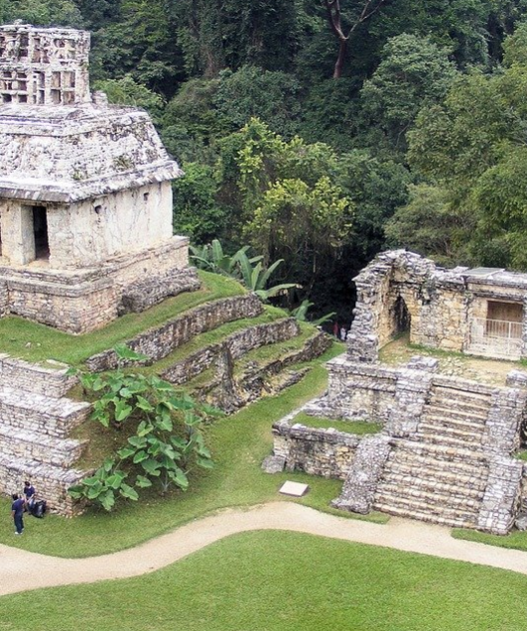
LC: Can I explore how invasion affected both the Maya and the Anglo Saxons?

Slide 4
Last week
We compared how the Maya and Anglo Saxons lived. We looked at their housing and what the similarities and differences were.
This week
We will be exploring how invasion affected both civilizations.

Slide 5
A reminder – Who are the Ancient Maya?
https://www.bbc.co.uk/bitesize/topics/zq6svcw/articles/zqv6msg

Slide 6
A reminder – Who are the Anglo Saxons?
https://www.bbc.co.uk/bitesize/topics/zxsbcdm/articles/zq2m6sg

Slide 7
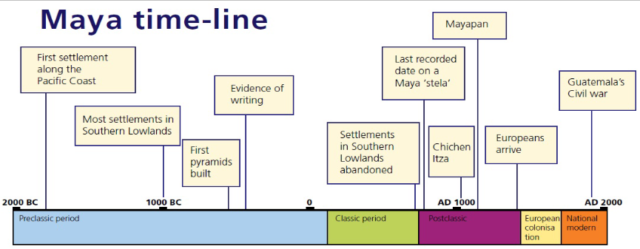
Anglo Saxons
Approximately what year do the Europeans (Spanish) arrive in the Maya land?
1066 – the Norman conquest of England

Slide 8
This lesson, we are going to compare what happened to the Maya and Anglo Saxons as a result of invasion.
You will learn some facts about the Norman invasion of England and the Spanish invasion of the Maya lands.

Slide 9

What questions could you ask about each invasion?
Write 5 questions in your history / remote learning book and see if you can answer them by the end of the lesson.

Slide 10
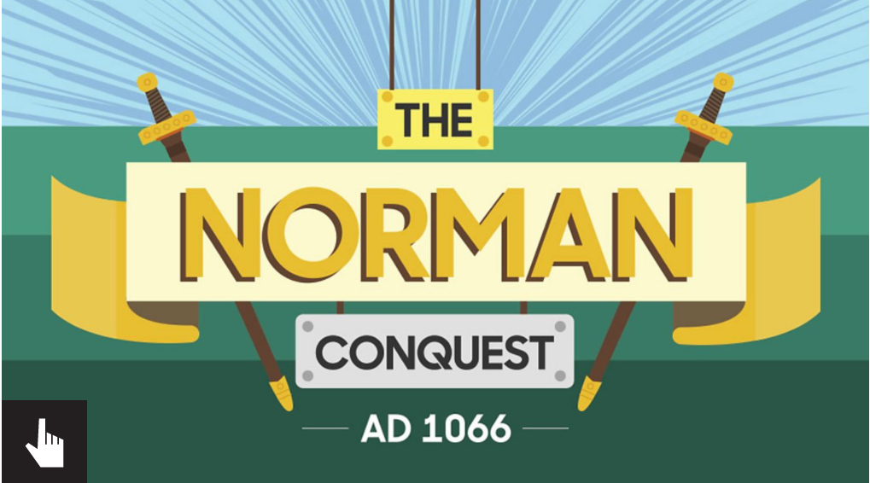
Anglo Saxons and
When Edward the Confessor died without leaving an heir in 1066, it set in motion events which would lead to the end of the Anglo-Saxon era in England.

Slide 11
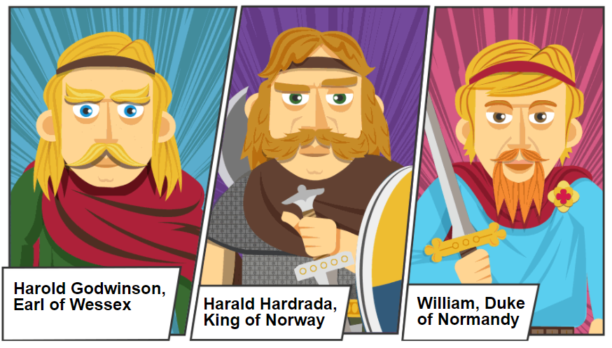
There were 3 main rivals for the throne of England

Slide 12
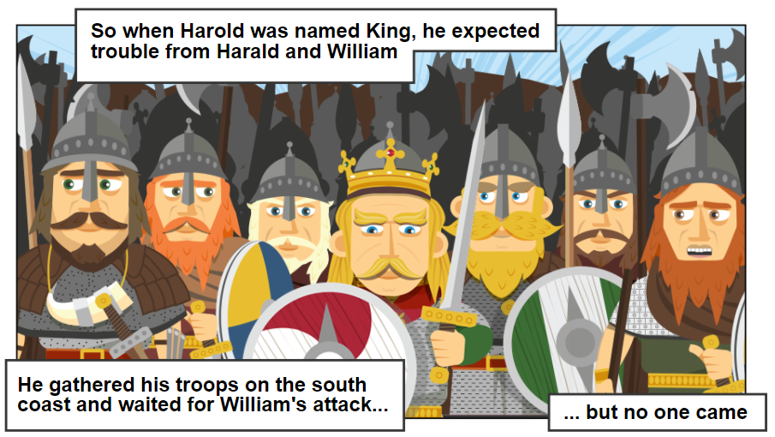

Slide 13
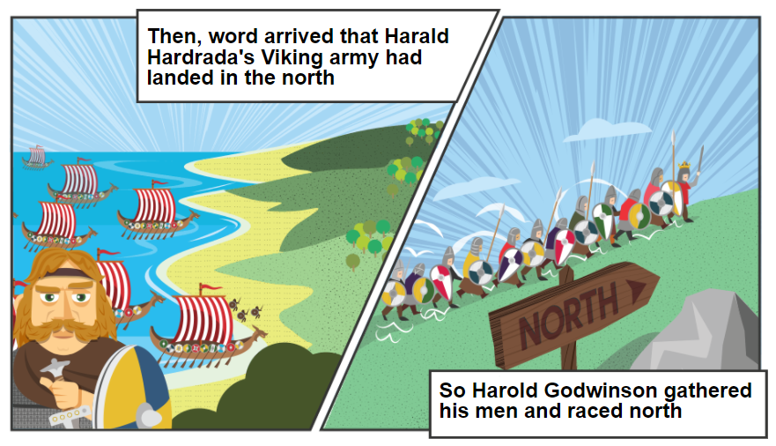

Slide 14
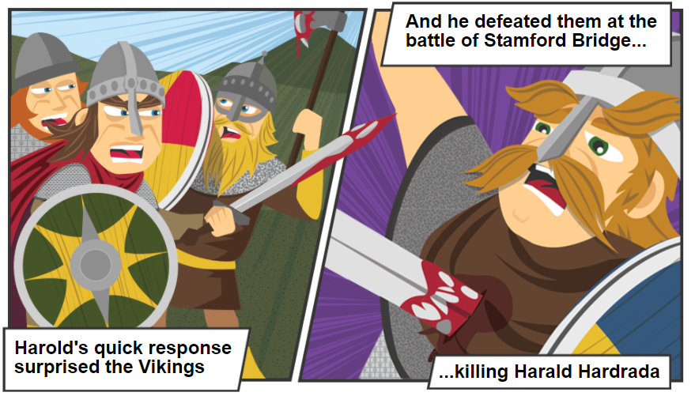

Slide 15
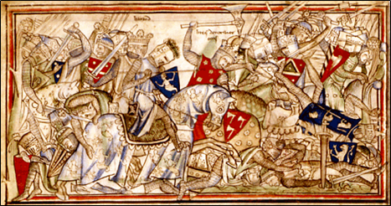

Slide 16
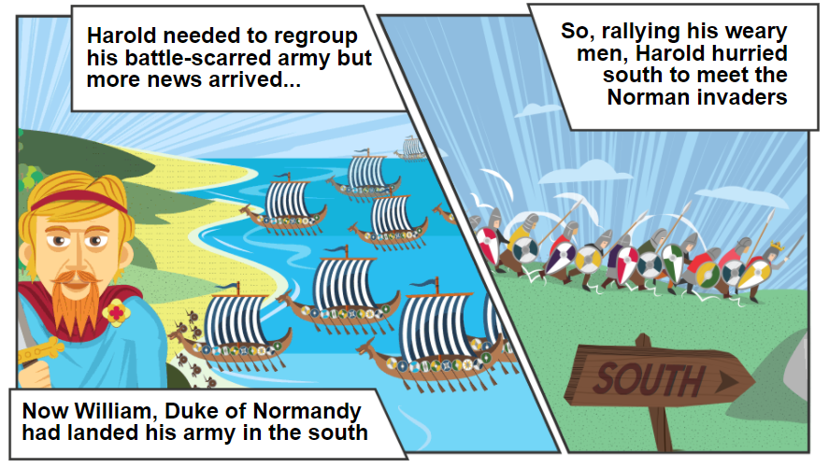

Slide 17
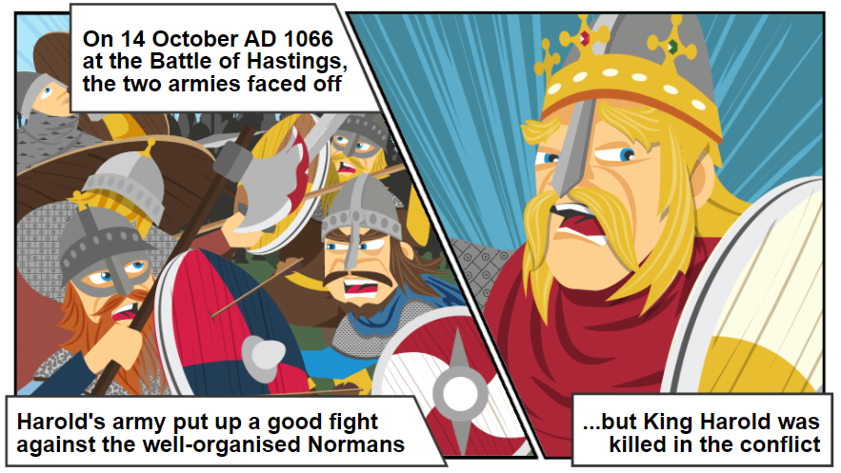

Slide 18
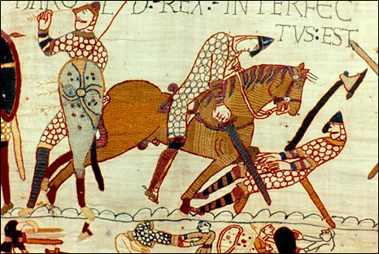

Slide 19
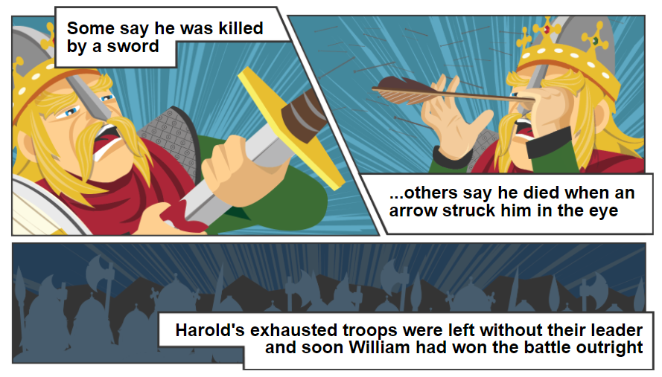

Slide 20
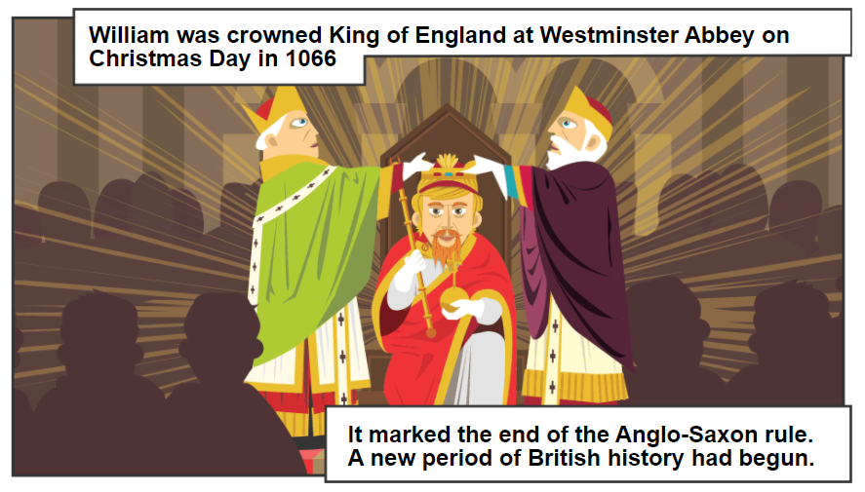

Slide 21
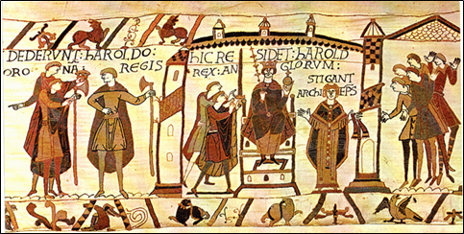

Slide 22
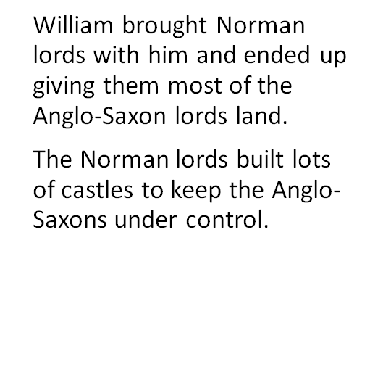
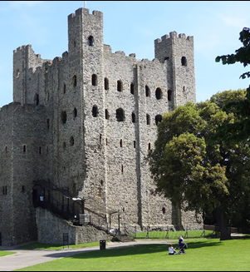

Slide 23

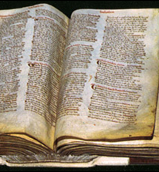

Slide 24
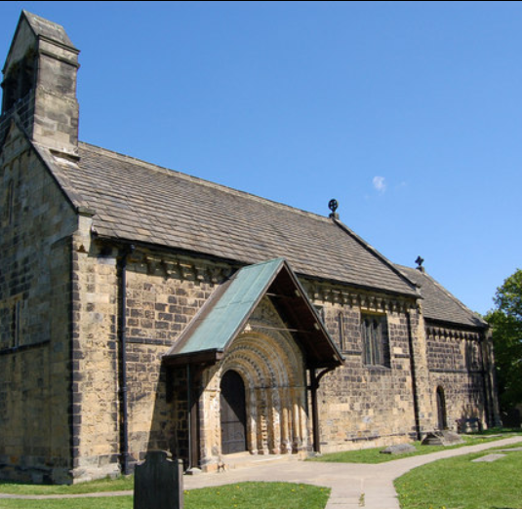
Adel St John church in Adel is a Norman church built between 1150 and 1170.

Slide 25
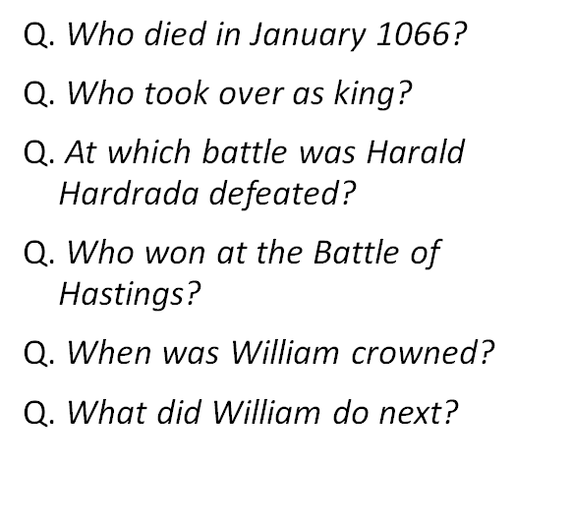
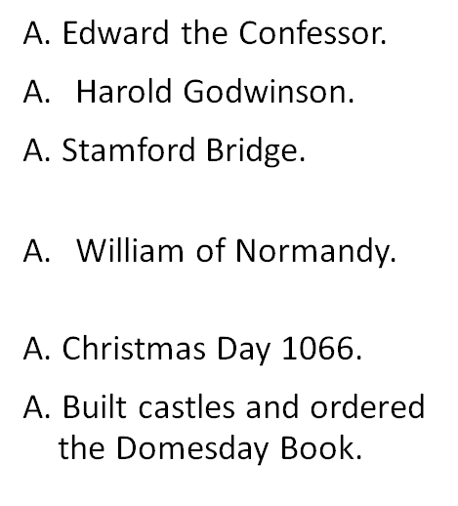
Norman Invasion – Quiz

Slide 26
Spanish invasion of the Maya – 16th Century
Anglo Saxons

Slide 27
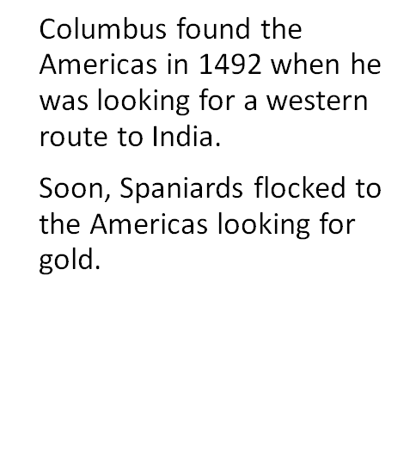
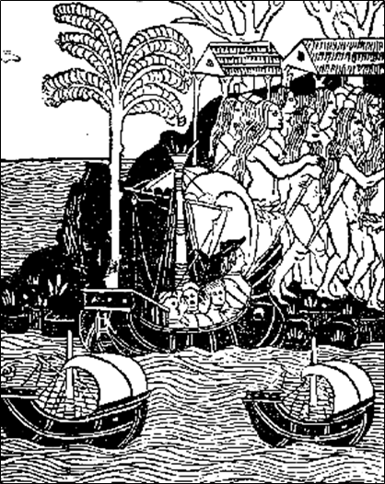
Some facts about the Spanish invasion

Slide 28
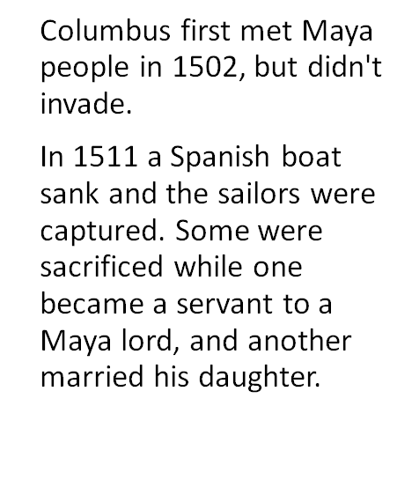
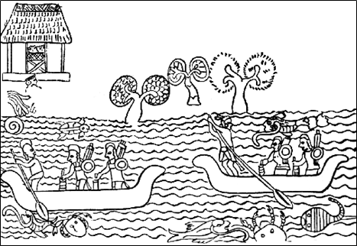
Some facts about the Spanish invasion

Slide 29
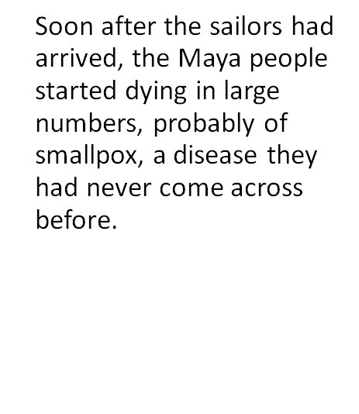
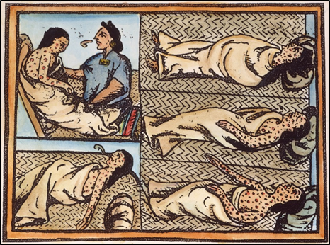

Slide 30
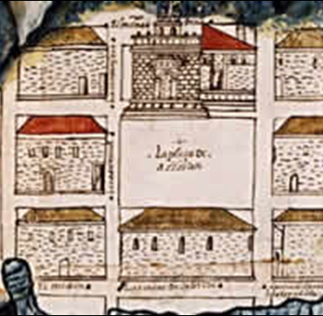
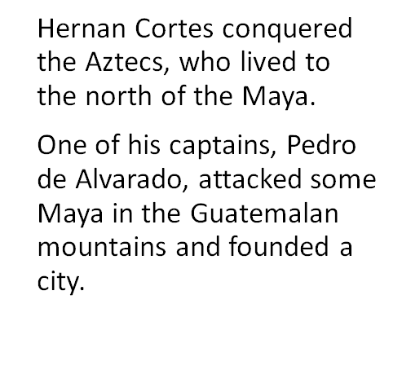
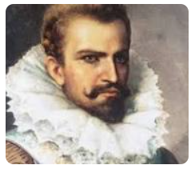
1523

Slide 31
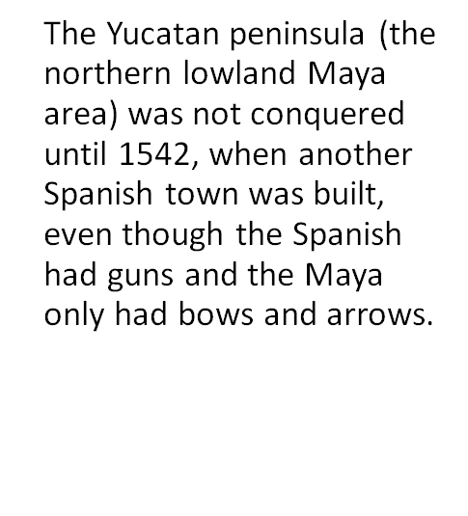
1542

Slide 32
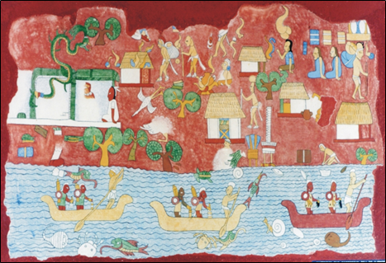
Some facts about the Spanish invasion
The Maya of Belize and Guatemala kept on resisting the Spanish, and were not conquered until 1697 after many battles.

Slide 33
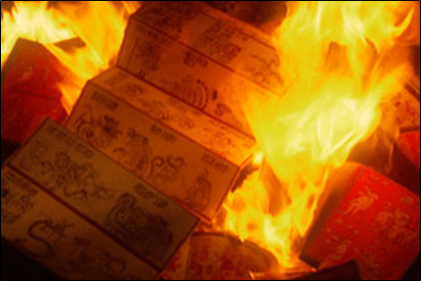
Some facts about the Spanish invasion
The Spanish burned anyone who didn't convert to Christianity and destroyed all the written texts they could find to get rid of the Maya culture.

Slide 34
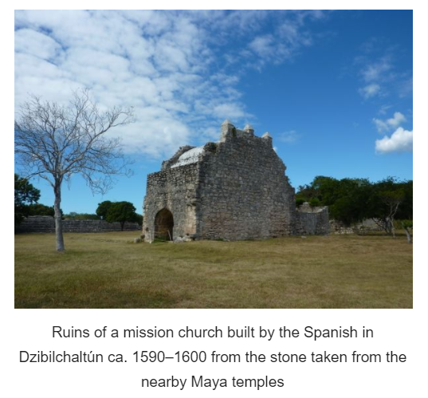

Slide 35
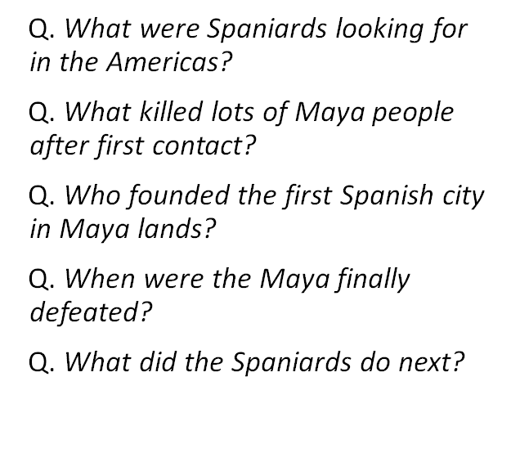
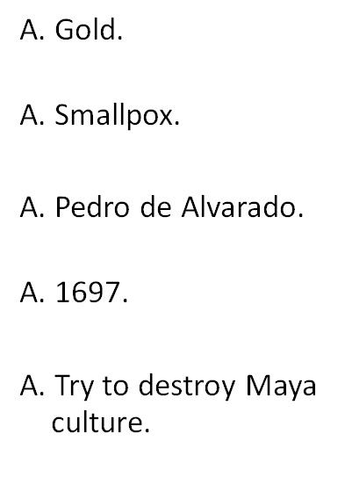
The Spanish invasion - quiz

Slide 36
To discuss – similarities / difference
Normans felt they had a valid claim to the English throne
Spanish were looking for gold and riches
The Normans had a short battle and took over immediately
The Spanish took over 150 years to conquer the Maya
The Norman conquest was brutal – many people died
The Spanish conquest of Maya was brutal – many people died.
England was already Christian so the Normans built their churches uncontested by the local people
The Spanish tried to convert the pagan Maya to Christianity and burnt those who refused.

Slide 37
Task
Choose how to show the similarities and differences between the two invasions.
1) create a simple story board sequencing the main events for each invasion. Try to show the similarities and differences discussed.
2) create two columns in your book and create a table - detail the similarities and differences for each invasion.
3) Write about each invasion in your book, detail the similarities and differences including the effects on the Anglo Saxon and Maya people.

