Slide 1
Wednesday: Warm Up
Spot the mistakes….
Shortly before 12 the officers arrived at the scene.
Happily Mrs Colbourn gave an interview.
After lunch the pupils had the shock of their lives!
Carefully animal rescue workers reached for the cat.

Slide 2
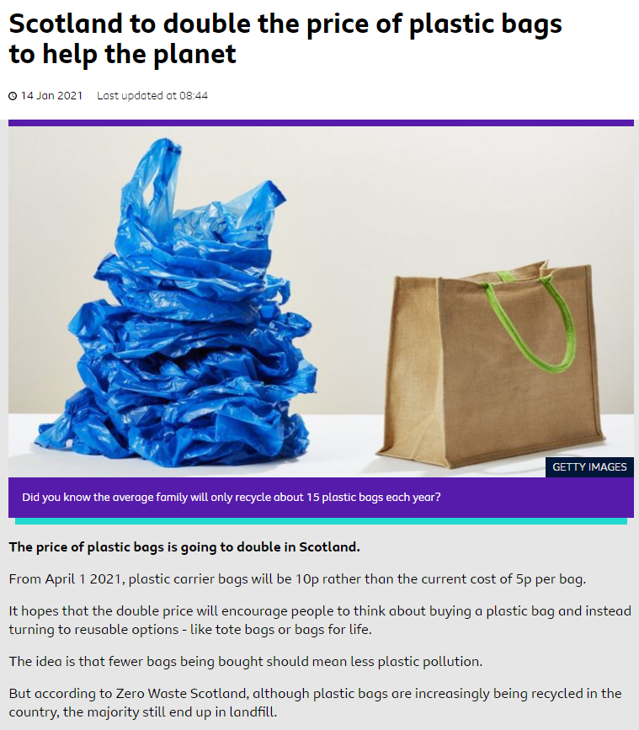

Recap Features:

Slide 3
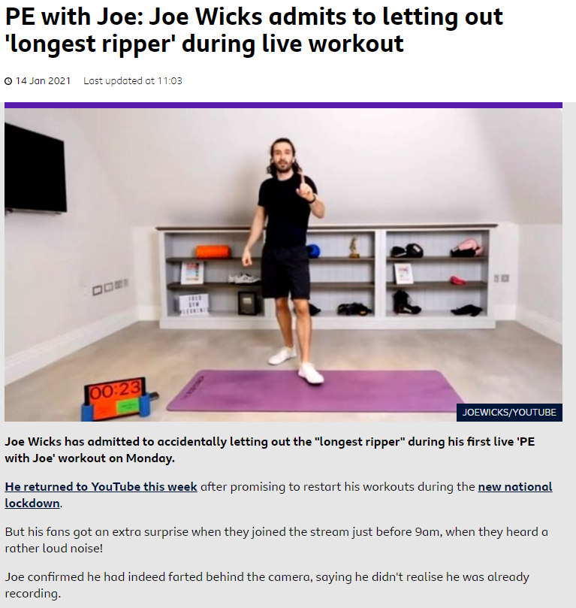
Recap: Key features.

Slide 4
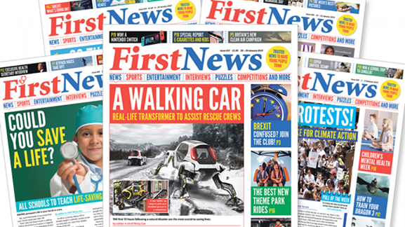

Yesterday, you wrote a mini report based on a headline.
Today, you are going to write another mini report. This time, we will use a picture as your inspiration.
LC: Can I write an article based on image?

Slide 5
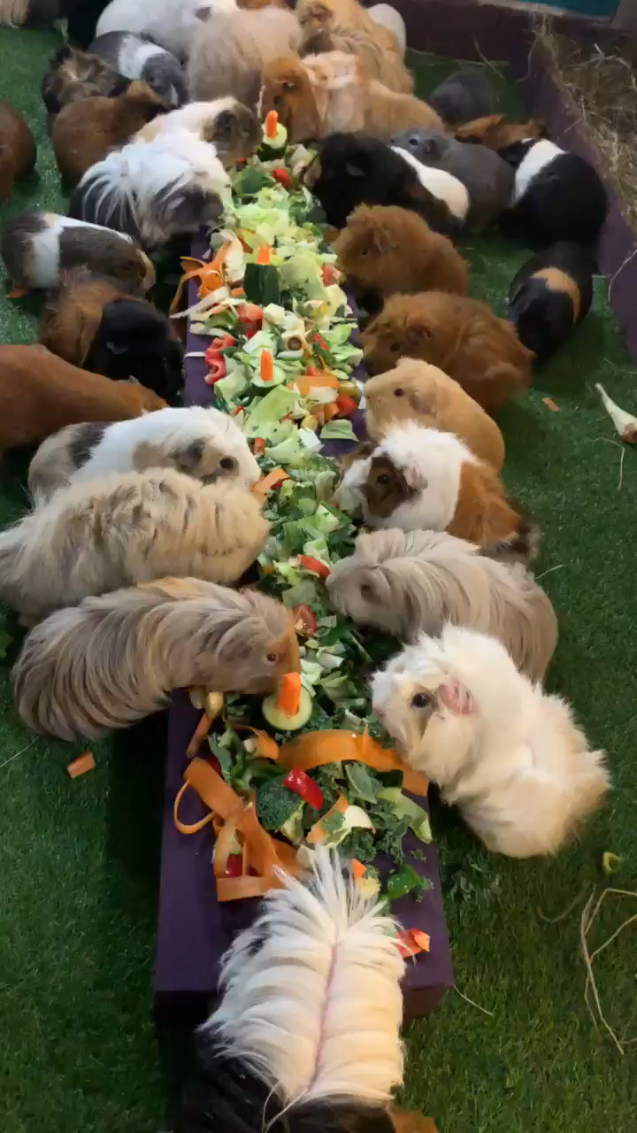
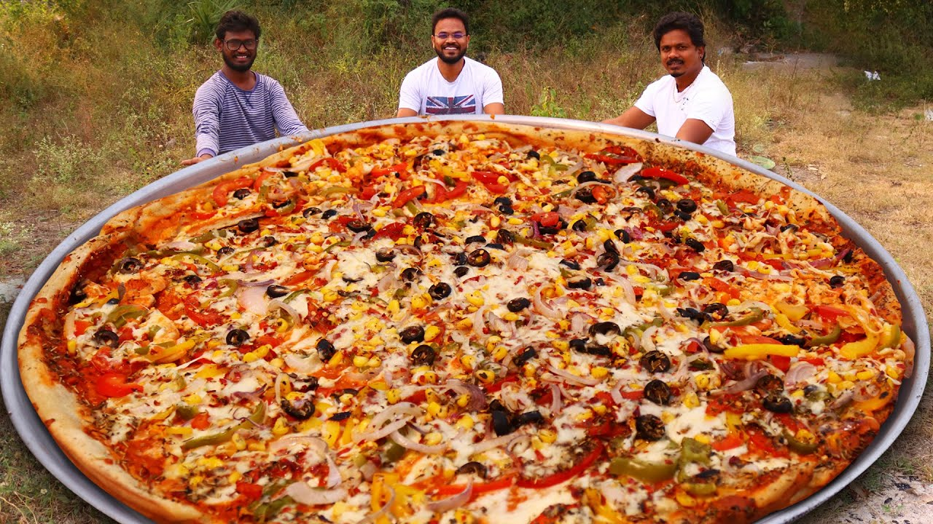
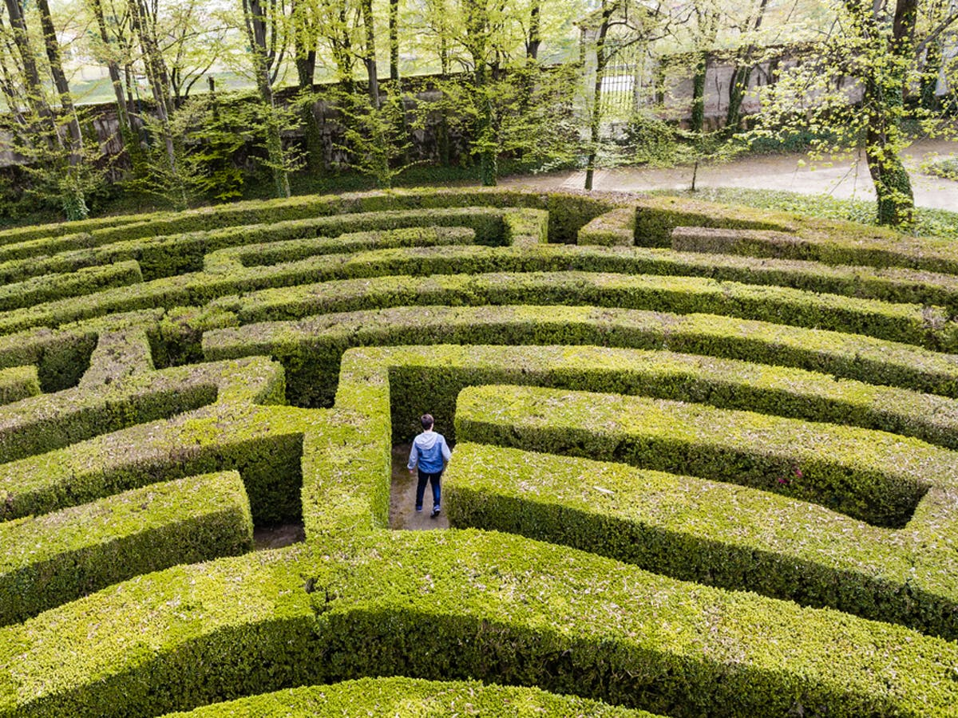

Slide 6

Tuesday: LC: Can I write a mini – article based on an image?
Toolkit
Choose one of the images
What do you think the 5Ws might be.
Write an introduction and main article for the headline.
Spag Focus: Use the conjunction word mat so you can make some 2 clause sentences.
This afternoon, we will read the actual articles and share some of your ideas.

Slide 7
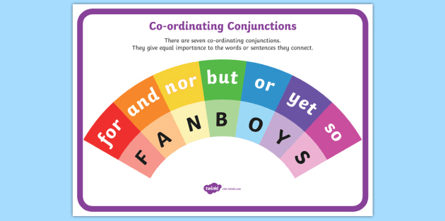
Today's Spag Focus:
Conjunctions: join 2 clauses in a sentence.
While police officers arrived at the scene, reporters crowded around.
Mrs Lawson was astounded to see the UFO and informed Mrs Colbourn immediately.
Although it was windy, they were still able to rescue the cat.
Try to use a variety of conjunctions in your article.

