Slide 1
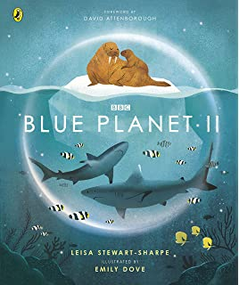
LC: Can I make inferences from a text?
We have read and learnt about a number of habitats from this text.
Today the extract has a different focus. Let's take a look at it and discuss how this differs to the rest of the text and why.
​
​
​
​
​
​

Slide 2
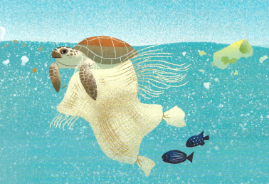
What do you think this extract is about?
What do you know about this topic already?
Nowhere to hide

Slide 3
Vocabulary
Vast - very great extent or quantity
Unexplored – undiscovered
Peril - serious and immediate danger
Now read through the text.

Slide 4
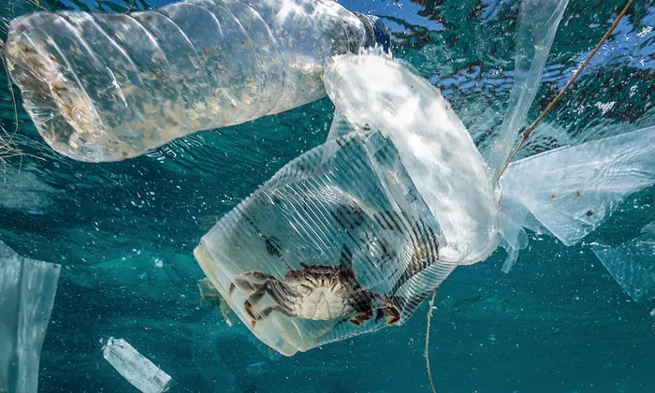
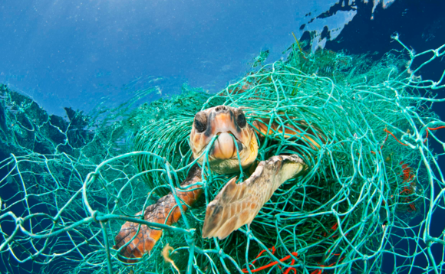
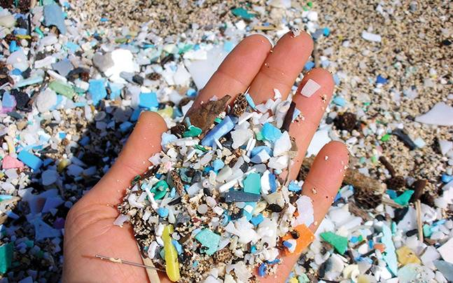
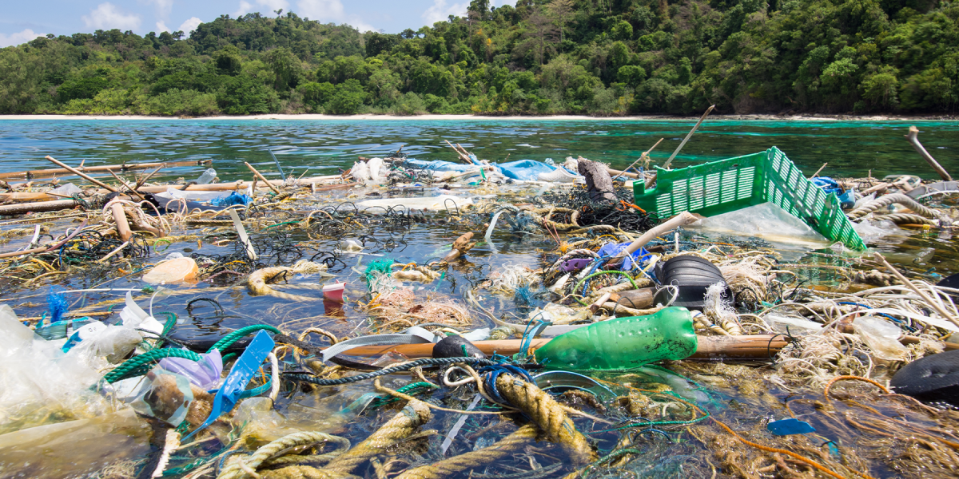

Slide 5
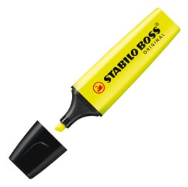
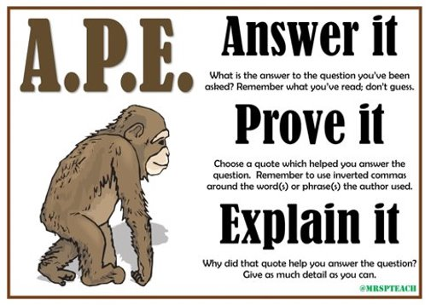
Remember: For your questions today, you can use your highlighters to help find points or clues in the text which support your ideas.
We are going to focus on APE:

Slide 6
Questions: Me
How does the author try to get the reader to understand how much plastic is being thrown away each year?

Slide 7
Answers: Me
It gives a real life comparison e.g. a garbage truckload of plastic each minute to help the reader imagine how much plastic that really is!

Slide 8
Questions: You
Why should we be bothered by this problem?

Slide 9
Answers: You
It impacts humans as well – the marine life we eat is consuming microplastic which we then consume.

Slide 10
Questions – remember to use the text
Why is it hard to imagine that the ocean would be impacted by the human world?
Why are the oceans and marine life under threat?
What is the impact of plastic on marine life?
Why does the author describe the microplastic as glitter-sized?
How are we trying to reduce the threat to marine life?
Chilli Challenge
Why is the extract called 'Nowhere to Hide'?
Why do you think this extract has been included in this book about marine habitats?

Slide 11
Answers
The ocean is so vast and undiscovered so it is hard to believe that humans can have a huge impact on the largest part of the planet (the ocean).
We are polluting the ocean with plastic and warming the seas through global warming which is threatening marine life.
Millions of tons of plastic goes into the seas which can be eaten by sea creatures and they can become trapped in plastic. This causes a threat to the lives of these animals.
To help the reader understand how small the pieces of plastic are.
We are trying to recycle plastic and use less single-use plastic to reduce the amount of plastic in the ocean which is threating the marine life.

Slide 12

Chilli Challenge​
1. It is called 'Nowhere to Hide' because it is talking about an immediate danger to marine life and even human life because of the amount of plastic being thrown away and we cannot hide from this problem any longer.​
2. ​To make people aware that all these amazing habitats are in danger if we don't do something about it.

