Slide 1
Tuesday: Warm Up
Complete the sentences:
Witnesses at the scene couldn’t believe that…..
Mrs Colbourn was so surprised to find out that….
Early on the morning of the 18th January, Mr Bradley.
According to investigators at the scene,……..

Slide 2

Recap – features of a newspaper report.
Link:
What is a newspaper report and its features?

Slide 3
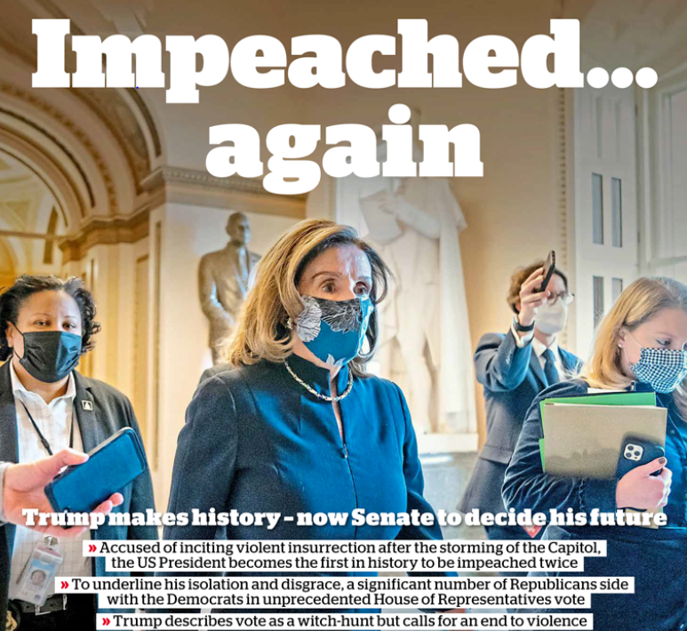
Let’s have a look at some newspaper front pages and spot the features.

Slide 4
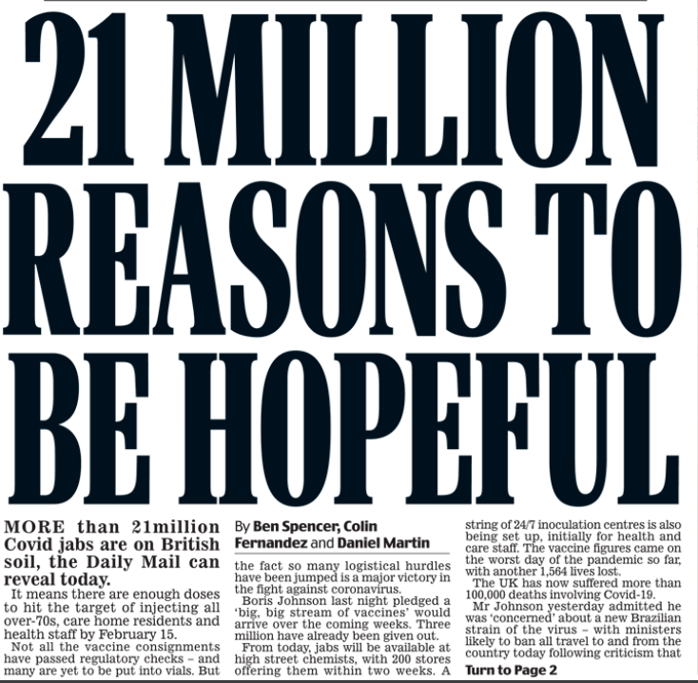
Let’s have a look at some newspaper front pages and spot the features.

Slide 5
So far we’ve focused on newspaper reports. This week, we are going to look at mini news reports. They are similar to the ones that you will find in The Week Junior.

Slide 6

LC: Can I write a mini-article based on a headline?

Slide 7
Let’s have a look at a few and see if we can guess what the articles might be about….

Slide 8
The 254 cheese pizza that broke a world record!

Slide 9
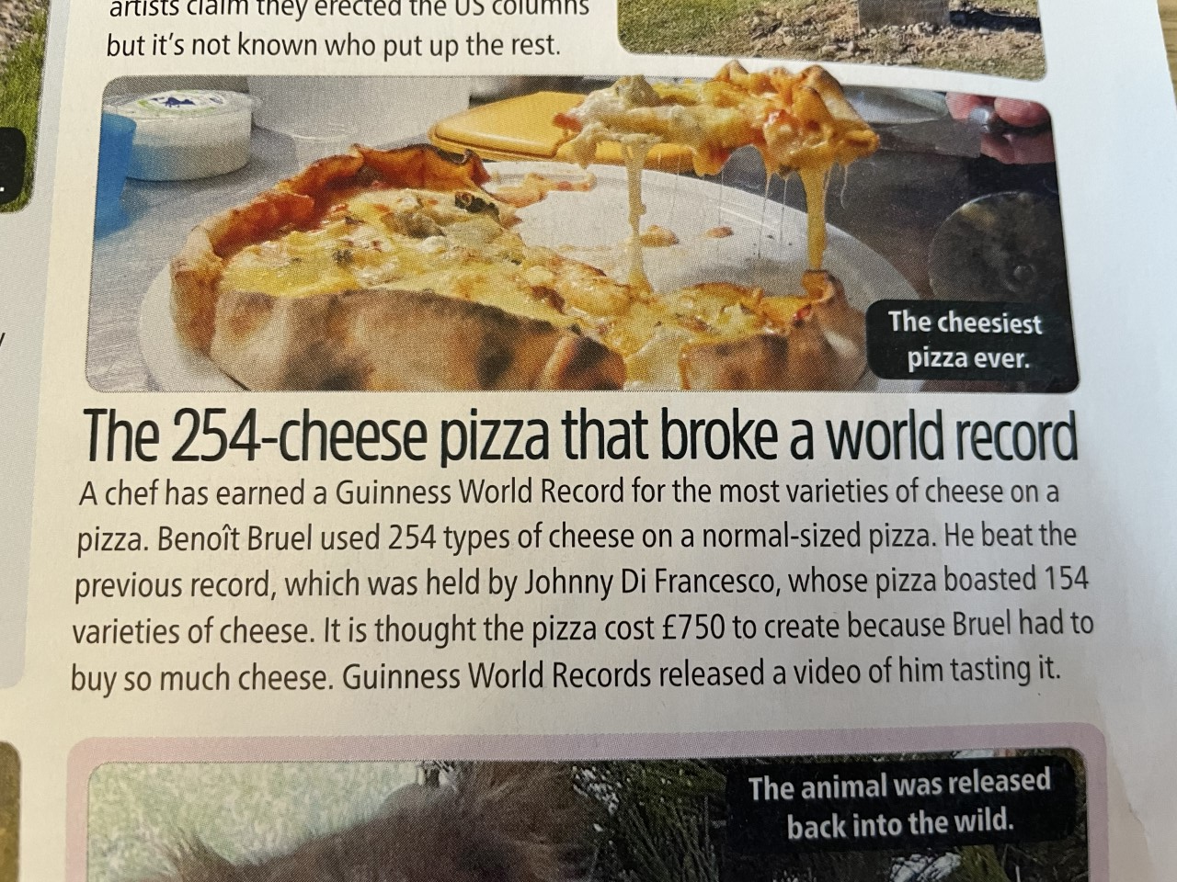

Slide 10
Family Find koala in Christmas Tree

Slide 11
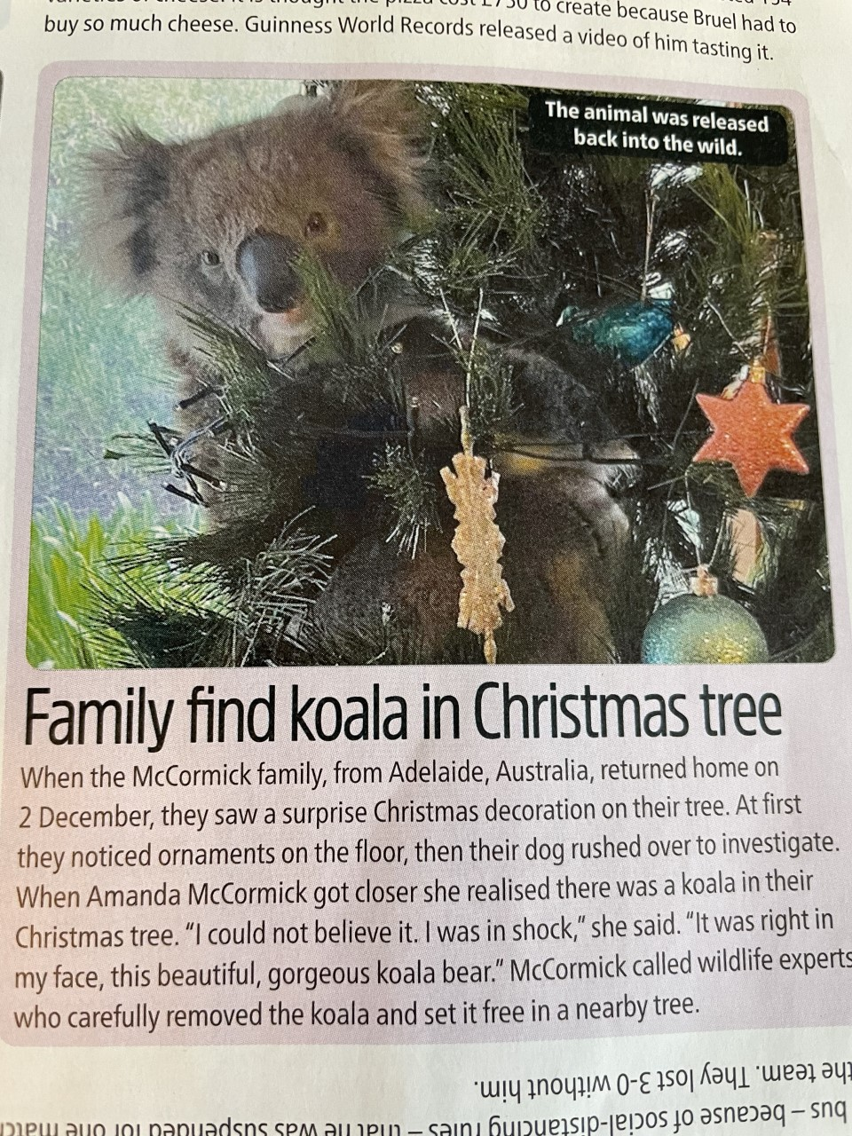

Slide 12
Monday: LC: Can I write a mini – article based on a headline?
Toolkit
Choose one of the headlines.
What do you think the 5Ws might be.
Write a mini-article.
Make sure you use the word mat to help with newspaper language
Year 4s: Fronted adverbials of time to add detail: e.g At 11am, shortly before., use the fronted adverbial sheet to help you.
This afternoon, we will read the actual articles and share some of your ideas.

Slide 13
Headlines to choose from:
World's Fastest wheelie bin!
A Friendly Python
Green Puppy is born in Italy

