Slide 1

L.C. Can I identify conductors and insulators?
Toolkit

Slide 2
Recap
Write a definition of:
component
symbol
buzzer
cell
bulb
switch

Slide 3
Task
In this lesson, we will learn what an electrical conductor and an electrical insulator are. We will conduct an investigation to see which materials are insulators and which are conductors. Finally, we will draw conclusions about the best material to make certain objects from, based on what we have learnt. You will need a piece of paper, a pencil and a ruler.

Slide 4
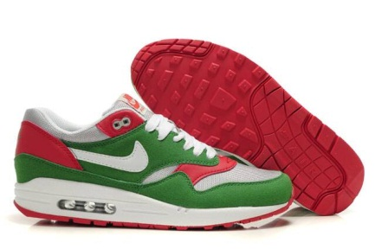
Match each object to the material that is it made out of.
Explain why that material is well suited to the purpose of the object.
E.g. Rubber helps to give the shoes good grip.
rubber
Notes:
Title, learning objective, starter.
Get students to repeat instructions and model a good answer
9:30 – 9:35

Slide 5
Match each object to the material that is it made out of. Explain why that material is well suited to the purpose of the object.
Can you think of any other uses? Why is it important to know what a material is made from?
glass | electric wires
cotton | soles of shoes
rubber | grips on cooking pans
leather | hair straighteners
plastic | window
copper | pavement
ceramic | clothes

Slide 6

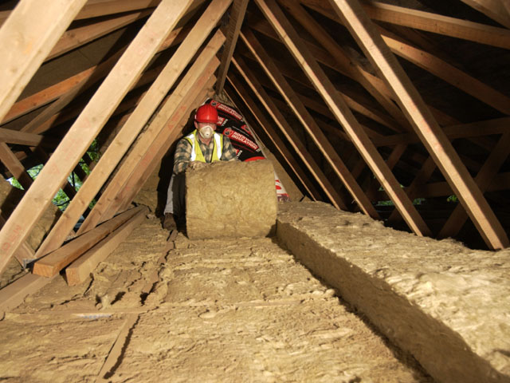
Conductor?
Insulator?
https://www.bbc.co.uk/bitesize/topics/z2882hv/articles/zxv482p
Notes:
Ask students what insulators and conductors are… Level 4
Watch clip and get students to clarify what insulators and conductors are
9:37 – 9:43

Slide 7
Complete the quiz and then watch the video.
https://classroom.thenational.academy/lessons/what-are-insulators-and-conductors-6rtp8t

Slide 8
Electrical conductors
An electrical conductor is a material that allows electric currents (flow of electric charges) to pass through it. All metals are electrical conductors.
An electrical conductor has lots of charges that are free to move. In a metal, the charges that are free to move are electrons. The electric current through the metal is the flow of these free electrons.
Electrical insulators
An electrical insulator is a material that doesn’t allow electric currents (flow of electric charges) to pass through it. Plastic and glass are electrical insulators.
An electrical insulator has no free electrons. No charges are free to move and carry a current.

Slide 9
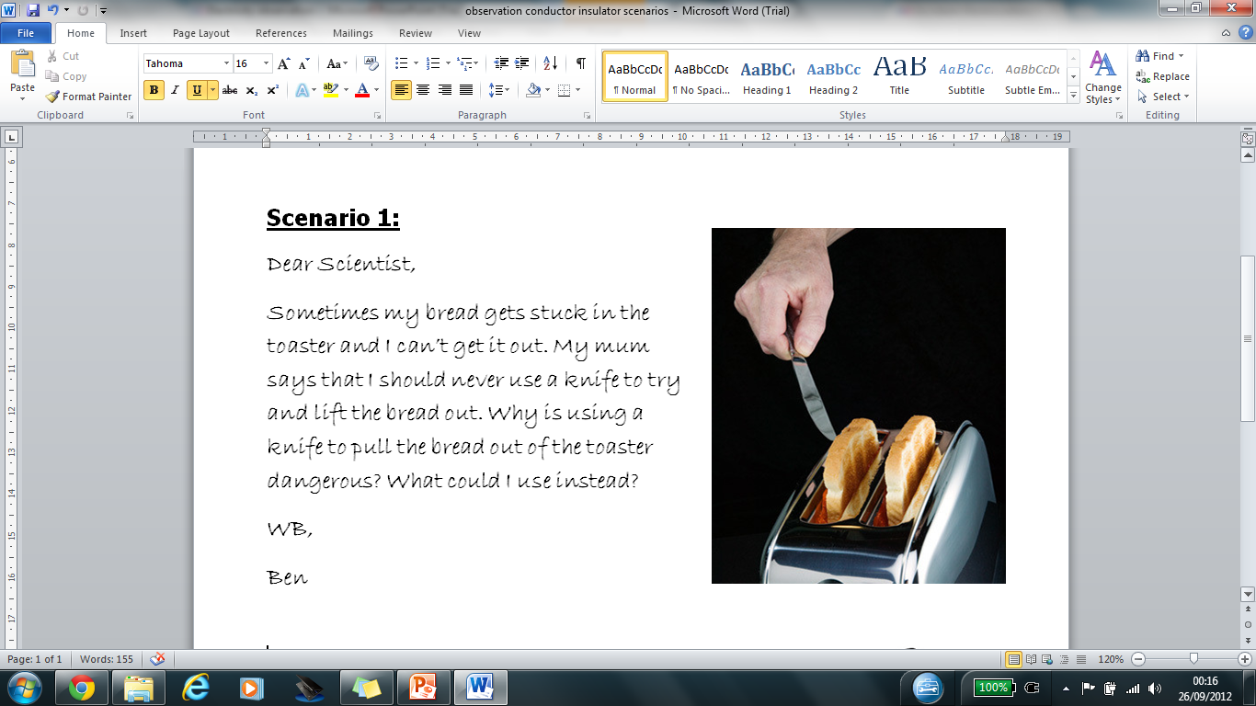
Write a letters back to Ben. Try to make your response as detailed as possible. Use and explain the key words ‘conductor’ and ‘insulator’ in your answer.
Notes:
Use key words… insulator/conductor what do they mean again? (Level 4)
Can you use your evidence from the experiment to back up your advice? (Level 5)
Briefly look at if have time

Slide 10
Challenge question.
Are all metals conductors? Use the information sheet to answer the question or complete your own research.

