Slide 1

Survivors
Extraordinary tales from the wild and beyond
Day Twelve

Slide 2
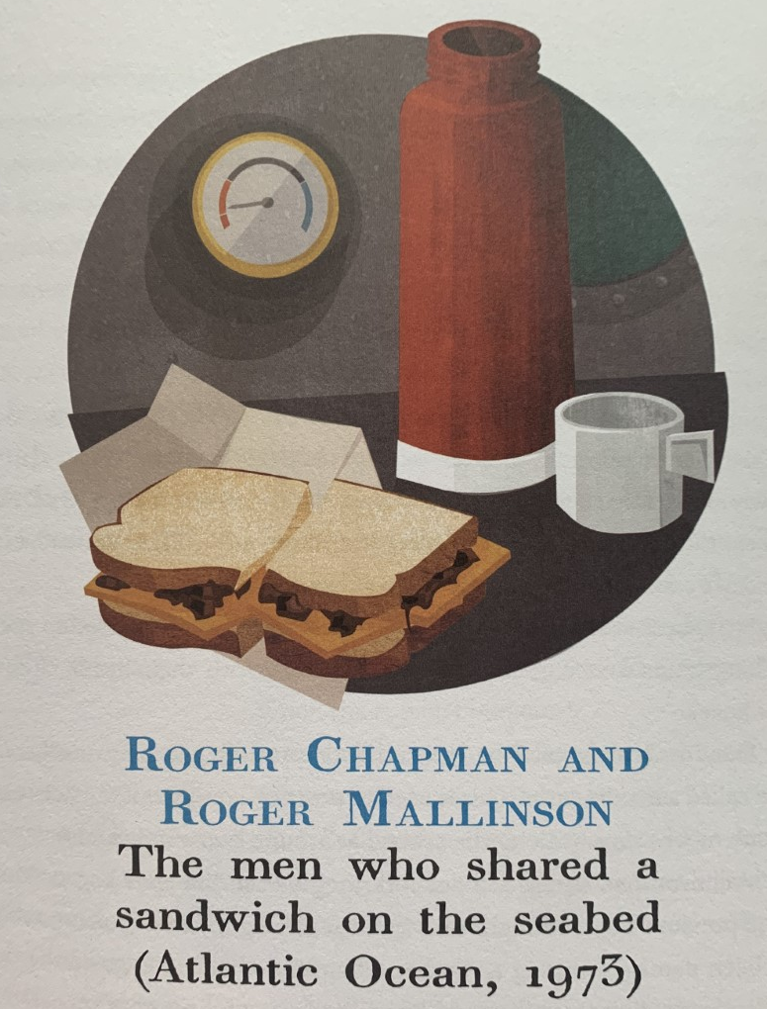

When and where is the story set?
Who is involved in the story and what do we know about them?
What was the expected outcome of the day?
How did the men react in the crisis?
What was the unexpected crisis?

Slide 3

What is likely happening above the sea?
Who else might start worrying on the surface?

Slide 4
LC: Can I write an imagined conversation ?
Toolkit
What rules do we know for structuring speech?
I’ll give you a clue, we have five.

Slide 5
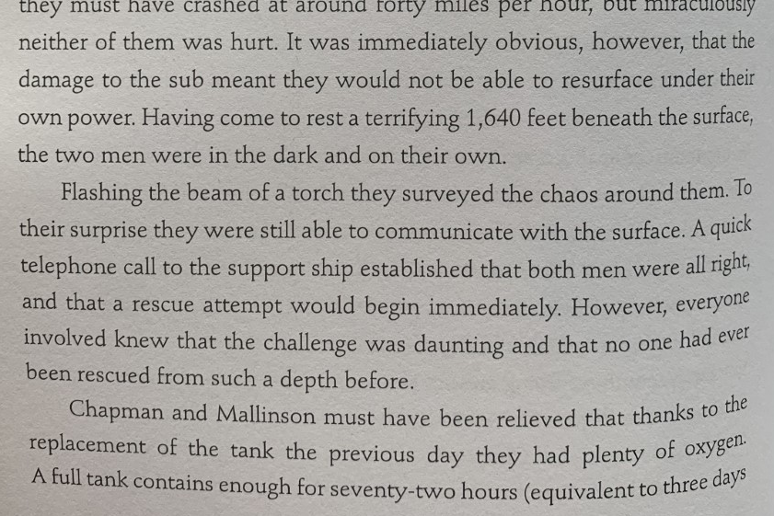
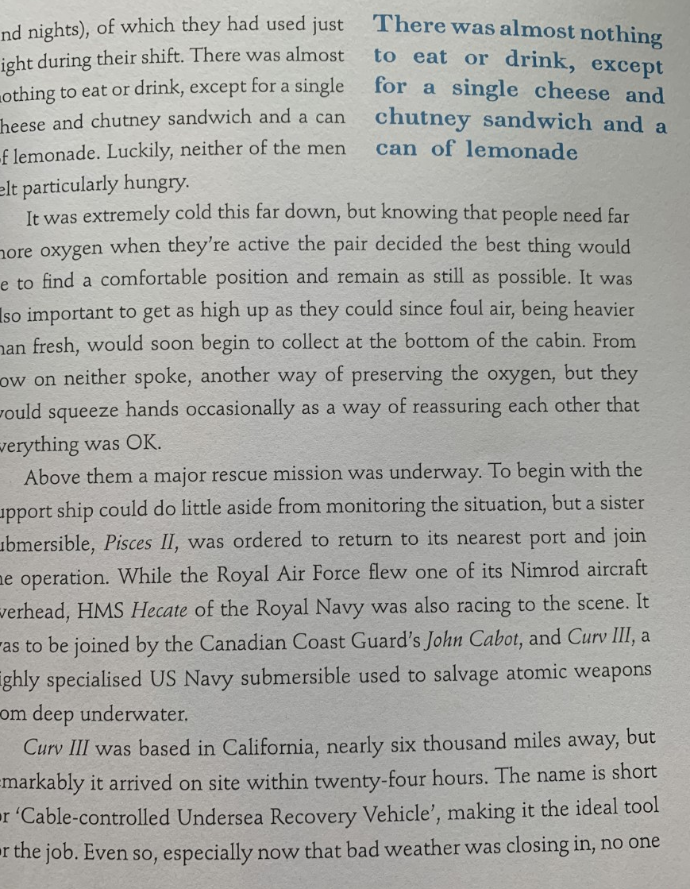
Pages 38 and 39

Slide 6
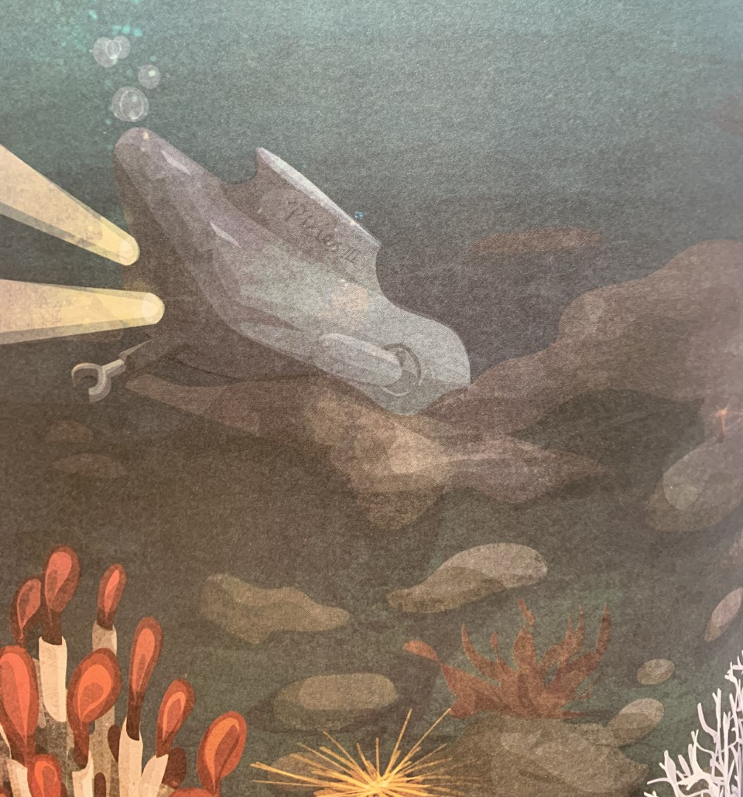
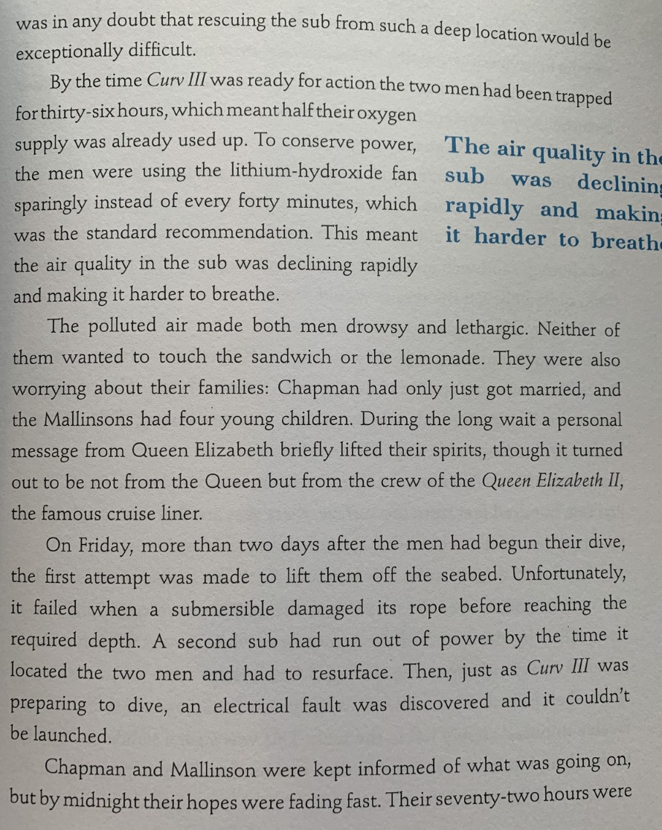

Slide 7
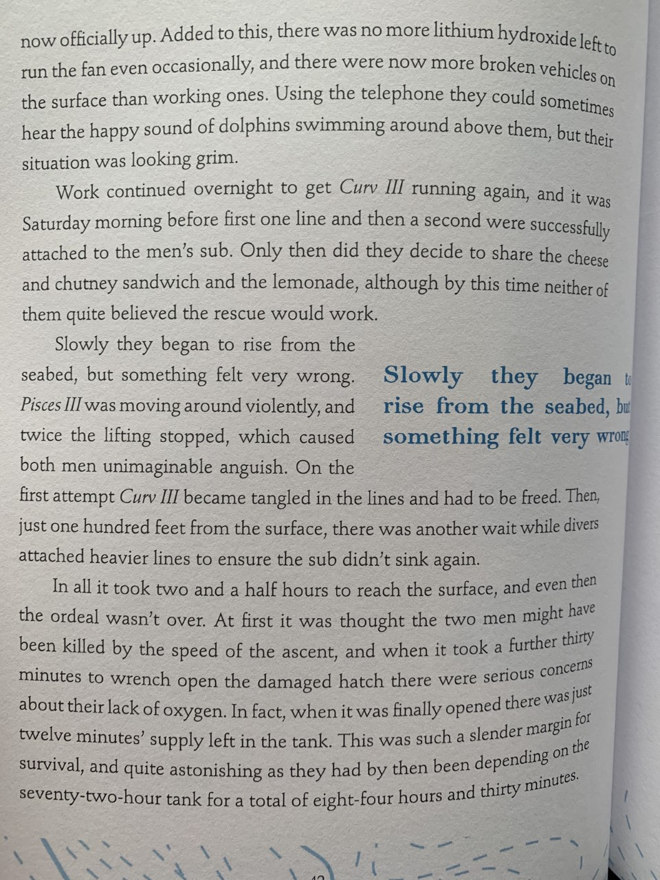
Page 42
Making inferences from the text.
-They shoved cloths in their mouths as the sub spiraled out of control.
-They remained as still as possible once the sub settled.
-They squeezed each other’s hands for comfort.
-They used the fan sparingly.
What does the above evidence tell you about Chapman and Mallinson?

Slide 8
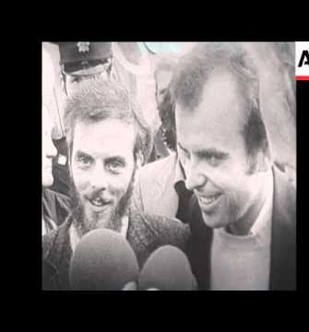
You might say they:
can think straight and take decisive action quickly,
are stoic, British adventurers of a bygone gone era like Captain Scott or Sir Robert Knox-Johnston
knowledgeable about what can happen and aware of best options for protecting themselves and prolonging life, calm,
are not selfish,
understand the power of solidarity and human comfort,
are effective planners –prepared for worst case scenario

Slide 9
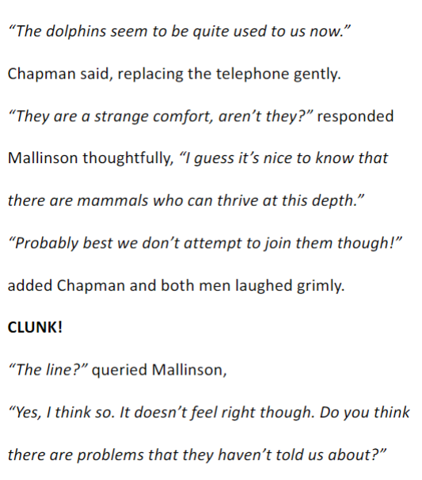
|Task
The task today is to write an imagined, narrated conversation between Chapman and Mallinson, leading to the point at which they decide to share the sandwich and drink. Look at the box to the left which is an example of how this conversation could start.
Use the rules of speech below to help structure your work.
Each new character's speech starts on a new line.
Speech is opened with inverted commas.
Each line of speech starts with a capital.
The line of speech ends with a comma, exclamation mark or question mark.
A reporting clause is used at the end (said Chapman, shouted Mallinson, replied Chapman).

Slide 10
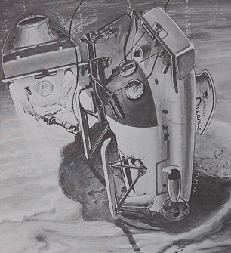
Take five minutes to check your work before uploading.
Each new character's speech starts on a new line.
Speech is opened with inverted commas.
Each line of speech starts with a capital.
The line of speech ends with a comma, exclamation mark or question mark.
A reporting clause is used at the end (said Chapman, shouted Mallinson, replied Chapman).

Slide 11
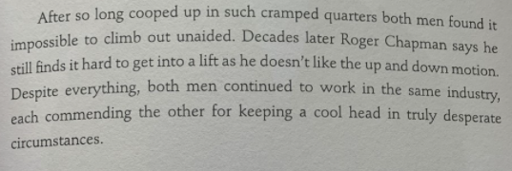
Pages 42 and 43

