Slide 1
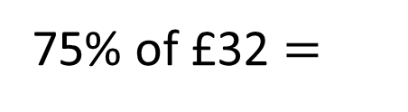
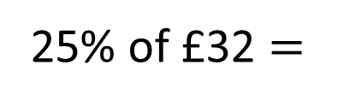
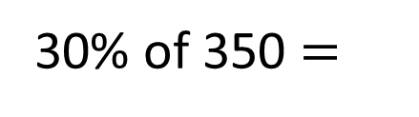
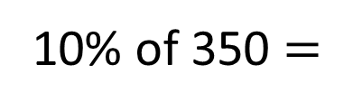
1)
2)
3)
4)
10% of 350 $=$
350
30% of 350 $=$
25% of £32 $=$
£32
75% of £32 $=$

Slide 2
35
1)
2)
3)
4)
10% of 350 $=$
350
105
30% of 350 $=$
?
25% of £32 $=$
£8
£32
8
8
8
75% of £32 $=$
£24

Slide 3
L.C. Can I calculate values of percentages?
Toolkit

Slide 4
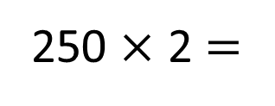
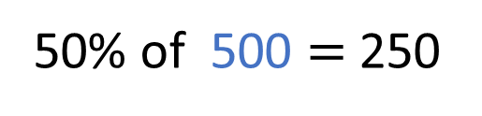
50% of 500 $=$ 250
500
?
250
250
250
250 $×$ 2 $=$
500

Slide 5

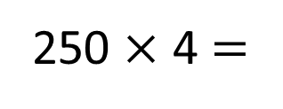
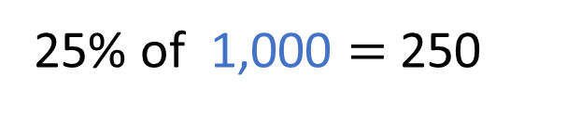
Have a think
25% of 1,000 $=$ 250
1,000
?
250
250
250 $×$ 4 $=$
1,000

Slide 6
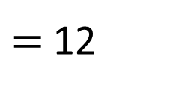
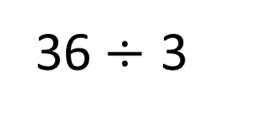
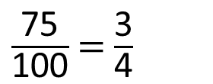
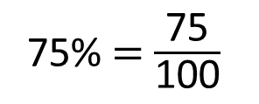
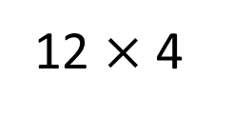
75% of Year 6 are boys.
There are 36 boys.
How many children are there in Year 6 altogether?
75% $=$ $\frac{\text{75}}{\text{100}}$
$\frac{\text{75}}{\text{100}}$ $=$ $\frac{\text{3}}{\text{4}}$
36$÷$ 3
$=$ 12
12 $×$ 4
48
?
12
12
12
12
36
48 children in Year 6

Slide 7
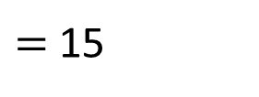
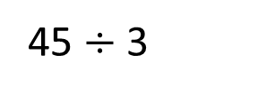
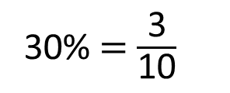

30% of people on the train are adults.
The rest are children.
There are 45 adults on the train.
How many people are on the train in total?
There are 150 people on the train.
30% $=$ $\frac{\text{3}}{\text{10}}$
150
?
15
15
15
15
15
15
15
15
15
15
45
45 $÷$ 3
$=$ 15
15 $×$ 10
Have a think

Slide 8

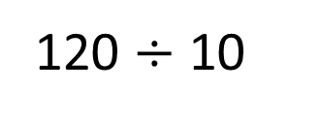

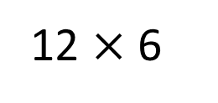
60% of 200 $=$ 120
I think the missing value is 72
120
12
72
120 $÷$ 10
12 $×$ 6
Have a think

Slide 9
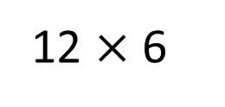

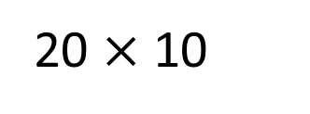
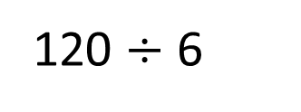

60% of 120 $=$ 72
60% of $=$ 120
I think the missing value is 72
120
?
200
12
20
120
72
120 $÷$ 10
20 $×$ 10
120 $÷$ 6
12 $×$ 6

Slide 10
A number of people voted on their favourite city.
Complete the table:
City | Percentage of people voted | Number of people voted
London | 35%
Tokyo
Paris |  | 360
Pisa | 10%
Total | 100% | 1,200
Have a think

Slide 11
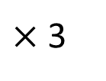
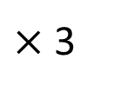
A number of people voted on their favourite city.
Complete the table:
City | Percentage of people voted | Number of people voted
London | 35%
Tokyo
Paris |  | 360
Pisa | 10%
Total | 100% | 1,200
30%
$×$ 3
$×$ 3
120
10% of 1,200

Slide 12


A number of people voted on their favourite city.
Complete the table:
City | Percentage of people voted | Number of people voted
London | 35%
Tokyo
Paris |  | 360
Pisa | 10%
Total | 100% | 1,200
420
25%
300
30%
120
30% $=$ 360
35% of 1,200
5% $=$ 60

