Slide 2
The New Seven Wonders of the World
The ancient world had seven significant places, known as ‘The Seven Wonders of the World’. In 2000, a campaign was started to choose seven wonders of the modern world.
Over 100 million votes were cast. The final seven places chosen were:
Chichén Itzá, Mexico;
Machu Picchu, Peru;
Christ the Redeemer, Brazil;
The Colosseum, Italy;
Petra, Jordan;
Taj Mahal, India;
The Great Wall, China.
Today, we are going to find out about Chichén Itzá in Mexico.

Slide 3
Where Is Mexico?
Mexico is in North America.

Slide 4
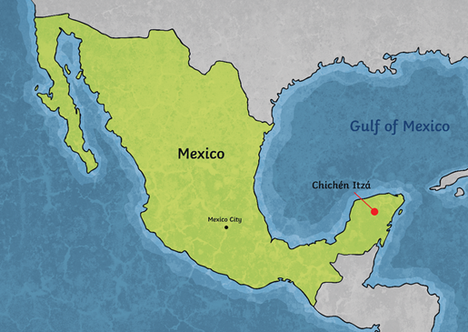
What Is Chichén Itzá?
Chichén Itzá is an ancient city built by the Maya people over 1500 years ago. Around AD 600, it became an important area.
It was built on the Yucatán Peninsula of Mexico. It was once a busy city for the Maya people as it was vital for trade.
‘Chichén Itzá’ means at the mouth of the well of Itzá. Two large sinkholes nearby would have provided much needed water, which is why it is believed to have been built where it was.

Slide 5
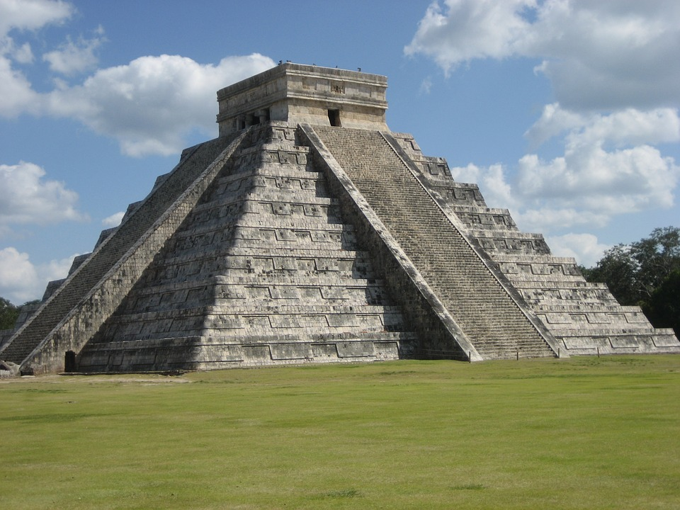
The Kukulkan Pyramid
The Maya people were great architects. Chichén Itzá demonstrates the vision of the world that the Maya people had, shown in the artwork and stone monuments that are still there today.
Within the Great North Platform area of the city, is the most recognised temple in Chichén Itzá - El Castillo (The Castle), also known as the Temple of Kukulkan or the Kukulkan Pyramid. This stands at 24 metres high.

Slide 6
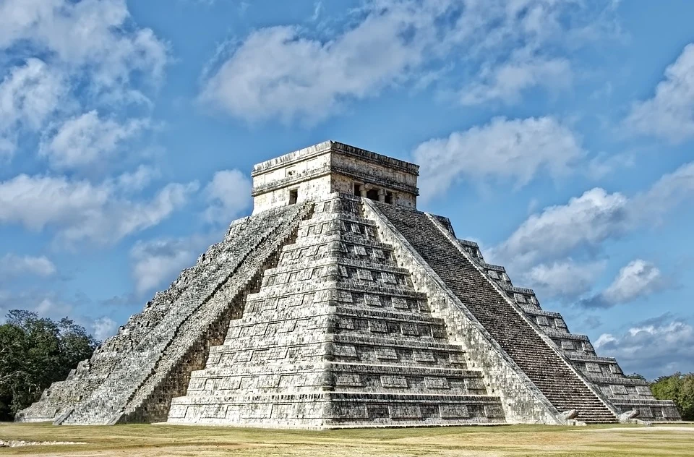
The Kukulkan Pyramid
Kukulkán was the most important of the gods that the Maya people worshipped. The name means ‘feathered serpent’.
During the spring equinox (around 20th March) and the autumn equinox (22nd September), the sun’s rays create a shadow across the Kukulkan Pyramid, which gives the impression of a snake slithering down the staircase.
It has 91 steps on each of its four sides which, when combined with the final step on top, makes 365 steps. This totals one step for each day of the year. This would have been deliberate as the Maya people were skilled astronomers and the Solar System was extremely important to them.

Slide 7
Today’s Art Activity
Have a go at drawing the Kukulkan pyramid. You can use this YouTube drawing video to help you if you want to. (https://www.youtube.com/watch?v=F2JTKYrHbKY )
or just sketch from the picture on the following page.
TIPS
Try to mark out the rough size you want the pyramid to be first
Sketch the rough shape of the pyramid VERY lightly until you are happy with it
You can then fill in the details
Concentrate on drawing what you SEE rather than what you THINK you see
You will need to focus on the perspective carefully to make your pyramid look 3D
You can add shading and/or colour if you wish
Have fun! ☺

Slide 8


