Slide 1


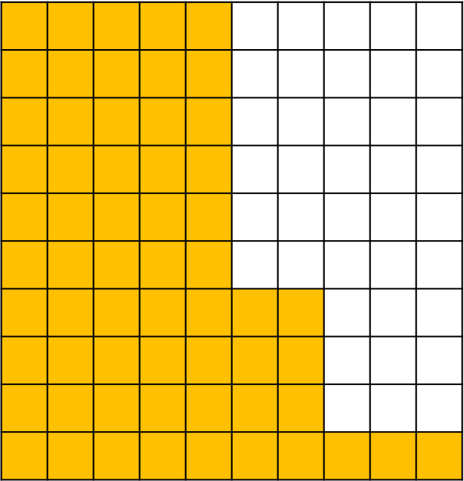
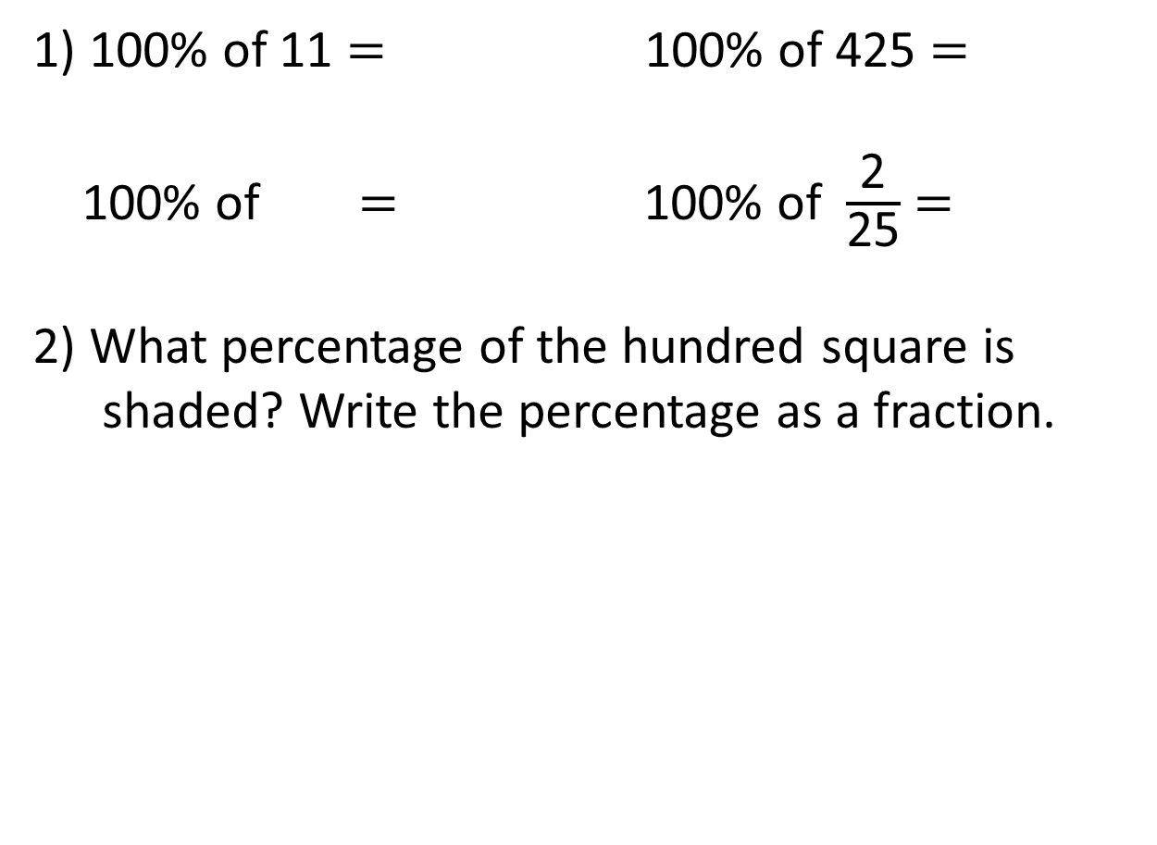
1) 100% of 11 $=$ 100% of 425 $=$
100% of $=$ 100% of $\frac{\text{2}}{\text{25}}$ $=$
2) What percentage of the hundred square is shaded? Write the percentage as a fraction.

Slide 2
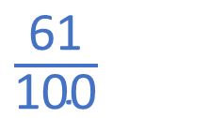
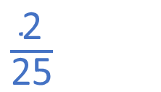
1) 100% of 11 $=$ 100% of 425 $=$
100% of $=$ 100% of $\frac{\text{2}}{\text{25}}$ $=$
2) What percentage of the hundred square is shaded? Write the percentage as a fraction.
11
425
$\frac{\text{2}}{\text{25}}$
61%
$\frac{\text{61}}{\text{100}}$

Slide 3
L.C. Can I calculate percentages of amounts?
Toolkit

Slide 4
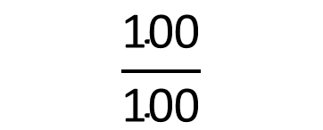
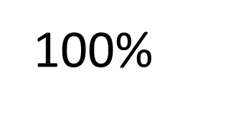
$$\frac{\text{100}}{\text{100}}$$
Everything
100$\text{\%}$
All
The whole

Slide 5
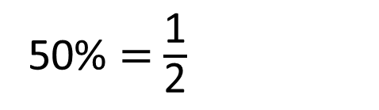
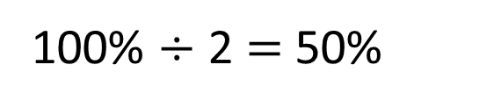
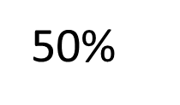
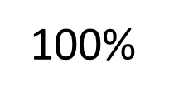
100$\text{\%}$
50$\text{\%}$
?
100$\text{\%}$ $÷$ 2 $=$ 50$\text{\%}$
50$\text{\%}$ $=$ $\frac{\text{1}}{\text{2}}$

Slide 6

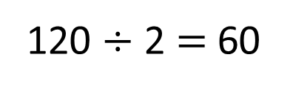
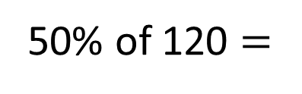
Have a think
120
60
60
?
60
50$\text{\%}$ of 120 $=$
60
120 $÷$ 2 $=$ 60

Slide 7
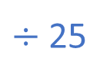


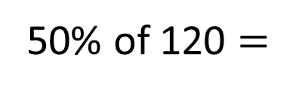
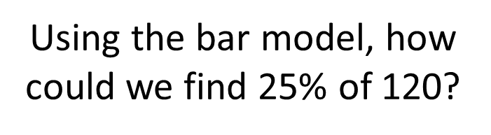

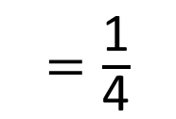
120
30 | 30 | 30 | 30
Using the bar model, how could we find 25$\text{\%}$ of 120?
$÷$ 25
$=\frac{\text{1}}{\text{4}}$
25$\text{\%}$ $=\frac{\text{25}}{\text{100}}$
120 $÷$ 4 $=$ 30
50$\text{\%}$ of 120 $=$
60
$÷$ 25

Slide 8
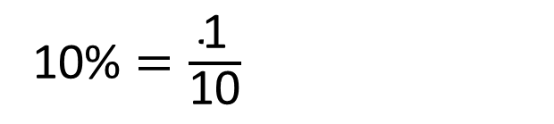
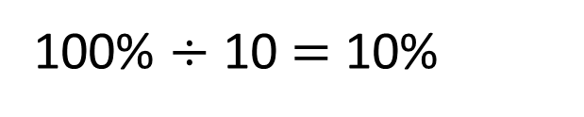
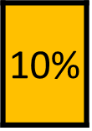
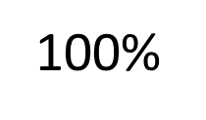
Have a think
What percentage would the shaded part represent?
100$\text{\%}$
10$\text{\%}$
100$\text{\%}$ $÷$ 10 $=$ 10$\text{\%}$
10$\text{\%}$ $=\frac{\text{1}}{\text{10}}$

Slide 9
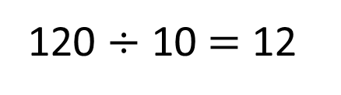
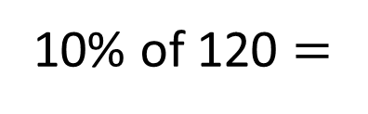
Have a think
120
12
12
10$\text{\%}$ of 120 $=$
12
120 $÷$ 10 $=$ 12

Slide 10
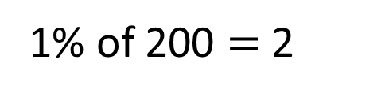
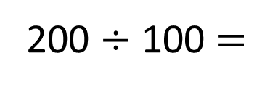
Find 1% of 200
The whole is worth 200
200 $÷$ 100 $=$
2
1% of 200 $=$ 2

Slide 11
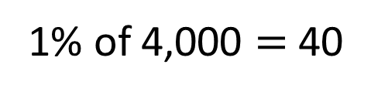
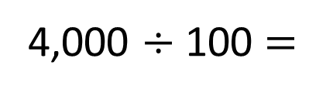
Find 1% of 4,000
Have a think
The whole is worth 4,000
4,000 $÷$ 100 $=$
40
1% of 4,000 $=$ 40

Slide 12
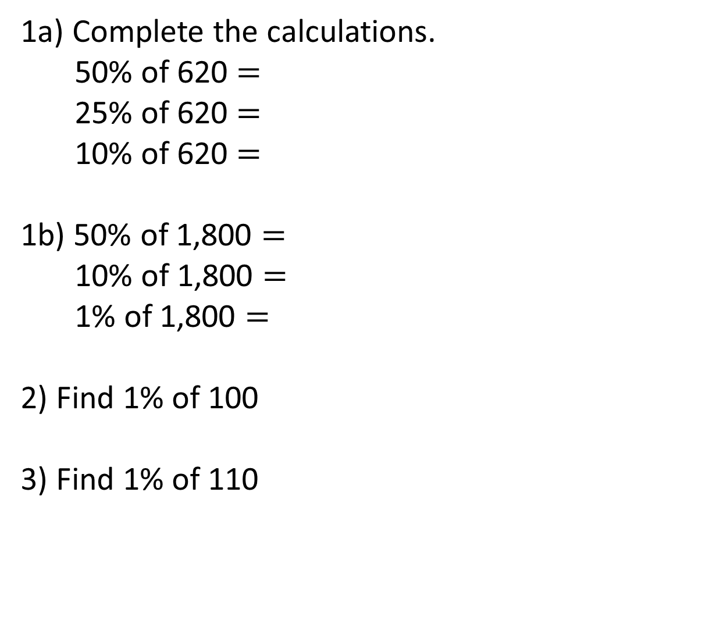
1a) Complete the calculations.
50% of 620 $=$
25% of 620 $=$
10% of 620 $=$
1b) 50% of 1,800 $=$
10% of 1,800 $=$
1% of 1,800 $=$
2) Find 1% of 100
3) Find 1% of 110

Slide 13
1a) Complete the calculations.
50% of 620 $=$
25% of 620 $=$
10% of 620 $=$
1b) 50% of 1,800 $=$
10% of 1,800 $=$
1% of 1,800 $=$
2) Find 1% of 100
3) Find 1% of 110
310
155
62
900
180
18
1
1.1

Slide 14
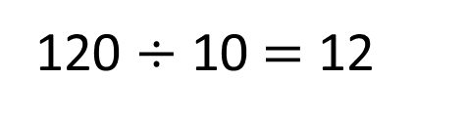
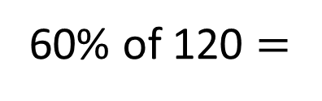
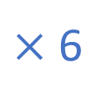
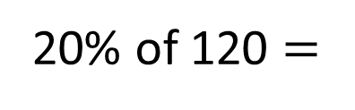
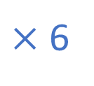
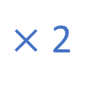
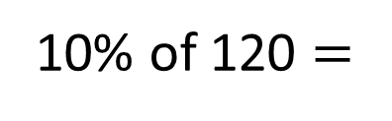

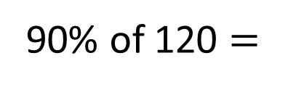
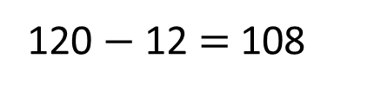
120
12
12 | 12 | 12 | 12 | 12 | 12 | 12 | 12 | 12 | 12
12 | 12 | 12 | 12 | 12 | 12 | 12 | 12 | 12 | 12
12 | 12 | 12 | 12 | 12 | 12 | 12 | 12 | 12 | 12
12 | 12 | 12 | 12 | 12 | 12 | 12 | 12 | 12 | 12
10$\text{\%}$ of 120 $=$
12
If I know this, how could I calculate these?
$×$ 2
120 $÷$ 10 $=$ 12
$×$ 2
$×$ 6
$×$ 6
20$\text{\%}$ of 120 $=$
24
60$\text{\%}$ of 120 $=$
72
120 $−$ 12 $=$ 108
90$\text{\%}$ of 120 $=$
108
Have a think

Slide 15
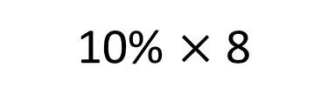
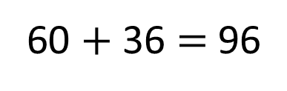
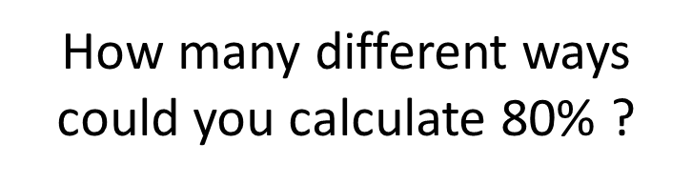
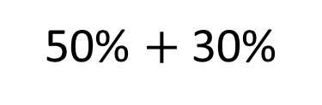
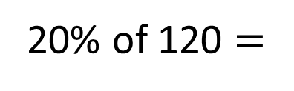
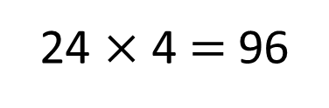
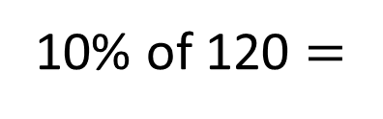
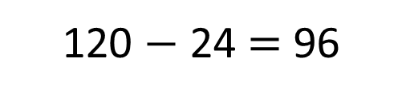
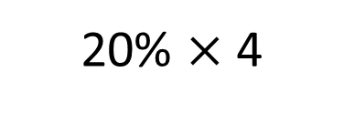
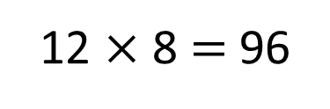
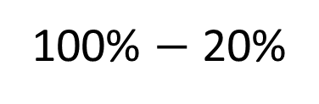
120
Have a think
12 | 12 | 12 | 12 | 12 | 12 | 12 | 12 | 12 | 12
10$\text{\%}$ of 120 $=$
12
How many different ways could you calculate 80$\text{\%}$ ?
20$\text{\%}$ of 120 $=$
24
10$\text{\%}$ $×$ 8
20$\text{\%}$ $×$ 4
12 $×$ 8 $=$ 96
24 $×$ 4 $=$ 96
50$\text{\%}$ $+$ 30$\text{\%}$
100$\text{\%}$ $−$ 20$\text{\%}$
60 $+$ 36 $=$ 96
120 $−$ 24 $=$ 96

Slide 16
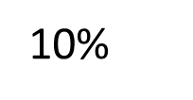
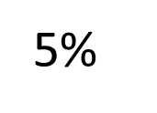
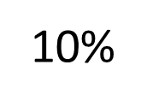




How could we calculate 15$\text{\%}$ of 80?
15$\text{\%}$ of 80 $=$ 8 $+$ 4
10$\text{\%}$
5$\text{\%}$
15$\text{\%}$ of 80 $=$ 12
80
8
8 | 8 | 8 | 8 | 8 | 8 | 8 | 8 | 8 | 8
8 | 4 | 4 | 8 | 8 | 8 | 8 | 8 | 8 | 8 | 8
10$\text{\%}$
5$\text{\%}$

Slide 17


Find 75% of 400
Have a think
I found 10% and multiplied by 7 to work out 70% and then found 5% and added them together.
I found 25% and then multiplied it by 3

Slide 18
Find 75% of 400
I found 10% and multiplied by 7 to work out 70% and then found 5% and added them together.
400
I found 25% and then multiplied it by 3
40
280
20
300

Slide 19
Find 75% of 400
400
I found 10% and multiplied by 7 to work out 70% and then found 5% and added them together.
100
300
I found 25% and then multiplied it by 3
300

Slide 20
Have a think
Complete the calculations
60% of 80
80% of 60
What do you notice?

Slide 21




60% of 80
80
80 $÷$ 10 $=$ 8
8 $×$ 6 $=$
48
80% of 60
60
60 $÷$ 10 $=$ 6
6 $×$ 8 $=$
48

Slide 22










Have a think
Find 45% of 500
How many different methods can you think of?
10% of 500 $=$ 50
1% of 500 $=$ 5
40% of 500 $=$ 200
5 $×$ 45 $=$ 225
5% of 500 $=$ 25
45% of 500 $=$ 225
45% of 500 $=$ 225
50% of 500 $=$ 250
5% of 500 $=$ 25
45% of 500 $=$ 225

Slide 23


Annie needs to make 1,270 cupcakes for a party.
In the morning she makes 50% of the cupcakes.
In the afternoon Annie makes another 10% of her target amount of cupcakes.
How many more cupcakes does she need to make?
Have a think

Slide 24


Annie needs to make 1,270 cupcakes for a party.
In the morning she makes 50% of the cupcakes.
1,270
635
635
635
?
50$\text{\%}$ of 1,270 $=$
635
1,270 $÷$ 2 $=$ 635

Slide 25


In the afternoon Annie makes another 10% of her target amount of cupcakes.
1,270
127
10$\text{\%}$ of 1,270 $=$
127
1,270 $÷$ 10 $=$ 127

Slide 26


Annie needs to make 1,270 cupcakes for a party.
In the morning she makes 50% of the cupcakes.
635
In the afternoon Annie makes another 10% of her target amount of cupcakes.
127
How many more cupcakes does she need to make?
508
635 $+$ 127 $=$
762
1,270 $−$ 762 $=$
508

