Slide 1

Survivors
Extraordinary tales from the wild and beyond
Day Eleven

Slide 2

A new week, a new story.

Slide 3
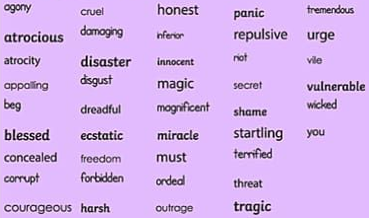
LC: Can I create poem to convey emotion?
Toolkit

Slide 4
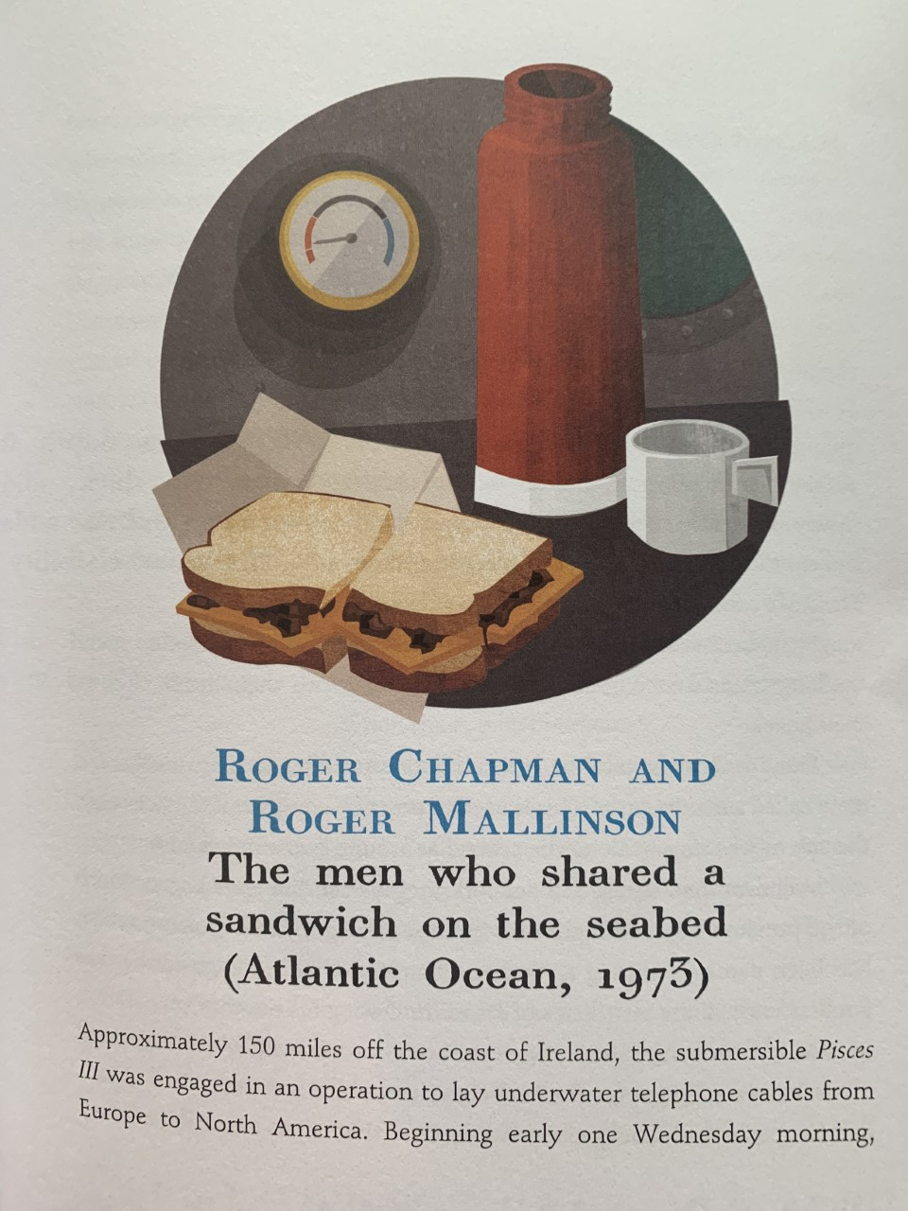
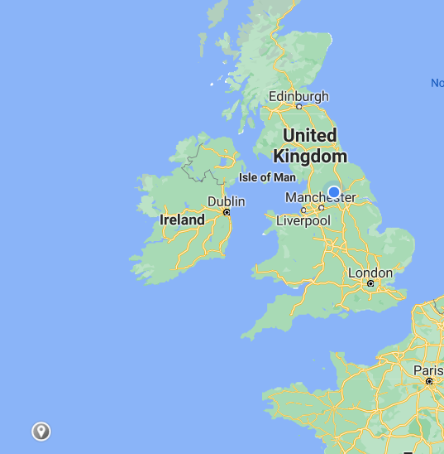
This is a true story from the Atlantic Ocean, 150 miles off the coast of the Emerald Isle (somewhere close to the grey marker).

Slide 5
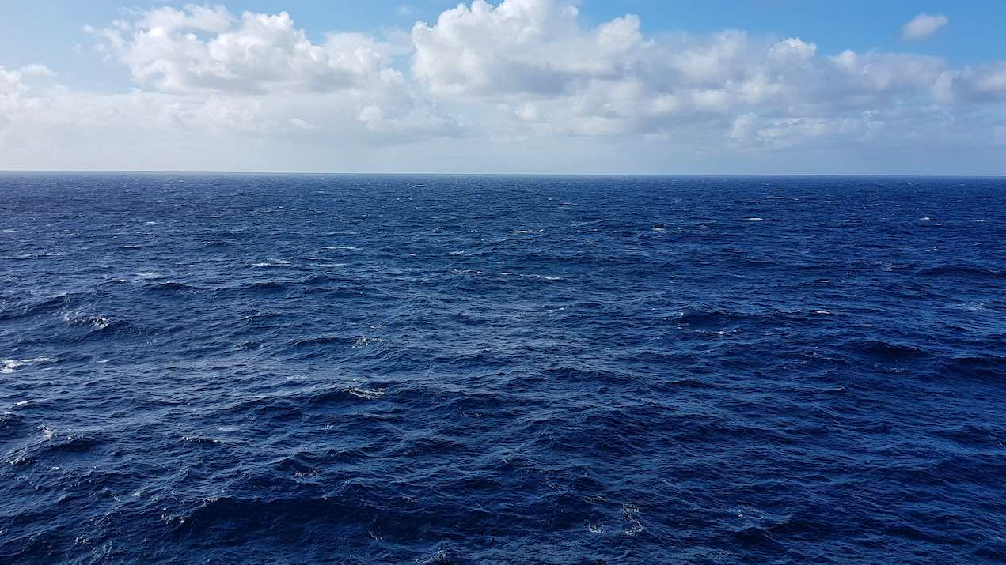
What might this story be about?
Who might be involved?
It’s set in the Atlantic, but I can’t see any boats.
A sandwich on the seabed, unusual place for a picnic.
The deepest any human had been prior to this dive was 334m. Roger and Roger were stuck at 500m. Click on this link for an idea of life at such depths. https://neal.fun/deep-sea/

Slide 6
Mini task
While you read think about how you might feel if you were tasked with a similar job.

Slide 7
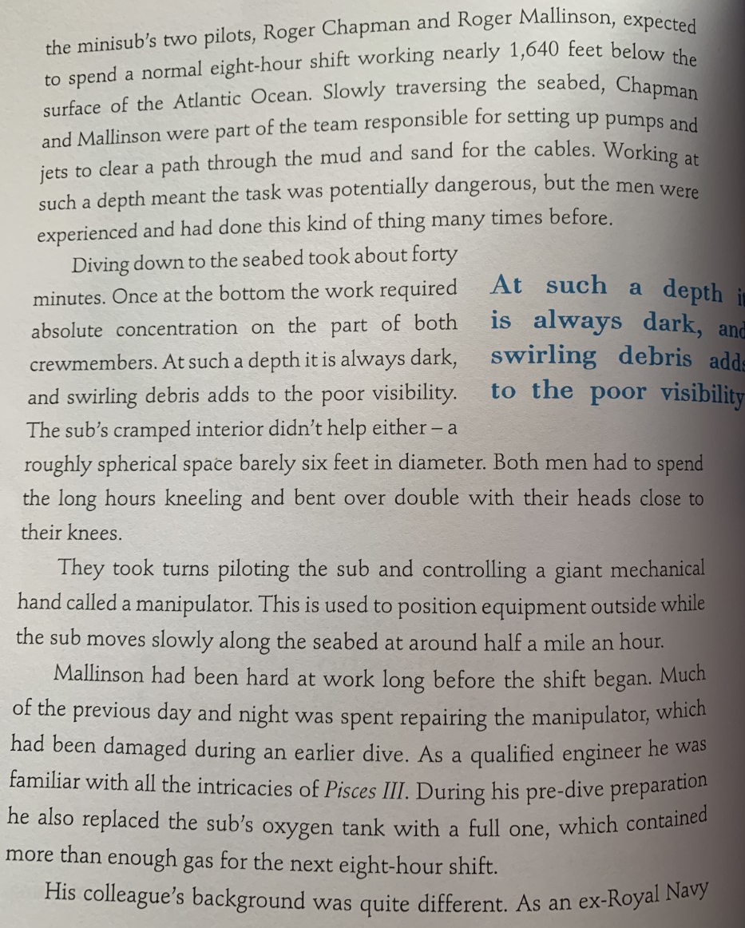
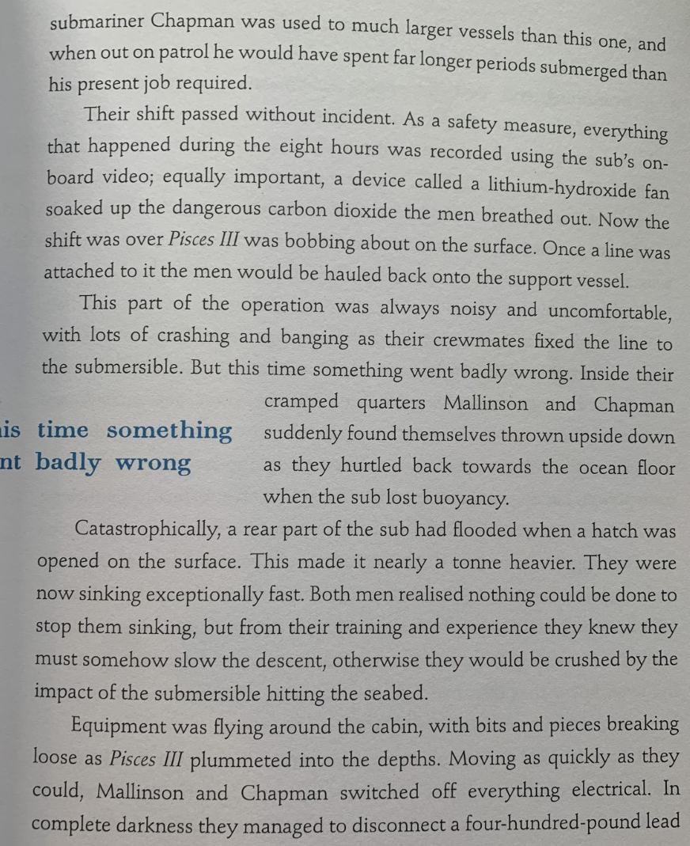
Pages 36 and 37

Slide 8
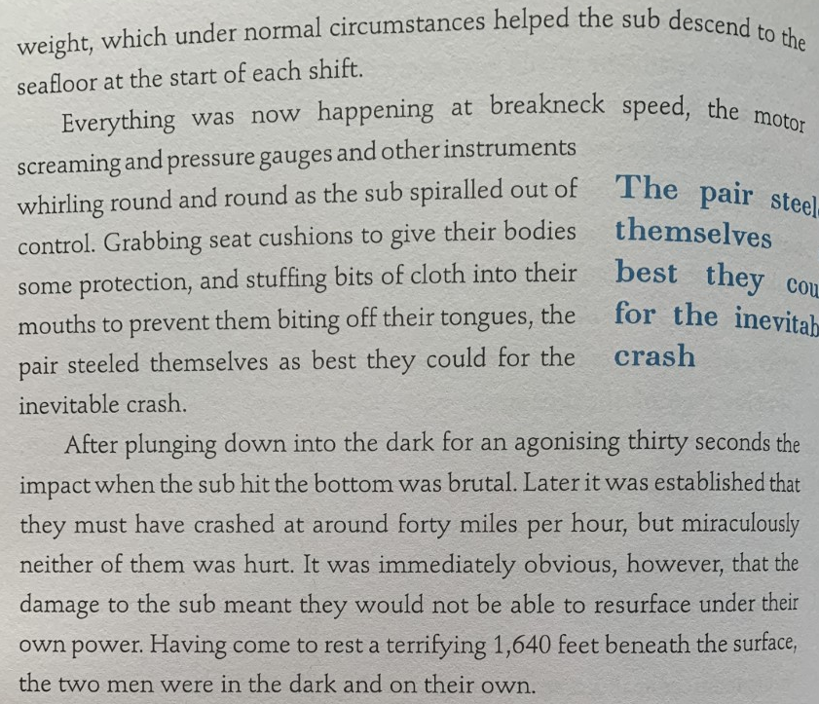
Pages 38
Oceanographers refer to this depth as the ‘Twilight Zone’. Sunlight is unable to reach this deep and sound is distorted. Bioluminescent creatures appear like stars in a vast empty landscape.

Slide 9
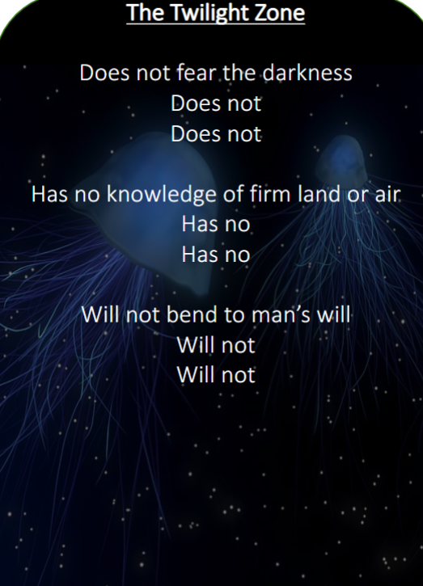
The twilight zone
An unfinished poem linked to the story.
Think about the purpose of this poem.

Slide 10
The twilight zone
An unfinished poem linked to the story.
Think about the purpose of this poem.
The clues in the lines given suggest the poem is designed to convey the power and mystery of the twilight zone, to evoke fear and highlight the alien nature of it.
How is repetition used?
How is the poem formatted?

Slide 11
The twilight zone
Completing the first verse together we must try to convey the strange and powerful nature of the twilight zone and evoke the fear likely felt by Chapman and Mallinson.
What is the most impactful adjective which you could add before ‘darkness’? Add it.
Repeat idea by adding one adjective to each of the other two lines. These must contribute to or deepen the meaning. Consider alliteration if appropriate.
Can these words link in theme?
•In which order should the three lines be written to achieve the most impact/to build to a crescendo? Number them.
•Cross out the ‘Does not’ at the start of lines 2 and 3. Replace with ‘Nor’ / ‘Nor does it’ or your own alternative.

Slide 12
|Task
Edit verses 2 and 3 independently, following the same process as followed on the previous page.
Then write completed poem and include a final line or verse for impact.
This piece of work does not need to be summited for feedback, however if you want to share it you can upload it to Teams.

