Slide 1
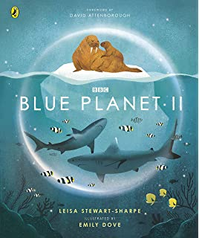
LC: Can I use subheadings and other key markers to help me locate information?
Today we are reading an extract from the Blue Planet book called ‘The inhabitants of the deep’.
​
​
​
​
​
​

Slide 2
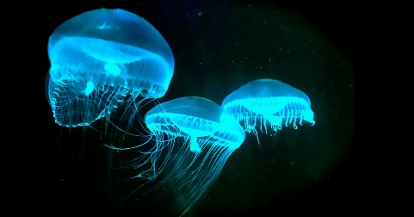
Vocabulary
Crustaceans – sea animal with a hard shell
Bioluminescence - the production and emission of light by a living organism.
Outmanoeuvre – avoid other animals by moving faster or with greater agility.
Now read through the text.

Slide 3
There are some weird and wonderful creatures that live in the depths of the ocean.
Write down three facts that you find interesting from the text.

Slide 4
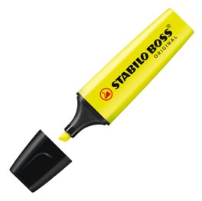
Remember: For your questions today, we want you to use your highlighters to locate vocabulary within the text.
Before we answer the questions, look at each section of the
text and identify the subheadings (you could highlight these).
Why might these subheadings be useful?
Why might the writing highlighted in bold be useful?

Slide 5
Questions: Me
Find out which animal has stinging tentacles which capture small crustaceans.

Slide 6
Answers: Me
Siphonophores.
Which subheading was useful here?

Slide 7
Questions: You
Which animal has needle-like teeth?

Slide 8
Answers: You
Stoplight loosejaw dragonfish.
Which subheading was useful here?

Slide 9
Questions
Why does the cockeyed squid have one eye larger than the other?
Why is the Siphonophore referred to as a ‘death net’?
What is bioluminescence used for? Find two ideas.
Which animal shoots off yellow sparks when under attack?
Find and copy the word which shows that the flapjack octopus has short tenctacles.
Chilli Challenge
Why do you think these creatures have larger features? Like big eyes/teeth/tentacles?
What is it like in the depths of the ocean? How do you know?

Slide 10
Answers
The larger left eye is used to look up (this could be to see predators above).
It is over 40 metres long and has stinging tentacles that capture small crustaceans.
Luring in prey and scaring away predators.
Tomopteris worms
Stubby
Chilli Challenge
They have larger eyes because it helps them to see better in the dark. They have larger tentacles to help them capture their prey. They use these features to help them survive.
It is dark in the depths of the ocean as it is referred to being ‘dim’ and also the fish use lights and have larger eyes to help them see in these dark conditions.

