Slide 1
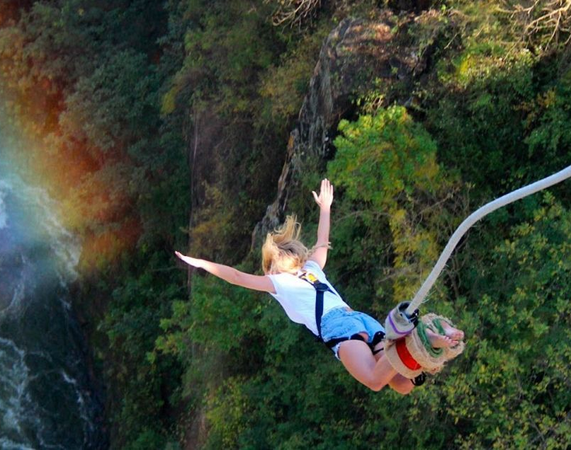
Warm Up
Write a headline to match the picture.

Slide 2
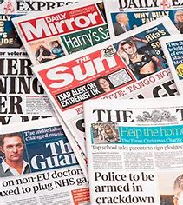
LC: Can I use fronted adverbials in my writing?
Fronted adverbials tell us: how, when or where an action might be taking place.
They are really useful in newspaper writing to add extra detail to our 5 Ws.
They also add variety to our sentence structure.

Slide 3
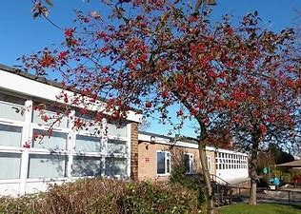
Some Examples. - When?
Shortly before break, the UFO landed on the playground.
At 11am, the officers are arrived at the scene.
During maths, Mrs Hahnel heard a tremendous noise.

Slide 4
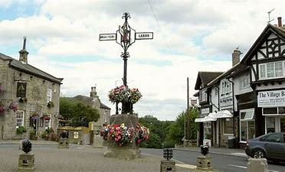
Some Examples. - Where?
In a small village in Yorkshire, the world record for the largest chocolate bar has been broken!
Behind the school shed, Mr Bradley found the stolen equipment.

Slide 5
Some Examples. - How?
Carefully, the police investigated the scene.
With determination, the reporters waited for the Prime Minister to arrive.
As quick as a flash, news of the new arrival spread around the village.

Slide 6
Can you add fronted adverbials to these sentences to add more detail?
The children left school.
The parents went home.
The teachers ran in the park.

Slide 7
LC: Can I use fronted adverbials?
Complete the worksheets on fronted adverbials. - How, when and where.
Tomorrow we will be writing some more articles and we are looking for you to use these in your writing.

