Slide 1
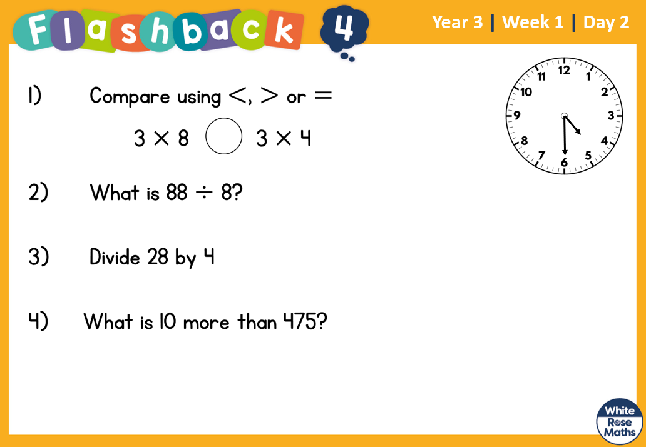

Slide 2
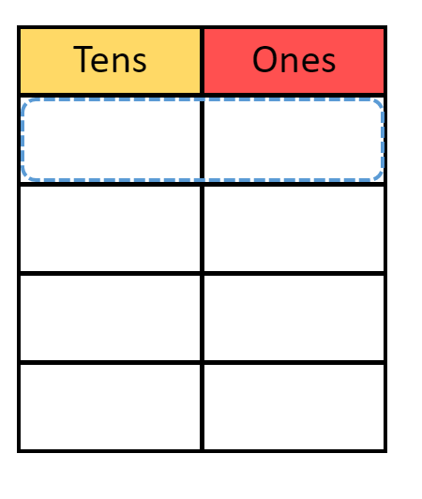
Recap from last week – pencil and paper ready!
84 ÷ 4 =
Remember share the tens equally into the tens column
and the ones in to the ones column.

Slide 3


84 ÷ 4 = 12
Now try 66 ÷ 3 =

Slide 4
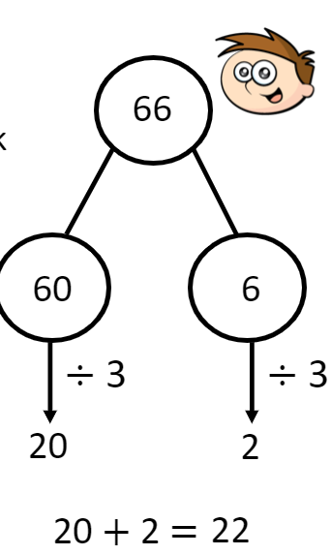
66 ÷ 3 = 22
Partitioning was
another useful method:

Slide 5
It became a bit trickier when the tens or the ones wouldn’t share equally….
45 ÷ 3 =
How many of the 4 tens can
you share equally?
What do we do with the remaining
tens?
Tens​ | Ones​
​ | ​
​ | ​
​ | ​

Slide 6
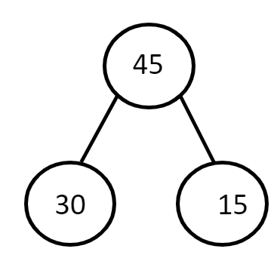
We could share three of the tens equally and then the
remaining ten had to be exchanged for ones. Then 15 ones
could be shared equally between 3 groups.
Tens​ | Ones​
​ | ​
​ | ​
​ | ​

Slide 7
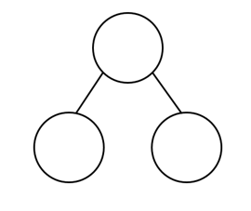
Your turn!
64 ÷ 4 =

Slide 8
Answer
64
40
24

Slide 9
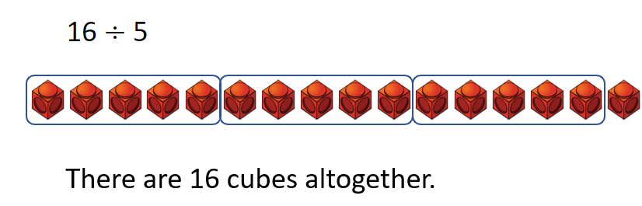
Remainders
When you have shared equally but have an amount left over
which cannot be shared equally.
How many groups of 5 are there?
How many left over?

Slide 10

Why grouping and not sharing?

