Slide 1
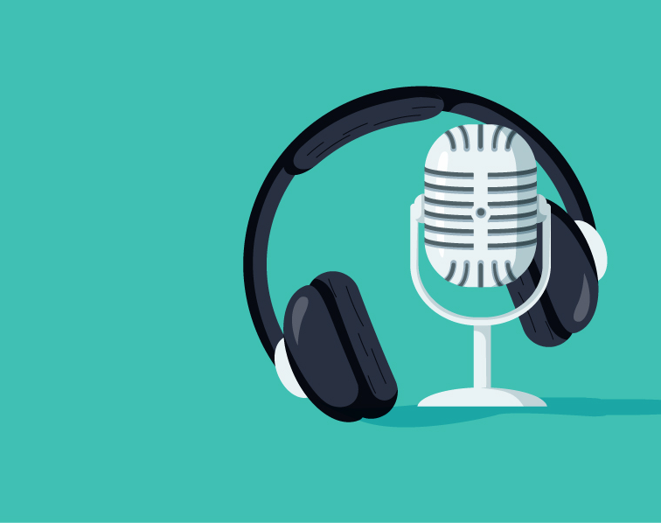
Podcasts and Podcasting

Slide 2
Lesson 1
What is a podcast?
Over the next couple of sessions, we are going to look at podcasts. Some of you may already listen to podcasts.
The word podcast comes from a mix of ipod and broadcasting.
A podcast is an audio programme; you listen to it just like on the radio. You download it to your phone/tablet/computer so that you can listen to it whenever and wherever you want to.

Slide 3
What is a podcast?
How?
You can listen to episodes using headphones, earphones or through speakers on your chosen device.
When?
Some of the most common times people listen to podcasts are at the gym, travelling in the car or by train/bus or maybe relaxing on an evening.
Format
They can be any length, from a couple of minutes to a couple of hours
They can be any frequency, from daily to weekly to monthly
They can be any format, from simple programmes with one presenter up to multi-person audio dramas
They can cover any topic and there will be podcasters out there making podcasts about something that interests you

Slide 4
Most podcasts will be themed around one particular topic. The host will talk about that topic on every episode. Sometimes it's really specific eg triathlon racing or dog training, and other times it's more general eg how to lead a happy life.
Then for each individual episode of that podcast the host will talk about something more specific within that topic – nutrition tips for taking part in a triathlon, or how to stop your dog fighting with other dogs.
Each episode is normally run by one or two regular presenters and they'll often get outside guests on to contribute, or to be interviewed.

Slide 5
A lot of podcasts are really simple, just a few friends chatting about something that they're all really passionate about eg films, a sport, music. Some are really polished and professional, including using theme music, sound effects, professional editing etc.
A podcast is a series of episodes, and refers to the programme as a whole. A podcast episode is just one recording from the entire podcast.
You can subscribe to a podcast so that you are notified when the next episode is broadcast and they are free!

Slide 6
Activity
Your task this week is to listen to some podcasts suitable for your age group.
I've put some links on the next slide to podcasts that I think might interest you.
There is a science podcast, interviews with famous people talking about lots of different things and there's a link to a story series.
Ready for the next session, think about:
What are the features of a podcast?
What makes a good podcast?
What would your podcast series be about?

Slide 7
Listen!
All age groups
https://www.funkidslive.com/podcast/the-fun-kids-science-weekly/
https://www.funkidslive.com/podcast/fun-kids-radios-interviews/
Y5/6
https://www.bbc.co.uk/sounds/play/p05lklqh

